Slide 1
Who is the Buddha?
Dr Naomi Appleton
University of Edinburgh, naomi.appleton@ed.ac.uk
Dr Chris Jones
University of Cambridge, cvj20@cam.ac.uk

Slide 2
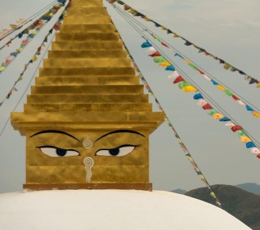
Programme
January 27th The Buddha: Historical Figure or Literary Character?
February 3rd The Buddha as Philosopher
February 17th The Buddha as Social Reformer
February 24th The Buddha in Buddhist Practice
March 10th The Buddha among Buddhas
March 17th The Buddha in Modern Britain
Each session will consist of roughly 45 minutes of presentation, and up to 30 minutes of questions and/or discussion.
The presentations (though not the discussions) will be recorded. Please keep cameras off during this part of the event.
Notes:
The image is free to use, and depicts the top of a stūpa (relic-chamber) at the Amarbayasgalant monastery in Mongolia (https://libreshot.com/eyes-of-the-buddha-on-the-stupa/). The eyes of the Buddha, here painted on the pinnacle of the structure, have a special significance in a number of Buddhist cultures and contexts – on stūpas as well as on images of the Buddha, a pair of eyes are often supplied last, and sometimes in a ritually specified manner, in what is understood to be the final empowerment or symbolic bringing to life of the object of worship.

Slide 3
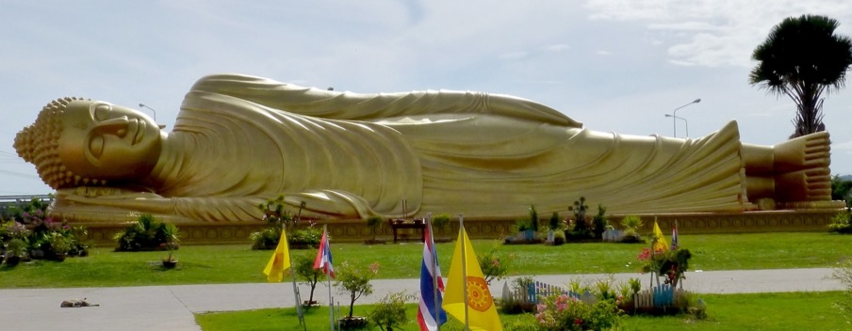
Some statements from the Mahāparinibbāna Sutta (being the Pāli account of the Buddha’s final days and teachings)
‘Therefore, Ānanda, be islands unto yourselves, refuges unto yourselves, seeking no external refuge; with the Dhamma as your island, the Dhamma as your refuge, seeking no other refuge…
…Behold now, monks, I exhort you: all compounded things are subject to cessation. Strive with earnestness!’
‘…Ānanda, as with the body of a universal monarch, so should it be done with the body of the Tathāgata (i.e., Buddha); and at a crossroads also a stūpa should be raised for the Tathāgata. And whosoever shall bring to that place garlands or incense or sandal paste, or pay reverence, and whose mind becomes calm there – it will be to his well being and happiness for a long time.’
Image by Anandajoti, of a reclining Buddha in Thailand: see notes to slide.
Notes:
The passages of text are taken and only slightly adapted from Vajira and Story’s (1998) translation of the Mahāparinibbānasutta, available in full here: https://www.accesstoinsight.org/tipitaka/dn/dn.16.1-6.vaji.html.
The image is of a modern reclining Buddha at Wat Phranon Laem Pho, Songkhla, Southern Thailand (by Anandajoti: https://commons.wikimedia.org/wiki/File:Wat_Phranon_Laem_Pho_-_001_Reclining_Buddha_Statue_(10358770663).jpg). These often gigantic images of the Buddha are common especially in the Theravāda Buddhist world, and perhaps in Thailand especially.
This is always a depiction of the Buddha on his deathbed, with a contented look on his face, accepting the end of his final existence undergoing transmigration (saṃsāra). This is of course the Theravāda interpretation of the image; many Mahāyāna Buddhists, informed by other Buddhist narratives, understand this to depict the end of the Buddha’s embodied existence in the world, but by no means the end of his involvement in it.

Slide 4
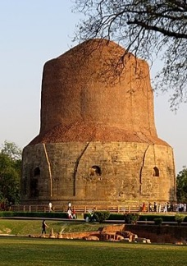
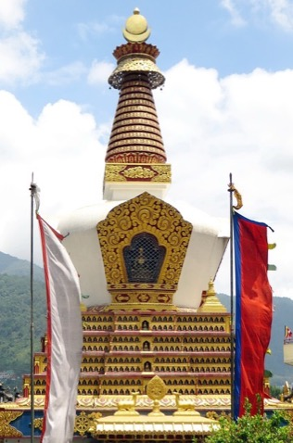
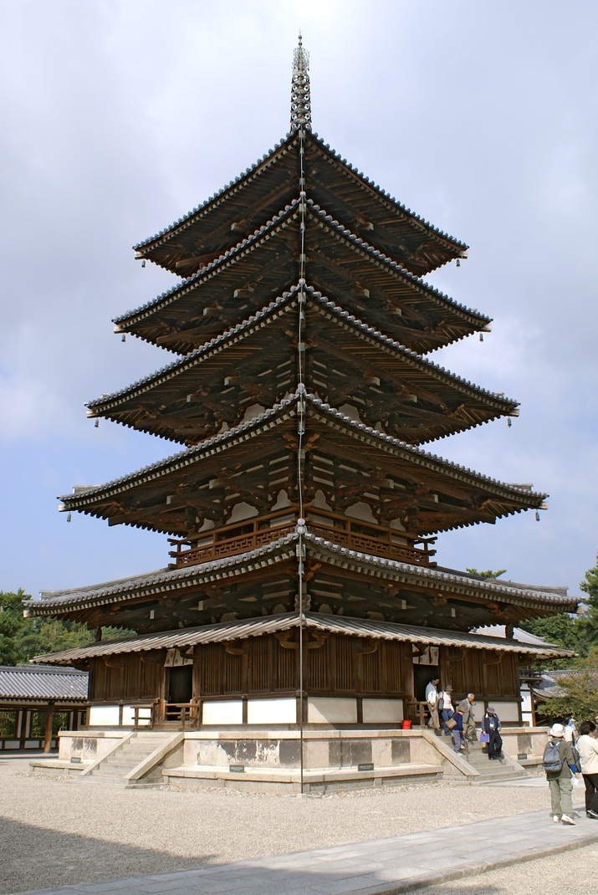
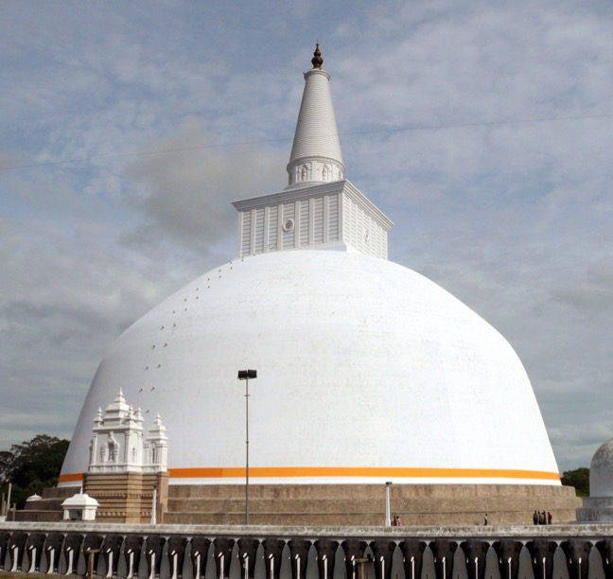
The Buddha’s relics, and relic-mounds (stūpas)
[Monk:] ‘Long is the time, lord of men, since we have seen the Buddha. We lived a life without a master; there is nothing here for us to worship.’
[King:] ‘Did you not tell me, sir, that the Buddha has passed into nibbāna?’
[Monk:] ‘If we behold the relics, we behold the Buddha.’
From the Mahāvaṃsa (c.C5th CE), reporting the
arrival of some Buddhist relics to Sri Lanka
Right: The thūpa (Sanskrit: stūpa) at Sarnath, near Varanasi, site of the Buddha’s first sermon.
Notes:
The Mahāvamsa is a chronicle in Pāli that claims to record the earliest history of Buddhism, with a particular focus on the arrival and establishment of Buddhism on the island of Sri Lanka. It is sometimes treated as a historical source, but it clearly has a rhetorical and historiographical agenda, and so is best viewed as an early work of Buddhist literature. The full text is available in an old translation on https://archive.org/stream/mahavamsagreatch00geigrich/mahavamsagreatch00geigrich_djvu.txt but the quotation above is our own, slightly adjusted translation, of a passage from chapter 17.
The four images are of variations of stūpas from across Asia: top left, the Dhamek Stūpa at Sarnath in India (supposed site of the Buddha’s first teaching); a stūpa in Kathmandu, Nepal; the five- story pagoda at Hōryū-ji, Japan (C7th – pagodas, at least originally, being East Asian stūpas); a stūpa in Anuradhapura, Sri Lanka. All images free to use.

Slide 5
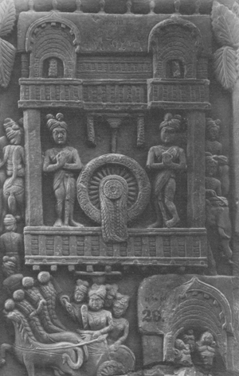
Buddha and Dhamma I
‘For a long time, Lord, I have wanted to come and set eyes on the Blessed One, but I had not the strength in this body to come and see the Blessed One.’
‘Enough, Vakkali! What is there to see in this vile body? He who sees Dhamma, Vakkali, sees me; he who sees me sees Dhamma. Truly seeing Dhamma, one sees me; seeing me one sees Dhamma.’
Vakkali Sutta (of the Pāli Canon: see notes)
rūpakāya – ‘form-body’: the Buddha ‘embodied in physical form’
dharmakāya – ‘dharma-body’: the Buddha ‘embodied in the Dharma’
Notes:
Text: Saṃyutta Nikāya 22.87, trans. M. Walshe: www.accesstoinsight.org/tipitaka/sn/sn22/sn22.087x.wlsh.html
Image: Worship of a dhamma wheel at the early Buddhist site of Bharhut, perhaps 2nd century BCE. Photograph Biswarup Ganguly of the image in an exhibition at the Indian Museum, Kolkata. CC-BY-3.0 https://commons.wikimedia.org/wiki/File:Worship_of_Chakra_-_Sandstone_-_ca_2nd_Century_BCE_-_Sunga_Period_-_Bharhut_-_ACCN_305_-_Indian_Museum_-_Kolkata_2016-03-06_1563.JPG.
The notion of a Buddha’s dharmakāya is a complex one: indeed, arguably it is not one notion, as different (Mahāyāna) Buddhist traditions have used the term to refer to various notions of how a Buddha truly, ultimately exists in contrast to his physical, clearly only temporal body. One doctrine that may come up in textbooks is the notion of ‘three bodies’ (trikāya) of the Buddha, a fairly developed Mahāyāna Buddhist teaching that understands the Buddha to be knowable through 1) a body that he manifests in the world (nirmāṇakāya), 2) an ‘enjoyment’ body that continues to engage with gods and other higher beings (saṃbhogakāya), and then 3) his abstract, unchanging true body (dharmakāya) that is the Dharma in the sense of how reality itself. None of this, it should be stressed, is well-represented in Pāli literature, and so is not accepted by forms of Theravāda Buddhism.

Slide 6
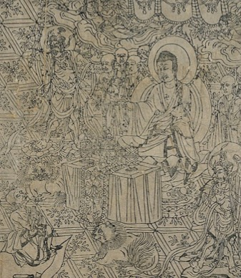
Buddha and Dhamma II
‘Moreover, Subhūti, on whatever piece of ground one elucidates this discourse (sūtra), that piece of ground will become worthy of worship, worthy of veneration and reverential circumambulation for the whole world with its gods, human beings and other deities – that piece of ground will become a shrine.’
Vajracchedikā Prajñāpāramitā
(aka. ‘The Diamond Sūtra’)
Notes:
The image is from the frontispiece of a Chinese printed version of the Diamond Sūtra, housed at the British Library, and printed in 868 CE (https://commons.wikimedia.org/wiki/File:Diamond_Sutra_of_868_AD_-_The_Diamond_Sutra_(868),_frontispiece_and_text_-_BL_Or._8210-P.2_(cropped).jpg).
This copy of the Diamond Sūtra is the world’s oldest printed book – a testament not only to Chinese technology, but also the well-established importance that Chinese Buddhists put on reproducing Buddhist texts. Many Mahāyānist texts mention in their lines the karmic merits of copying out the text, and we know that across Central and East Asia Buddhists took this idea very seriously; the ability to print the word of the Buddha obviously made the proliferation of these works far easier!
The Diamond Sūtra itself was likely produced in the fourth or fifth century CE in India; it is a (relatively) late example of the ‘Perfection of Wisdom’ (prajñāpāramitā) genre of Mahāyāna Buddhist sūtras, the focus of which is (in short) realizing the illusory character of all things that we experience in the world, to better alleviate ourselves from attachment to anything at all.

Slide 7
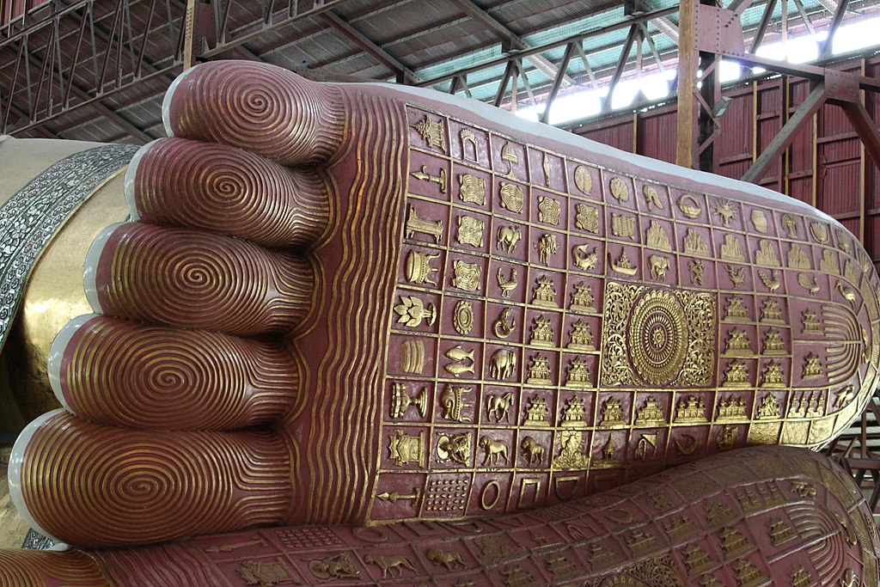
Buddha images
Above: Buddha footprint on reclining Buddha-image in Myanmar
Right: Bharhut Stupa depiction of the descent from heaven, photograph by Ken Kawasaki: CC-BY-SA3
Notes:
Images:
Photograph of the feed of the massive reclining Buddha statue at Chaukhtatgyi Buddha temple Yangon Myanmar. CCO 1.0. https://commons.wikimedia.org/wiki/File:Buddha_Footprint_(1).jpg
Ken Kawasaki: Bharhut Stupa In the Indian Museum, Kolkata: https://commons.wikimedia.org/wiki/File:Bharhut_Ajatasattu_Pillar_-_Descent_From_Tavatimsa.jpg
The Knowing Buddha Organization has some thought-provoking ideas around what constitutes proper respectful use of Buddha images: https://www.knowingbuddha.org/about-kbo
This is a Thai campaign group and doesn’t necessarily represent the mainstream view – indeed its campaign for fierce blasphemy laws in Thailand has drawn a lot of criticism from other Buddhists as well as non-Buddhists.

Slide 8
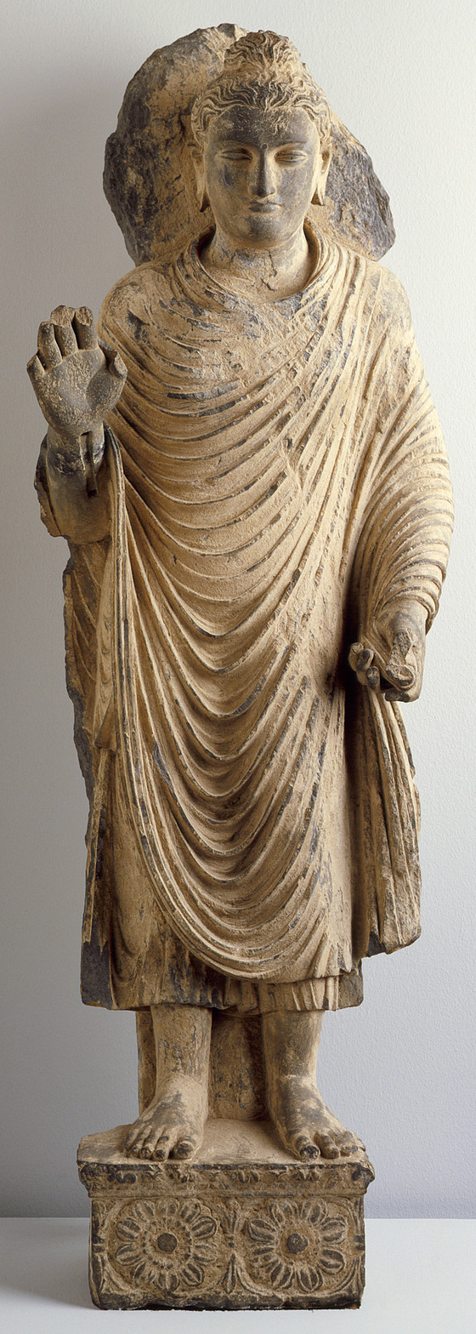
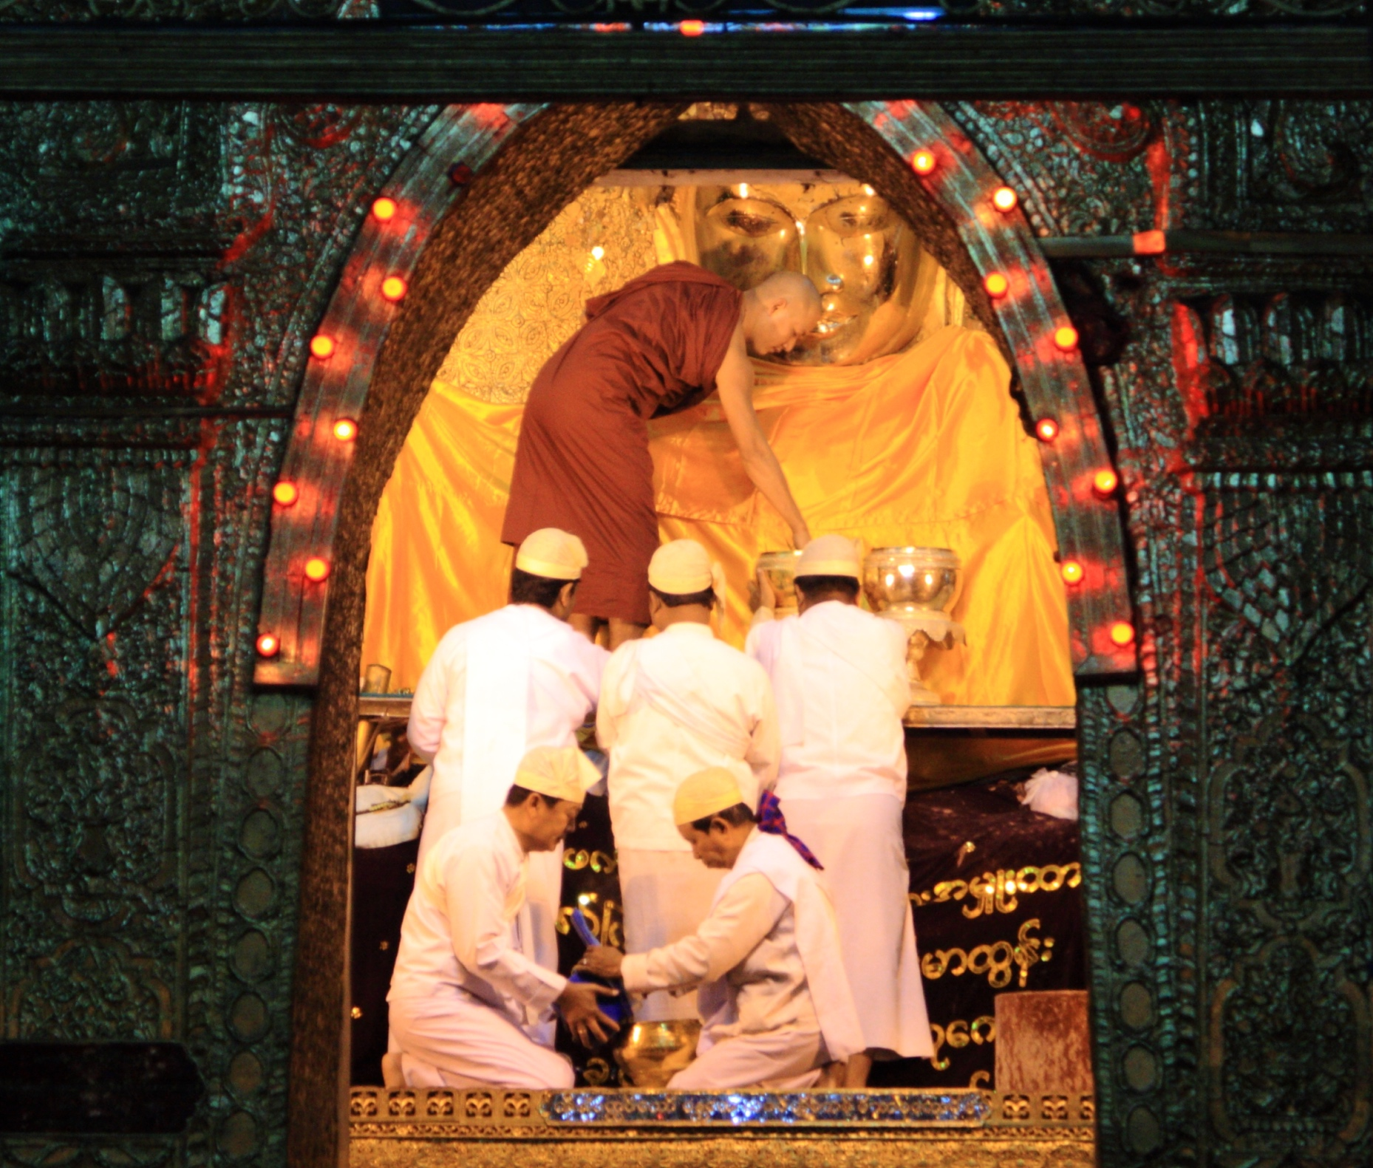
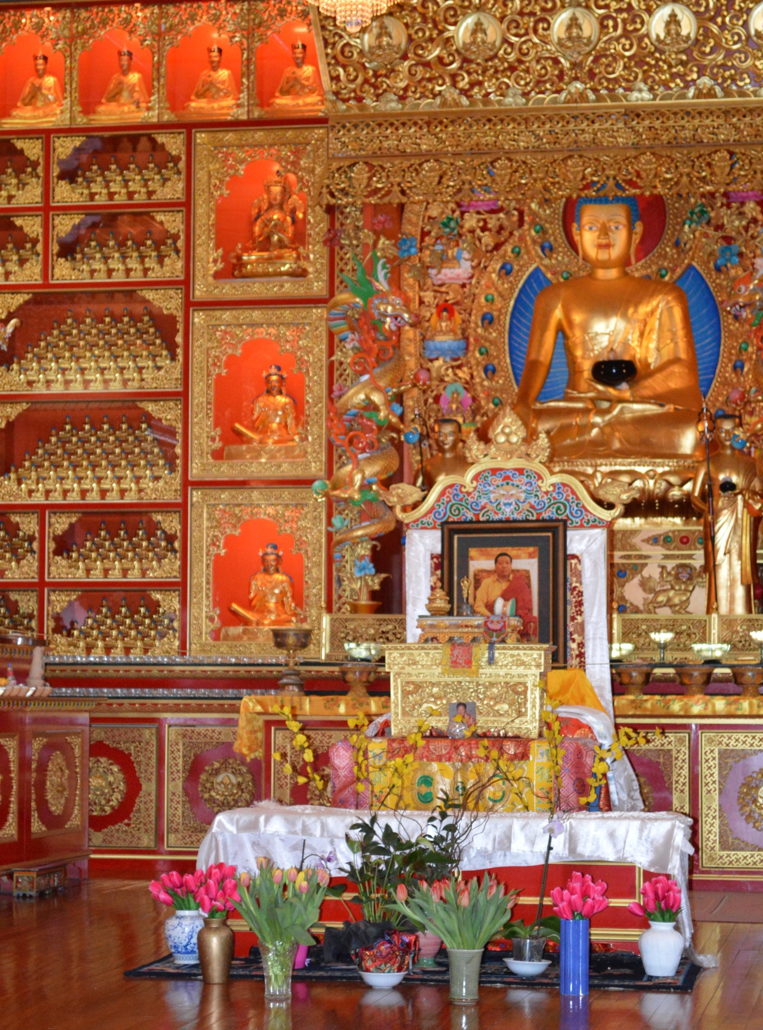
Buddha image worship (Buddha-pūjā)
Left: Buddha image from Gandhāra, 2nd-3rd c., image in public domain courtesy of LACMA
Centre: pūjā of the Mahamuni Buddha image in Myanmar: Photo by Damien HR, CC-BY-SA
Right: the main shrine room at Samye Ling monastery, Scotland
Notes:
Images:
Early Gandhāran representation of the Buddha, courtesy of the Los Angeles County Museum of Art (who have an amazing range of freely downloadable images) - https://collections.lacma.org/node/172042
Pūjā of the Mahāmuni Buddha image in Myanmar: Photo by Damien HR, CC-BY-SA https://commons.wikimedia.org/wiki/File:Mahamuni_Buddha_(1).jpg
Photograph, by Naomi Appleton, of the main shrine at Samye Ling monastery, the first Tibetan Buddhist centre outside Asia. Note that images of teachers other than the Buddha, including living teachers, are also included in the shrine.
The following short film, made by an anthropologist at Bristol University, Professor Rita Langer, shows buddha-worship in a Sri Lankan home shrine, and can make a good starting point for a class: “Making food for the Buddha” vimeo.com/113047607
A translation of the Pali chant, including the verse about flowers, can be found here https://thebuddhistcentre.com/internationalretreat/buddha-puja-words-translation-and-chant

Slide 9
Mindfulness of the Buddha
Image in the public domain, courtesy of LACMA
Iti’ pi so bhagavā
arahaṃ
sammāsambuddho
vijjacaraṇasampanno
sugato
lokavidu
anuttaro purisadammasārathi
satthā devamanussānaṃ
buddho
bhagavā ’ti
Like this indeed is the Blessed One:
a worthy one
fully and perfectly awakened
perfect in knowledge and conduct
a well-gone one
knower of the world
unsurpassed tamer of those to be tamed
teacher of gods and humans
awakened one
blessed one
Notes:
Image: https://collections.lacma.org/node/200822
Image in the public domain: 11th century manuscript cover held at Los Angeles County Museum of Art.
For an example of the recollection as recommended in an early sutta text see here:
https://www.accesstoinsight.org/tipitaka/an/an11/an11.013.than.html#recall-Buddha
You can listen to some clear Pali chants, including the Iti pi so, here:
https://www.samatha.org/explore-publications/chants
An accessible scholarly introduction to meditation is Sarah Shaw’s book “Introduction to Buddhist Meditation” (Routledge 2008).
She also has an excellent short film on YouTube that explains clearly how mindfulness fits into Buddhist practice in a different way to its use in secular mindfulness practices in the west: https://youtu.be/kn5MlrIw-zs

Slide 10
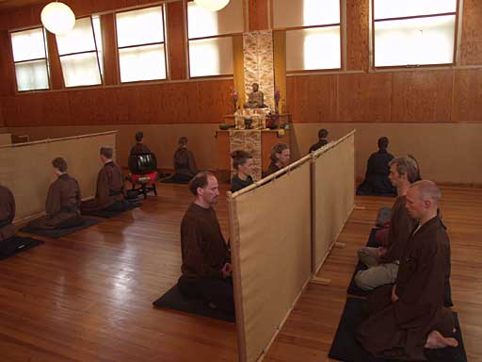
(The) Buddha(s) in other meditation practices
“If you meet the Buddha on the road, kill him.”
Linji Yixuan (9th century Chinese Zen monk)
Zen practitioners in seated meditation. Photograph Spoktu, CC-BY-SA3.0
Notes:
For one assessment of this instruction see https://www.lionsroar.com/if-you-meet-the-buddha-on-the-road-kill-him/
Photograph: Spoktu: https://commons.wikimedia.org/wiki/File:Zazen.jpg CC-BY-SA3.0
These are Zen practitioners at the Zengården temple and retreat centre of the Swedish Zen Buddhist Society: https://zentraining.org/index.php

Slide 11
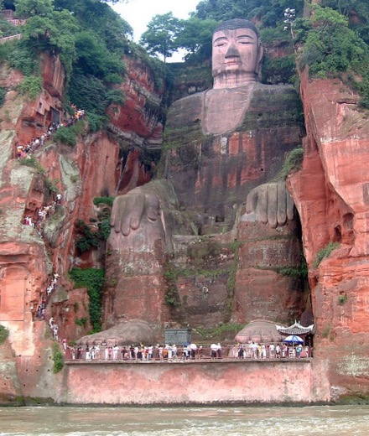
Conclusion
The matter of the Buddha’s relationship to the world is not a simple one, and Buddhist traditions disagree over how this best be understood. However, perhaps all forms of Asian Buddhism understand the Buddha to still influence the world and the lives of people in it, materially and/or immaterially, and that he remains available as a potent object of reverence and devotion.
Right: the gigantic Leshan Buddha (C8th) in Sichuan, China.
Notes:
The image is of the gigantic Leshan Buddha (71m tall), an eighth century sculpture in the side of a cliff-face in Sichuan, China (https://en.wikipedia.org/wiki/Leshan_Giant_Buddha). The Buddha depicted is in fact not ‘our’ Buddha, that is Śākyamuni, but rather the forthcoming Buddha, Maitreya, whom Buddhists across traditions and sectarian divides understand to be the next fully awakened teacher who will appear in the world.
The practice of constructing titanic images of buddhas and bodhisattvas is well-established across Asia. One might take only a quick look at a list of the world’s largest statues, and their provenance, to get a sense of how dominated this practice is with specifically Buddhist iconography (https://en.wikipedia.org/wiki/List_of_tallest_statues).

