Slide 1
Introduction to Key Concepts in Buddhism
for RMPS Teachers
Dr Naomi Appleton
University of Edinburgh, naomi.appleton@ed.ac.uk
Dr Chris Jones
University of Cambridge, cvj20@cam.ac.uk
Feb-Jun 2021

Slide 2
Programme
February 9th Buddha, Dhamma, and Saṅgha (‘The Three Jewels’)
March 9th Dukkha, Anicca, and Anattā (‘Three Marks of Existence’)
April 13th Saṃsāra, Kamma, and Nibbāna
May 11th The Eightfold Path and Five Precepts
June 8th Meditation and Worship (Pūjā)
Each session will consist of roughly 30 minutes of presentation, and up to 30 minutes of questions and/or discussion.
The presentation (though not the discussion) will be recorded. Please keep cameras off during this part of the event.
Image Copyright British Museum, London
Notes:
The image is of a Buddhist reliquary, and its contents, from the region Gandhāra, in modern-day Afghanistan, and perhaps the first century CE (https://www.britishmuseum.org/collection/object/A_1900-0209-1). Among the contents of the reliquary when it was discovered were small beads and precious stones, some of which were likely, at some point, to have been considered remains of the Buddha’s body. The veneration of relics, at relic mounds across South, Southeast, Central and East Asia (stūpas, or in East Asian pagodas), is an important aspect of Asian Buddhist practice to this day, although not so prominent among Western Buddhists.
Further to an opening note from the previous session (regarding donations to the Saṅgha), the Buddha’s relic – which in a sense is the Buddha himself, enduring in the world – provides for Buddhists, both monastic and lay, with the best of all possible recipients of generosity; by making an offering to the Buddha, the donor generates tremendous merit.

Slide 3
Some language of Buddhist ‘meditation’
terms are in Pāli, explained in accordance with Theravāda tradition
bhāvanā – ‘bringing to being’; ‘cultivation’
samādhi – ‘concentration’
sati – ‘mindfulness’; ‘remembrance (in the sense of ‘keeping in mind’)’
samatha – ‘calming’: a specific kind of meditative practice
vipassanā – ‘insight’: a specific kind of meditative practice
jhāna – a heightened, pleasant state of consciousness that is achieved through samatha, and taken to be the basis for the practice of vipassanā
Notes:
Another term that Buddhist tradition uses in connection with ‘meditation’ (although the Theravāda tradition less so) is yoga. This term has a very complex history in India, but broadly speaking yoga refers to programmes of self-discipline that aim to affect one’s character, ultimately in the direction of liberation. Across forms of Hinduism, types of yoga very often focus on bodily discipline; in Buddhism, for which it is the mind that really needs attention, what is considered effective yoga is the systematic effort to make one’s thoughts fundamentally wholesome, characterized by equanimity, compassion and insight.

Slide 4
From the Nibbedhika-sutta
(see our fourth session for original discussion of this material)
[The Buddha is here explaining a number of core Buddhist teachings...]
‘Monks, I say to you that kamma is intention; by intention, one does kamma through the body, speech and mind’
cetanā – ‘intention’; the character of the mind when thinking.
This same idea put a little differently:
…the activities that affect our futures (kamma) are the character of one’s thought (cetanā); by the character of thought (cetanā), one affects one’s future through the body, speech and mind’
Notes:
A full translation of the Nibbedhika-sutta can be found here: https://www.accesstoinsight.org/tipitaka/an/an06/an06.063.than.html
See slides accompanying the fourth session for more on this topic.

Slide 5
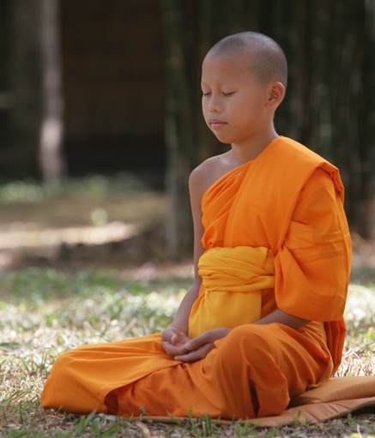
From the Satipaṭṭhāna-sutta
(‘the discourse [sutta] on being established in mindfulness [sati])
Monks, this is the direct path for the purification of beings, the surmounting of sorrow and lamentation, the disappearance of pain and grief, the attainment of the true way, the realization of nibbāna: the four kinds of establishing mindfulness…
…a monk abides contemplating:
1) the body as a body…2) feelings as feelings…3) thoughts as thoughts…4) mental phenomena as mental phenomena [including obstructions to meditative focus: desire, ill-will, doubt, sloth etc.].
A Theravādin novice in meditation. Image available free via wikimedia commons (commons.wikimedia.org).
Notes:
One of many full translations of the Satipaṭṭhāna-sutta, complete with a commentary, is available here: https://www.accesstoinsight.org/lib/authors/soma/wayof.html. The translation in the slide is more closely related to that of Bhikkhus Ñāṇamoli and Bodhi (1995), The Middle Length Discourses of the Buddha, Wisdom Publications.

Slide 6
From the Satipatthāṇa-sutta
(‘the discourse [sutta] on being established in mindfulness [sati])
How, monks, does a monk abide contemplating the body as a body? A monk, having gone to the forest or the root of a tree or to an empty hut, sits; having folded his legs, he sits straight and establishes mindfulness before him, mindful as he breathes in and breathes out. Breathing in long, he understands: ‘I breath in long’; or breathing out long, he understands: ‘I breathe out long’ [etc.]…
…again, monks, as though he were to see a corpse thrown aside in a charnel ground, being devoured by crows [and other animals], a monk compares this same body [of his] with it thus: ‘this body [of mine] is of the same nature, it will be like that, it is not exempt from that fate.’
Notes:
The Satipaṭṭhāna-sutta suggests to us some of the foundations of both samatha and vipassanā as separate traditions of practice. However, the world of Buddhist meditation outside of the Theravāda tradition is broader still. Tantric Buddhism, with origins in the middle of the first millennium CE, boasts colourful, imaginative mental exercises that are heavily ritualized; Zen Buddhism, prominent in Japan but with routes in China in the late first millennium, is by contrast somewhat austere but preserves a strong focus on mindfulness, as described here.
A good source book for these traditions is Sarah Shaw’s (2009) Introduction to Buddhist Meditation, Routledge.

Slide 7
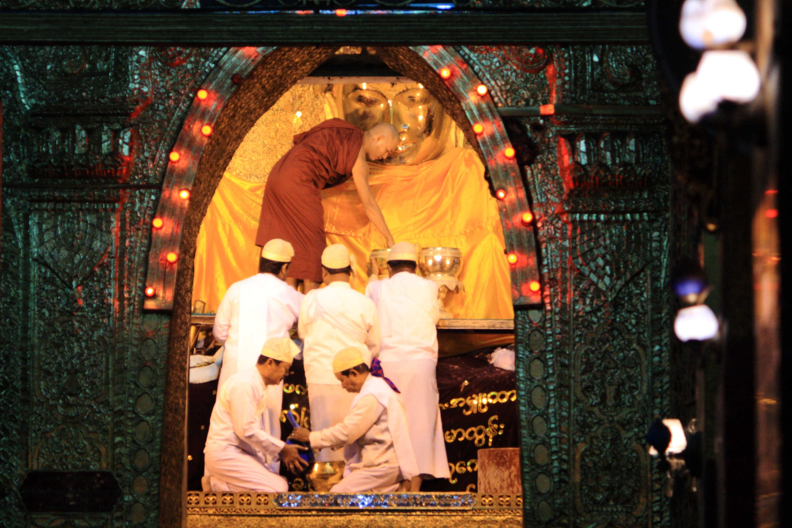
Pūjā – ‘worship’, ‘devotion’
Who or what is worshipped?
the Buddha
the Dhamma and Sangha
gods?
The role of kamma:
“fields of merit”
giving without receiving
giving to an appropriate recipient
giving to benefit others
Pūjā of the Mahamuni Buddha image
“Making food for the Buddha” vimeo.com/113047607
Notes:
Image: pūjā of the Mahamuni Buddha image in Myanmar: Photo by Damien HR, CC-BY-SA https://commons.wikimedia.org/wiki/File:Mahamuni_Buddha_(1).jpg
The video is part of a series made by Rita Langer of Bristol University, and all are worth a look as potential teaching aids. This particular film captures the daily rites of a Sri Lankan family of Buddhists.
The story of the origins of the Mahamuni image is helpfully explained on https://en.wikipedia.org/wiki/Mahamuni_Buddha_Temple, though a more scholarly source would be Schober’s chapter in her volume Sacred Biography in the Buddhist Traditions of South and Southeast Asia (University of Hawaii Press, 1997); this is an excellent volume overall, with lots of rich reflections on how the Buddha’s lifestory is key to understanding early Buddhist practice and tradition.

Slide 8
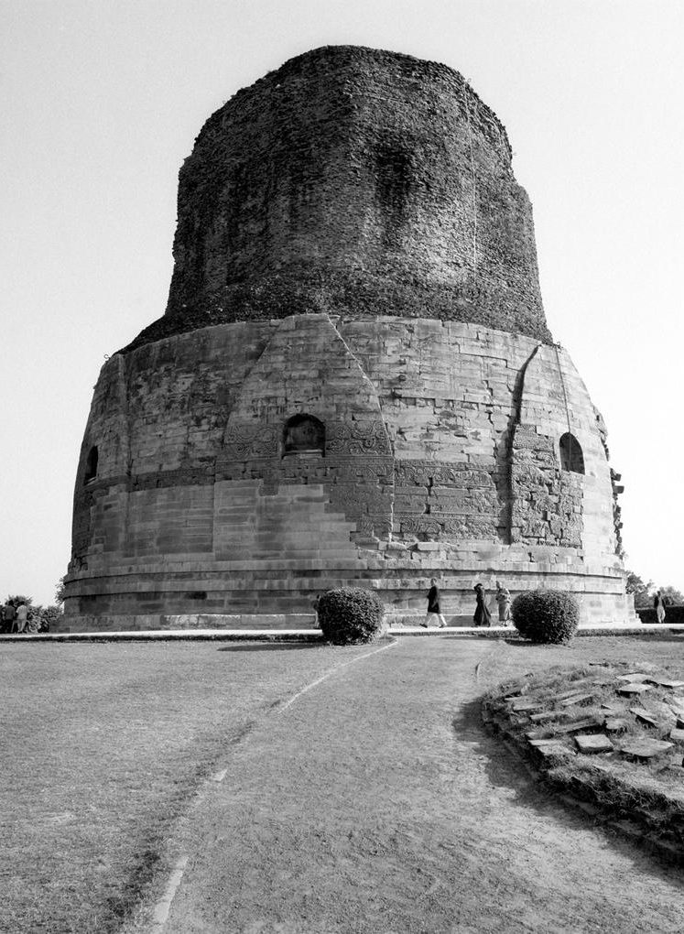
The Buddha’s relics
[Monk:] ‘Long is the time, lord of men, since we have seen the Buddha. We lived a life without a master; there is nothing here for us to worship.’
[King:] ‘Did you not tell me, sir, that the Buddha has passed into nibbāna?’
[Monk:] ‘If we behold the relics, we behold the Buddha.’
From the Mahāvaṃsa (c.C5th CE), reporting the arrival of some Buddhist relics to Sri Lanka
Right: The thūpa (Sanskrit: stūpa) at Sarnath, near Varanasi, site of the Buddha’s first sermon.
Notes:
The Mahāvamsa is a chronicle in Pāli that claims to record the earliest history of Buddhism, with a particular focus on the arrival and establishment of Buddhism on the island of Sri Lanka. It is sometimes treated as a historical source, but it clearly has a rhetorical and historiographical agenda, and so is best viewed as an early work of Buddhist literature. The full text is available in an old translation on https://archive.org/stream/mahavamsagreatch00geigrich/mahavamsagreatch00geigrich_djvu.txt but the quotation above is our own, slightly adjusted translation, of a passage from chapter 17.
Image: The Dhamekh Stupa, courtesy of the John C. and Susan L. Huntington Archive of Buddhist and Related Art: https://huntingtonarchive.org/

Slide 9
Pūjā – ‘worship’, ‘devotion’
Who or what is worshipped?
the Buddha
the Dhamma and Sangha
gods?
The role of kamma:
“fields of merit”
giving without receiving
giving to an appropriate recipient
giving to benefit others
Pūjā of the Mahamuni Buddha image
“Making food for the Buddha” vimeo.com/113047607
Notes:
Image: pūjā of the Mahamuni Buddha image in Myanmar: Photo by Damien HR, CC-BY-SA https://commons.wikimedia.org/wiki/File:Mahamuni_Buddha_(1).jpg
The video is part of a series made by Rita Langer of Bristol University, and all are worth a look as potential teaching aids. This particular film captures the daily rites of a Sri Lankan family of Buddhists.
The story of the origins of the Mahamuni image is helpfully explained on https://en.wikipedia.org/wiki/Mahamuni_Buddha_Temple, though a more scholarly source would be Schober’s chapter in her volume Sacred Biography in the Buddhist Traditions of South and Southeast Asia (University of Hawaii Press, 1997); this is an excellent volume overall, with lots of rich reflections on how the Buddha’s lifestory is key to understanding early Buddhist practice and tradition.

Slide 10
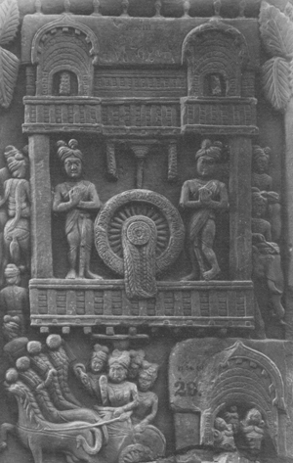
Buddha and Dhamma
“For a long time, Lord, I have wanted to come and set eyes on the Blessed One, but I had not the strength in this body to come and see the Blessed One.”
“Enough, Vakkali! What is there to see in this vile body? He who sees Dhamma, Vakkali, sees me; he who sees me sees Dhamma. Truly seeing Dhamma, one sees me; seeing me one sees Dhamma.”
Vakkali Sutta (Saṃyutta Nikāya 22.87)
Notes:
Text: Saṃyutta Nikāya 22.87, trans. M. Walshe: www.accesstoinsight.org/tipitaka/sn/sn22/sn22.087x.wlsh.html
Image: Worship of a dhamma wheel at the early Buddhist site of Bharhut, perhaps 2nd century BCE. Photograph Biswarup Ganguly of the image in an exhibition at the Indian Museum, Kolkata. CC-BY-3.0 https://commons.wikimedia.org/wiki/File:Worship_of_Chakra_-_Sandstone_-_ca_2nd_Century_BCE_-_Sunga_Period_-_Bharhut_-_ACCN_305_-_Indian_Museum_-_Kolkata_2016-03-06_1563.JPG

Slide 11
Programme
February 9th Buddha, Dhamma, and Saṅgha (‘The Three Jewels’)
March 9th Dukkha, Anicca, and Anattā (‘Three Marks of Existence’)
April 13th Saṃsāra, Kamma, and Nibbāna
May 11th The Eightfold Path and Five Precepts
June 8th Meditation and Worship (Pūjā)
Each session will consist of roughly 30 minutes of presentation, and up to 30 minutes of questions and/or discussion.
The presentation (though not the discussion) will be recorded. Please keep cameras off during this part of the event.
Image Copyright British Museum, London

