Slide 1
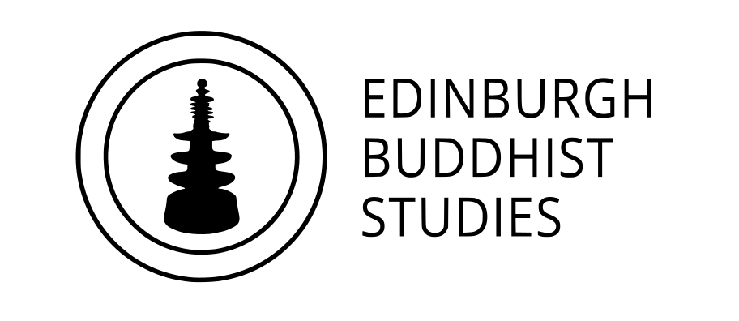
Introduction to Key Concepts in Buddhism
for RMPS Teachers
Dr Naomi Appleton
University of Edinburgh, naomi.appleton@ed.ac.uk
Dr Chris Jones
University of Cambridge, cvj20@cam.ac.uk
Feb-Jun 2021

Slide 2
Series aims
To discuss and clarify concepts that appear in the N5 and Highers curricula
(e.g. what is saṃsāra?)
To introduce some potentially useful sources for understanding these concepts
(e.g. some illuminating passages from the Pāli Canon)
To situate these concepts, over five months of presentations, in relation to one another (e.g. what has meditation to do with karma?)
Method
We will consider primarily Theravāda Buddhism, and through this also consider the background to Buddhist thought and practice in South Asia (modern day India, Nepal etc.)
We will primarily refer to concepts using the Buddhist scriptural language Pāli (e.g. kamma, not karma; nibbāna, not nirvāṇa), discussing these as one might on an undergraduate course.
These slides, with accompanying notes (including links to further resources), will be made available to the group.
Image Copyright Ashmolean Museum, Oxford
Notes:
Slides in this series will be accompanied by notes providing further details about sources or images that we use.
We invite you to ask further questions about any of these during our meetings, and are happy to respond to any other questions by email.

Slide 3
Programme
February 9th Buddha, Dhamma, and Saṅgha (‘The Three Jewels’)
March 9th Dukkha, Anicca, and Anattā (‘Three Marks of Existence’)
April 13th Kamma, Saṃsāra, and Nibbāna
May 11th The Eightfold Path and Five Precepts
June 8th Meditation and Worship (Pūjā)
Each session will consist of roughly 30 minutes of presentation, and up to 30 minutes of questions and/or discussion.
The presentation (though not the discussion) will be recorded. Please keep cameras off during this part of the event.
Image Copyright British Museum, London
Notes:
The image depicts a stone relief panel from Gandhāra, modern-day Pakistan/Afghanistan, dated to the 1-2nd century CE (https://www.bmimages.com/preview.asp?image=01613030008&itemw=4&itemf=0001&itemstep=1&itemx=15).
Gandhāra was the western-most region of the Buddhist cultural sphere, and remained so until the arrival of Islam in the C8th. Incidentally, the central figure is not the Buddha who is central to this series of presentations (i.e it is not Siddhattha Gotama, aka Śākyamuni), but in fact is another Buddha, called Dīpaṃkara, whom Buddhist tradition situates in the far distant past, and is considered to have been the first teacher of the person who would eventually go on to become the Buddha of our age.

Slide 4
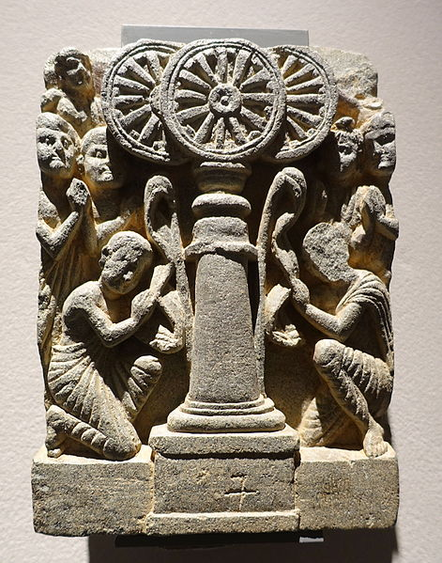
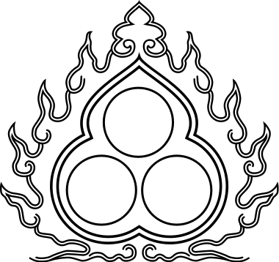
The Three Jewels (tiratana)
alternatively ‘three refuges’ (tisaraṇa)
Buddha – the revealer of Buddhist teaching
Dhamma – the substance of Buddhist teaching
Saṅgha – the community of Buddhist practitioners
Image Copyright Ethnologisches Museum, Berlin
Notes:
You can find a useful video showing how Buddhists take the three refuges (and five precepts) here: https://youtu.be/_o9ScjUn2Ec and here are some longer chants in praise of the three jewels/refuges, as used at a memorial day for Ajahn Chah, a famous monk in the Thai forest tradition of Theravada Buddhism: https://youtu.be/JFcKKBcAE80. Both videos have English subtitles so you can easily follow what is going on.
The image on the left is again from Gandhāra (see notes to the previous slide), and again the earliest centuries of the Common Era (https://commons.wikimedia.org/wiki/File:Veneration_of_the_Three_Jewels,_Chorasan,_Gandhara,_2nd_century_AD,_schist_-_Ethnological_Museum,_Berlin_-_DSC01642.JPG).
Monks are depicted showing reverence to three wheels (cakkas; Sanskrit equivalent cakra), which symbolize the three jewels. The wheel was a symbol of authority in ancient India, as reflected in the motif of the Buddha’s ‘dhammacakka’ (see later slide), but also in imperial artwork associated with the Emperor Aśoka (reign c. 268-232 BCE); the wheel found in inscriptions attributed to Aśoka today features at the centre of the Indian national flag.
The image on the right is a modern depiction of the three jewels, which adorn any number of Buddhist buildings and publications across the world.

Slide 5
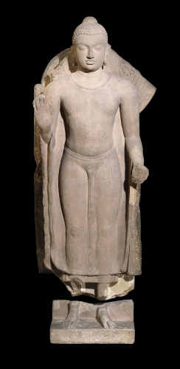
Buddha ‘awakened one’; ‘enlightened one’
Possibly lived during the fifth century BCE (ca. 480–400 BCE), although traditional accounts tend to put this a century or more earlier.
The title ‘Buddha’ is given to Siddhattha Gotama; also in Buddhist tradition called ‘Śākyamuni’ (‘the Sage of the Śākya clan’, who were resident in what is present-day North India/Nepal); otherwise ‘Tathāgata’ (‘one who has gone thus’), or simply ‘Bhagavan’ (‘Blessed One’ or perhaps ‘Lord’).
“So what do we actually know about the [historical] Buddha? It is fair to say that he was born, he lived, and he died. The rest remains lost in the mists of myth and legend…” Bernard Faure (with my insertion – CJ).
Image Copyright British Museum
Notes:
The term ‘Buddha’ means, very literally, ‘awakened’. Although it is widely accepted that Buddhism has to do with ‘enlightenment’, this specific choice of language is a result of early European study of Buddhism in the nineteenth century, which conceptualized the Buddha as a figure comparable to Western ‘enlightened’ religious teachers or philosophers.
The Buddha depicted in this slide is again from Gandhāra (see earlier slide), and the early centuries of the Common Era. Buddha images wherever they are found bear a series of physical ’marks’ or attributes that Buddhist tradition associates with the bodies of Buddhas, which mark them out as having performed a superlative amount of good activity over the many lives leading up to their awakening. These marks (traditionally 32 in total) include a protuberance on the top of the head, webbed-fingers and a curl of hair in the centre of the forehead (https://en.wikipedia.org/wiki/Physical_characteristics_of_the_Buddha). The origins and individual significance of these marks are unknown to us.
The quotation is from Faure (2009), Unmasking Buddhism (https://www.amazon.co.uk/Unmasking-Buddhism-Bernard-Faure/dp/1405180641).

Slide 6
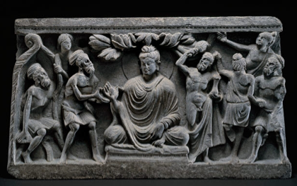
A passage from the Doṇa-sutta (of the Pāli Canon)
[The Buddha is approached by a religious mendicant, named Doṇa (whom the Buddha respectfully addresses as ‘brahmin’), who asks the Buddha what the Buddha will be in his next existence…]
Will you be a deity?
(the Buddha says:) No, brahmin, I will not.
Will you be a ‘celestial spirit’?
…No, brahmin, I will not.
Will you be a ‘worldly spirit’?
…No, brahmin, I will not.
Will you be a human being?
…No, brahmin, I will not.
…
[The Buddha eventually concludes…]
The [mental] contaminations by which I would go to the state of a deity, or celestial spirit in the sky, or to the state of a worldly spirit or human – those have I destroyed, ruined, removed their roots. Like a lotus, rising up, untainted by water, untainted by the world; I, brahmin, am awoken (Buddha).
Image Copyright British Museum
Notes:
For a full translation of the Doṇa-sutta see https://www.accesstoinsight.org/tipitaka/an/an04/an04.036.than.html.
Note a complication with the translation (a good example of how the interpretation of Buddhist literature is still very much open to debate!): in the slide, questions asked to the Buddha are in the future tense, which is a literal reading of the Pali text and seems to refer to what the Buddha will be in a next life, given that he appears so magnificent in this life; in the translation online the questions are in the present tense, following some scholars who argue that use of the future tense in the Pali text conveys perplexity or surprise. Arguments can be made for either case!
The image is yet again from Gandhāra (see previous slides), and the 2-3rd century CE. It may well not depict the specific discourse (sutta; Sanskrit equivalent sūtra) discussed here, but it certainly features the Buddha interacting with an ascetic with long, matted hair, who may be what we call a brahmin (in brief: someone committed to rituals that were believed to bring about better rebirth). On the other side of the Buddha is depicted a burly figure called Vajrapāṇi, who is a ‘worldly spirit’ (yakkha; Sanskrit equivalent yakṣa) such as those mentioned in the translation, who was often depicted accompanying the Buddha as a protector. Notice that here this spirit looks conspicuously ’Herculean’; Gandhāra was between the Indian and Greek cultural spheres, and its art exhibits influence by both worlds.

Slide 7
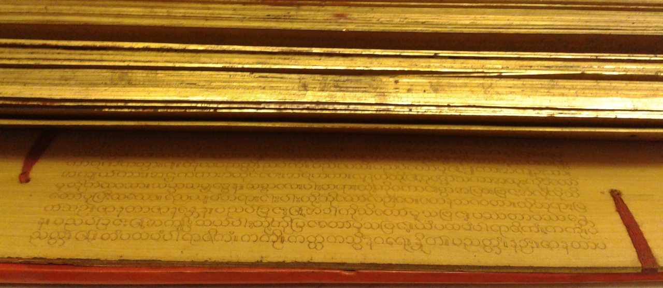
Dhamma ‘teaching’; ‘truth’
Many other possible translations, and different (though related) meanings in Hinduism (Sanskrit equivalent = dharma)
Descriptive (how things are) and Prescriptive (how things should be)
The truth about the human condition (rebirth, suffering, etc) and the truth about what we should do about it (Buddhist practices)
Also:
The teachings of the Buddha, as containing these truths
The scriptures of Buddhism, as containing these teachings
Burmese Buddhist manuscript, photograph by Naomi Appleton
Notes:
The image shows a Burmese Buddhist manuscript that was donated to an Oxfam bookshop a few years ago, during a house clearance, and then placed in the University of Edinburgh Library Special Collections. The scripture, containing monastic regulations, is written in Burmese script but Pali language, and is made of palm leaves, a traditional writing material in South Asia. The careful writing, binding and gilding show the respect with which scriptures are treated. Photograph by Naomi Appleton (no copyright – please use however you like).

Slide 8
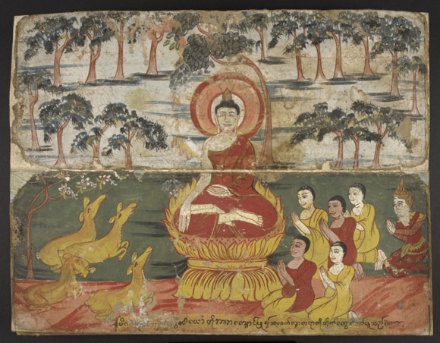
From the Dhammacakkappavattana-sutta
(‘the discourse [sutta] on setting in motion the wheel of Dhamma’)
Understood to be the Buddha’s first sermon, this sets out the Four Noble Truths:
Suffering / dissatisfaction (dukkha)…
All things that we experience are characterized by suffering, or are ‘unsatisfactory.’
2) The arising of suffering…
Our suffering has a root cause, which is craving (taṇhā).
3) The cessation of suffering…
By eliminating the cause of suffering (craving), this suffering can be ended.
4) The path to the cessation of suffering…
This is achieved by following a ‘Middle Way’, the ‘Eightfold Path’
Image in the public domain
Notes:
For a full translation of the Dhammacakkappavattana-sutta see https://www.accesstoinsight.org/tipitaka/sn/sn56/sn56.011.nymo.html
The image is from a Burmese manuscript in the British Library, and depicts the first sermon – for a discussion and some further images see https://blogs.bl.uk/asian-and-african/2015/12/scenes-from-the-life-of-the-buddha-.html

Slide 9
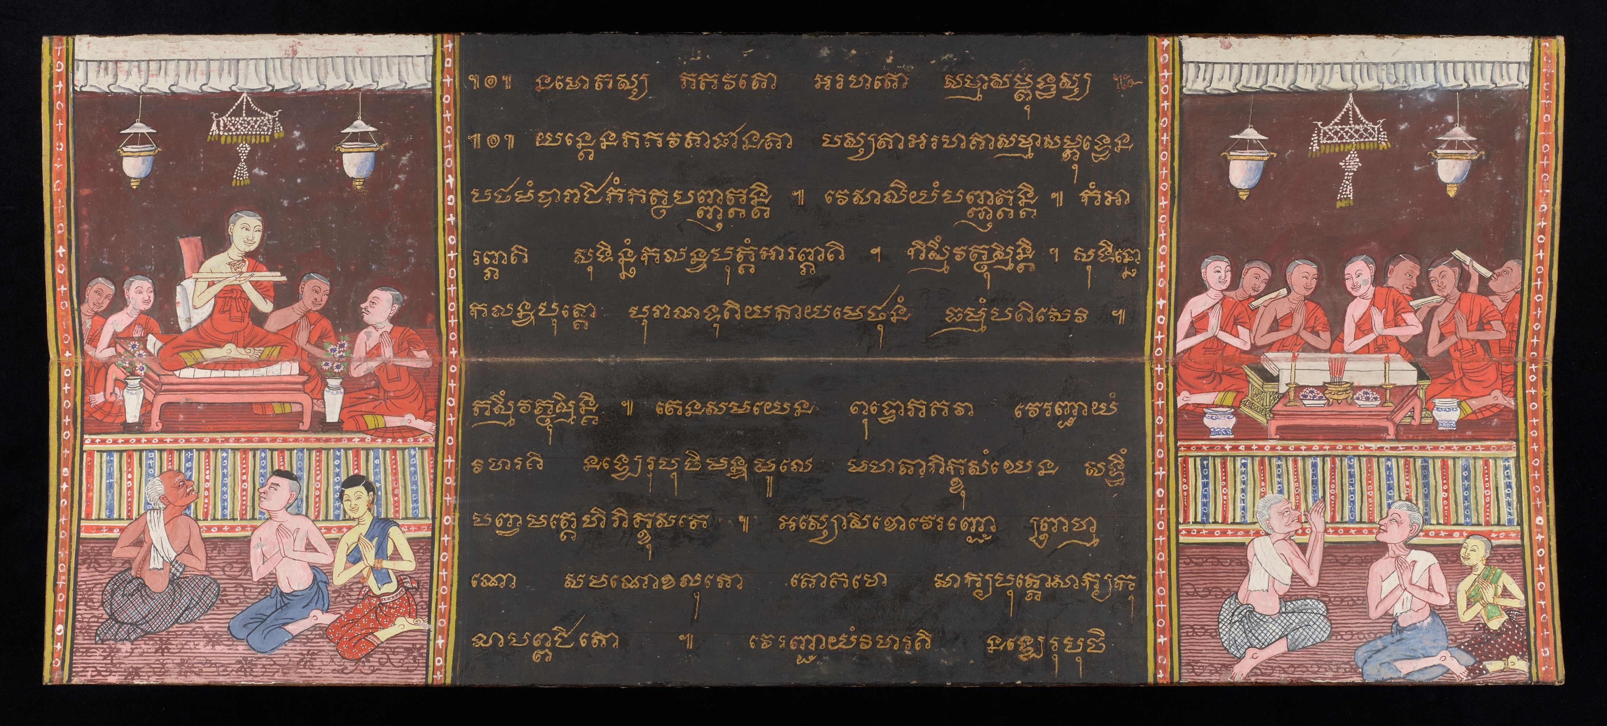
Saṅgha ‘community’; ‘congregation’
The “fourfold saṅgha”
Monks
Nuns
Laymen
Laywomen
(Note gender issues)
Thai manuscript showing monks reading Buddhist scriptures. Image copyright Chester Beatty Library.
The monastic saṅgha: Monks and nuns (bhikkhus and bhikkhunis) renounce worldly ties and possessions (in theory at least), and dedicate their lives to Buddhist practice, including meditation, study/preservation of the Dhamma, services for laypeople…
Notes:
The image shows an illustrated page from a 19th century Thai manuscript that shows the close relationship between the Saṅgha and the Dhamma. Here we see monks reading from two different types of manuscript commonly used in Theravāda Buddhism: palm leaf bundles (on the left) and a folded paper manuscript made from mulberry leaves (on the right). The monks are shown in the traditional ochre robes, with laypeople making respectful gestures below. The manuscript is in the Chester Beatty Library in Dublin and can be found here: https://cbl01.intranda.com/viewer/object/Thi_1318/3/LOG_0000/
Here is a short film on lay-monastic interactions in Sri Lanka, showing the gift of a meal from laypeople to a group of monks: http://vimeo.com/112263908. It was made by Dr Rita Langer of Bristol University as part of a research project into food and Buddhist cosmology. You may enjoy watching it – or others in the series – with your pupils

Slide 10
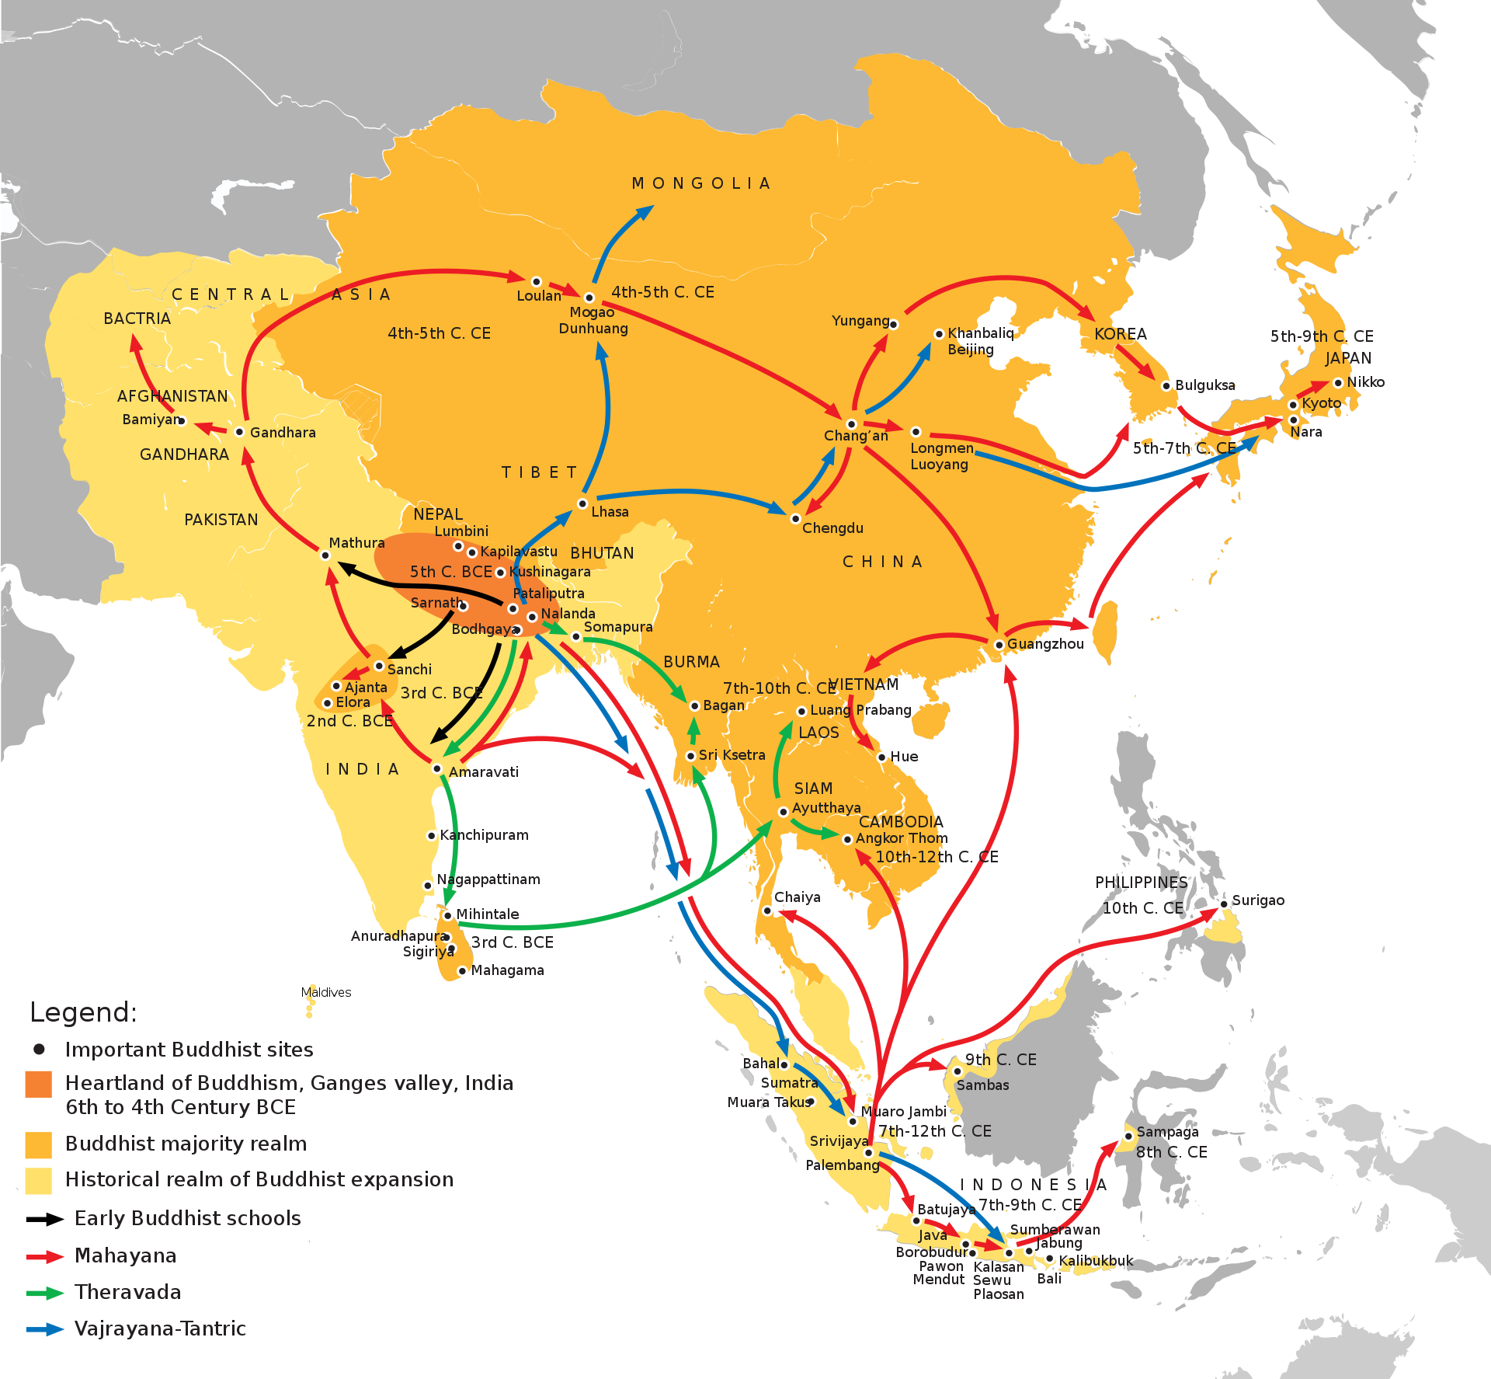
The Saṅgha across Asia
Left: the historical spread of Buddhism (map from www.wikipedia.com).
Right: the contemporary distribution of Buddhism across Asia (map from www.studybuddhism.com).
Notes:
Either map can be enlarged to see its details; however, the specifics of the left-hand map, such as the dates shown, are the subject of ongoing debate among scholars. The right-hand map is more valuable for discussing Buddhism as it exists in the world today.
A common threefold division of types of Buddhism in the world (talk of ‘schools’ or ‘sects’ is less accurate) is as follows:
1) Theravāda Buddhism is found in Sri Lanka, across Southeast Asia (especially Myanmar/Burma, Thailand, Laos and Cambodia), and in pockets elsewhere in the world. Its primary scriptural authority is the Pali Canon, and most of this series of presentations will focus on ideas and practices proper to Theravāda Buddhist.
2) Mahāyāna Buddhism is an umbrella term for a great diversity of types of Buddhism, some (but not all) of which survive across East Asia (China, Korea, Japan, Vietnam) and Central Asia (Tibet and Nepal, but see below). Forms of Mahāyāna Buddhism also have a following in the West, for example Zen and Nichiren, both of which are from Japan.
3) Vajrayāna Buddhism, otherwise ‘Tantric’ Buddhism, is a distinctive sub-set of forms of Mahāyāna Buddhism, found primarily in Tibet and Nepal but also, since the middle of the last century, with a significant following across the West.
Other forms of Buddhism exist; for example, Buddhism essentially disappeared from India around the fourteenth century, but since the middle of the twentieth century there have been Buddhists in India who draw inspiration from the Theravāda world (although they are not strictly speaking Theravādin themselves). Many forms of Buddhism similar to Theravāda have been lost over the centuries, as have many forms of Mahāyāna Buddhism that are known to us today only by their surviving literature.

