Slide 1
Build your own chatbot
Kathrin Haag, Informatics and IS
Stewart Cromar, IS LTW
Sian Bayne, School of Education

Slide 2
1.00 introduction to the ‘teacherbot’ (Sian)
1.10 walkthrough creating a chatbot using Pandora (Kate)
1.30 hands-on bot building (guided by Kate and Stewart)
2.00 comfort break
2.10 testing your bot on Twitter
2.30 feedback and thoughts (Sian)

Slide 3
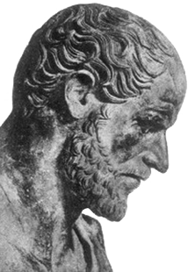
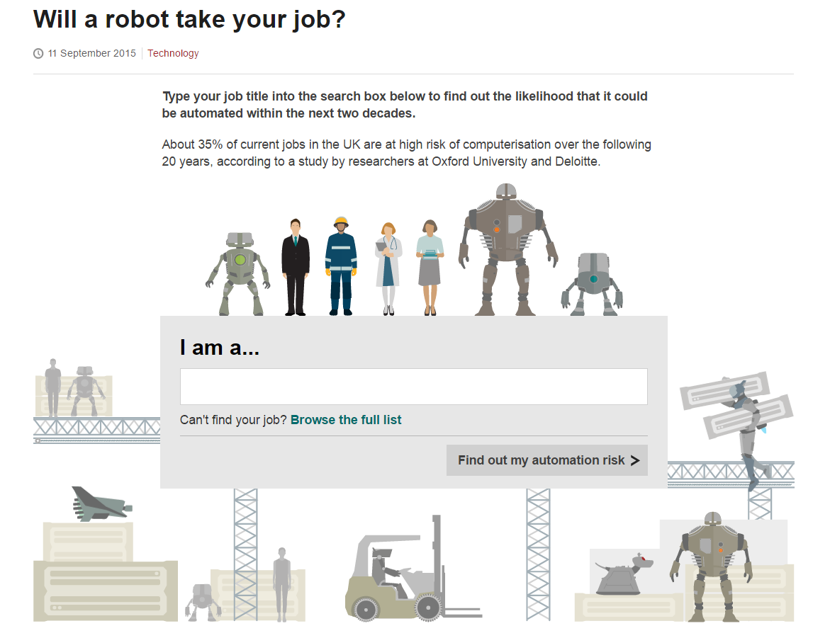
“One can predict that in a few more years millions of school children will have access to what Philip of Macedon’s son Alexander enjoyed as a royal prerogative: the personal services of a tutor as well-informed and responsive as Aristotle.”
Suppes, P. (1966). The uses of computers in education. Scientific American, 215(2): 206-20.
Frey and Osborne (2013) The future of employment: how susceptible are jobs to computerisation? Oxford Martin Programme on the Impacts of Future Technology. http://www.futuretech.ox.ac.uk/

Slide 4
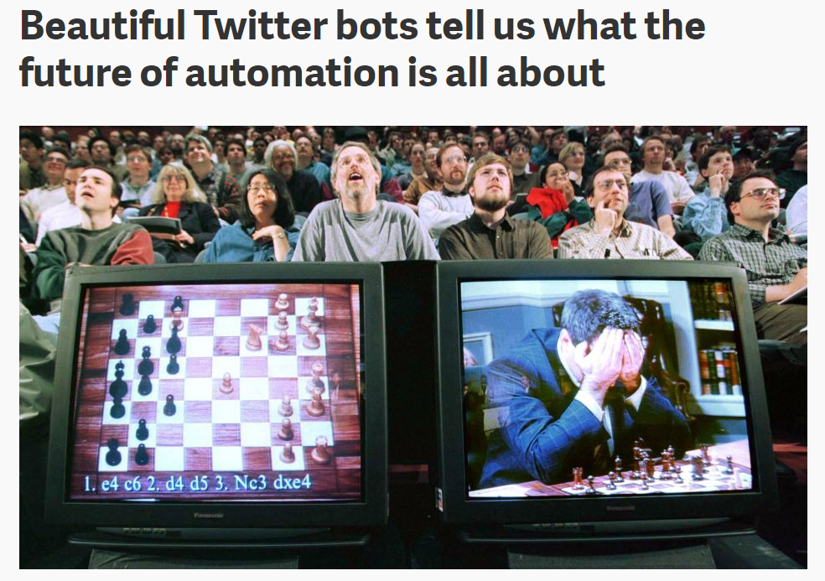
“In the software-centered future, individuals and institutions won’t compete with computer programs so much as they’ll compete with each other over who can work best alongside computers.”
Sonnad, N. (2014) Beautiful Twitter bots tell us what the future of automation is all about. Quartz, June 12 2014. http://qz.com/219696

Slide 5
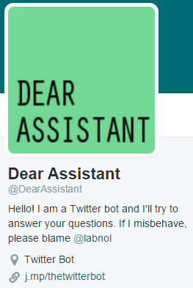
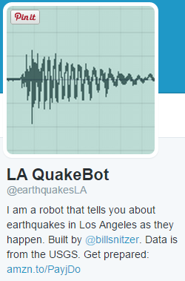
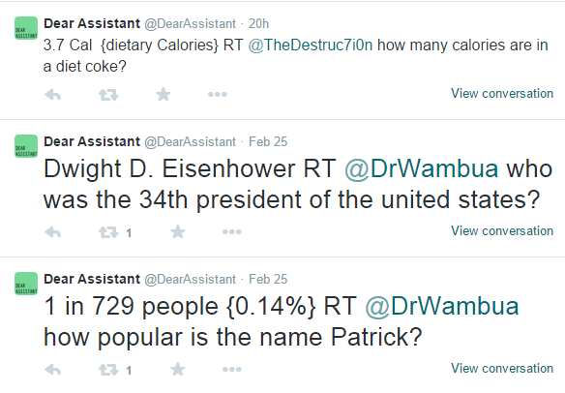
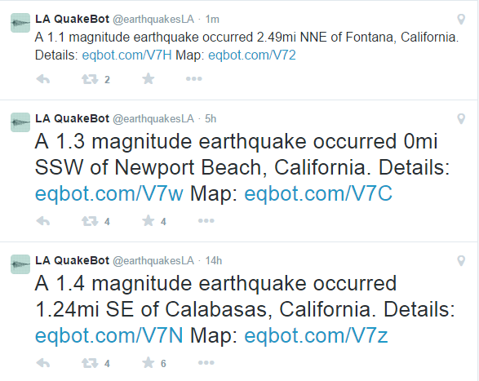
made by Amit Agarwal
made by Bill Snitzer

Slide 6
This bot generates 3-4 line poems using a method inspired by Raymond Queneau’s Cent mille milliards de poèmes and the cut-up. In the tradition of ebook bots, it selects 3-4 random lines from different poems in a haiku database and tweets the resulting generated poem every two hours.
http://collection.eliterature.org/

Slide 7
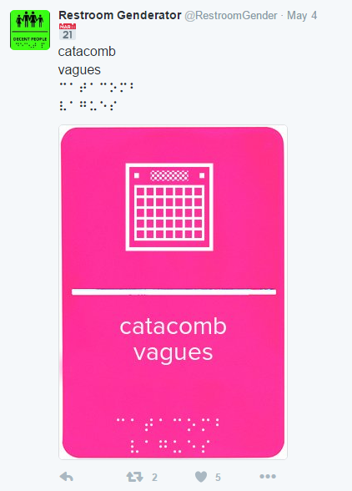
“Perhaps this is my own gender showing, but that bot is really doing the lord’s work; every four hours or so, it produces a new abstract gender, pairs it with a unicode symbol and braille translation, and tweets an image of a restroom sign. The resulting timeline points at real issues with public facilities access, transness, and contemporary relationships with bodies that don’t always feel like home.”
http://nymag.com/selectall/2015/11/12-weirdest-funniest-smartest-twitter-bots.html

Slide 8
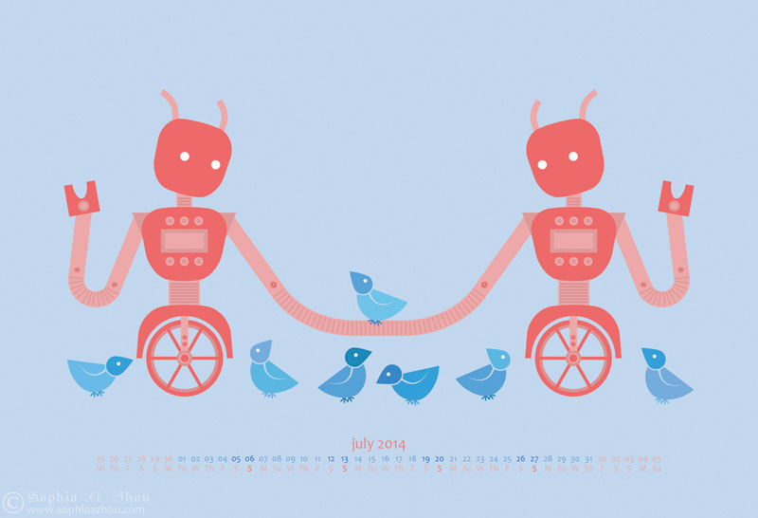
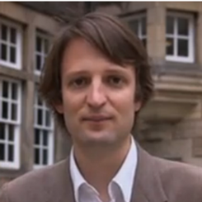
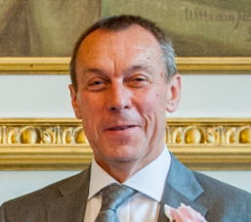
Teacherbot: an intervention in teacher automation

Slide 9
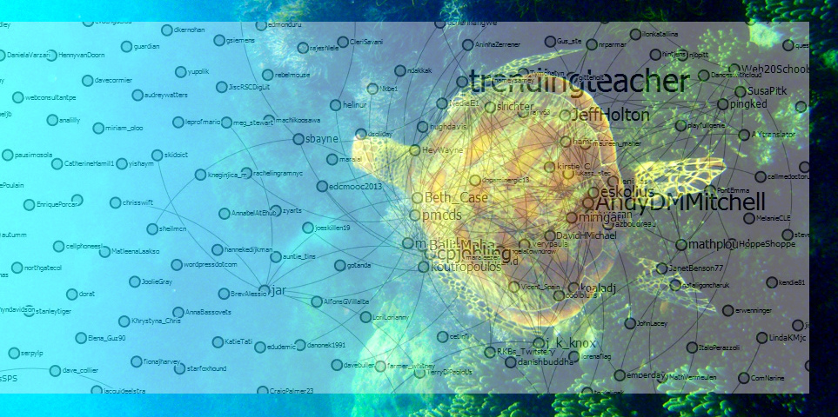
E-learning and Digital Cultures MOOC, part 3: October-November 2014
c.12,000 enrolments from 158 countries
4,000+ in the student Facebook group
9,000+ in the student G+ group
4000+ tweets to #edcmooc over course run
1,900 posts in Coursera forums
c.50% with postgraduate degrees
c.50% working in Education
image made by Ping Lee-Wragge

Slide 10
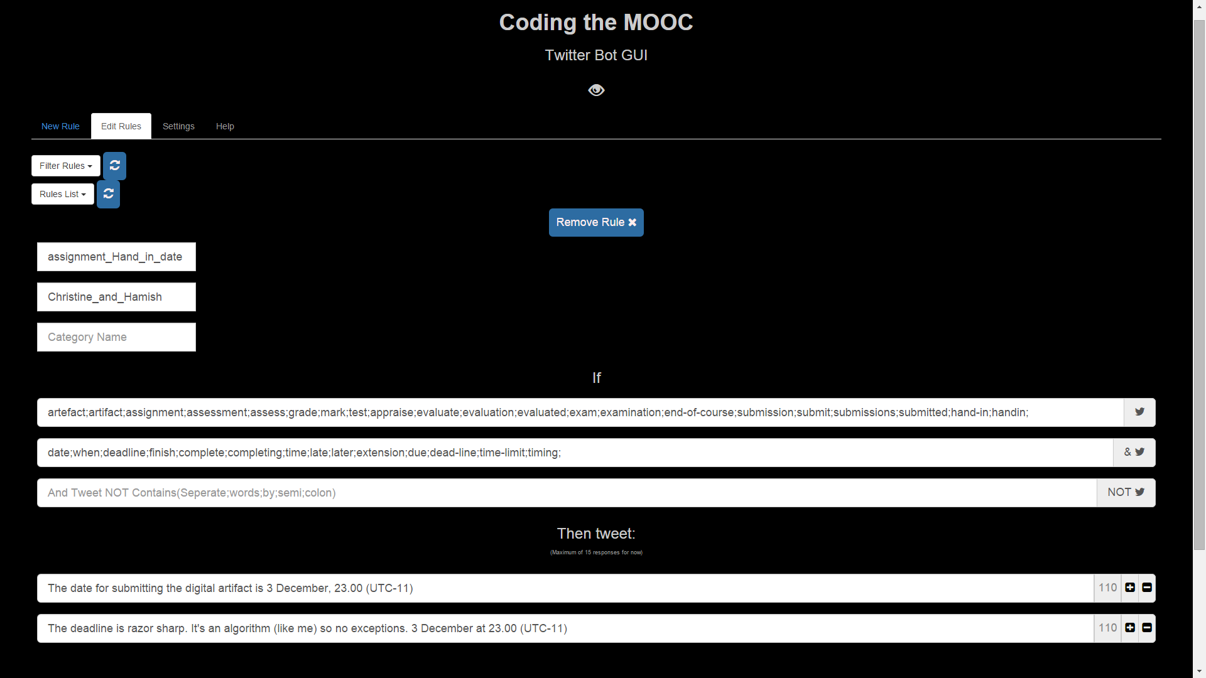
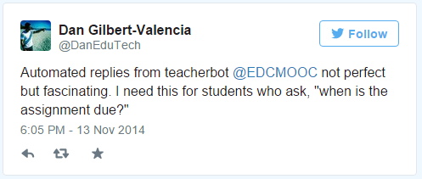
Teacherbot

Slide 11
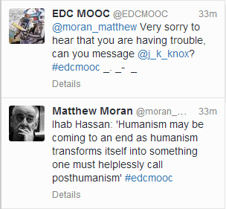
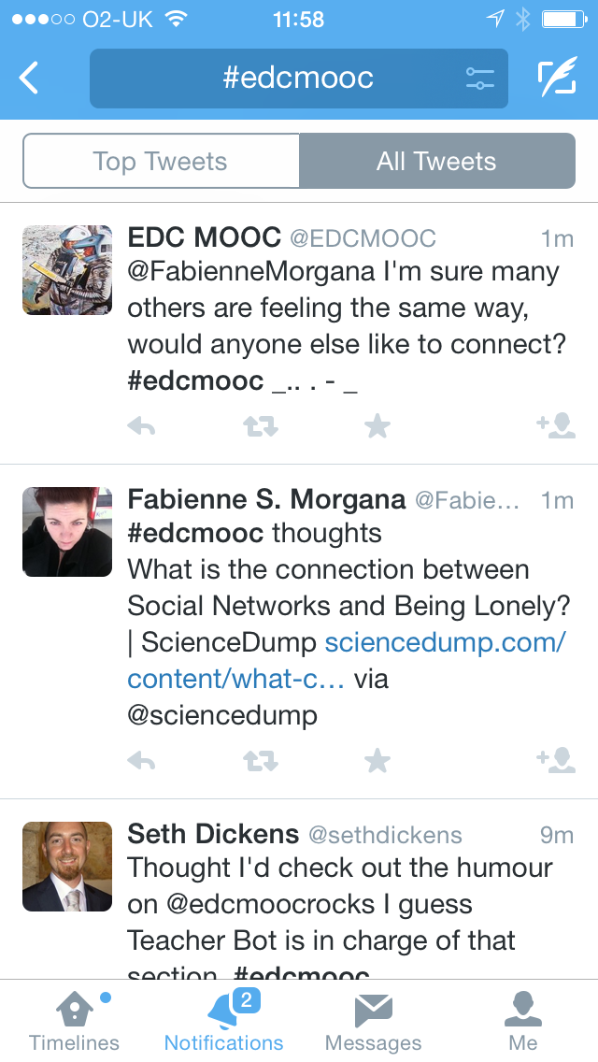
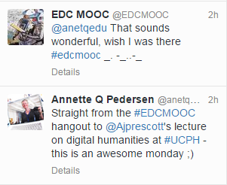
Notes:
trying to create rules for emotion – and mostly failing

Slide 12
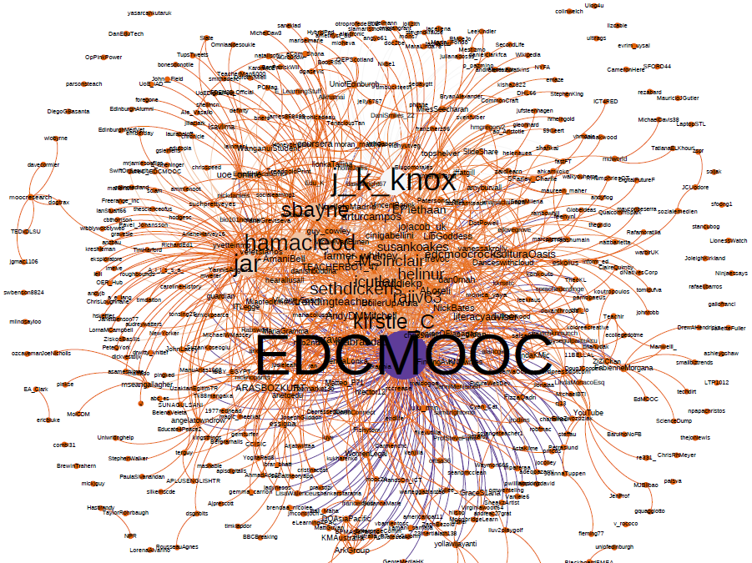
“While I was trying to figure out what the hell ‘post-humanism’ means, the teacher bot led me on a merry chase looking up quotes and obscure academic references, which had the interesting side effect of ‘ambush teaching’ me. I will happily admit, that I do not feel like I have been to a class. I do not feel like I have been taught, either. I do, however, think I have learned something. I’ve certainly been prompted to think. Isn’t this what every good teacher/trainer strives for?”
Seth Giddens 2013

