Slide 1
Peripheral Futures
Xinger Gao
10 days exhibition in Summerhall Science Gallery
Notes:
Kolb, Ronald, Camille Regli, and Dorothee Richter. “Centres ⁄ Peripheries– Complex Constellations.” Notes on Curating 41 (June 2019): 3-11.

Slide 2

Content
01
Exhibition Inspiration
02
Exhibition Concept
03
Artists and Artworks
04
Artist and Venue Costs
05
Exhibition Souvenirs

Slide 3
1. Exhibition Inspiration

Slide 4
Exhibition Inspiration
My Public: People of Edinburgh, International Students Worldwide
Most of them come from urban backgrounds, so I defined the exhibition's purpose to reveal the truth about how cities exploit rural areas. Such an exhibition encourages city residents to reflect on urban exploitation of the countryside, preventing them from viewing rural areas solely as vacation destinations attached to cities.
Kathrin Bohm & Wapke Feenstra, “Introduction” in MyVillages (eds.), The Rural (Whitechapel Gallery, 2019), pp. 16.
An endless stream of images of the rural enters our imaginations through multiple screens and printed matter. This intense objectification of the rural is alarming and splits our roles into spectators and dwellers. The transition from an agricultural and mining economy to a service, and above all non-land-based, economy has fixed our view of the landscape. We see the rural environment as an image that serves us. We build the picture that we long for.

Slide 5
Exhibition Prompt Public to Reflect
Exhibition Inspiration
01.
03.
In the era of modernization, are rural areas being drained by surrounding metropolises?
Do industries in village truly serve the local residents, or are they primarily serving the cities near them?
02.
Has the migration of young people to work in cities led to a decline in village's youth population, hindering labor supply and economic growth?
Kathrin Bohm & Wapke Feenstra, “Introduction” in MyVillages (eds.), The Rural (Whitechapel Gallery, 2019), pp. 15.
The rural is equally shaped by industrial production both within the rural and the cities. Industrial and technological revolutions/infrastructures in urban areas offered overcrowded and economically weak rural communities a new home, causing depopulation and a new urban working class, while industries that rely on ground and soil resources dig up rural landscapes and spit them out as hubris and holes.

Slide 6
2. Exhibition Concept
Art design transforming rural areas rather than industrial production

Slide 7

Exhibition Concept
This exhibition explores the central question: With urban expansion and accelerating capital flows, must rural areas exist solely as peripheral spaces to be consumed?
It explores this theme through two approaches: “Problem Identification” and “Design Responses.”
01
02
Problem Identification
Design Responses

Slide 8
Exhibition Concept
Periphery Future does not regard the countryside as a place of decline, but rather as a pioneering frontier for experimenting with future social structures. Here, art and design become tools for reimagining the possibilities of rural life.
Problem Identification
Design Responses
Reveals the reality that peripheral areas are being replaced by industrial production in the course of urbanization.
For Rural Tourism
For Industrial Legacy Wastelands
For Agriculture and Nature

Slide 9
03. Artists and Artworks
Most are students at ECA

Slide 10
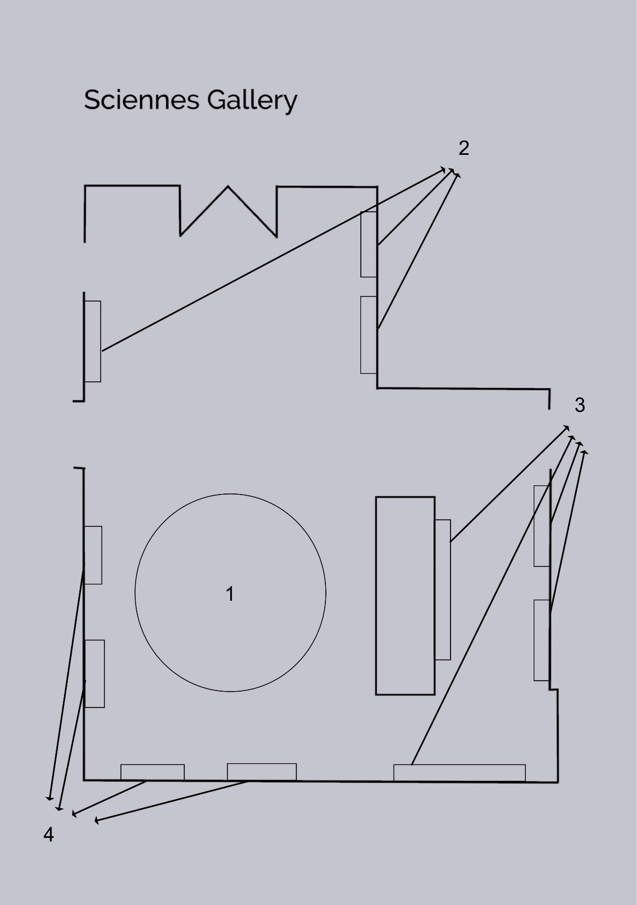
Floor Map 1 Concrete Bamboo 2 Alness Memorial Geopark Sequence 3 Intelligent Wilderness 4 Cooped . Farmed . Displayed

Slide 11
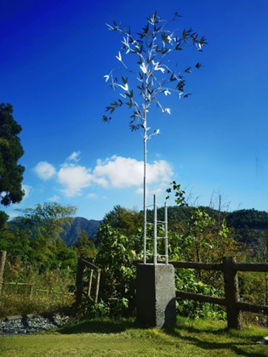
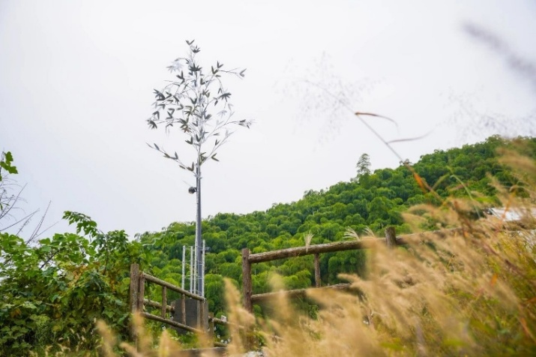

Artists and Artworks
Yuhang Liu: Concrete Bamboo
As an installation placed in the middle of the gallery
Comprising two parts, the lower section depicts a familiar “landscape” of China’s urbanization process—concrete-poured columns—while the upper section features a tall, slender bamboo stalk crafted from welded metal. In other words, it presents a natural landscape constructed by human industry. The contrast and conflict between this industrial feel and nature make the work thought-provoking, expressing the artist's reflection and questioning of the drawbacks exposed in the urbanization process of rural areas under the influence of industrial civilization.
Notes:
“艺向山川——清华大学美术学院2023安吉青年艺术创作营成果展”启幕-清华大学美术学院

Slide 12
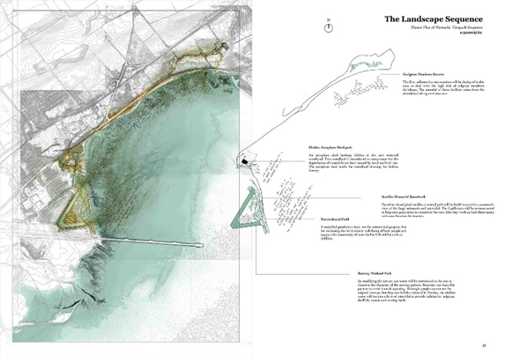
Focused on Problem Solving--------For Rural Tourism
Fangyuan Zheng: Alness Memorial Geopark Sequence
Print his work with authorization and display it as a dense series of images on a wall
01
A graduation project by a student from the Landscape Architecture program at ECA.
02
Could be implemented in coastal rural areas worldwide to both entertain local residents and attract tourism.
03
Solving problem: outward-focused tourism development that fails to align with the daily needs of local residents.
Notes:
Fangyuan Zheng | Edinburgh College of Art Graduate Show 2021

Slide 13
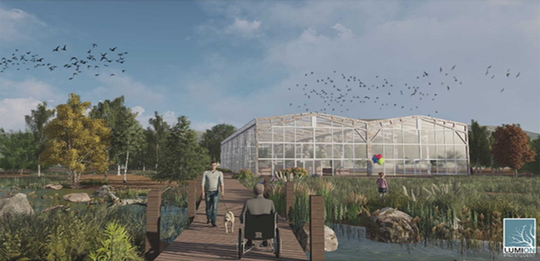
Alness Memorial
Geopark Sequence

Slide 14
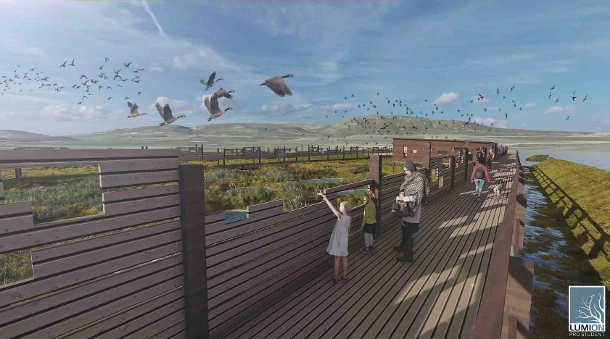
Alness Memorial
Geopark Sequence

Slide 15
Focused on Problem Solving-------- For Industrial Legacy Wastelands Kate Saldanha: Intelligent Wilderness
Print his work with authorization and display it as a dense series of images on a wall
A graduation project by a Landscape Architecture student.
Examines how agricultural areas become wastelands after industrial impact and seeks solutions
Achieve mutual benefit between agriculture and wilderness through the project
Notes:
Kate Saldanha | Edinburgh College of Art Graduate Show 2021

Slide 16
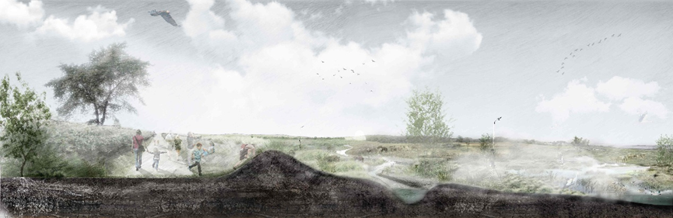
Intelligent Wilderness

Slide 17
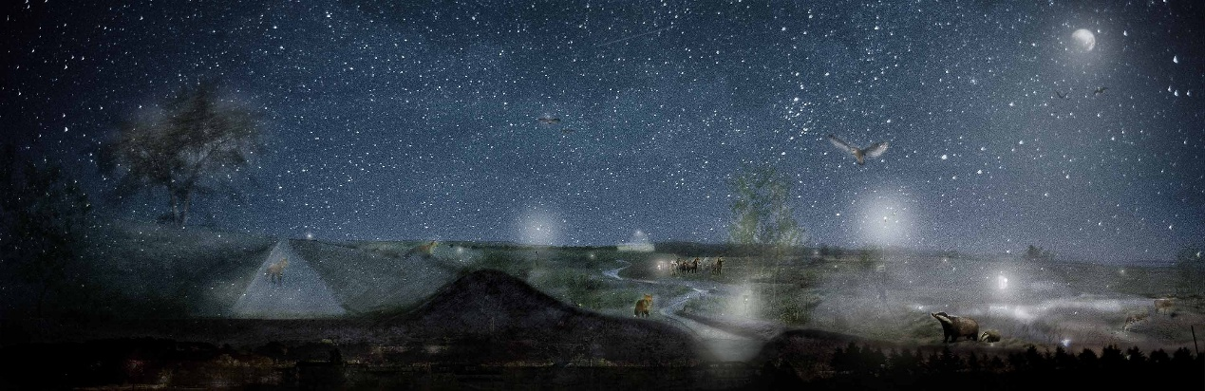
Intelligent Wilderness

Slide 18
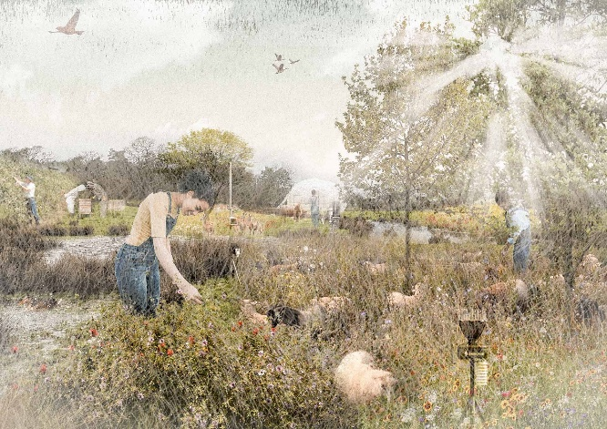
Intelligent Wilderness

Slide 19
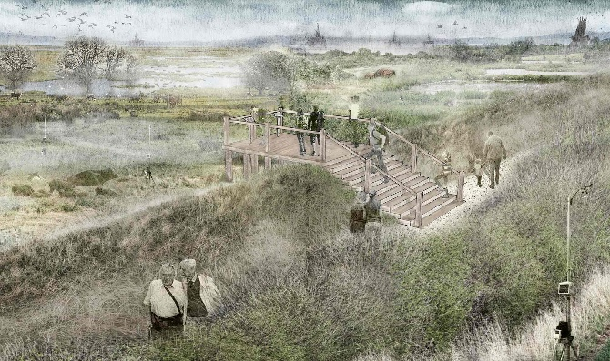
Intelligent Wilderness

Slide 20
Focused on Problem Solving-------- For Agriculture and Nature Sara Dobbs: Cooped . Farmed . Displayed
Present these works as a series on the wall
A graduation project of an ECA Painting undergraduate.
How communities form around food, and how artistic production mirrors patterns in farming.
Explores the intersection of patterns in food systems and art.
Notes:
Sara Dobbs | Edinburgh College of Art Graduate Show 2021

Slide 21
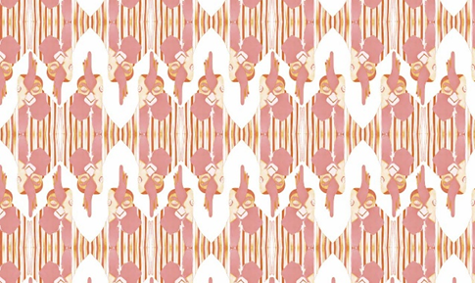
Cooped . Farmed . Displayed

Slide 22
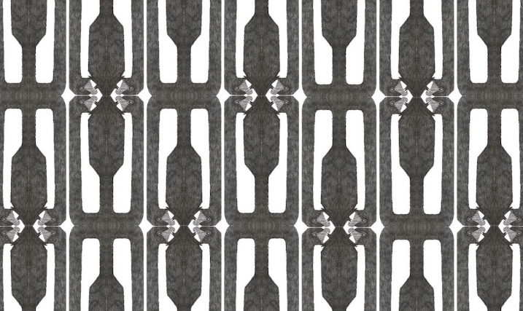
Cooped . Farmed . Displayed

Slide 23
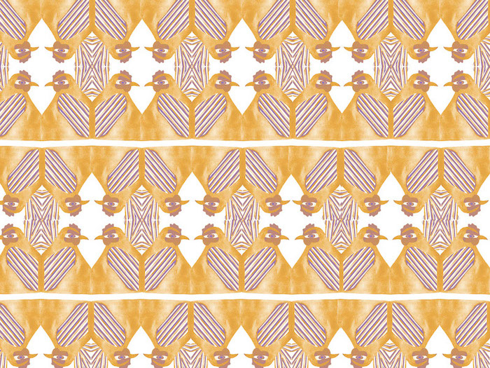
Cooped . Farmed . Displayed

Slide 24
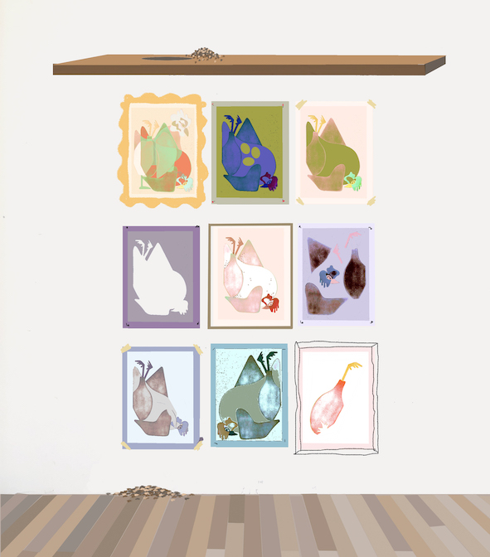
Cooped . Farmed . Displayed

Slide 25
04. Artist and Venue Costs

Slide 26
Total artist fee (Recommended Rates of Pay (RRoP) | Scottish Artist Union)
New Graduate Artist
£234.40 p/day (£117.20 p/ ½ day)
£1,796.00 (Five Days, Five Years Artist) + £179.60 (Half-Day Five-Year Artist) + £117.20 (Half-day newly graduated artist) + £117.20 (Half-day new graduated artist) = £2,210.00.
3+ Years' Experience
£290.40 p/day (£145.20 p/ ½ day)
01
02
5+ Years' Experience
£359.20 p/day (£179.60 p/ ½ day)
03
Notes:
Recommended Rates of Pay (RRoP) | Scottish Artist Union

Slide 27
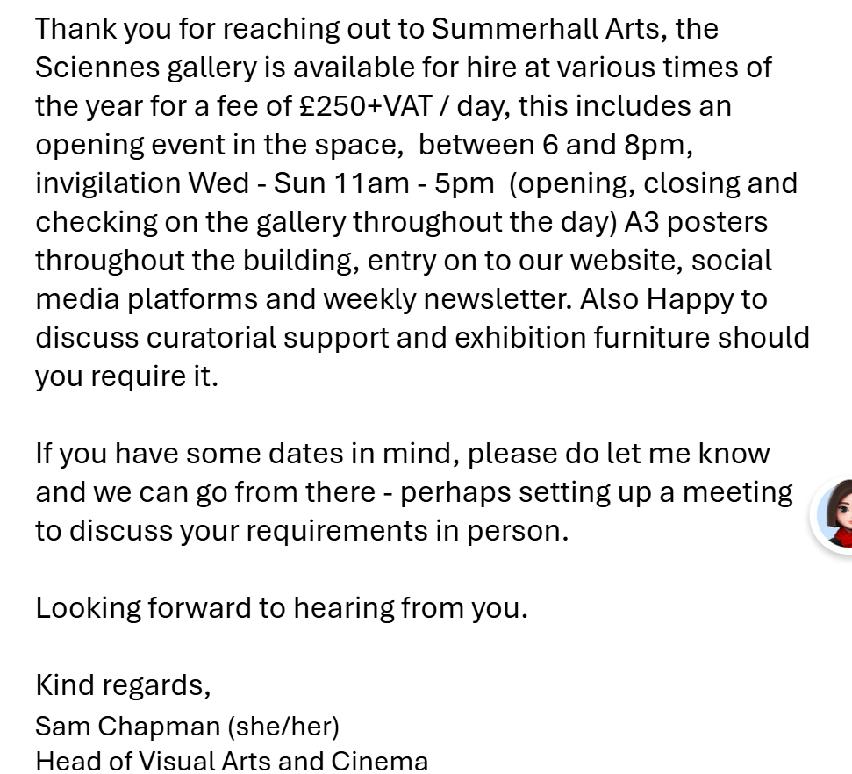
Venue Cost
Summerhall Science Gallery for a 10-day Exhibition: ￡2500
By reviewing the 2024 Summerhall pricing for cinema venues and performing the necessary calculations, I estimate that renting a space comparable in size to the Science Gallery for a 24-day arts festival would cost approximately £4,000.
I anticipate the cost for a ten-day booking would be around £1,600.
Summerhall Arts, Summerhall Festival Information Pack 2024 (Edinburgh: Summerhall, 2024), 7–8, https://www.summerhall.co.uk/wp-content/uploads/2023/11/Summerhall-Festival-Information-Pack-2024.pdf

Slide 28
05. Exhibition Souvenirs
Canvas bags, silk scarves, and hats

Slide 29
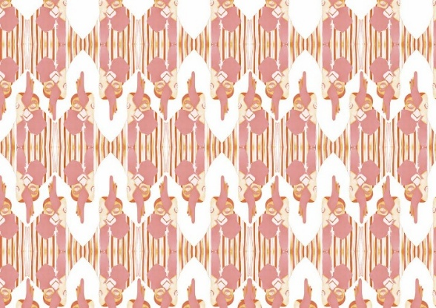
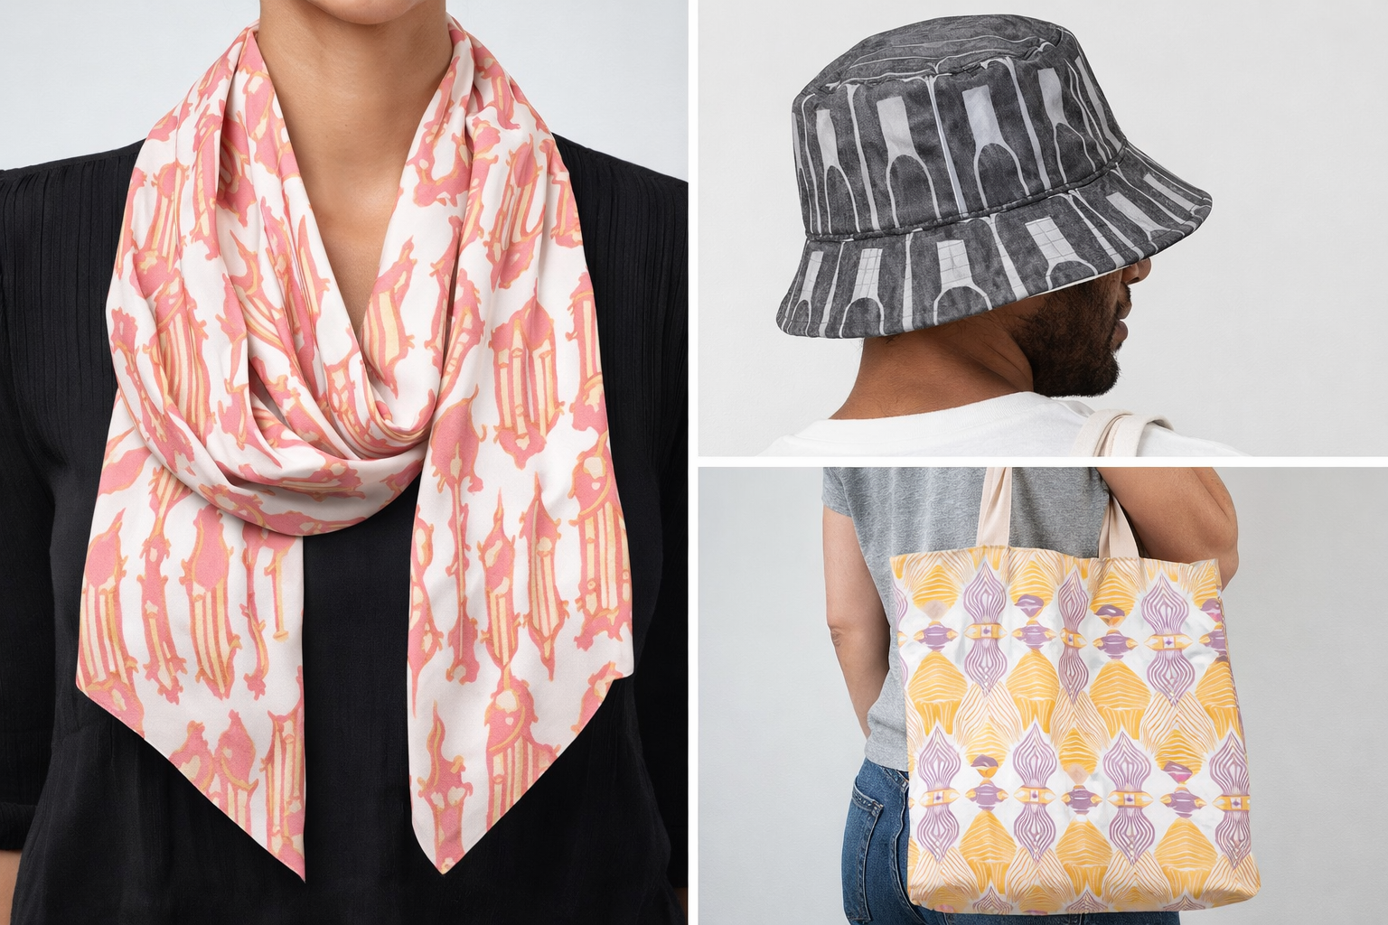
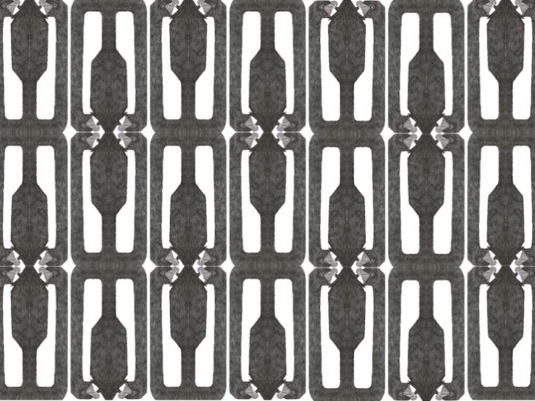
Canvas bags, silk scarves, and hats Product images are generated by AI

Slide 30
Thank You
Xinger Gao

