Slide 1
Curatorial pitch
THEME: PLAY
NAME: Tianai Zhang

Slide 2
What is play?
Form of understanding
Engagement
Used for expression
Contextual: Comprises the environment
Thinking, manipulating, changing and adapting rules
In-between rational and irrational pleasures

Slide 3
Rhetoric of play
Ambiguity of reference: gun sound
Referent: object or toy
Intent: mean or pretend
Sense: serious or non-sense
Transition: only playing
Contradiction: man pretend being a woman
Meaning: play or playfighting

Slide 4
Conceptual ideas:
Modern culture ideologies
The balance of power and fantasy
The theory of Victor Turner: ‘Liminal’ and ‘Liminoid’
‘Liminal’: The liminal is part of society, an aspect of social or religious rites.
‘Liminoid’ is a break from society, part of "play" or "playing". It has the potential to produce revolutionary change.
Progress, imaginary and self

Slide 5
Remix theory
A liminal space in which colonial ideology becomes appropriated by those on whom it was initially imposed.
Remix carries this critical trace of colonial resistance.
Extended, selective and reflexive.
There is no original version, but versions.

Slide 6
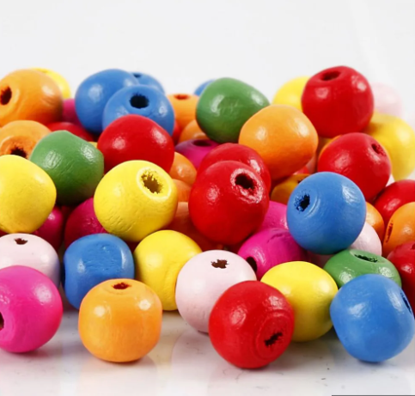
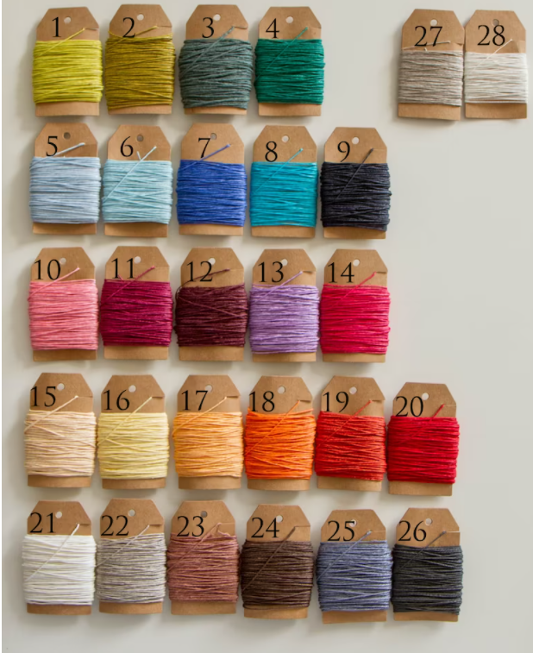
Play-everyday life (Referent)
Playing cards
Linen wax cords
Wooden beads

Slide 7
Play-Intent
A collaboration of craft production.
A remix theory is contain.
The rules between power and imaginary .
The extension of art thinking.

Slide 8
Space-Market
Open to everyone.
Set up a stall.
Collaborative and becoming experience.

Slide 9
Notes:
Navas. (2012). Remix theory : the aesthetics of sampling / Eduardo Navas. Springer. https://doi.org/10.1515/9783990435007
Sicart. (2014). Play matters / Miguel Sicart. MIT Press.
Sutton-Smith. (1997). The ambiguity of play / Brian Sutton-Smith. Harvard University Press.

Slide 10
Questions:
I have searched for some board game artists, but seems like they are not the sample that I could borrow, they were set up for rules and background. What could I do?

