Slide 1
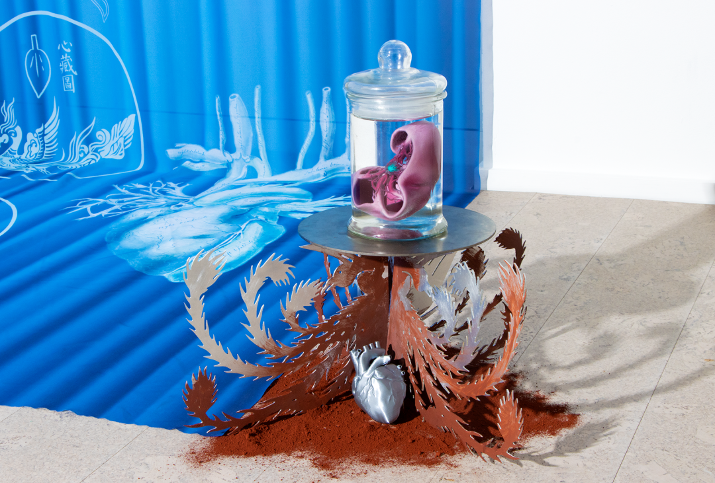
Alienation
&
Bionics
NUANXIN ZHANG

Slide 2
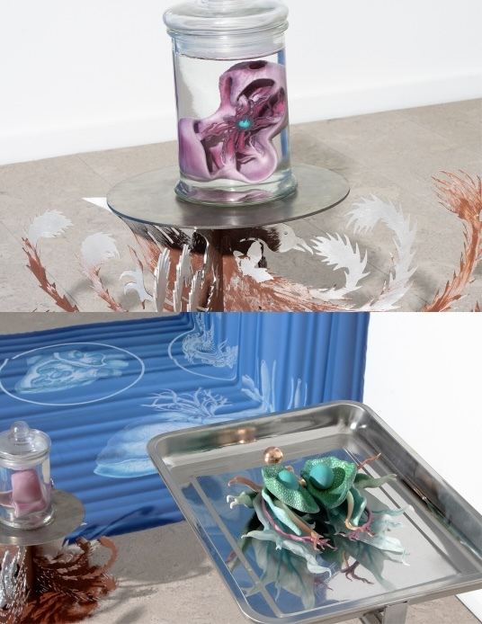
Table of contents
01
Conception & Theme
02
Form & Venue
03
Exhibition Invited Artists
04
Budget

Slide 3
01
Conception
&
Theme

Slide 4
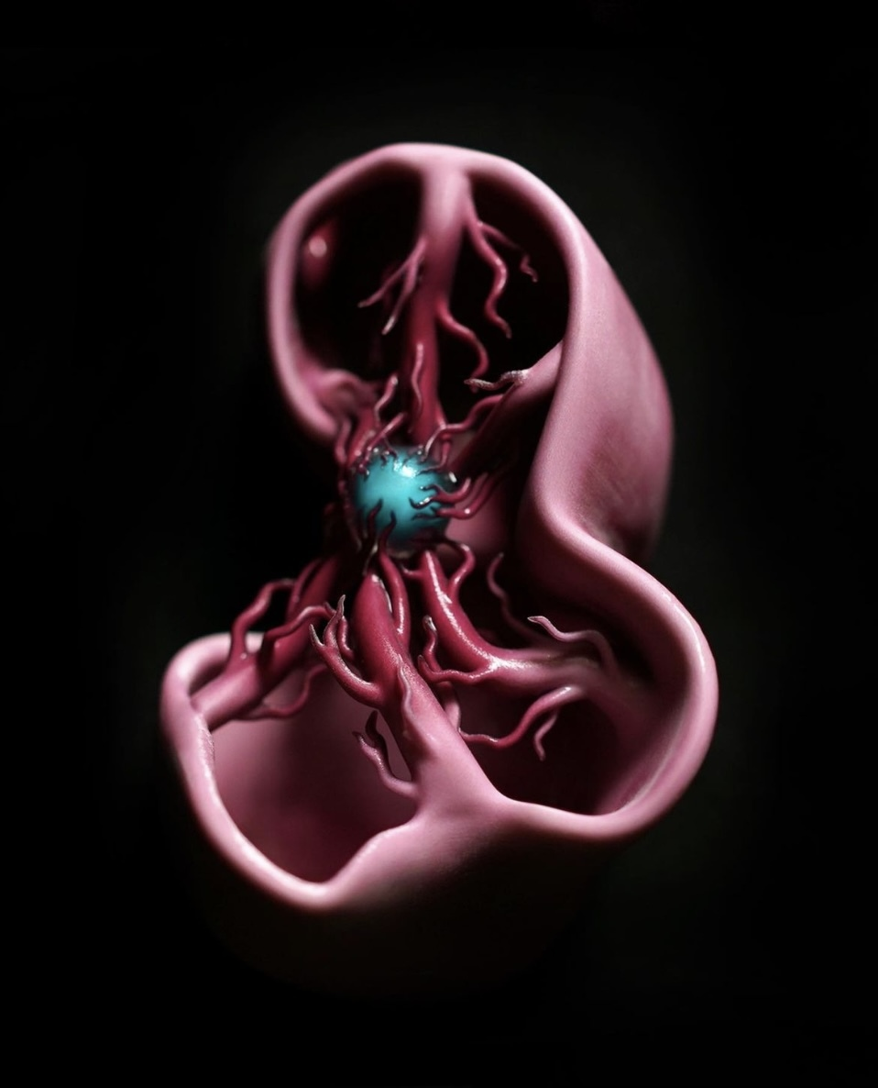
The exhibition will examine the impact of bionic technologies on oursenseof self, ourrelationshipswith others, and our connection to the natural world. The works in the exhibition will explore the ways in which bionics can both enhance and constrain human capabilities, and the ethical and social implications of integrating technology into the human body.
The theme of "Alienation & bionic" centers around the ways in which bionic technology can both enhance and constrain human capabilities, and the impact this can have on our sense of self and our relationships with others.
The exhibition explores the followingquestions:
How does the use of bionic technology affect our understanding of what it means to be human?
What are the social and ethical implications of integrating technology into the human body?
How can bionic technology both enhance and constrain human capabilities?
What impact does bionic technology have on our sense of self and our relationships with others?
The exhibition would feature a variety of works by contemporary artists, includinginstallations, sculptures, and digital media,that explore the theme of alienation and bionictechnology.

Slide 5
02
Form
&
Venue

Slide 6
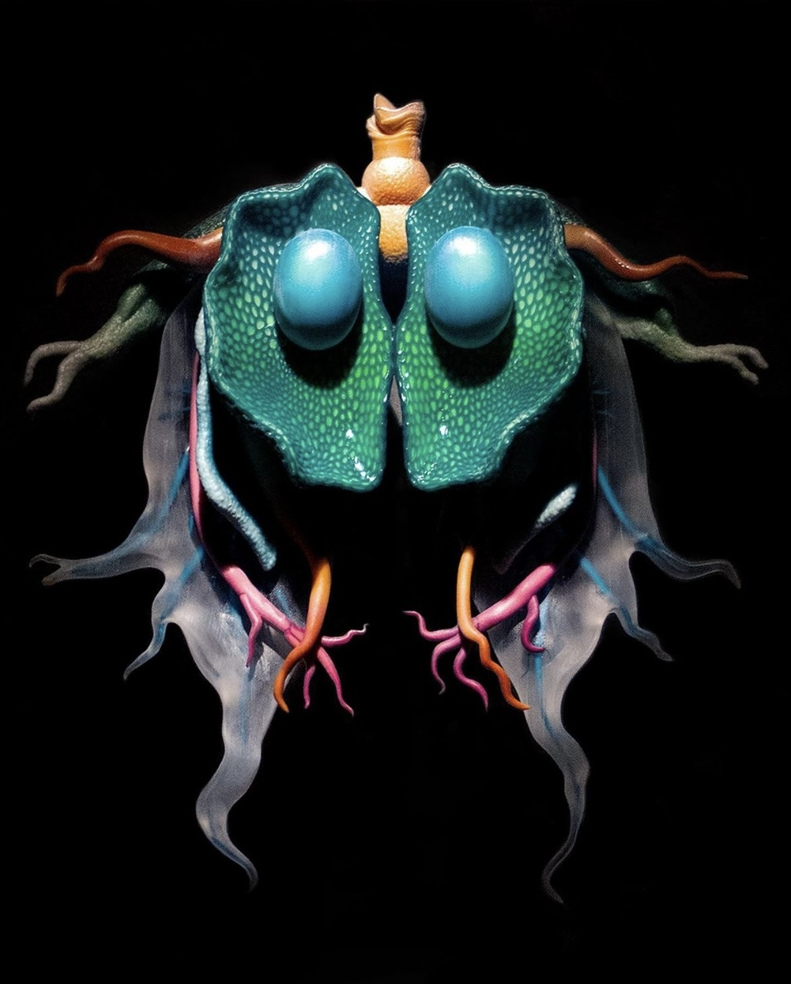
The exhibition is organised by myself and the young curatorYIFAN XU, a graduate of the University of Glasgow. We are working with a number of young artists from the Glasgow School of Art, the Royal College of Art and the University of the Arts London.
Due to our consideration of exhibition costs and budget, this exhibition will be anonline exhibition.
In order to better present the artwork online, we will create awebsiteand design avirtual gallery space.
We are aware that access tohigh quality imagesand videos is essential and we will ensure that they are in the correct format and optimised for online viewing.
We will considerinteractive elements, such as video, podcasts or virtual reality experiences. Consider how these elements can enhance the viewer's experience and allow them to interact with the artworks.
We willpromoteit through social media, email newsletters and other channels. And consider partnering with additional organizations and influencers to raise awareness.
We willmonitor and respondto visitor feedback, it is important to respond to visitor feedback and we will use analytical tools to trace engagement and adjust the exhibition as necessary.

Slide 7
03
Exhibition
Invited
Artists

Slide 8
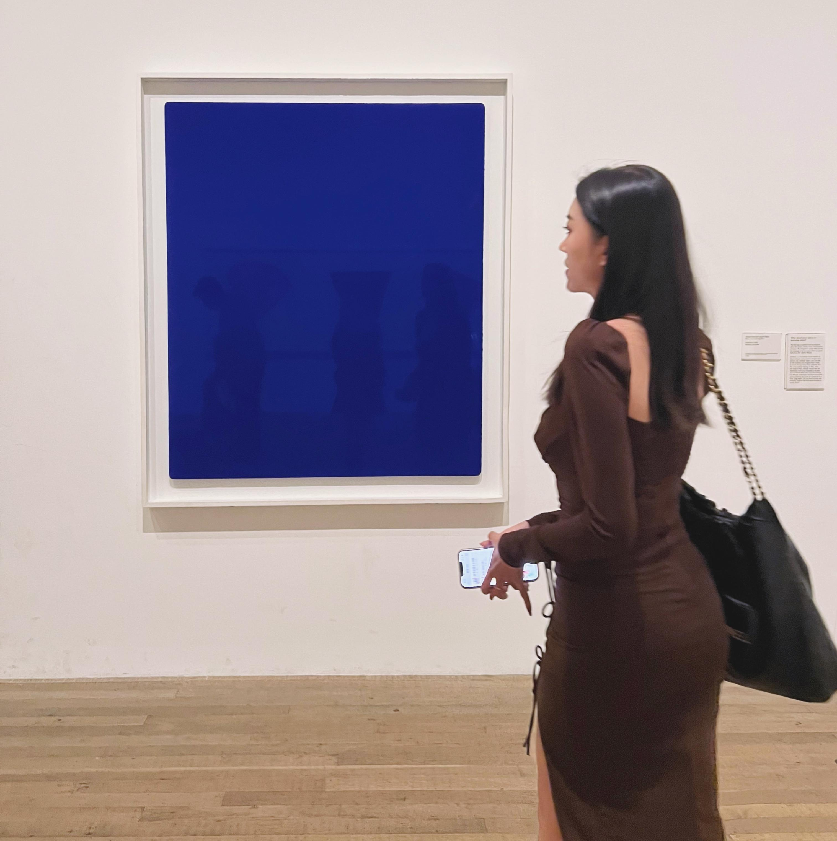
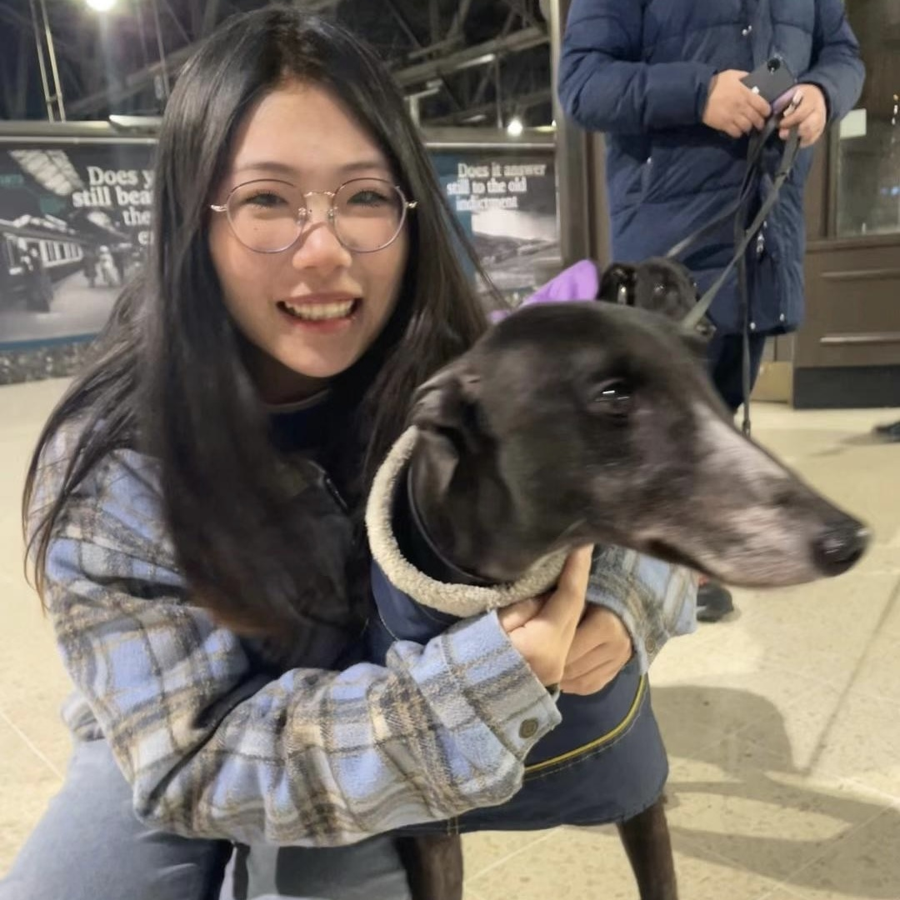
Curator
Nuanxin Zhang is studying MA Contemporary Art Theory at Edinburgh college of art and graduated from the Nanjing university of Art in Art Management as an undergraduate. A young curator, she participated in the Nanjing Art Institute's Autumn 2018 Art Auction and has organized several art exhibitions in Nanjing and Shanghai.
YiFAN XU Based in Glasgow. Graduated from Nanjing university of Art with a degree in Landscape Architecture, After graduating from Glasgow University with an MA she chose to stay in Scotland to pursue an art-related career. She is currently running an art workshop and working as a young curator.

Slide 9
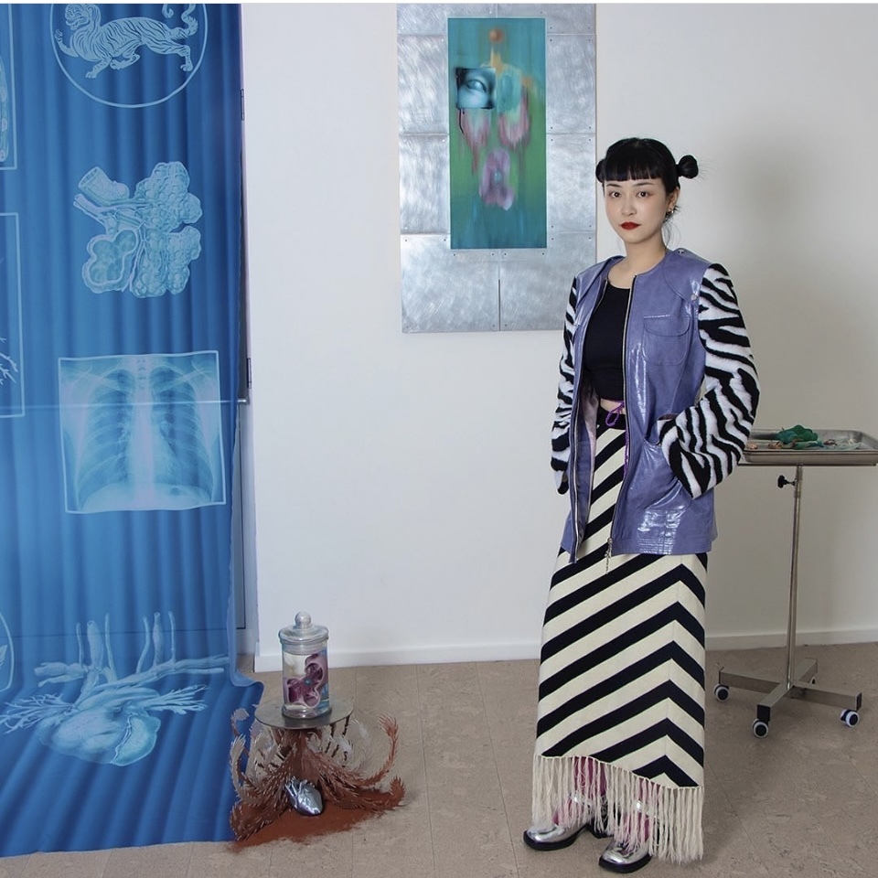
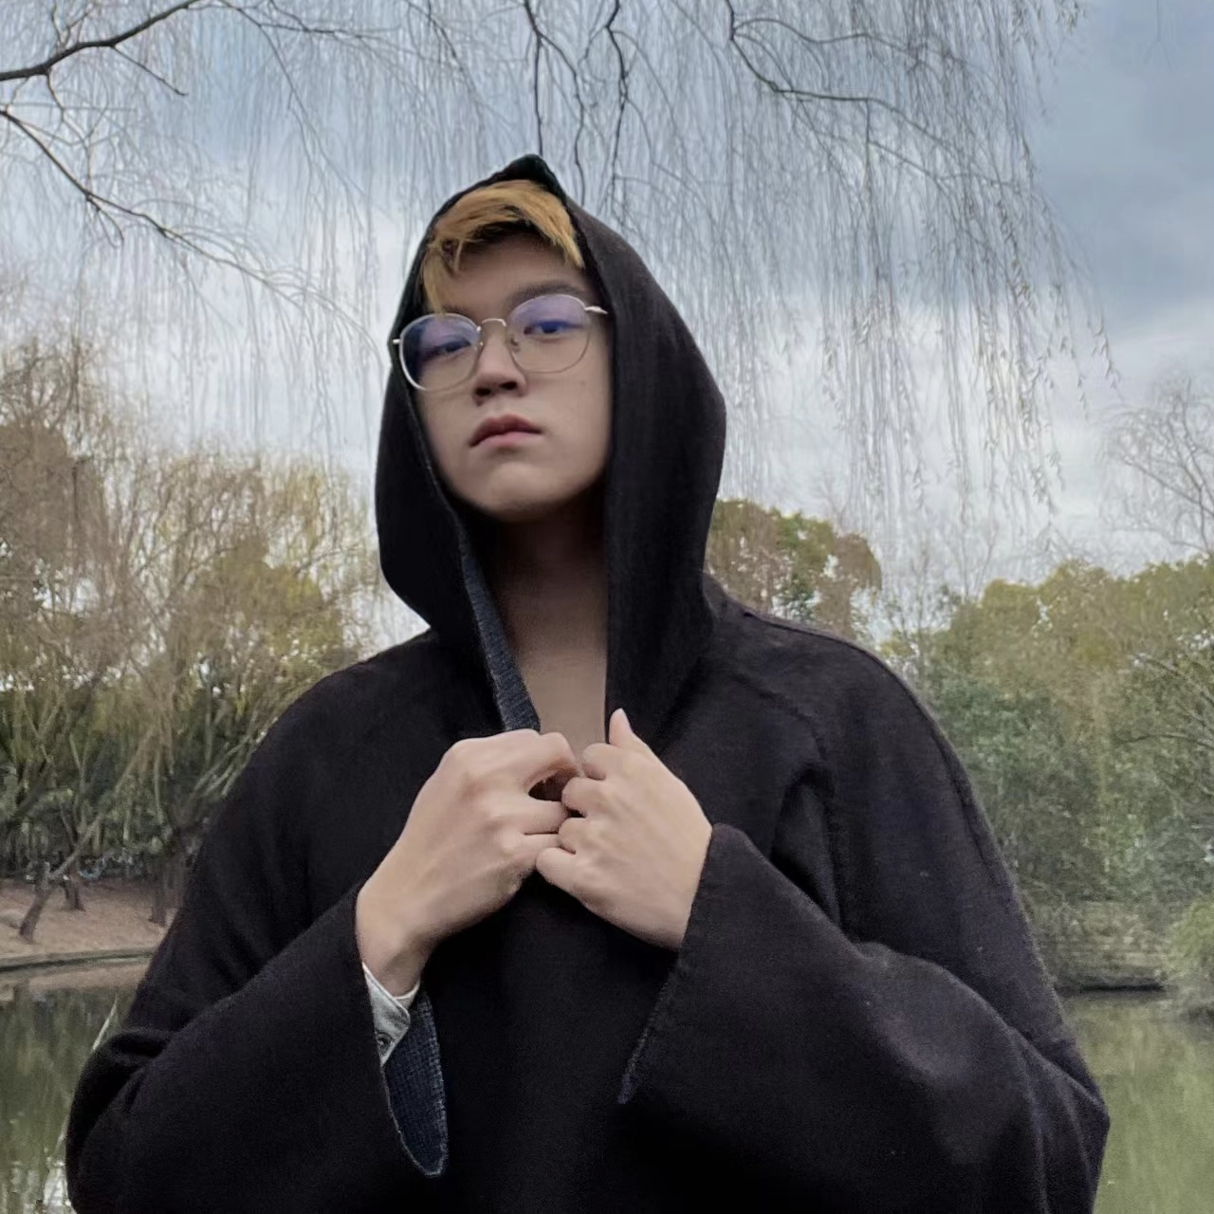
artist
CHUN SUN is a multi-media artist whose work combines installation, painting, digital art and film. He has collaborated and exhibited with art institutions such as the Shanghai Museum of Contemporary Art (PSA), the Rome International Art Fair, the Genoa Art Biennale, the CICA Art Museum in Korea, the Himalayan Museum of Art in Shanghai, and the Anaya Theatre Festival.
Chen Congpu (ccp), graduated from Shanghai Institute of Visual Arts, is a solo conceptual designer and independent artist whose work explores and reflects on social issues. He combines multiple narratives, scenography, digital art, film and formality to closely link virtual creation and reality.

Slide 10
04
Budget

Slide 11
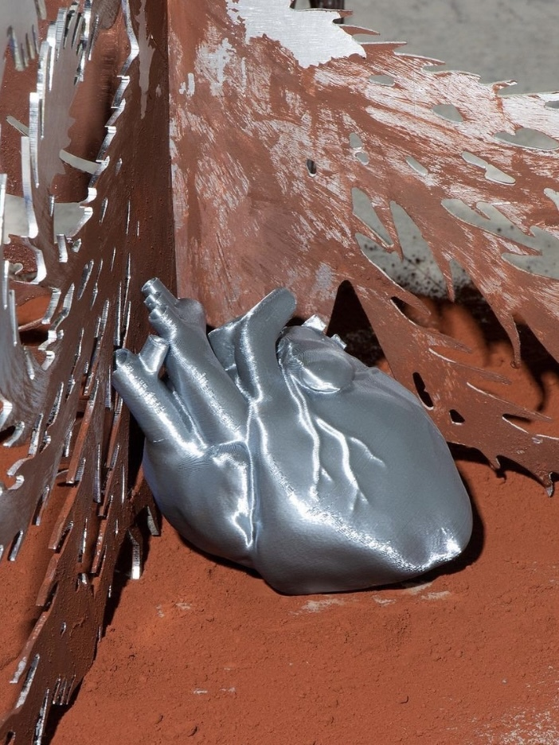
Platform fees
We may use a virtual reality platform to build our virtual gallery, so platform fees may exist.
Website development
We will build a website for the exhibition, so there will be website development costs, including design, development and hosting.
Photography and video production
We will photograph the artwork ourselves, so the cost of this part is 0.
Marketing and promotion
We do not plan to spend additional promotion costs, although we would like to attract a wider audience.
Miscellaneous expenses:
There may be additional expenses, such as hiring someone to design the exhibition posters

Slide 12
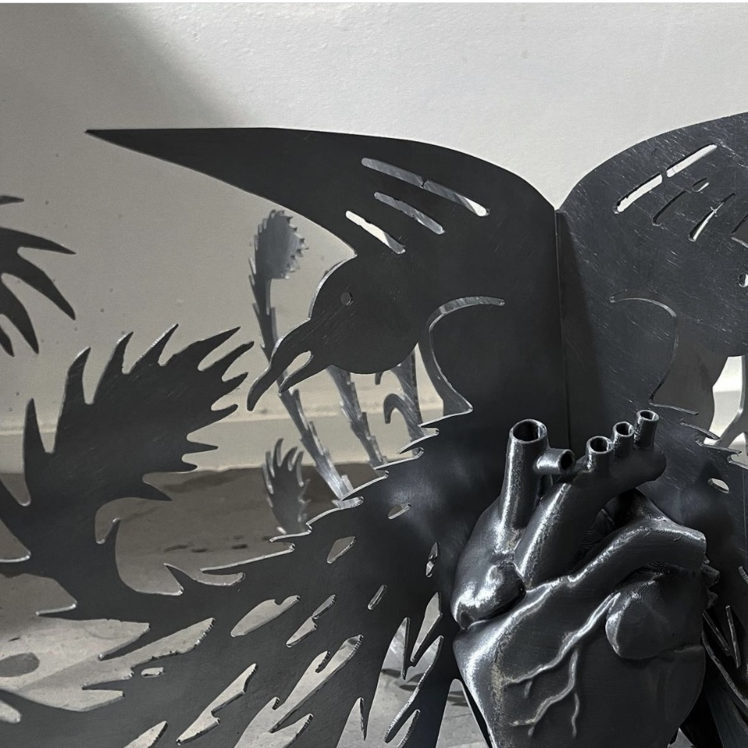
THANK YOU FOR YOUR WATCHING
All images used for this PowerPoint are from the artist
Chun Sun.

