Slide 1
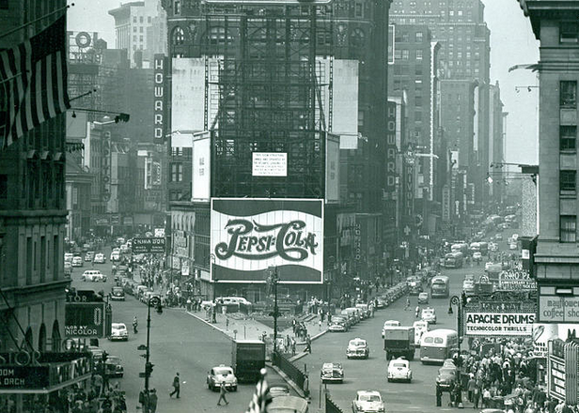
Neuromorphic Square, or, where Predictive Processing and Robotics meet
Johan Kwisthout, Donders Center for Cognition

Slide 2
Robotics Square, or, where Predictive Processing and Neuromorphic meet
Johan Kwisthout, Donders Center for Cognition

Slide 3
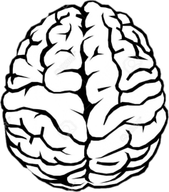
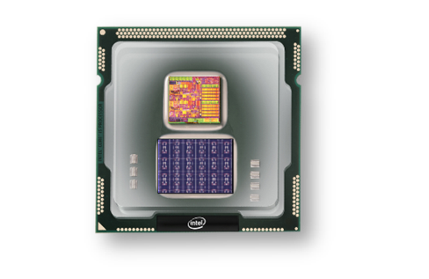
Probabilistic Graphical Models unifying all of Robotics, Predictive Processing, & Neuromorphic
Johan Kwisthout, Donders Center for Cognition

Slide 4
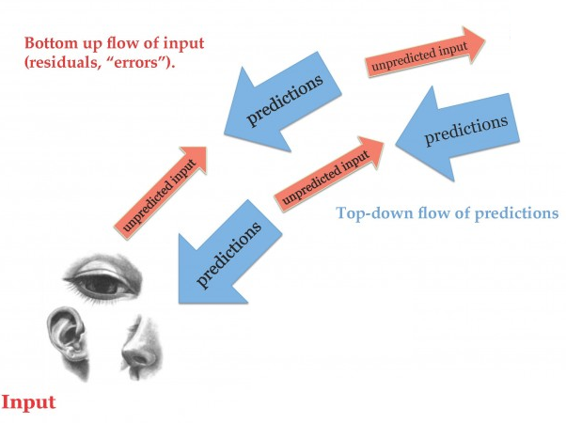
A novel view on the brain – Predictive Processing
“...essentially a sophisticated hypothesis-testing mechanism...”
Clark, A. (2015). Surfing Uncertainty.

Slide 5
Key sub-processes in Predictive Processing
Making (stochastic) predictions of expected input based on generative models
Comparing predicted inputs with actual inputs and establishing prediction error
Explaining away prediction errors (minimizing prediction error) by action or perceptual updates
Learning and adapting generative models over time

Slide 6
The crucial role of precision weighting
Prediction errors are weighted with their expected precision – pushes posterior more or less to prior
Generative (or inverse) models are updated with each new experience according to principles of Bayesian updating, governed by hyperparameters
Seth, A. (2013). Interoceptive inference, emotion, and the embodied self.

Slide 7
Predictive Processing as unifying concept
The idea that perception is a two-way process (bottom-up & top-down) is not new (e.g. Helmholtz)
Novel suggestion: action is just a logical, necessary consequence of a self-created prediction error
Prediction not how I believe the world to be, but how I intend the world to be – think of a set point
Action (‘motor commands’) is a means to reduce prediction error between current and desired state

Slide 8
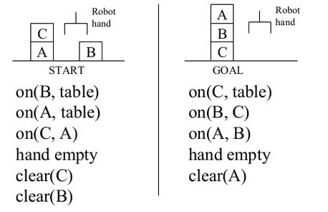
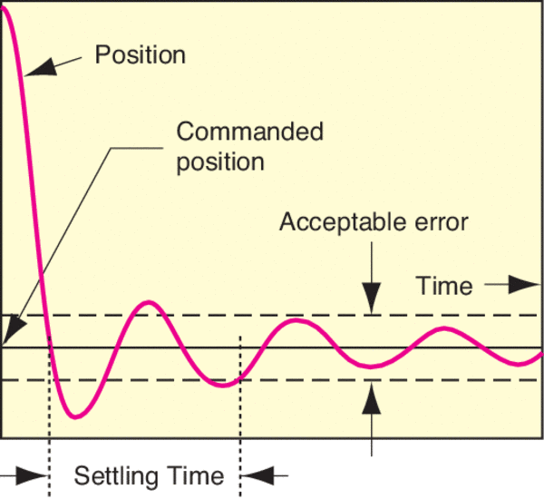
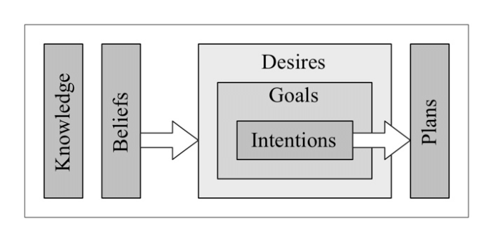
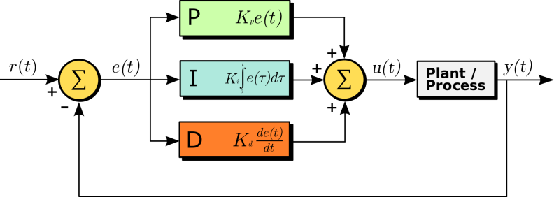
Active inference in robotics & agent systems
High level control
Low level control

Slide 9
Conceptual similarity (part 1)
Prediction error minimization as unifying principle?
Means-end action planning (high-level active inference)
PID controlled actuators (low-level active inference)
Inference to the best explanation (high-level perception)
Movement detection (low-level perception)
Generative model + prediction mechanism + error detection + (weighted) prediction error minimization

Slide 10
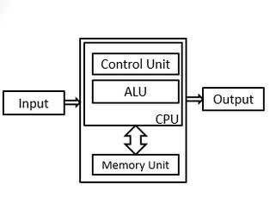
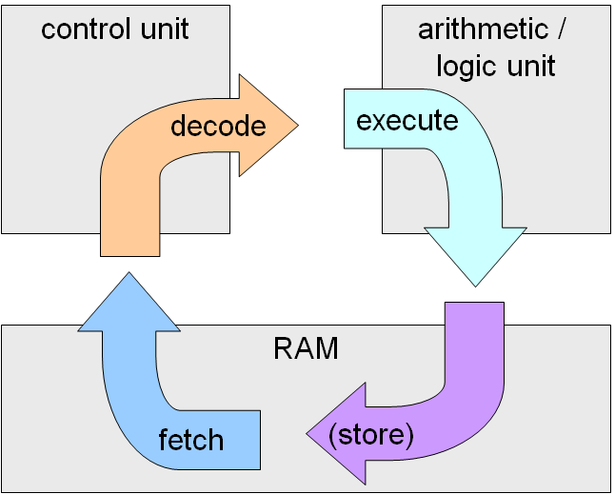
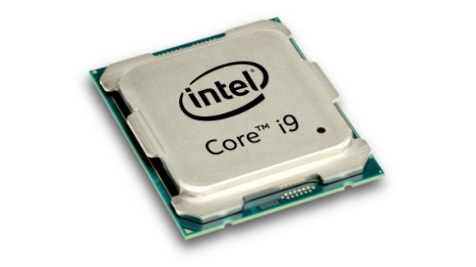
A novel view on computing
Traditional (Von Neumann) model of computation
Physically separated memory and computation
Information and computation based on Boolean logic
Serial (or only very limited parallel) computation
Energy-demanding; symmetry (1s and 0s equal)
Well established computational model (Turing Machine), algorithms, computational complexity theory

Slide 11
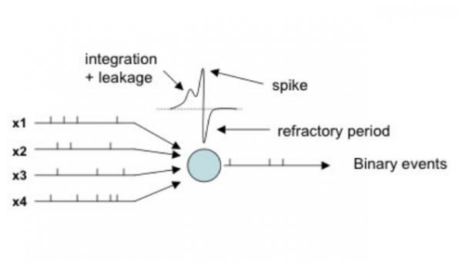
A novel view on computing
Neuromorphic (brain-inspired) model of computation
Co-located memory and computation
Information and computation based on spiking neurons
Massively parallel computation
Energy-lean (at least potentially); spikes cost energy
Computational model, algorithms, computational complexity results are still in their infancy

Slide 12
A different way of thinking
Neuromorphic architectures allow for (and dictate!) a different way of thinking about computations
Analog behavior → get rid of digital regime
Stochastic behavior → randomized algorithms
Define connectivity matrix rather than instructions
Characteristics of novel materials (e.g spin glasses) let you think differently about synchronization
Spiking behavior allows temporal data structures

Slide 13
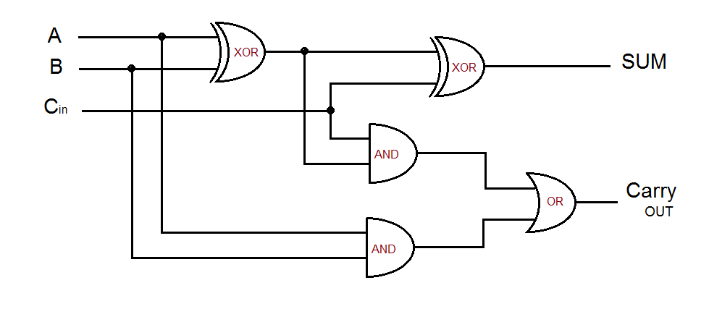
A different way of thinking
Digital adder circuit
Numbers are encoded as binary digits in memory
Computation (adding two numbers) implemented by a logical circuit within the CPU
Spiking neural networks allow for a different way of representing information and computing with it

Slide 14
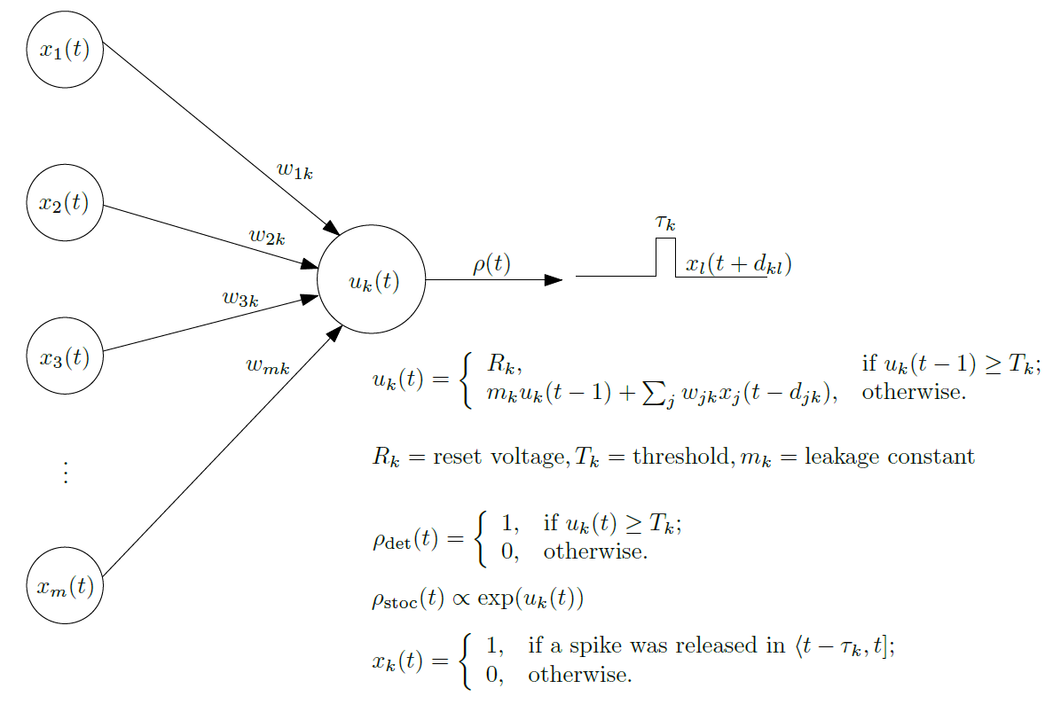
Neuronal model: basically simple LIF model
Specific input and readout neurons to inject / extract information
Stochasticity or determinism
Discrete time steps

Slide 15
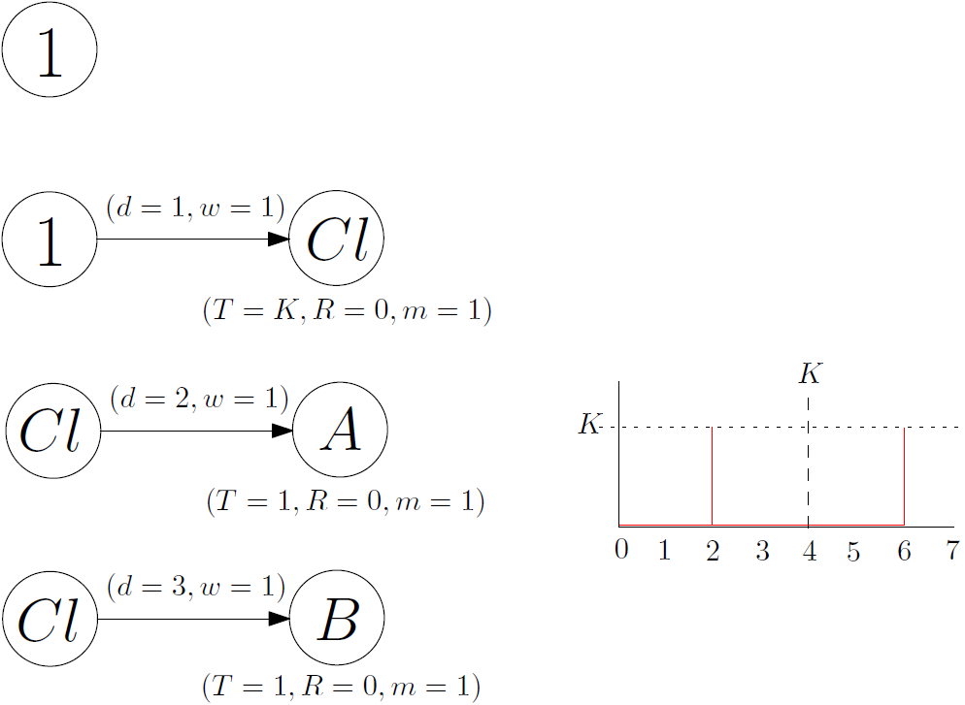
Example problem: adding two numbers mod K
Special neuron Const fires at every time step >= 0 (bias = threshold)
Clock neuron fires every K timesteps
A and B fire at time d mod K (d = 2,3)
Spiking time of the neuron relative to clock encodes its value!

Slide 16
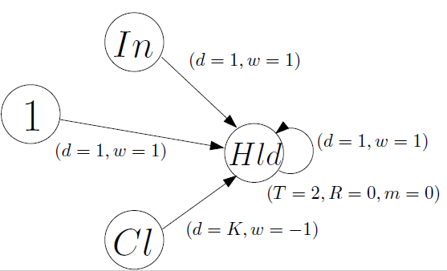
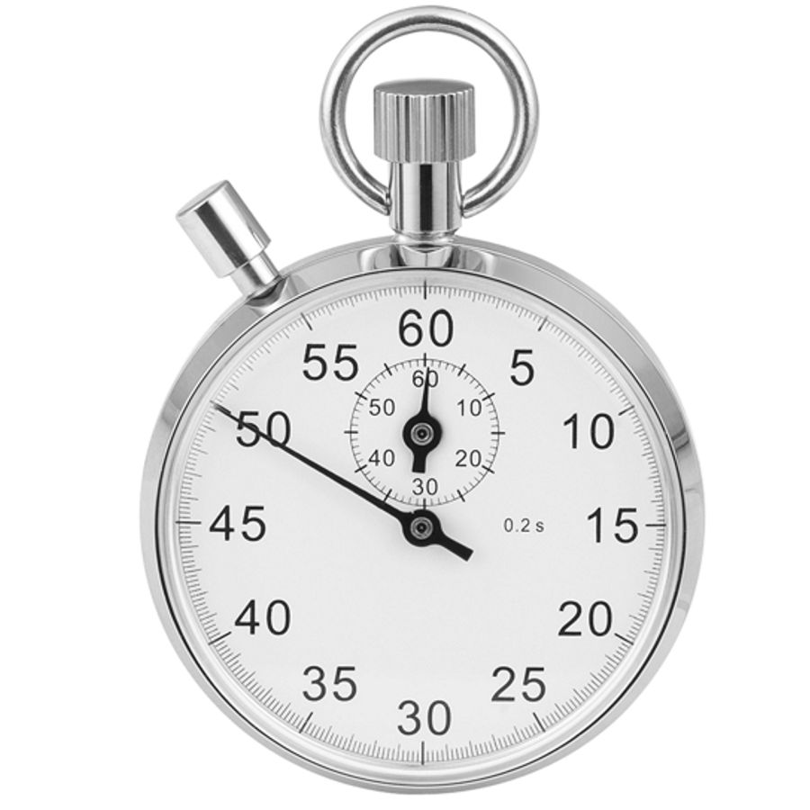
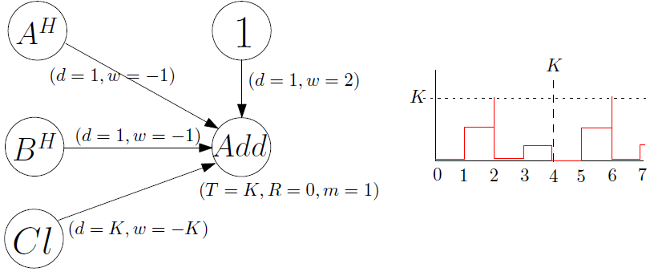
Example problem: adding two numbers mod K
Circuit ensuring that once a neuron fires, it fires until reset by the clock
Adder circuit spikes on carry-out, neuron potential at clock intervals encodes A+B mod K

Slide 17
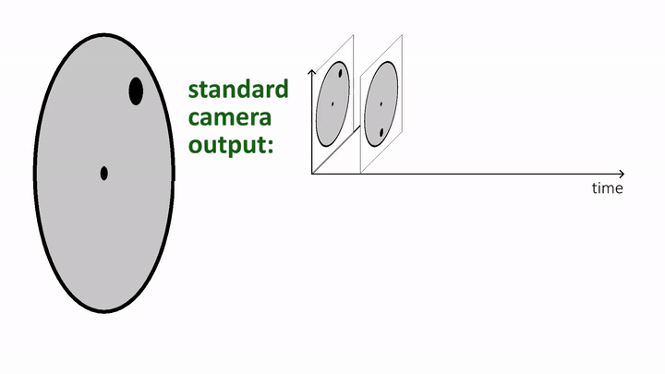
Neuromorphic computing in robotics
Event-driven sensors (e.g. dynamic vision sensors)
Report change rather than full frame
Temporal information (when as well as what)
Energy lean (in a stable environment)

Slide 18
Conceptual similarity (part 2)
Event-driven signaling as unifying principle?
Predictive Processing: only process information that was not anticipated (surprising / stochastic information)
Spike-based neuronal communication: spikes (neuron firing) signifies relevant event
But: prediction error ≠ spike (save maybe at the very lowest input level, e.g., retinal cells)

Slide 19
How to tie it all together?
Prediction error minimization (active and perceptual inference) seems a useful paradigm for robotics
Prediction error as information carrier almost begs to be implemented by neuromorphic architectures
Mission: Formulate PP in a unifying computational framework
One language for describing high- and low-level operation
Framework fits naturally with neuromorphic architectures
Scientific as well as engineering benefits
Explainable & justifiable – avoid black boxes

Slide 20
Probabilistic graphical models as pivot element
PGMs can describe high-level structured information as well as low-level statistical regularities
Computational Bayesian models of cognition
Same principles for low-level vision, motor control
Explainable AI comes ‘for free’ with PGMs – nodes represent stochastic variables
Offer meaningful descriptions at all Marr’s levels of explanation: computation, algorithm, implementation

Slide 21
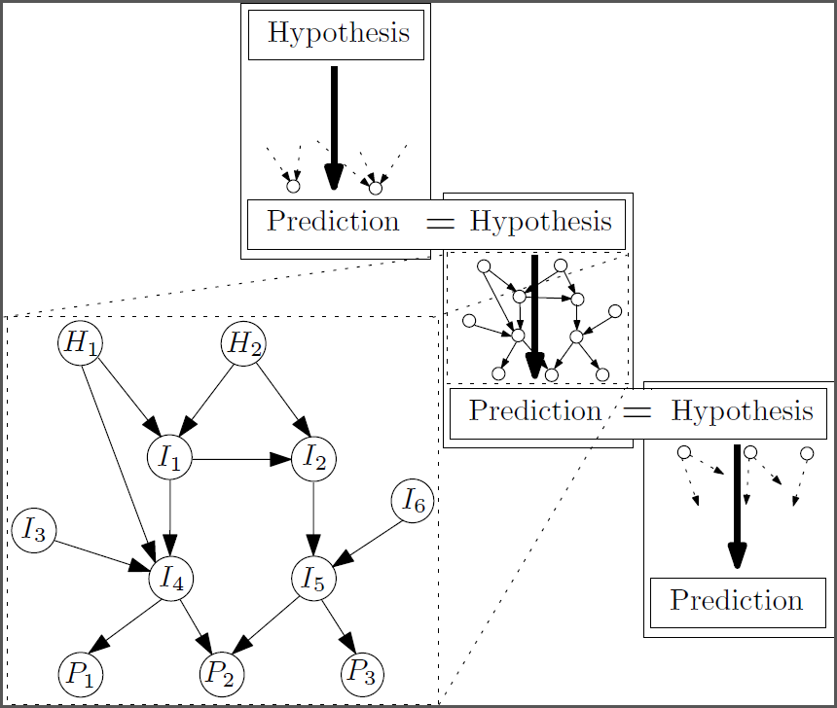
PP at the Computational level
Example: Causal Bayesian networks describing (context-specific, structured, complex) relation between hypotheses and predicted consequences
Hypothesis variables Hyp = {H₁, H₂}
Prediction variables Pred = {P₁, P₂ , P₃}
Intermediate variables Int = {I₁, … I₆}
Hyperparameters (Beta or Dirichlet distribution)

Slide 22
PP at the Computational level
Prediction and Observation are probability distributions over the prediction variables Pred
Prediction is defined as computing the marginal distribution Pr_{(Pred)} given the parameters in the network
Prediction error is set difference Pr_{(obs)} - Pr_{(Pred)}
The size of this error is defined as the KL-divergence between predicted distribution and observed distribution

Slide 23
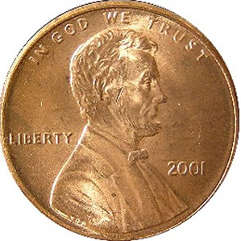
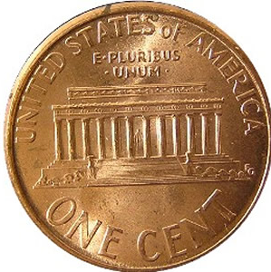
Example: tossing coins
“Hypothesis”
OUTCOME
“HEADS”
“TAILS”
Inference
VISUAL INPUT
“Prediction”

Slide 24
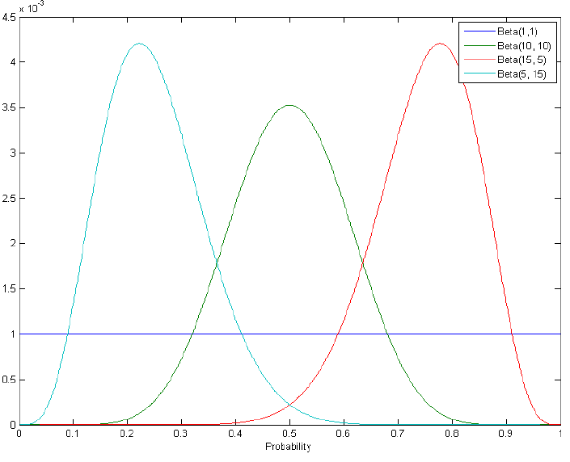
Beta distribution
Visual input
Percept

Slide 25
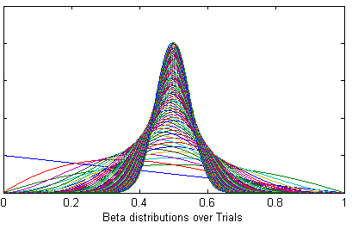
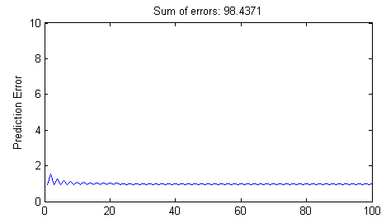
Bayesian Updating
Visual input
s = heads, n-s = tails

Slide 26
PP at the Computational level
All relevant concepts in PP can be precisely defined
Precision of predictions: entropy of P(predictions)
Expected precision of observations
Precision-weighted prediction error
Impact of prediction error on generative model
Intervention (do-calculus) for active inference
Belief revision (explaining away) for perceptual inference
But a few conceptual challenges come to play
State-space granularity, level-of-detail of predictions
Non-trivial action selection to minimize prediction error
Learning beyond Bayesian updating (e.g. new concepts)

Slide 27
PP at the Algorithmic level
Approximate Bayesian inference
Making predictions by sampling or variational methods
Minimizing prediction error by local search methods
Learning by (approximately) updating hyper-parameters
Heuristics, stereotypes, exemplars may help approximate action selection to a satisfactory level
But a few practical challenges remain
Tractability remains an issue also for approximation!
Conceptual issues must be solved first before they can be implemented at the algorithmic level

Slide 28
PP at the Implementational level
Probability distributions and approximate Bayesian inferences can be realized with Spiking Neural Nets
See work in Wolfgang Maass’ group
Hyperparameters of generative models can be encoded in spiking frequency (rate / temporal)
t
t
P(heads) = 0.66
α = 2, β =1
α = 20, β =10

Slide 29
PP at the Implementational level
Probability distributions and approximate Bayesian inferences can be realized with Spiking Neural Nets
See work in Wolfgang Maass’ group
Hyperparameters of generative models can be encoded in spiking frequency (rate / temporal)
t
P(heads) = 0.66
α = 20, β =10

Slide 30
Still a long way to go
There still remain challenges in realizing
Learning hyperparameters
Establishing prediction error
Weighting errors with precision
Processing weighted prediction error
….
We don’t yet know very well how and what to compute efficiently with SNNs and how PP information processing can be realized
Work in progress in our lab: Neuromorphic complexity theory (INRC project)

Slide 31
Research agenda – challenges
Conceptual & computational
Algorithm & implementation
Hardware level

Slide 32
Computational and conceptual challenges
Translation of some conceptual aspects of PP to computational model still work in progress:
How to learn and represent expected precision in generative models?
How to learn and represent expected state space granularity in generative models?
How to formalize counterfactual reasoning?
Creative part of learning mostly ignored in PP
When do we need a new concept or context-dependency? How to integrate that in our generative models?
How do generative models / PP mechanisms change in development?

Slide 33
Implementational challenges
Basically we have just started…
Challenge of different levels of abstraction
Prediction can be single cell firing / silent (retina)
Prediction can be complex combination of intentions
Need different neural encoding – how to integrate?
Challenge of brains vs neuromorphic architecture
Dopamine is believed to be associated with precision error modulaton, serotonin with state-space-granularity
No direct translation to spiking neural networks!

Slide 34
Hardware / sensor challenges
Does it even make sense?
Further develop the concept of “prediction-driven sensors” (signal when deviating from prediction)
How to ‘load’ a prediction in such a sensor and ‘retrieve’ an error? What is the overhead and is it even worth it?
How to translate abstract concepts (I am walking in a busy street and expect to see ‘movement’ around me) to concrete predictions that such a sensor can use?
What inspiration can we get from the brain (e.g., movement sensitive cells in V1)

Slide 35
Conclusion
PP as unifying theory for both “life as we know it” as artificial intelligence / robotics may be fruitful
PGMs as natural computational modeling and descriptive language for PP at all levels of description
Neuromorphic computation is a natural candidate for implementing PP principles realized by PGM computations
Work needs to be done on prediction-error based sensors, computations, and implementations

Slide 36
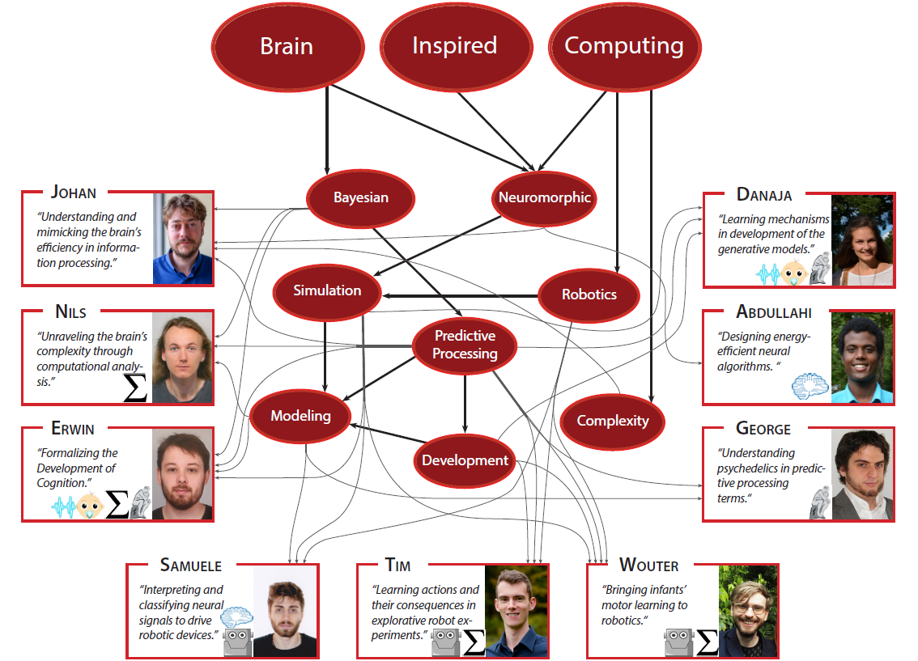
Co-authors and funders

