Slide 1
Ethics, Design and AI Series: 4th Oct 2023. Dr Lachlan Urquhart
Senior Lecturer in Technology Law and Human-Computer Interaction
Director of Regulation and Design Lab; CRISP and SCRIPT.

Slide 2
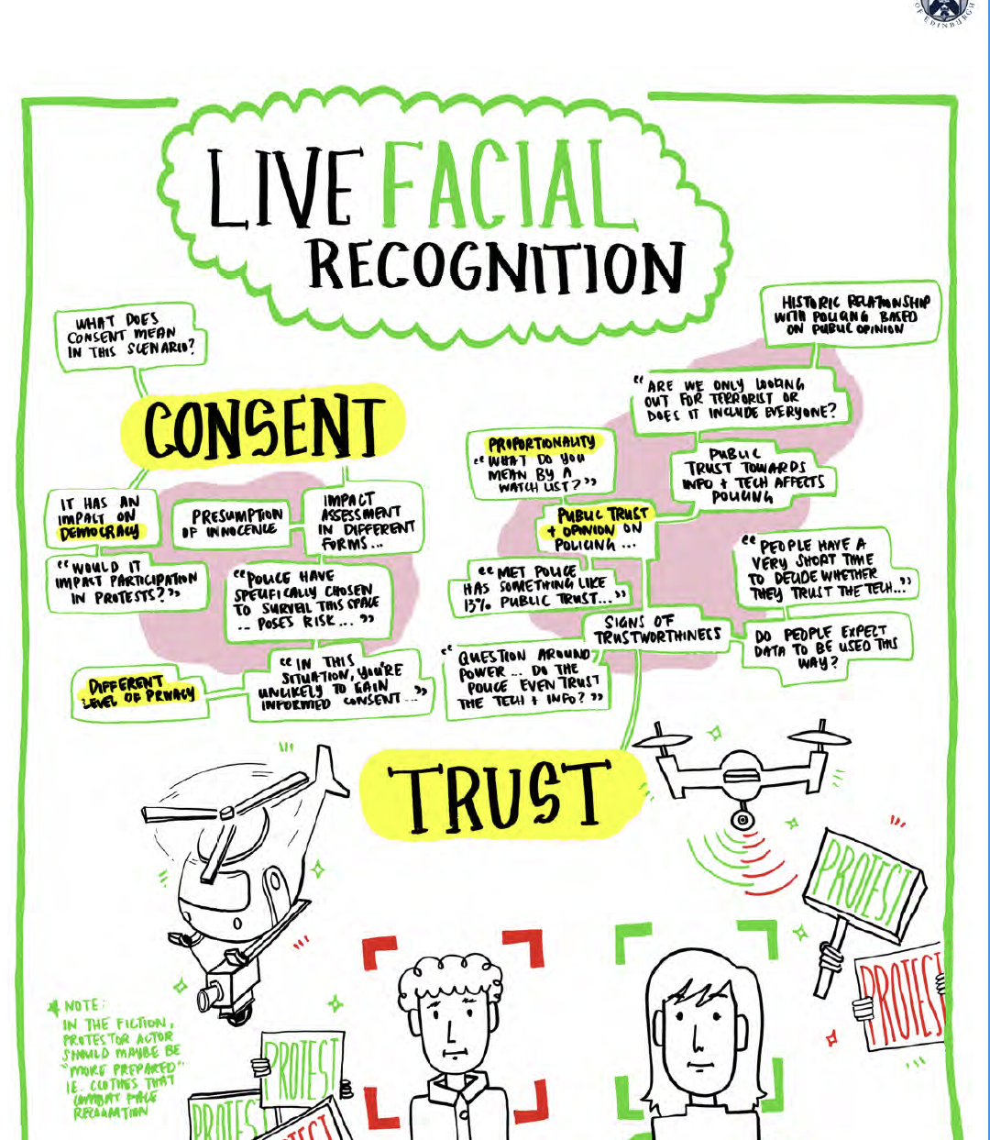
Law as a Design Brief?
Law is formalising ethical design requirements for AI.
Not a choice (unlike ethics?)
Implicate Design for Privacy, Autonomy, Trust, Safety…
How can AI service and product designers respond to law and account for their actions?

Slide 3
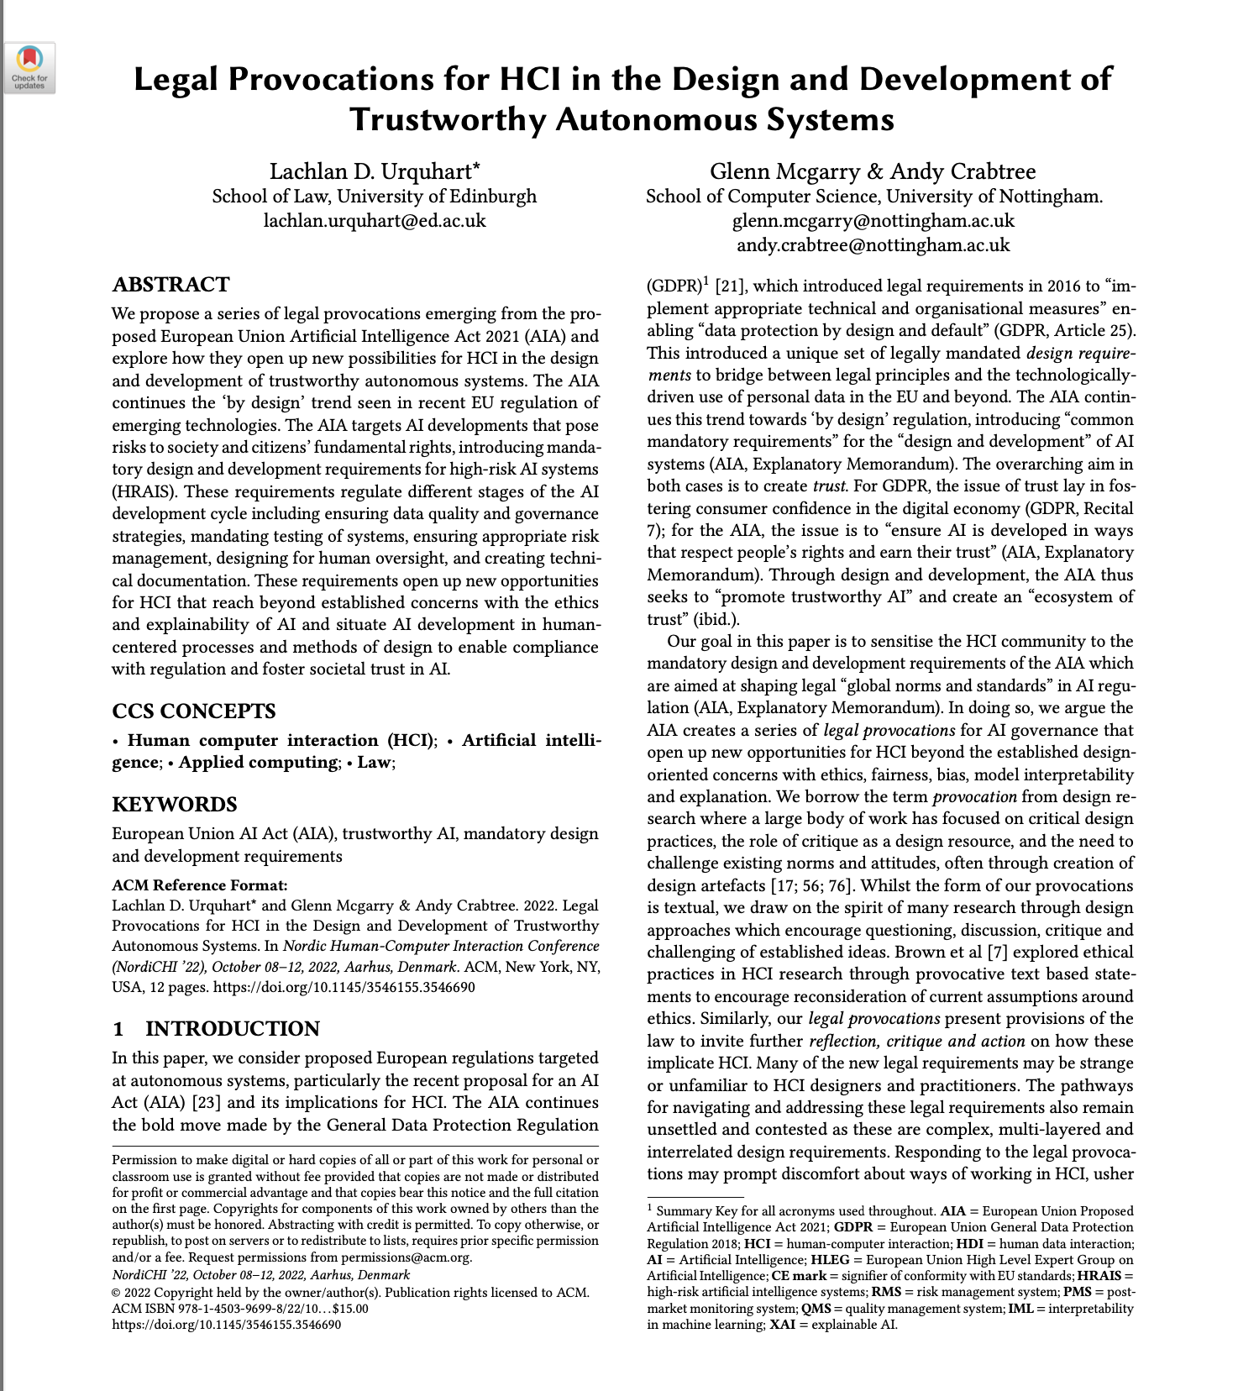
Legal Values in AI Design
Laws: GDPR; Cyber Resilience Act; new EU AI Act etc.
Human Oversight – not just explanation, support in situ action.
Data Governance – provenance of training data; bias; copyright.
Risk Management – low (transparency); high – D+D reqs ; prohibited?
Consequence - fines, can’t sell product in EU market, distrust - create societally harmful AI?

Slide 4
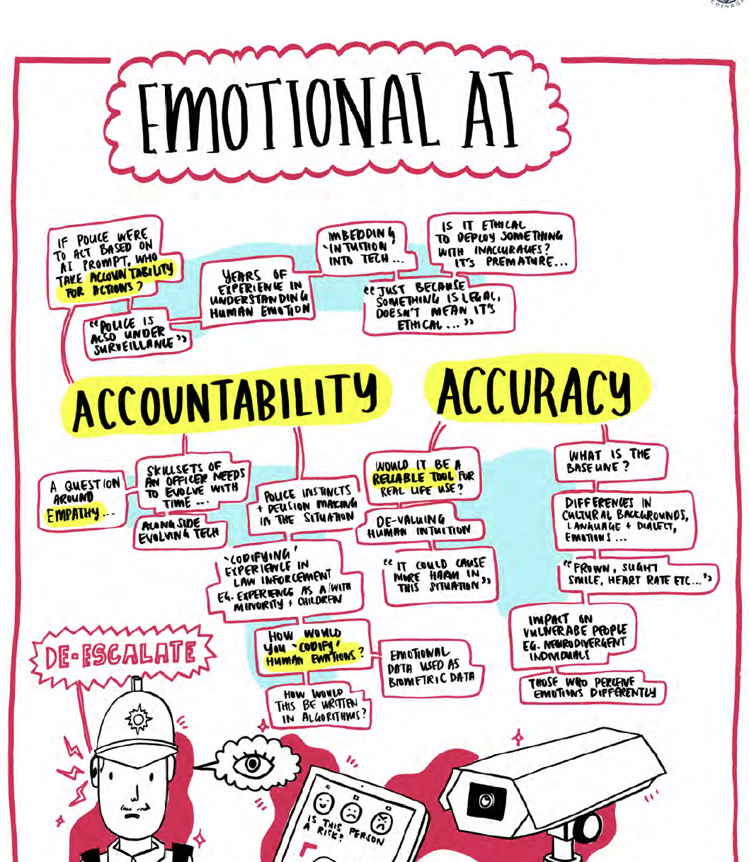
Sensemaking through Design Methods
Explore grounded, situated and current risks around AI.
What to do about them?
Need to look at contexts of use in everyday life, real people, real legal issues…
Can design help?

Slide 5
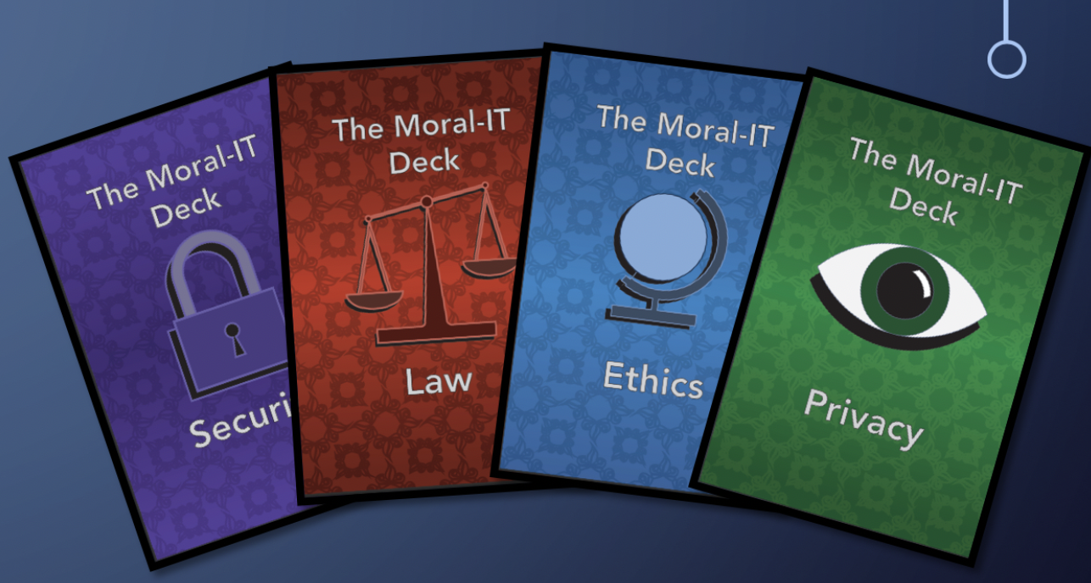
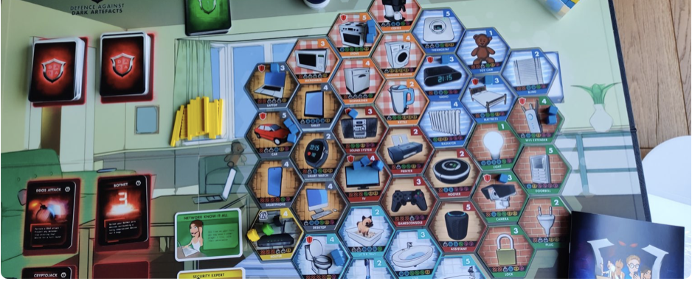
Role for Design
Ideation Decks e.g., Moral-IT Cards to map values
Research through Design and Play e.g., board games to understand risk.
Human Centred – human-AI interaction +oversight.
More than human design e.g., transparency about environmental costs of LL.M.

Slide 6
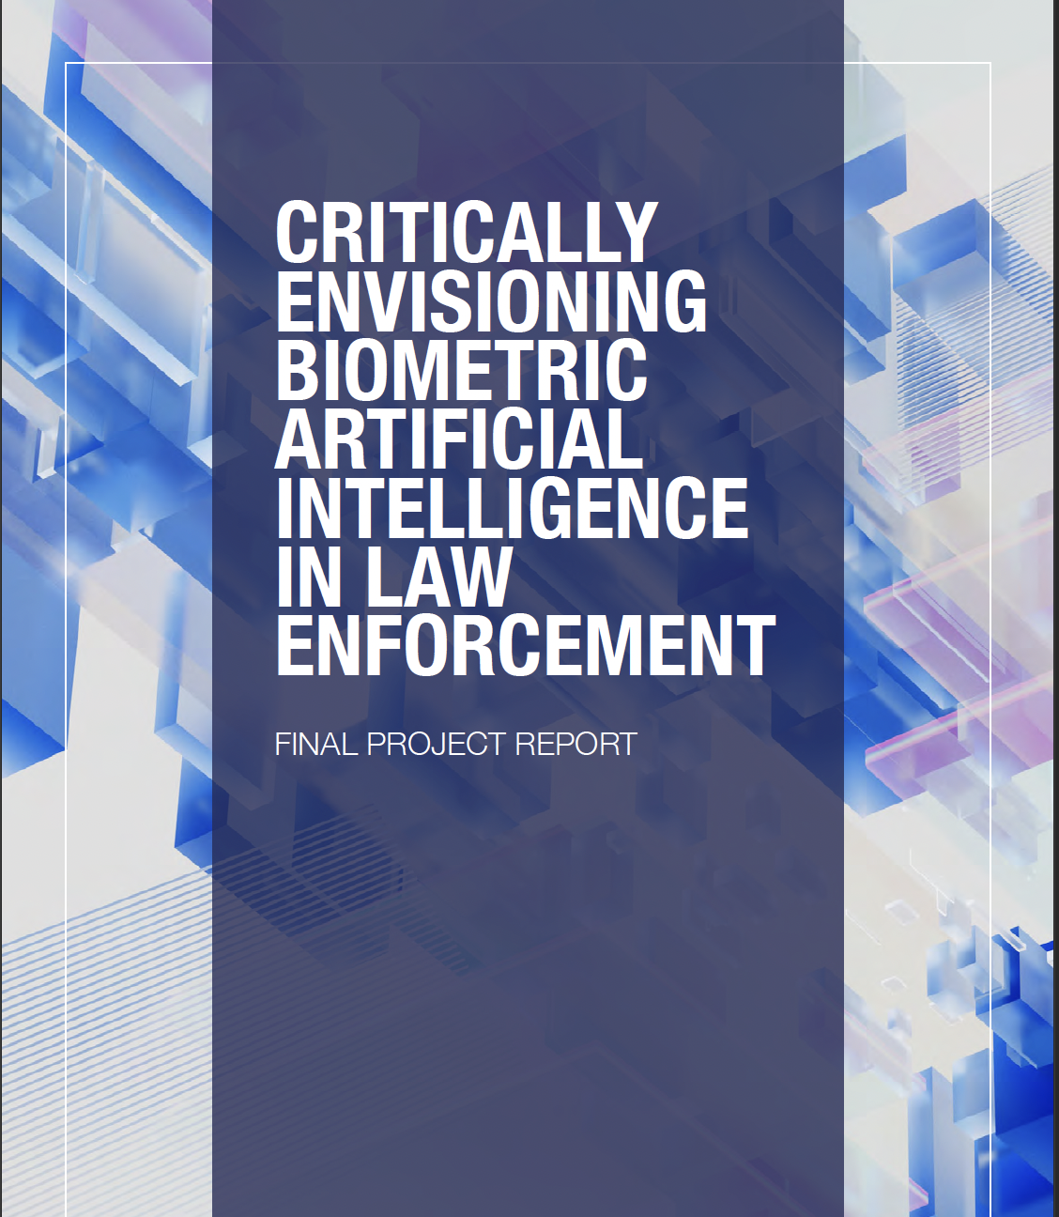
Sensemaking (2)
Speculative Design – design fictions to envisage futures we want (and those to avoid)
Co-creation with citizens or reflect with experts
Help question fitness for purpose of law?

Slide 7
Thanks for listening
Contact
Lachlan.Urquhart@ed.ac.uk
RAD Lab Website
https://blogs.ed.ac.uk/radlab/
Forthcoming Book:
Clever Computing through Accountable Design. Cambridge University Press (2024)

