Slide 1
Using learning analytics to support formative assessment
Yi-Shan Tsai
University of Edinburgh
yi-shan.tsai@ed.ac.uk
@yi_shan_tsai
Online Learning Network
9 November 2017

Slide 2
Learning analytics
Formative assessment
http://sheilaproject.eu/
Notes:
LA: what is learning analytics?
Formative assessment: examples of teacher facing tools (Loop and OnTask)
SHEILA: Student perspectives

Slide 3
Are my students happy?
https://unbounce.com/conversion-rate-optimization/the-top-10-user-feedback-tools-for-improving-conversion/
Notes:
When teaching a big class especially, it gets difficult to know how each student is doing in the class. Learning analytics is meant to provide a solution for this.

Slide 4
Learning analytics is…
“the measurement, collection, analysis and reporting of data about learners and their contexts, for purposes of understanding and optimising learning and the environments in which it occurs.” (Long et al., 2011)
Long, P. D., Siemens, G., Conole, G., & Gašević, D. (Eds.). (2011). In Proceedings of the 1st International Conference on Learning Analytics and Knowledge (LAK’11). Banff, AB, Canada: ACM.
Notes:
LA is meant to give us data-based evidence for a better understanding of student engagement and performance.

Slide 5
Learning analytics data flow
http://sheilaproject.eu/
Notes:
Data: academic data, background data, and engagement data
Purposes: Inform the provision of educational services for students and encourage self-regulated learning.
If predictive modelling is used, the traffic lights may be applied to indicate the likelihood of failing a course (there’

Slide 6
The emergence of learning analytics
The need to understand how students learn
The maturity of data technology
The rise of MOOC
Political concerns for educational institutions
Ferguson, Rebecca (2012). Learning analytics: drivers, developments and challenges. International Journal of Technology Enhanced Learning, 4(5/6) pp. 304–317.
Notes:
The maturity of data technology: the ability to collect massive amounts of data, process them, and generate useful information about individuals’ behavioural patterns – data gold mining (e.g., marketing strategies, educational data mining)
Political concerns for educational institutions: to measure, demonstrate and improve performance.
Drop-out → economic pressure on universities

Slide 7
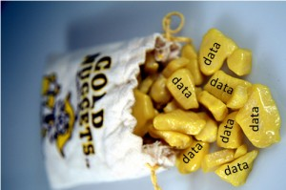
“[D]ata trails offer an opportunity to explore learning from new and multiple angles.” (Siemens, 2013)
Siemens, G. (2013). Learning analytics: The emergence of a discipline. American Behavioral Scientist, 57(10), 1380-1400. Chicago
https://cdn.business2community.com/wp-content/uploads/2011/07/databasemining-300x199.jpg

Slide 8
How can we extract value from these big sets of learning-related data?
Educational Data Mining
How can we optimise opportunities for online learning?
Learning analytics
Ferguson, Rebecca (2012). Learning analytics: drivers, developments and challenges. International Journal of Technology Enhanced Learning, 4(5/6) pp. 304–317.

Slide 9
Using learning analytics for formative assessment

Slide 10
Are my students learning?
https://www.linkedin.com/pulse/d2i-diversity-inclusion-integration-step-2-peter-bryttne
Notes:
We want to know if students do access the coursework and materials that we have prepared for them. Have they accessed them? When? Any catch-up behaviour?
Assignment? Log-in?

Slide 11
Loop
http://edin.ac/2m3vklH
Notes:
Example course:
Introduction to Accounting
Student number: 500

Slide 12
Loop
Notes:
Week 3

Slide 13
Page views over three months

Slide 14
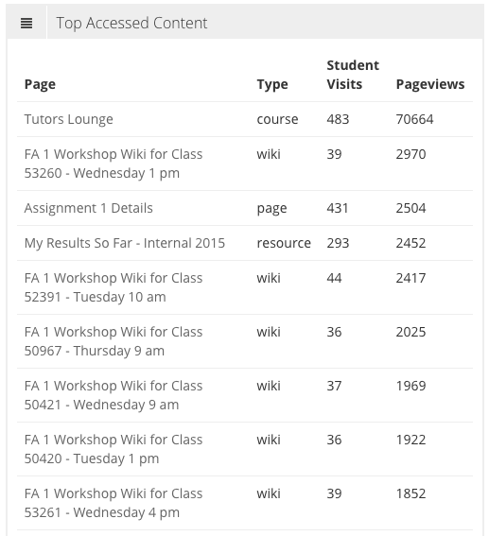

Slide 15
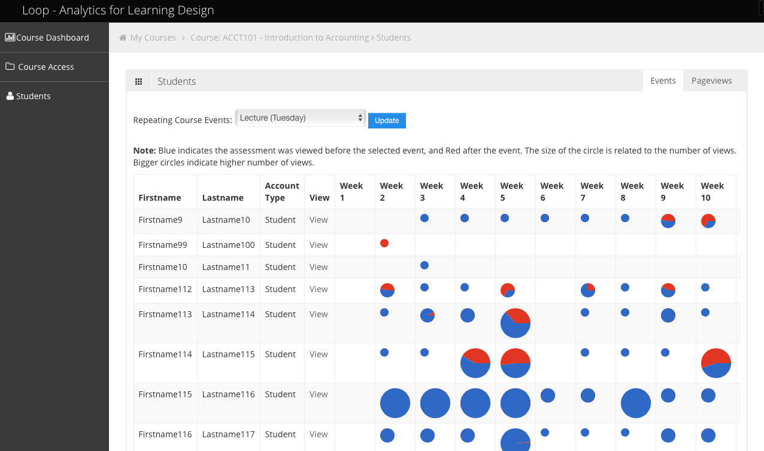
Preview & review

Slide 16
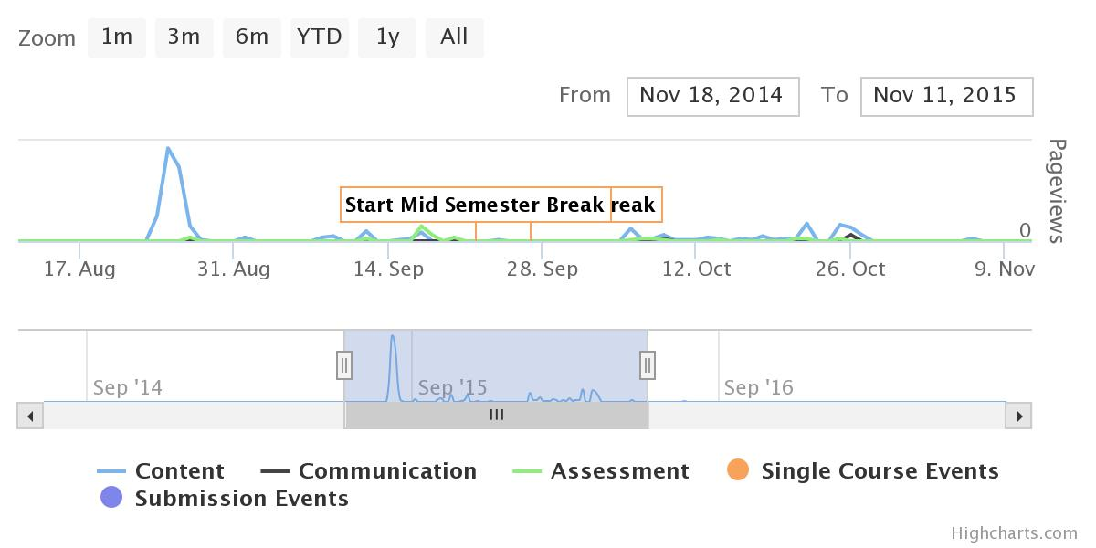
Page views – student no.121

Slide 17
Forum & assessment – student no.121
Notes:
You may want to write an email to understand why the student did not engage with the required assignments and quizzes. But if data shows that there are 100 students who are not engaged with the coursework as they should, writing 100 e-mails can be difficult, let alone doing it regularly.

Slide 18
Personalised feedback

Slide 19
On-Task
https://www.ontasklearning.org/

Slide 20
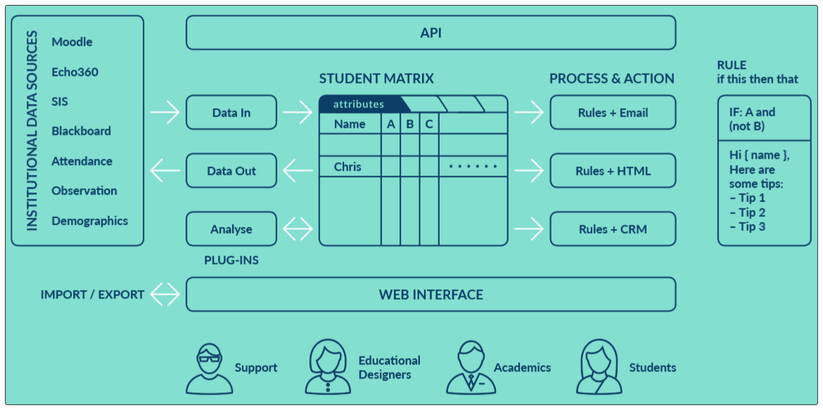

Slide 21
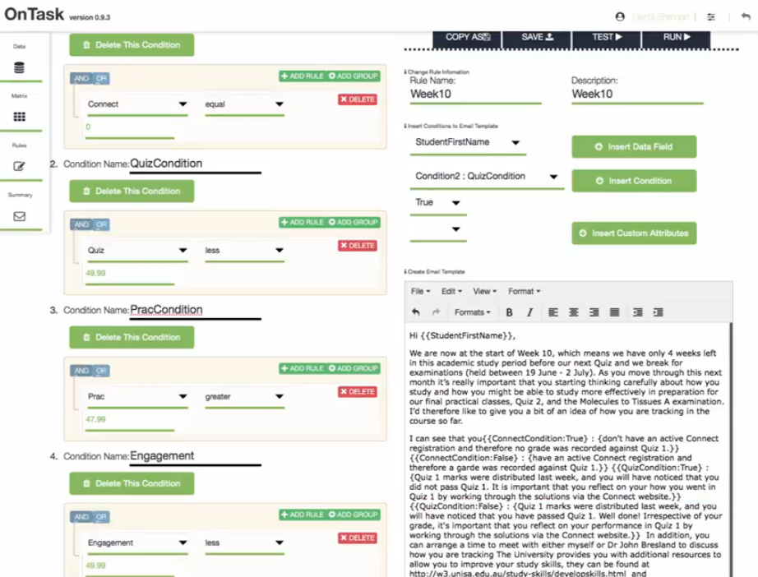

Slide 22
Data is not students
http://www.tate.org.uk/context-comment/blogs/treachery-images-rene-magritte
Notes:
René Magritte – This is not a pipe
Data is not students. It’s about students.

Slide 23
Supporting Higher Education to Integrate Learning Analytics
http://sheilaproject.eu/
Notes:
Partner organisations:
The University of Edinburgh, UK
Universidad Carlos III de Madrid, Spain
Open University of the Netherlands, Netherlands
Tallinn University, Estonia
Erasmus Student Network aisbl (ESN), international
European Association for Quality Assurance in Higher Education, international
Brussels Educational Services, international

Slide 24
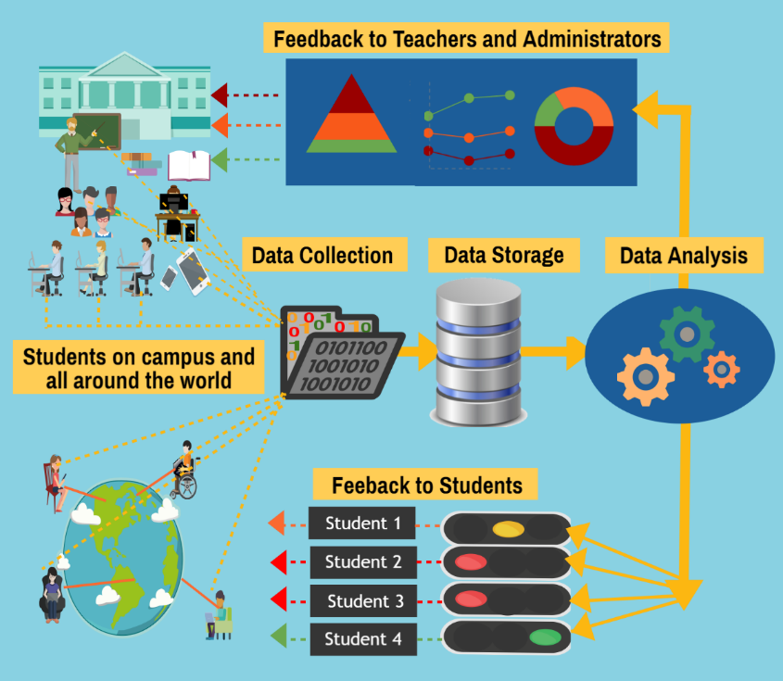
Supporting Higher Education to Integrate Learning Analytics
http://sheilaproject.eu/
The state of the art
Direct engagement with key stakeholders
A comprehensive policy framework
Notes:
SHEILA aims to support the adoption of LA in higher education. To do so, we have 3 clear objectives: 1. understanding the state of the art in Europe. 2. Direct engagement with key stakeholders; 3. policy development

Slide 25
Methodology
http://sheilaproject.eu/
Managers
Students
Teachers
64 Interviews with 51 HEIs across 16 countries in Europe
An institutional survey completed by 46 HEIs across 22 countries in Europe.
Survey
Focus groups
4 HEIs

Slide 26
Interests – senior managers
http://sheilaproject.eu/
To improve student learning performance (16%)
To improve student satisfaction (13%)
To improve teaching excellence (13%)
To improve student retention (11%)
To explore what learning analytics can do for our institution/ staff/ students (10%)
LA
Learner
driver
Teaching
driver
Institutional
driver
Notes:
The interviews identified three common aspects of internal drivers for the adoption of learning analytics:
Learner-driver: to encourage students taking responsibility for their own studies by providing data-based information or guidance.
Teaching-driver: to identify learning problems, improve teaching delivery, and allow timely, evidence-based support.
Institution-driver: to inform strategic plans, manage resources, and improve institutional performances, such as retention rate and student satisfaction.
An equivalent question (multiple choices) in the survey provided 11 options for motivations specific to learning and teaching. The results identified five top drivers.

Slide 27
Interests – teaching staff
http://sheilaproject.eu/
An overview of student attendance, submission of assignments, access to coursework and resources, and performance.
Inform course design.
Manage a big class.
Know ‘why’ students struggle.
Notes:
Student engagement data: when, how long, etc.
Inform course design: reflect on places where students fail.
Know ‘why’ students struggle: it’s not good enough to just know that students fail certain questions.

Slide 28
Student expectations
http://sheilaproject.eu/
Personalised approach
Inform teaching support and curriculum design.
Support a widening access policy.
Support students at all achievement levels to improve learning.
Assist with transitions from pre-tertiary education to higher education, and from higher education to employment.

Slide 29
SHEILA policy framework
http://sheilaproject.eu/

Slide 30
http://sheilaproject.eu/
Thank you!
Training event:
Learning analytics: what has data ever done for me? (http://edin.ac/2m59yxZ)
Time: 10th Nov 2017 (2-4pm)
Place: 1.21 Paterson’s Land (Moray House)
* Bring your own device!
Yi-Shan Tsai
yi-shan.tsai@ed.ac.uk
@yi_shan_tsai

