Slide 1
Support and Resources for Designing Online Courses
Institute for Academic Development
University of Edinburgh
21st May 2018

Slide 2
Who we are…
Provide University-level support for teaching, learning and researcher development.
Staff and students supported through workshops, online resources, networks and advice, delivered in partnership with Schools and other Services.
Support for enhancing and innovating Course and Programme design.
1 Morgan Lane, next to Levels Café
Notes:
The IAD was initiated in January 2010 by merging a number of pre-existing units and services, all of which have had important national and international reputations:
the Centre for Teaching, Learning and Assessment (TLA)
the Postgraduate Transferable Skills Unit (transkills)
the Researcher Development Programme
•Support College/University strategic priorities in teaching, learning and researcher development.
•Work closely and collaboratively with Schools and support services to develop support and encourage the identification and sharing of good practice.
•Provider clearer routes to support and information (for students and staff).
•Consider the full continuum of audience requirements and make connections between them.

Slide 3
Practical Strategies
Booking: https://www.ed.ac.uk/institute-academic-development/learning-teaching/cpd/workshops/institute-events

Slide 4
Teaching Matters
http://www.teaching-matters-blog.ed.ac.uk/

Slide 5
IAD Case Study Wiki
https://www.wiki.ed.ac.uk/display/casestudies/Online+and+Distance+Learning

Slide 6
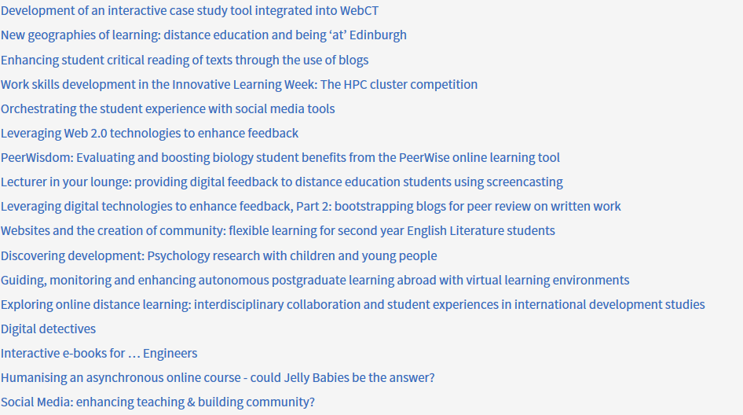
PTAS Projects
https://www.ed.ac.uk/institute-academic-development/learning-teaching/funding/funding/previous-projects/theme/odl
43 online & distance learning projects

Slide 7
Board of Studies Training: Administrators and Conveners
Date: 28th May 2018
Time: 12:00-16:00
Venue: 5.02 Charteris Land
Date: 11th Jul 2018
Time: 09:00-13:00
Venue: Room G21, Paterson's Land
Date: 05th Nov 2018
Time: 12:00-16:00
Venue: TBC (Kings Buildings)
Date: 04th Feb 2019
Time: 09:00-13:00
Venue: TBC (Holyrood)
Workshop covers pedagogical considerations for developing and reviewing course and programme proposals, and clarification of Boards of Studies’ roles and responsibilities:
Evaluating appropriate learning outcomes
Understanding key internal and external reference points (e.g. relevant university strategic priorities and regulations)
Considering key factors for approval of new courses and programmes - business cases and Competition and Markets Authority compliance.
Booking: https://www.ed.ac.uk/institute-academic-development/learning-teaching/cpd/workshops/institute-events

Slide 8
Explore our webpages
https://www.ed.ac.uk/institute-academic-development/learning-teaching/staff/course-programme-design

Slide 9
Explore our webpages
https://www.ed.ac.uk/institute-academic-development/learning-teaching/staff/digital-ed

