Slide 1
Embedding the ELDeR process into course design
Ruth McQuillan, Co-Programme Director, MPH (online)

Slide 2
What is ELDeR?
Who we are and why we use this approach
What we actually do – how we have adapted ELDeR to our own needs and context
How it felt, what we learned and how it changed us

Slide 3
What is ELDeR?
Collaborative, highly practical approach to learning design
Explicitly prioritises the design of student learning experiences over the development of content (Mor and Craft, 2012)
Based on CAIeRO framework, University of Northampton
Developed by Fiona Hale and colleagues from IS
1 – 2 day workshop to produce detailed blueprint of course/programme and comprehensive action plan
We were guinea pigs (January 2016)

Slide 4
Who we are and why we wanted to do this
Online MPH launched September 2015
Developing lots of new courses
Modifying lots of existing courses
Building a new team
Learning how to do it properly!

Slide 5
Basic principles
What do students need to be able to do by the end of the course (Wiggins and McTighe, 2005)?
How will students know they are getting there?
Iterative development of learning outcomes, feedback and assessment so that there is congruence (McCune and Hounsell, 2005)

Slide 6
Blueprint
What is the essence of this programme? What should students on this programme definitely not miss?
Split into two groups
Each group comes up with course mission statement
Compare and reach consensus
Repeat this process for each course
Congruence

Slide 7
Example - Master of Public Health
Programme | Mission Statements
Team 1 | The programme aims to equip health professionals with tools and ways of thinking to take an applied multidisciplinary approach to a variety of public health problems

Slide 8
Example - Master of Public Health
Programme | Mission Statements
Team 1 | The programme aims to equip health professionals with tools and ways of thinking to take an applied multidisciplinary approach to a variety of public health problems
Team 2 | To equip students with the conceptual and practical evidence-based skills and knowledge to face future global public health challenges

Slide 9
Example - Master of Public Health
Programme | Mission Statements
Team 1 | The programme aims to equip health professionals with tools and ways of thinking to take an applied multidisciplinary approach to a variety of public health problems
Team 2 | To equip students with the conceptual and practical evidence-based skills and knowledge to face future global public health challenges
Collaborative | The programme aims to equip students with evidence-based conceptual and practical tools, to take an applied interdisciplinary approach to public health challenges

Slide 10
Example: Epidemiology for public health practice
Course mission statement:
To introduce students to knowledge, skills and tools necessary for public health practice
Course lead:
Ms Magda Mekky

Slide 11
Look and feel
Definitely want (~6)
Not sure
Definitely don’t want
Sometimes we edit them!
Surfaces areas of agreement and disagreement
Helps focus

Slide 12
Begin with the end in mind
On completion students will be able to... | They will know they are getting there from...
Critically understand principles and practice of screening, surveillance, outbreak response and health impact assessment | Formative MCQs, flow diagram activity, staff and peer feedback
Critically appraise a technical report | Summative assessment
Apply principles/knowledge to a context of their choice | Individual enquiry activity, staff and peer feedback via discussion board
Apply principles/knowledge to a particular context (provide choices) | Summative assessment
Critically appraise value of routine data and understand the advantages and limitations for decision-making | Critically appraise a (dodgy) routine data set (e.g. peak of low-birthweight in Canada, district data in SA, WHO observatory, gapminder)
Introduce them to key tools available for public health practice, and practice using one (or more) of them (e.g. CDC framework for evaluating screening programmes, epicurve) | Weekly activities using tools
Communicate, using appropriate methods, to a range of audiences with different levels of knowledge/expertise | Write media statement/infographic/summary for public - peer discussion
What do you want your students to be able to do at the end of this course?
How will they know that they are getting there?

Slide 13
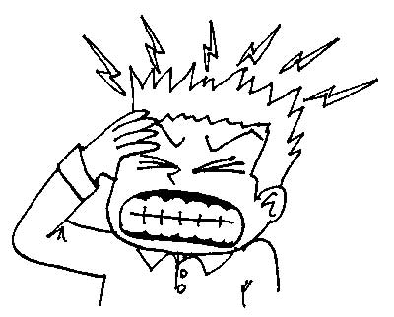
Translate this into learning outcomes
Sense (are they clear to the learner?)
Level (are they appropriate to the level of the course?)
Assess-ability (is it clear how the learner will be able to demonstrate achievement?)

Slide 14
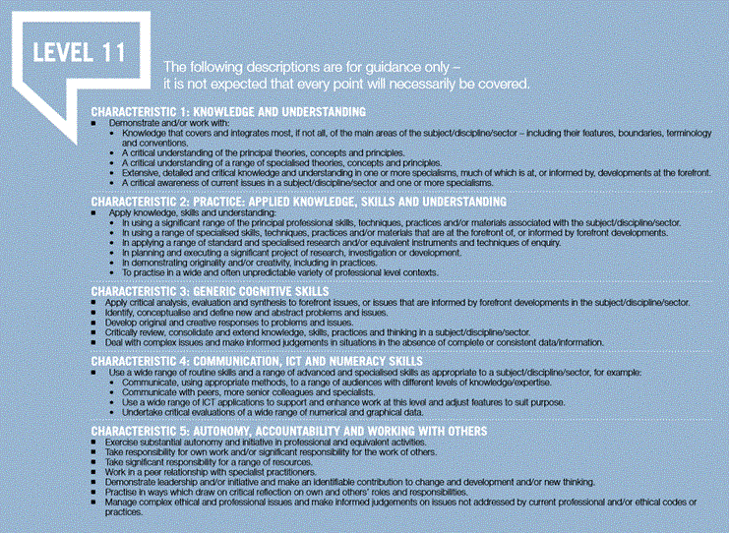
Map to SCQF characteristics
Check that LOs are at appropriate level
SCQF level descriptors: http://scqf.org.uk/wp-content/uploads/2014/03/SCQF-Revised-Level-Descriptors-Aug-2012-FINAL-web-version1.pdf

Slide 15
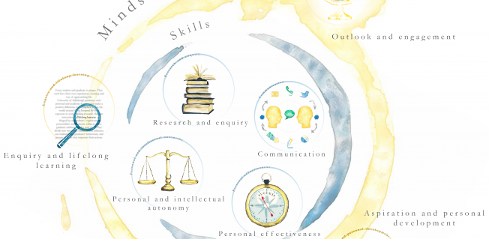

Slide 16
Learning outcomes On completion of this course, you will be able to: | SCQF characteristic
Critically understand principles and practice of screening, surveillance, outbreak response, use of routine data and health impact assessment | 1 (knowledge)
Apply these principles to different contexts using appropriate tools and skills | 2 (applied knowledge)
Deal with complex public health issues and make informed judgements in situations in the absence of complete or consistent data | 3 (generic cognitive skills)
Communicate public health information to a range of audiences with different levels of knowledge/expertise | 4 (communication)

Slide 17
Assessment | Learning outcome
30% summative assessment - online activities (on blog/discussion board): - Communication posts throughout the course - Write media statement/ infographic/ summary for public - peer discussion/blog | 1,2,3,4
70% summative assessment - Plan/Design surveillance programme using CDC framework (context and topic of their choice) - max 2500 words - Use framework critically - Have done sufficient reading - Plan thought through in depth, demonstrating reflection on complexities and ambiguities and justifying choices/decisions and acknowledging trade-offs - Communicate in clear and concise way | 1,2,3
(formative) MCQ for weekly check of understanding | 1
(formative activities) CDC outbreak game, generate Epicurve and explain, appraise a poor-quality routine data set (e.g. peak of low-birthweight in Canada, district data in SA, WHO observatory, gapminder) | 1,3

Slide 18
Alignment
How are we going to assess this course?
Modify assessment and/or mission statement and/or look and feel and/or learning outcomes
Does this align with mission statement, look and feel and learning outcomes?

Slide 19
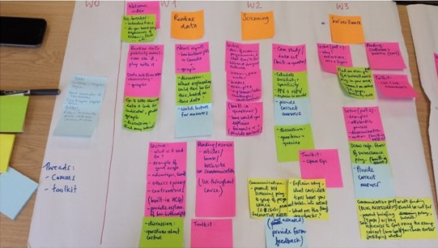

Slide 20
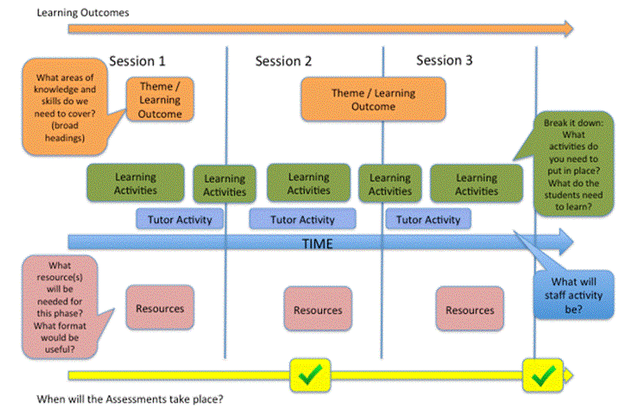
Story board

Slide 21
Day Two (half day)
Recap
(Build prototype online)
Reality check – critical friends
Review and adjust
Make an action plan
We have modified this. Retained:
Sleeping on it, critical friends, review and adjust, make action plan
We build course later

Slide 22
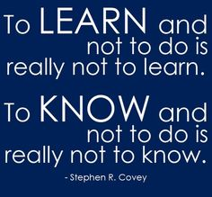
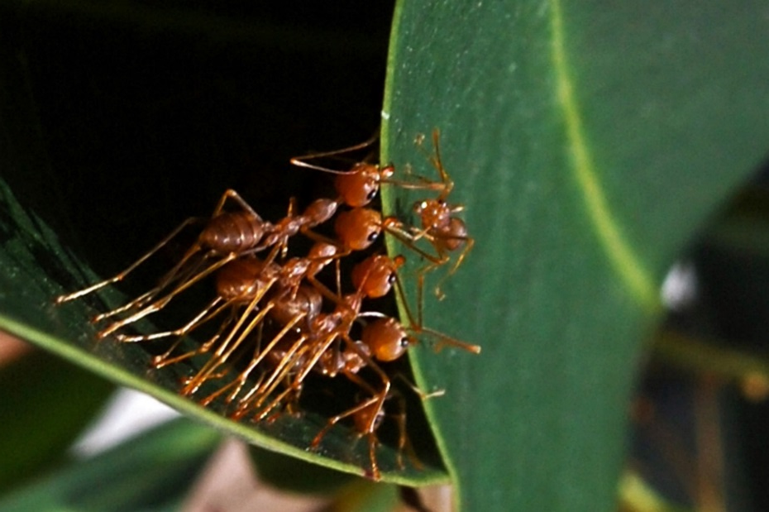
How it felt and what we learned

Slide 23
How it changed us
Changed our practice
All new courses
All existing courses (thought process)
Shaped our values

Slide 24
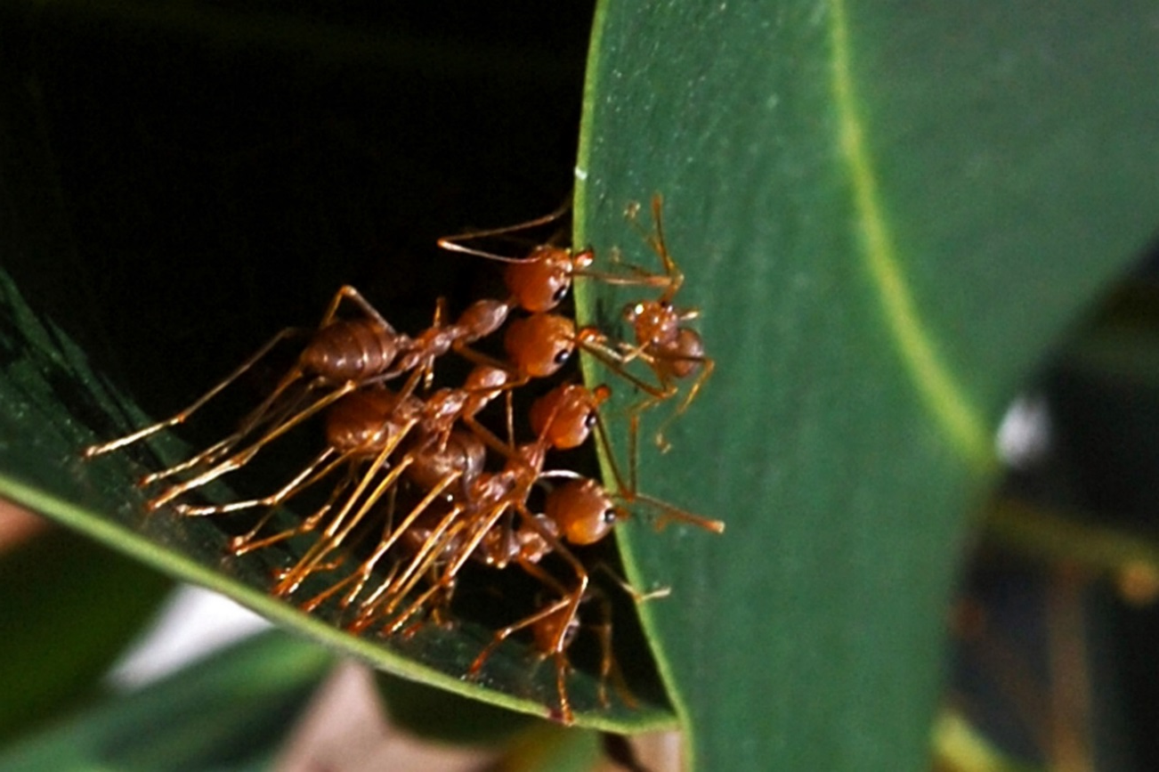
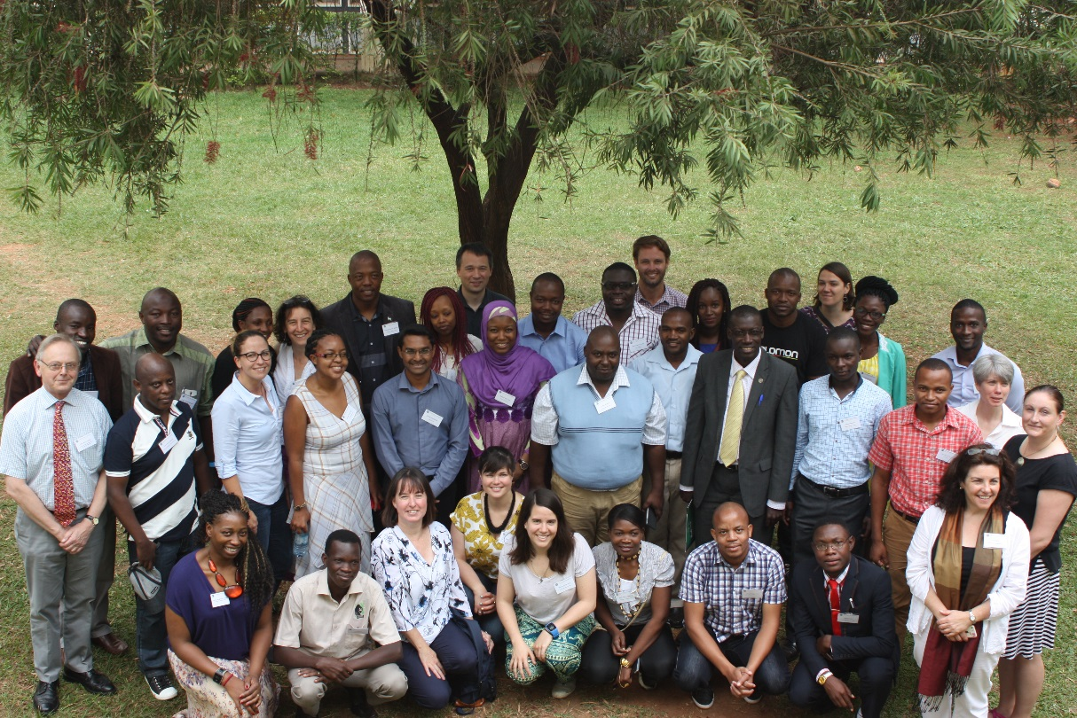
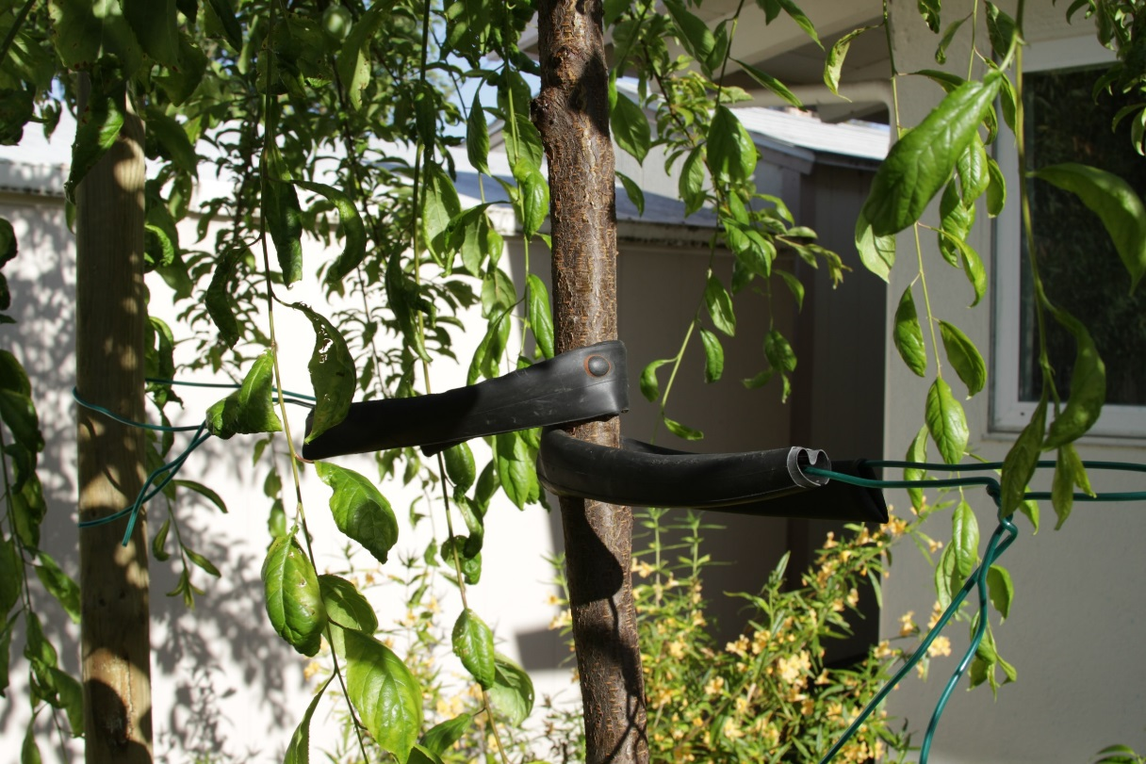
Image: blackbass
Image: Daniel Wehner
Image: Lenore Edman

Slide 25
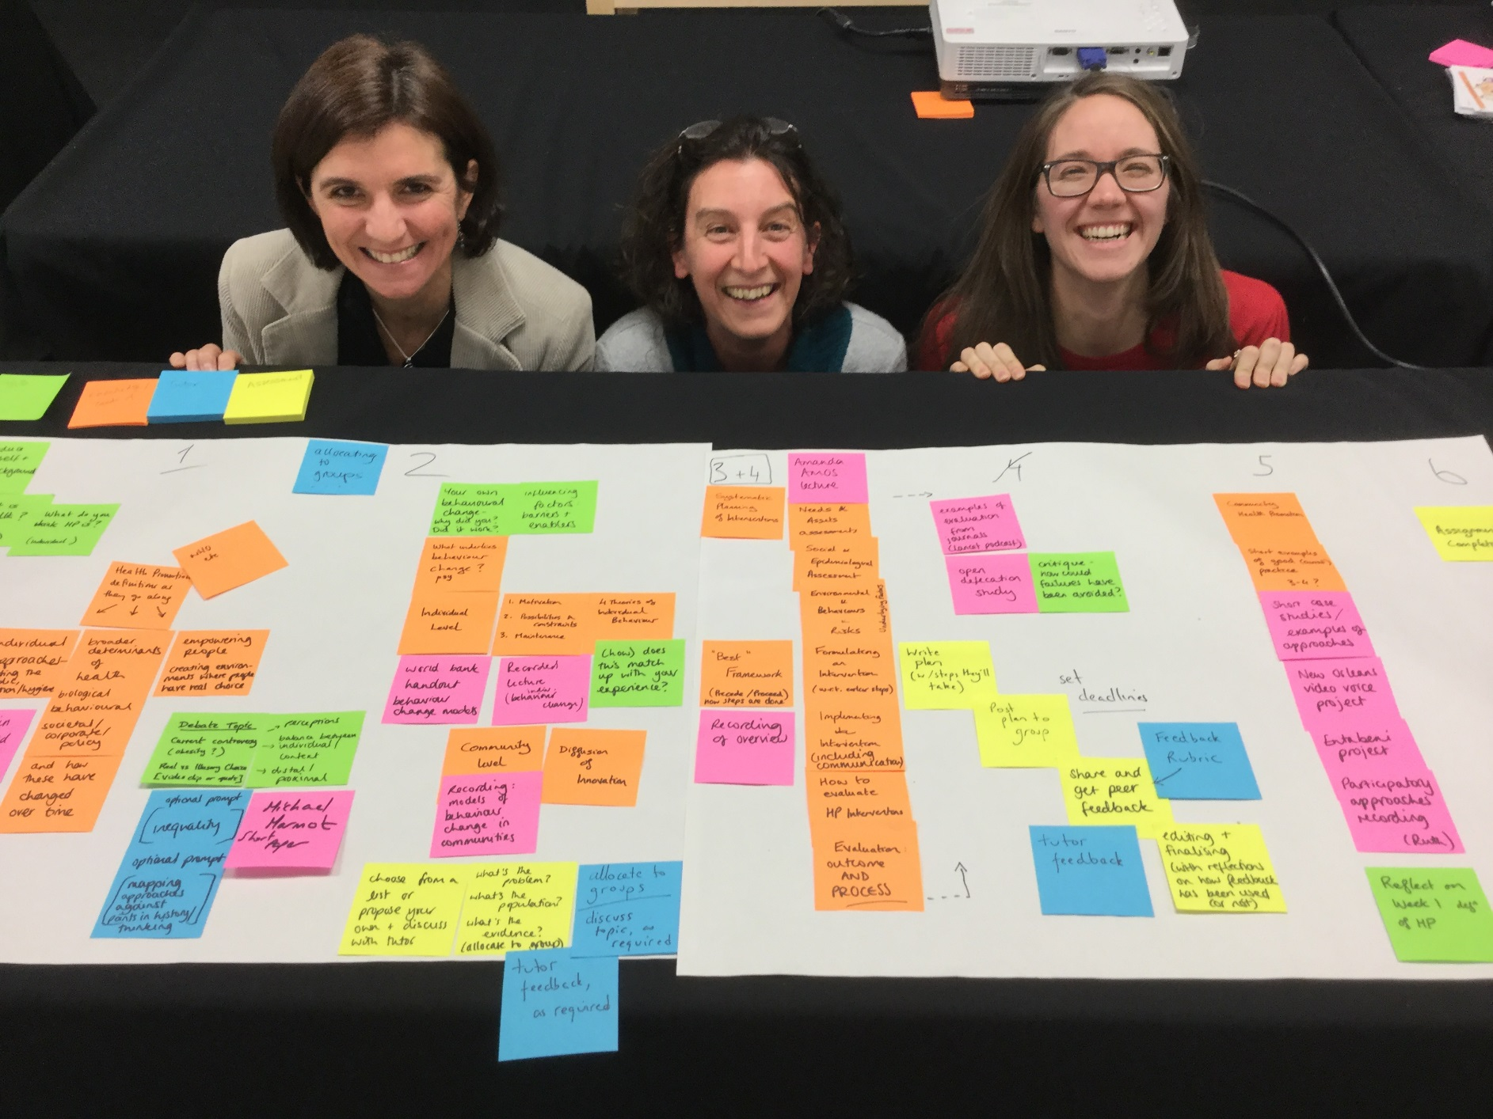

Slide 26
Acknowledgements
Fiona Hale
Julie Usher, University of Northampton
Our team, past and present

