Slide 1
Introduction for educators.
The objective of this lesson is for students to apply their knowledge of latitude and longitude to read and plot coordinates in latitude and longitude.
Ideally, students should have prior knowledge of what lines of latitude and longitude are. However, these are covered in the lesson.
Introductions to the objectives of the research voyage associated with this series of lessons can be seen on slides 3 and 4. These slides describe the same objectives but targeted at different levels of reader.
Answers for the activities can be found on the slides towards the end of this presentation.
These lessons have all been tested in a UK secondary school setting. However, any feedback or reviews are warmly received.

Slide 2
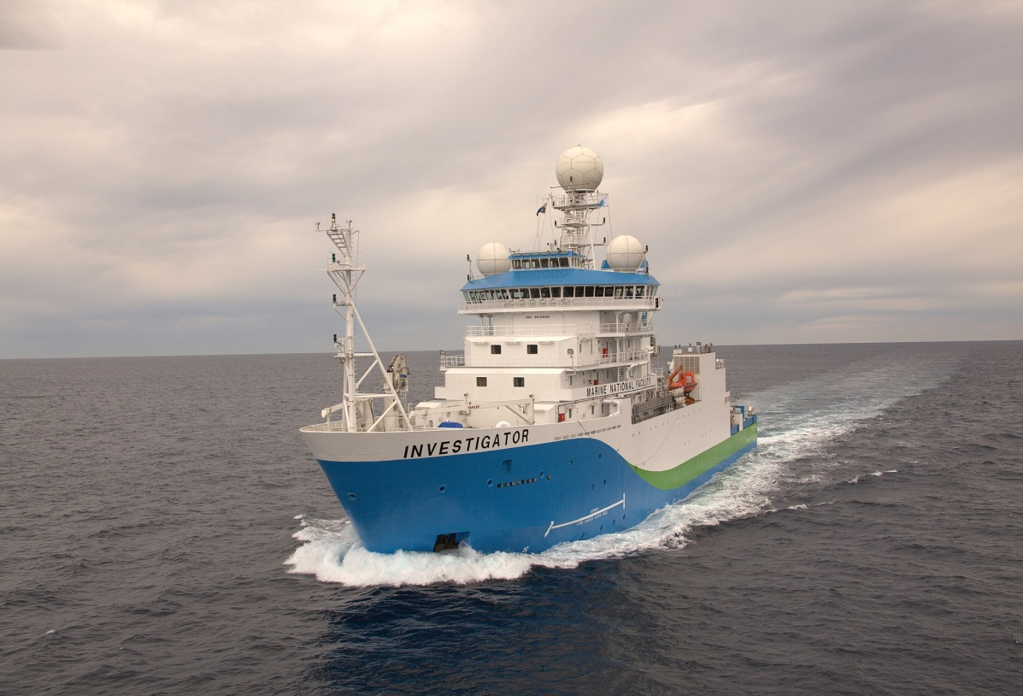
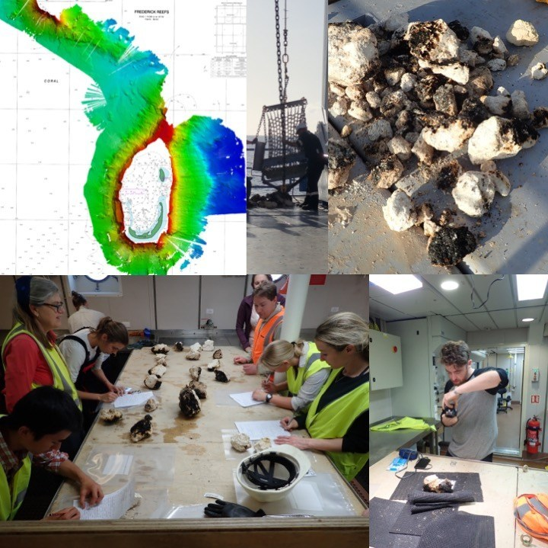
Australia’s R/V Investigator, the ship being used for the research. Image credit: CSIRO
Title: Latitude and Longitude
This lesson is one of a series focused on
‘Mysteries of the Deep Earth:
Expedition to Australia's Underwater Volcanoes’
Notes:
Top left: Bathymetry map created using multibeam sonar. Background chart Australian Hydrographic Office Chart AUS00612P2. Top middle: Dredge being unloaded by CIR James Hogg. Top right: Sampled rocks on deck. Bottom left: Scientists describing the rocks. Bottom right: Educator on Board Jamie Menzies photographing rock samples.

Slide 3
What are we investigating?
The science objectives of this voyage are:
Hotspot dynamics in the Coral Sea: connections between the Australian Plate and the deep Earth. Scientists will be collecting rocks from volcanoes along a submerged seamount chain and using sound, magnetics and gravity to make 3D maps of the volcano shapes. These chains are similar to the Hawaiian and Canary Islands in that they are volcanoes which formed away from the edges of tectonic plates (such as in the Pacific ‘Ring of Fire’, and scientists want to understand how, why and when they formed.
Understanding the spatial links between geomorphology and biodiversity in the Coral Sea Australian Marine Park. Maps of the underwater volcanoes will be analysed to understand how different shapes, structures and ‘landscapes’ provide habitats for marine species such as corals and invertebrates.
Spatial and temporal variability in the distribution and abundance of seabirds. Scientists on the observation deck high on the ship will be observing seabirds and marine mammals (such as whales, dolphins and sharks) to understand where they live and their behaviours.

Slide 4
What are we investigating?
The science objectives of this voyage are:
Mapping the underwater landscapes. Scientists will use special mapping techniques to make 3D maps of underwater volcanoes that have been discovered in the Coral and Tasman Seas. Using rocks that they collect from these sites, scientists want to understand how, why and when these underwater volcanoes formed.
Why do marine species like living on underwater volcanoes? Maps of the underwater volcanoes will be analysed to understand how different shapes, structures and ‘underwater landscapes’ provide habitats for marine species such as corals and invertebrates.
Are there more seabirds and marine mammals near these underwater volcanoes than in the surrounding waters? Scientists on the observation deck high on the ship will be observing seabirds and marine mammals (such as whales and dolphins) to understand where they live and their behaviours.
Notes:
A simpler explanation.

Slide 5
Where are we going?
UK
Coral Sea, Australia

Slide 6
For this lesson you will need:
Ruler
Pencil

Slide 7
How do you know where you are at sea if there is nothing around you?
Australia’s R/V Investigator, the ship being used for the research. Image credit: CSIRO
Latitude and Longitude!!

Slide 8
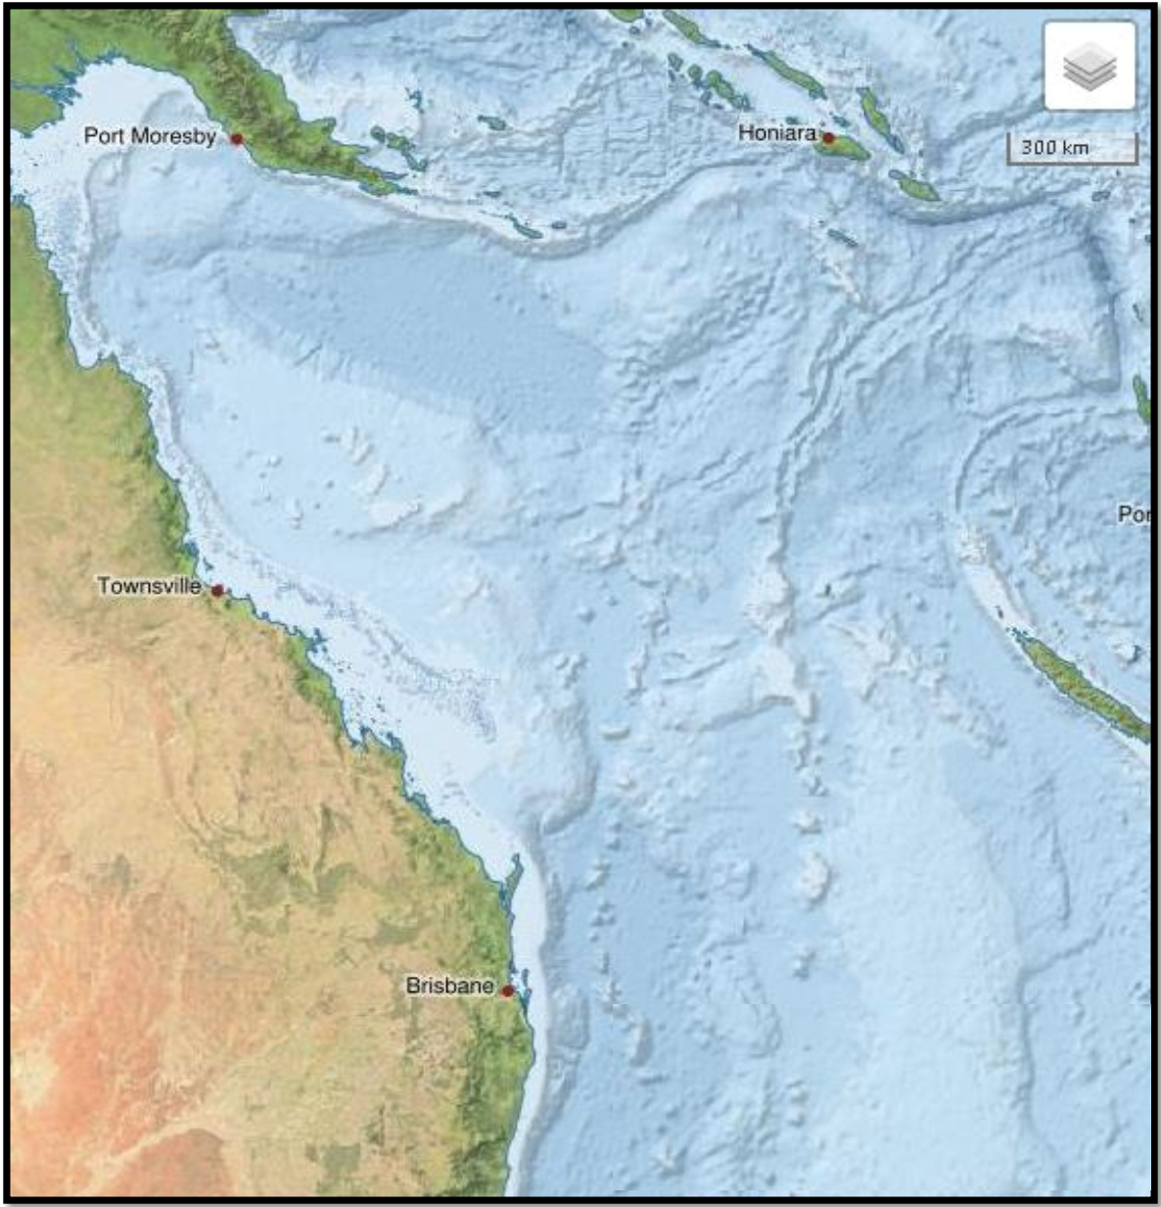
For your GCSEs you must: “use and understand latitude and longitude”
Brisbane Location
Latitude (N/S) | 27º S
Longitude (E/W) | 153º E
Brisbane

Slide 9
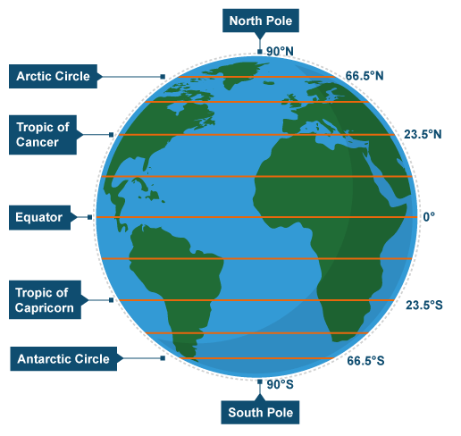
Warm up task
Task: Can you label any of the lines of latitude on the diagram?

Slide 10
Warm up task
Task: Can you label any of the lines of latitude on the diagram?

Slide 11
Latitude Lines
Go across the map
Measured in degrees (°)
North and south of the Equator
They are parallel
Decrease in length towards the Poles

Slide 12
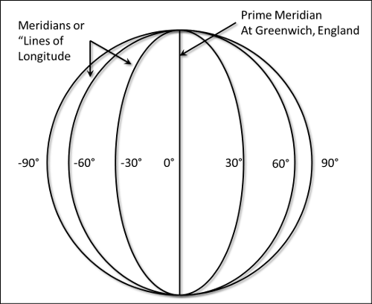
Longitude Lines
Go up and down the map
Measured in degrees (°)
East and west of the Greenwich Meridian (London)
They converge at the Poles
They are all the same length
Notes:
The Greenwich Meridian: Britain was a world leader in exploration and map making.
Thus navigators of other nations often used British maps.
As a result, in 1884 the meridian of Greenwich was adopted throughout most of the world as the prime meridian.

Slide 13
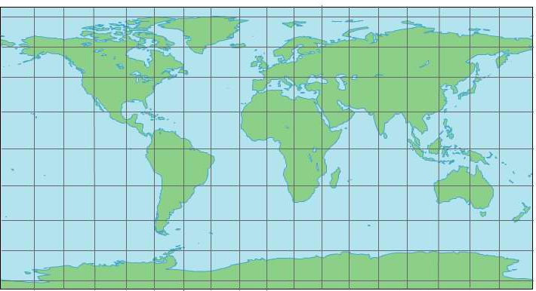
Finding the Latitude and Longitude – The Rules
Latitude is always NORTH or SOUTH from the Equator.
Longitude is always EAST or WEST from the GM.
80^{O} N
Greenwich meridian
60^{O} N
40^{O} N
20^{O} N
0^{O}
Equator
20^{O} S
40^{O} S
60^{O} S
80^{O} S
160^{O}
140^{O}
120^{O}
100^{O}
80^{O}
60^{O}
40^{O}
20^{O}
0^{O}
20^{O}
40^{O}
60^{O}
80^{O}
100^{O}
120^{O}
140^{O}
160^{O}
West longitude
East longitude
Notes:
North or South of the equator
Meridian – East or west (2nd)

Slide 14
Finding the Latitude and Longitude – Your turn…
80^{O} N
Greenwich meridian (GM)
60^{O} N
1
4
1
40^{O} N
4
20^{O} N
0^{O}
Equator
3
20^{O} S
3
2
2
5
40^{O} S
5
60^{O} S
80^{O} S
160^{O}
140^{O}
120^{O}
100^{O}
80^{O}
60^{O}
40^{O}
20^{O}
0^{O}
20^{O}
40^{O}
60^{O}
80^{O}
100^{O}
120^{O}
140^{O}
160^{O}
West longitude
East longitude
Don’t forget the rules…
Latitude is always NORTH or SOUTH from the Equator.
Longitude is always EAST or WEST from the GM.
Notes:
1 = 60 South
20 West

Slide 15
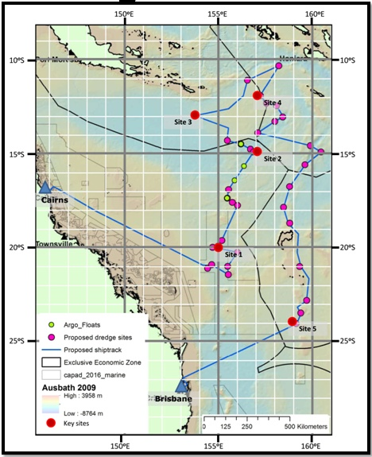
Task 1 – Identifying the latitude and longitude of key sites
Whilst on the research vessel in the Coral Sea, scientists use latitude and longitude to help navigate to key sites that they think will be of particular interest.
E.g., Cairns: 17ºS,146ºE
Can you identify the latitude and longitude of the 5 key sites marked on the map?
Longitude
Latitude
1. Site 1: 20ºS,155ºE
2. Site 2: 15ºS,157ºE
3. Site 3: 13ºS,154ºE
4. Site 4: 12ºS,157ºE
5. Site 5: 24ºS,159ºE

Slide 16
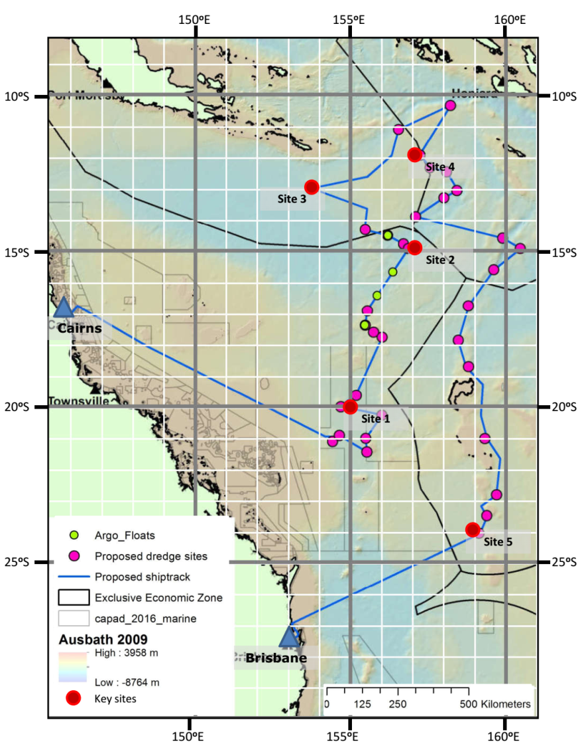
Task 2 – Reasoning with latitude and longitude
Answer each of the following questions to the nearest degree.
Describe the location of Brisbane using geographical terminology, and latitude and longitude.
What is the difference in latitude between Cairns and Brisbane?
What is the approximate latitude and longitude of the most northerly proposed dredge site?
What is the approximate latitude and longitude of the most easterly proposed dredge site?
What is the difference in longitude between the most northerly and most easterly of the proposed dredge sites?
Longitude
Latitude
1. Brisbane is located on the east coast of Australia and is southeast of Cairns. Its latitude and longitude is approximately 27ºS,153ºE.
2. Brisbane Latitude = 27ºS or 28ºS Cairns Latitude = 17ºS – Difference = 10/11ºS
3. Approximately 10ºS,158ºE
4. Approximately 15ºS,160/161ºE
5. 160/161ºE - 158ºE = 2/3ºE
Notes:
Dredging is the method used to collect the rock samples from the ocean floor. These rocks can be analysed to tell us about the age of the earths crust and how it was formed. Dredging basically involves dragging a big bucket along the floor of the ocean seeing what you find.

Slide 17
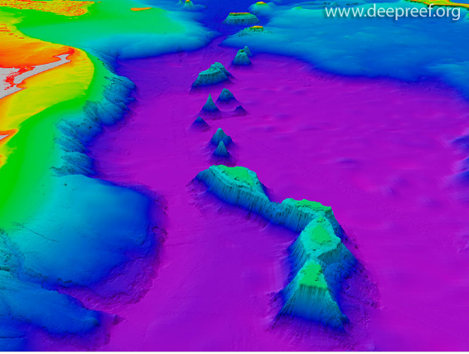
Task 3 – Plotting latitude and longitude
Using multibeam underwater mapping equipment, scientists recently discovered a new chain of deep-sea volcanoes, some of which rise over 3000m up from the ocean floor! We know the latitude and longitude of their positions. Can you help us plot them on the map?
1. v1: 28ºS,155ºE
2. v2: 26ºS,156ºE
3. v3: 24ºS,155ºE
4. v4: 21ºS,157ºE
5. v5: 18ºS,158ºE
6. v6: 15ºS,157ºE
Longitude
Latitude
Notes:
Picture Credit: Beaman, R.J., 2010. Project 3D-GBR: A high-resolution depth model for the Great Barrier Reef and Coral Sea. Marine and Tropical Sciences Research Facility (MTSRF) Project 2.5i.1a Final Report, MTSRF, Cairns, Australia, pp. 13 plus Appendix 1.

Slide 18
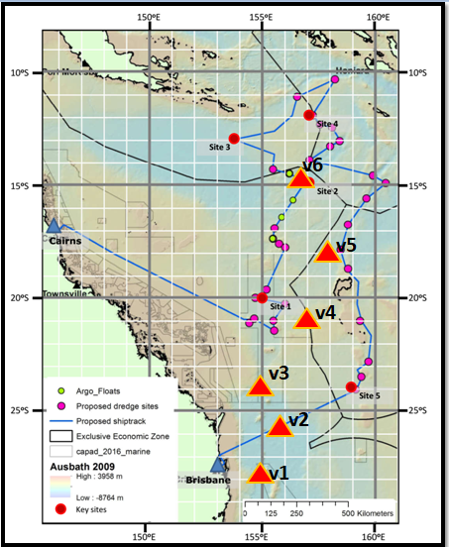
Task 3 – Plotting latitude and longitude
Longitude
Using multibeam underwater mapping equipment, scientists recently discovered a new chain of deep-sea volcanoes, some of which rise over 3000m up from the ocean floor! We know the latitude and longitude of their positions. Can you help us plot them on the map?
1. v1: 28ºS,155ºE
2. v2: 26ºS,156ºE
3. v3: 24ºS,155ºE
4. v4: 21ºS,157ºE
5. v5: 18ºS,158ºE
6. v6: 15ºS,157ºE
Latitude
Notes:
Picture Credit: Beaman, R.J., 2010. Project 3D-GBR: A high-resolution depth model for the Great Barrier Reef and Coral Sea. Marine and Tropical Sciences Research Facility (MTSRF) Project 2.5i.1a Final Report, MTSRF, Cairns, Australia, pp. 13 plus Appendix 1.

Slide 19
Review Quiz – True or False
 |  | True | False
1 | Lines of latitude give how far north or south a place is.
2 | Lines of latitude give how far east or west a place is.
3 | Lines of longitude give how far east or west a place is.
4 | Brisbane is south of the equator.
5 | Cairns is west of the Greenwich meridian.
6 | Underwater volcanoes are never more than 2000m higher than the seabed.
X
X
X
X
X
X

