Slide 1
Introduction for educators.
The objective of this lesson is for students to apply their knowledge of estimation to an investigation of dolphin populations.
This is lesson is aimed at the UK national curriculum, which dictates that estimates should always be rounded to one significant figure.
Introductions to the objectives of the research voyage associated with this series of lessons can be seen on slides 3 and 4. These slides describe the same objectives but targeted at different levels of reader.
Answers for the activities can be found on the slides towards the end of this presentation.
These lessons have all been tested in a UK secondary school setting. However, any feedback or reviews are warmly received.

Slide 2
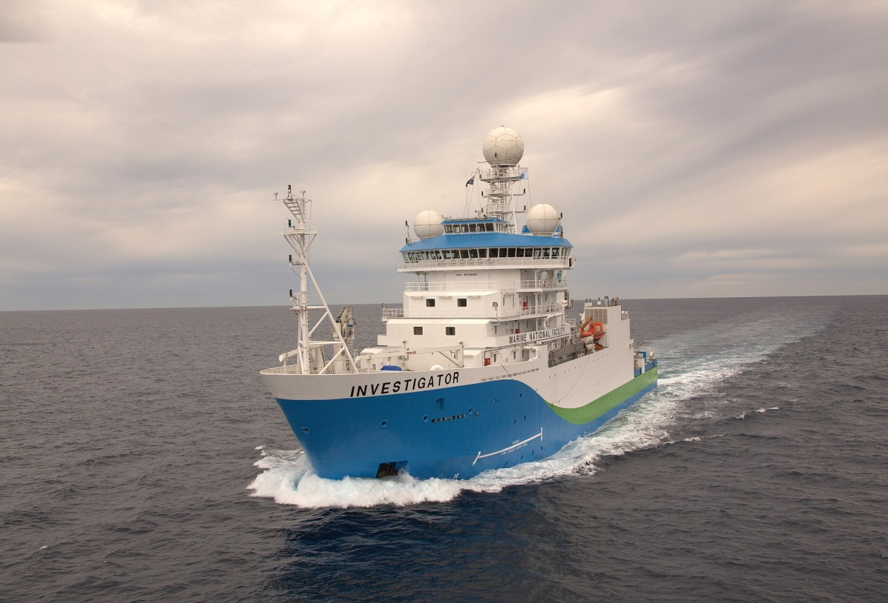
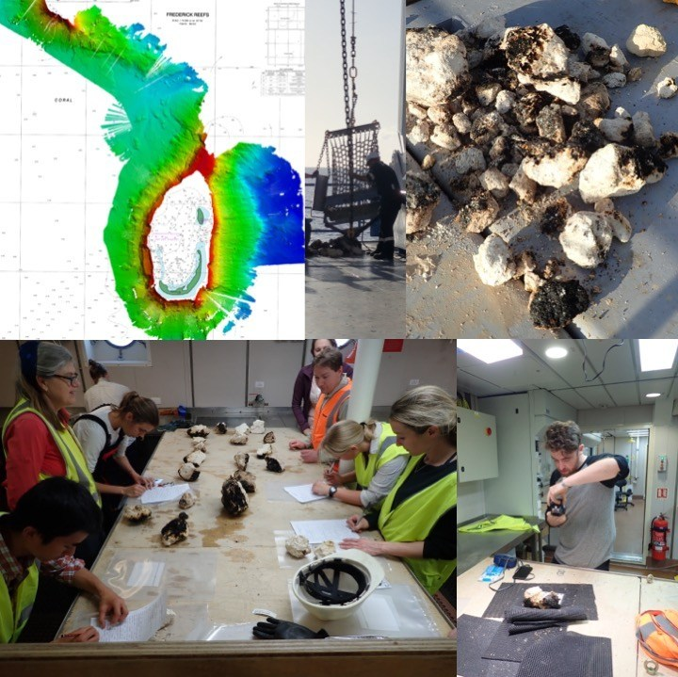
Australia’s R/V Investigator, the ship being used for the research. Image credit: CSIRO
Title: Rounding and Estimation
This lesson is one of a series focused on
‘Mysteries of the Deep Earth:
Expedition to Australia's Underwater Volcanoes’
Notes:
Top left: Bathymetry map created using multibeam sonar. Background chart Australian Hydrographic Office Chart AUS00612P2. Top middle: Dredge being unloaded by CIR James Hogg. Top right: Sampled rocks on deck. Bottom left: Scientists describing the rocks. Bottom right: Educator on Board Jamie Menzies photographing rock samples.

Slide 3
What are we investigating?
The science objectives of this voyage are:
Hotspot dynamics in the Coral Sea: connections between the Australian Plate and the deep Earth. Scientists will be collecting rocks from volcanoes along a submerged seamount chain and using sound, magnetics and gravity to make 3D maps of the volcano shapes. These chains are similar to the Hawaiian and Canary Islands in that they are volcanoes which formed away from the edges of tectonic plates (such as in the Pacific ‘Ring of Fire’, and scientists want to understand how, why and when they formed.
Understanding the spatial links between geomorphology and biodiversity in the Coral Sea Australian Marine Park. Maps of the underwater volcanoes will be analysed to understand how different shapes, structures and ‘landscapes’ provide habitats for marine species such as corals and invertebrates.
Spatial and temporal variability in the distribution and abundance of seabirds. Scientists on the observation deck high on the ship will be observing seabirds and marine mammals (such as whales, dolphins and sharks) to understand where they live and their behaviours.

Slide 4
What are we investigating?
The science objectives of this voyage are:
Mapping the underwater landscapes. Scientists will use special mapping techniques to make 3D maps of underwater volcanoes that have been discovered in the Coral and Tasman Seas. Using rocks that they collect from these sites, scientists want to understand how, why and when these underwater volcanoes formed.
Why do marine species like living on underwater volcanoes? Maps of the underwater volcanoes will be analysed to understand how different shapes, structures and ‘underwater landscapes’ provide habitats for marine species such as corals and invertebrates.
Are there more seabirds and marine mammals near these underwater volcanoes than in the surrounding waters? Scientists on the observation deck high on the ship will be observing seabirds and marine mammals (such as whales and dolphins) to understand where they live and their behaviours.
Notes:
A simpler explanation.

Slide 5
Where are we going?
UK
Coral Sea, Australia

Slide 6
For this lesson you will need:
Ruler
Pencil

Slide 7
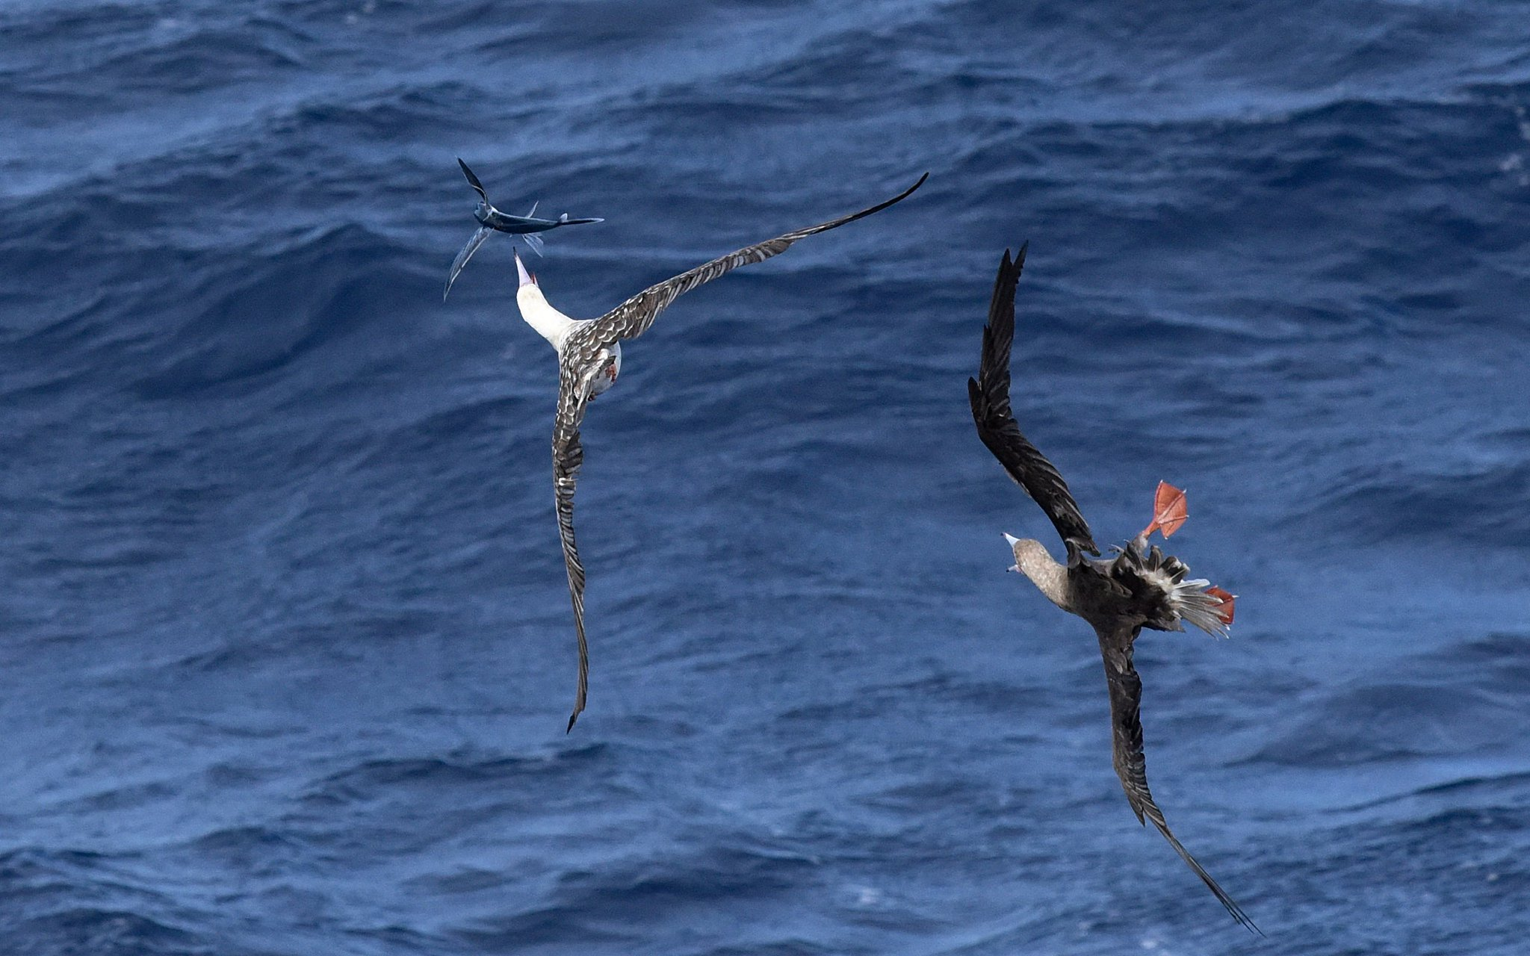
A part of the voyage is researching the wildlife that lives around the underwater volcanoes
Photo Credit: Eric Woehler @BirdLifeTas

Slide 8
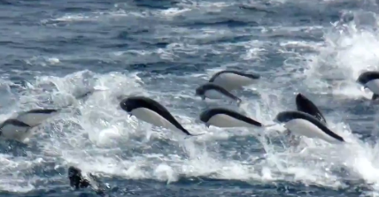
Let’s take a look at some of the wildlife spotted. Try and remember as much information as you can…
Southern Right Whale Dolphin Average length: 1.87m,
Average weight: 85.47kg
Photo Credit: CSIRO

Slide 9
Let’s take a look at some of the wildlife spotted. Try and remember as much information as you can…
Brown Booby (A Booby is a kind of seabird)
Average wingspan: 1.53m
Average weight: 0.946kg
Photo Credit: Eric Woehler/Huw Morgan

Slide 10
Let’s take a look at some of the wildlife spotted. Try and remember as much information as you can…
Whale Shark Average length: 14.2m
Average weight: 13.2 tonnes
Photo Credit: Eric Woehler/Huw Morgan

Slide 11
1. What were names of the three creatures we just looked at? 2. What were the lengths of the three creatures we just looked at? 3. What were the weights of the three creatures we just looked at?
Quick Quiz
Remembering the EXACT value of a long number is tricky: that’s one of the reasons why we often use estimation to make things simpler.
Southern Right Whale Dolphin, Brown Booby, Whale Shark
1.87m, 1.53m, 14.2m
85.47kg, 0.946kg, 13.2 tonnes
Notes:
Students unlikely to have got the exact numbers, leading into estimation.

Slide 12
When using estimation in maths, we must always round to 1 significant figure (sf)
Using estimation to simplify values
Southern Right Whale Dolphin Average length: 1.87m,
Average weight: 85.47kg
1sf
2sf
3sf
1.87m
2m
1sf
2sf
3sf
4sf
85.47kg
Photo Credit: CSIRO
90kg

Slide 13
Find estimates of the measurements and weights of the wildlife below.
Whale Shark Average length: 14.2m
Average weight: 13.2 tonnes
Brown Booby
Average wingspan: 1.53m
Average weight: 0.946kg
Wingspan = 2m
Weight = 1kg
Average length = 10m
Average weight = 10 tonnes
Photo Credit: Eric Woehler/Huw Morgan

Slide 14
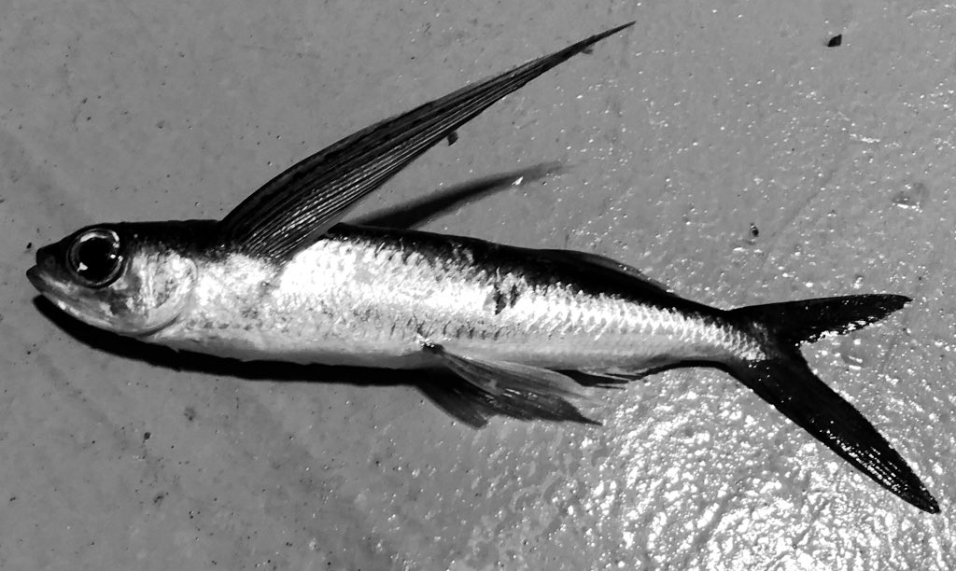
Let’s take a look at some more of the wildlife spotted… Try and remember estimates of the lengths and weights of the creatures
Flying Fish
Average length: 45cm
Average weight: 332g
Photo Credit: Huw Morgan

Slide 15
Let’s take a look at some more of the wildlife spotted… Try and remember estimates of the lengths and weights of the creatures
Photo Credit: Eric Woehler/Huw Morgan
Hammerhead Shark Average length: 4.5m
Average weight: 230kg

Slide 16
Let’s take a look at some more of the wildlife spotted… Try and remember estimates of the lengths and weights of the creatures
Bridled Tern
Average wingspan: 77cm
Average weight: 110g
Photo Credit: Eric Woehler/Huw Morgan

Slide 17
1. What were names of the three creatures we just looked at? 2. What were the estimated lengths of the three creatures we just looked at? 3. What were the estimated weights of the three creatures we just looked at?
Quick Quiz – Round 2
Notice that all of our estimates never have more than one number that isn’t a zero.
Flying Fish, Hammerhead Shark, Bridled Tern
50cm, 5m, 80cm
300g, 200kg, 100g
Notes:
Students unlikely to have got the exact numbers, leading into estimation.

Slide 18
This pod of Southern Right Whale Dolphins was filmed from the ship. Watch the video and see how many you think there are in the group.
We can use estimates to help us calculate sea-life populations
Notes:
Video in attached file if the link does not work.

Slide 19
This pod of Southern Right Whale Dolphins (SRW Dolphins) was filmed from the ship. Can you help the scientists work out how many SRW Dolphins are in the pod?
Investigation How many Dolphins are in the Pod?
What skills could we use to work this out?
Estimation?
Area calculations?
Averages?
What assumptions would we have to make?
Can you justify these assumptions?

Slide 20
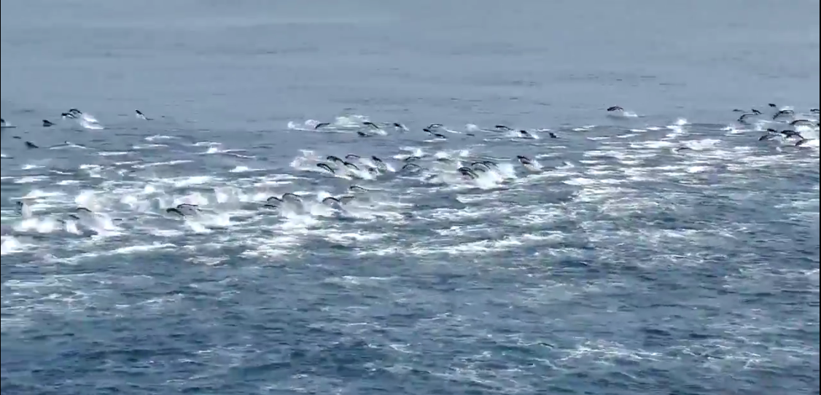
Investigation How many Dolphins are in the Pod?
45m
95m
Estimate of the area the dolphin pod covers = 100m x 50m = 5000m²
Notes:
The simplest way of generating an estimate.

Slide 21
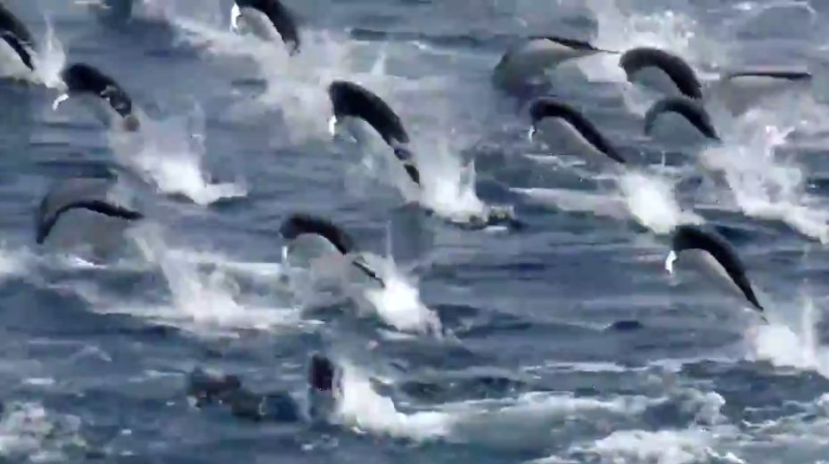
Investigation How many Dolphins are in the Pod?
Zoomed part of the dolphin pod covers 9.5m x 9.5m
To make calculations easier, we round 9.5m to 10m
10m x 10m = 100m²
13 dolphins counted within 100m²
To make calculations easier, we round our count of 13 to 10 dolphins
9.5m
9.5m
10 dolphins counted within 100m²

Slide 22
Investigation How many Dolphins are in the Pod?
Dolphin pod covers an area of 5000m²
10 dolphins counted within 100m²
5000m² / 100 = 50
50 x 10 = 500 estimated total
9.5m
9.5m
50m
100m

Slide 23
Investigation How many Dolphins are in the Pod?
Dolphin pod covers an area of 5000m²
10 dolphins counted within 100m²
5000m² / 100 = 50
50 x 10 = 500 estimated total
What are my assumptions?
There are the same number of dolphins in every square.
The dolphins are all on the surface of the water, and there aren’t lots swimming below the surface that we don’t see.
All of the Dolphins within the pod are within the area covered.
How could I have improved the reliability of my estimate?
Is there a better way that I could have found out how many dolphins were in the pod?
Is my estimate an overestimate or an underestimate?
Notes:
More reliable ways – counting the number of dolphins in more squares and then finding the average number of dolphins per square

Slide 24
Plenary
Estimate the answers to the following:
What is the combined weight of a Brown Booby and a Bridled Tern?
What is the combined length of a Bridled Tern and a SWR Dolphin??
How much heavier is a Hammerhead Shark than a SWR Dolphin?
What is the combined length of 22 Hammerhead Sharks?
What is the combined weight of 8 Flying Fish?
900g + 100g = 1000g or 1kg
2m + 0.8m = 2.8m or 280cm
200kg – 100kg = 100kg
20 x 5m = 100m
8 x 300g = 2400g or 2.4kg
Hammerhead Shark – 4.5m, 230kg
Southern Right Whale (SRW) Dolphin – 1.87m, 85.47kg
Flying Fish – 45cm, 332g
Brown Booby – 153cm, 946g
Bridled Tern – 77cm, 110g
Whale Shark – 14.32m, 13.2 tonnes

