Slide 1
Investigating Dolphin Populations
A pod of Southern Right Whale Dolphins (SRW Dolphins) was filmed from the ship. Using the available resources can you help the scientists work out how many SRW Dolphins are in the pod? - What skills could we use to work this out?
Estimation?
Area calculations?
Averages?
- What assumptions would we have to make? - Can you justify these assumptions?
Write your answers below. You must state your assumptions and show how you worked out your estimate
Estimated Number of Dolphins: _________________________________________________________ _________________________________________________________ _________________________________________________________
Assumptions & Justification _________________________________________________________ _________________________________________________________ _________________________________________________________
_________________________________________________________
_________________________________________________________ _________________________________________________________
_________________________________________________________ _________________________________________________________ _________________________________________________________
_________________________________________________________ _________________________________________________________
_________________________________________________________ _________________________________________________________ _________________________________________________________
_________________________________________________________ _________________________________________________________
_________________________________________________________ _________________________________________________________ _________________________________________________________
This lesson is one of a series focused on
‘Mysteries of the Deep Earth:
Expedition to Australia's Underwater Volcanoes’

Slide 2
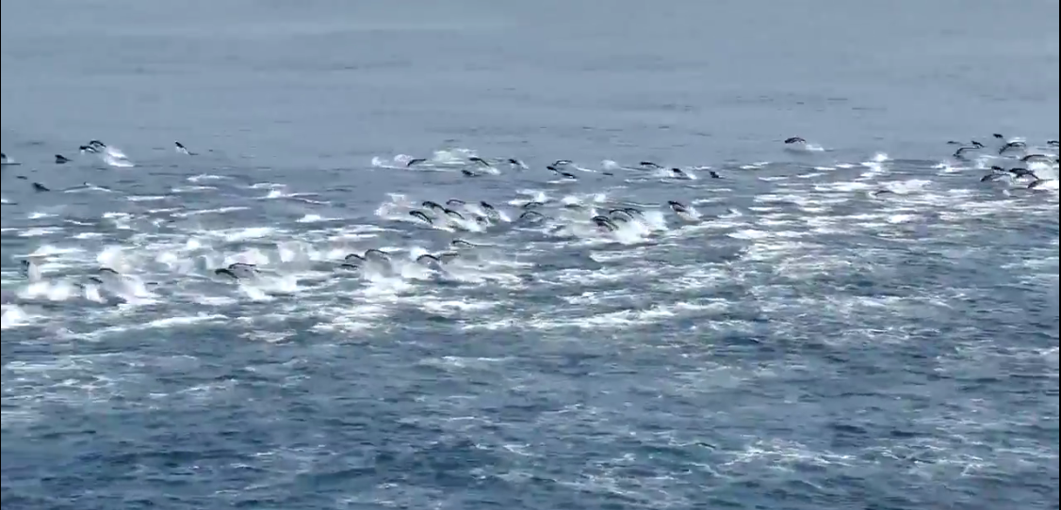
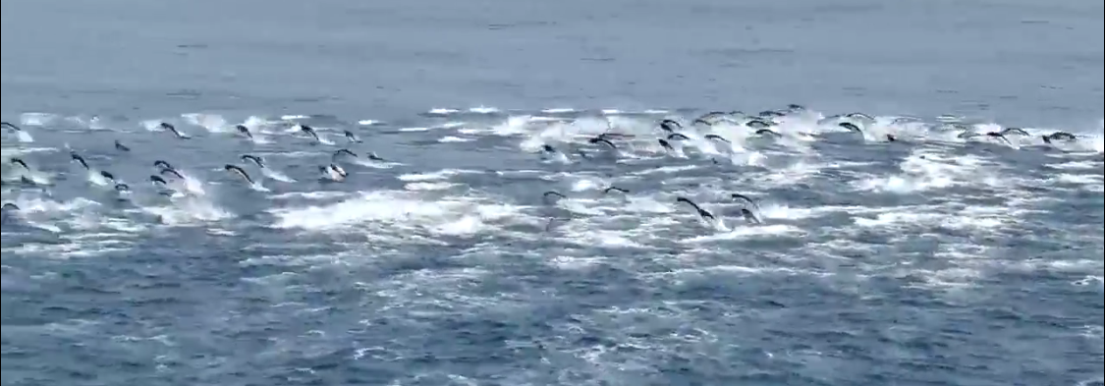
Investigating Dolphin Populations
Resource 1 – Photographs of the whole pod
Roughly 45m
Roughly 95m
Roughly 45m
Roughly 95m
Roughly 45m
Roughly 95m
Photo Credit: CSIRO
This lesson is one of a series focused on
‘Mysteries of the Deep Earth:
Expedition to Australia's Underwater Volcanoes’

Slide 3
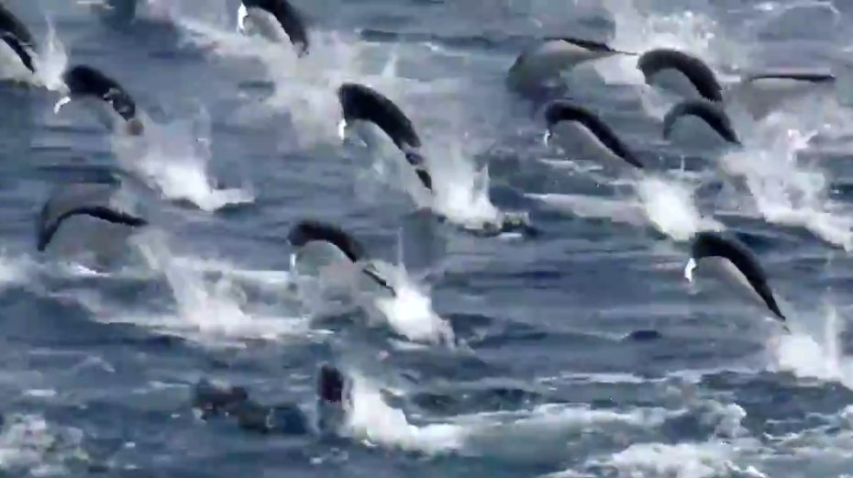
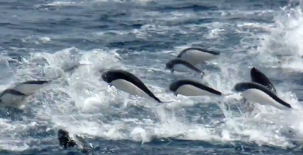
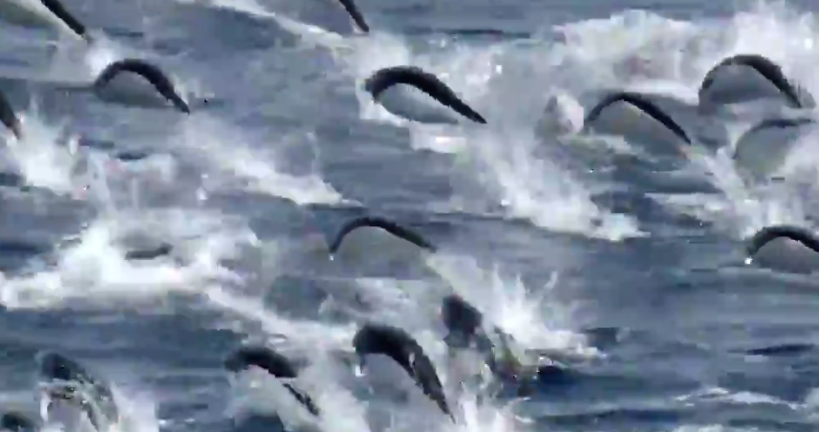
Investigating Dolphin Populations
Resource 2 – Zoomed pictures of the pod
9m
9m
9m
9m
9m
9m
Photo Credit: CSIRO
This lesson is one of a series focused on
‘Mysteries of the Deep Earth:
Expedition to Australia's Underwater Volcanoes’

Slide 4
Investigating Dolphin Populations
Rough Calculations
This lesson is one of a series focused on
‘Mysteries of the Deep Earth:
Expedition to Australia's Underwater Volcanoes’

