Slide 1
Introduction for educators
Before undertaking this lesson, students should be confident with the use of protractors to measure angles.
The objective of this lesson is for students to apply their knowledge of bearings to a real-world navigation scenario. Students will be required to measure bearings and, if they reach the extension activity, construct bearings.
In addition to using bearings, students are also required to use their knowledge of scale to calculate the distances travelled on each bearing.
Introductions to the objectives of the research voyage associated with this series of lessons can be seen on slides 3 and 4. These slides describe the same objectives but targeted at different levels of reader.
Answers for the activities can be found on the slides towards the end of this presentation.
These lessons have all been tested in a UK secondary school setting. However, any feedback or reviews are warmly received.

Slide 2
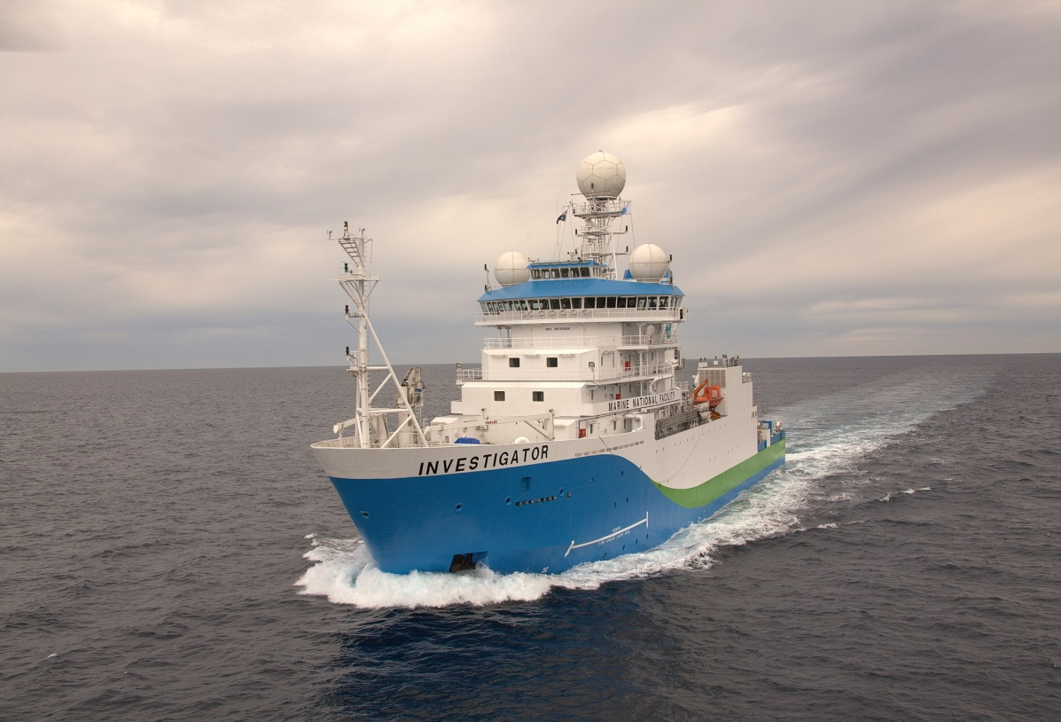
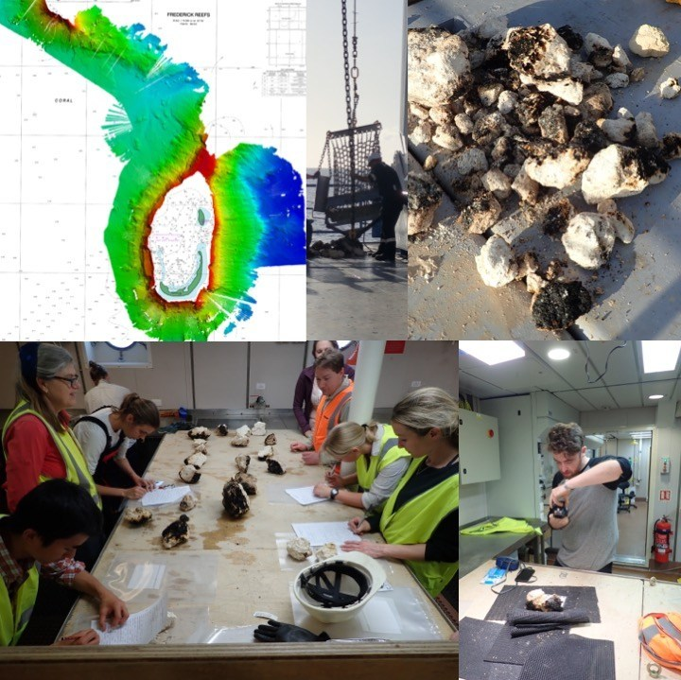
Australia’s R/V Investigator, the ship being used for the research. Image credit: CSIRO
Title: Bearings and Navigation Planning the voyage
This lesson is one of a series focused on
‘Mysteries of the Deep Earth:
Expedition to Australia's Underwater Volcanoes’
Notes:
Top left: Bathymetry map created using multibeam sonar. Background chart Australian Hydrographic Office Chart AUS00612P2. Top middle: Dredge being unloaded by CIR James Hogg. Top right: Sampled rocks on deck. Bottom left: Scientists describing the rocks. Bottom right: Educator on Board Jamie Menzies photographing rock samples.

Slide 3
What are we investigating?
The science objectives of this voyage are:
Hotspot dynamics in the Coral Sea: connections between the Australian Plate and the deep Earth. Scientists will be collecting rocks from volcanoes along a submerged seamount chain and using sound, magnetics and gravity to make 3D maps of the volcano shapes. These chains are similar to the Hawaiian and Canary Islands in that they are volcanoes which formed away from the edges of tectonic plates (such as in the Pacific ‘Ring of Fire’, and scientists want to understand how, why and when they formed.
Understanding the spatial links between geomorphology and biodiversity in the Coral Sea Australian Marine Park. Maps of the underwater volcanoes will be analysed to understand how different shapes, structures and ‘underwater landscapes’ provide habitats for marine species such as corals and invertebrates.
Spatial and temporal variability in the distribution and abundance of seabirds. Scientists on the observation deck high on the ship will be observing seabirds and marine mammals (such as whales and dolphins) to understand where they live and their behaviours.

Slide 4
What are we investigating?
The science objectives of this voyage are:
Mapping the underwater landscapes. Scientists will use special mapping techniques to make 3D maps of underwater volcanoes that have been discovered in the Coral and Tasman Seas. Using rocks that they collect from these sites, scientists want to understand how, why and when these underwater volcanoes formed.
Why do marine species like living on underwater volcanoes? Maps of the underwater volcanoes will be analysed to understand how different shapes, structures and ‘underwater landscapes’ provide habitats for marine species such as corals and invertebrates.
Are there more seabirds and marine mammals near these underwater volcanoes than in the surrounding waters? Scientists on the observation deck high on the ship will be observing seabirds and marine mammals (such as whales and dolphins) to understand where they live and their behaviours.
Notes:
A simpler explanation of the objectives.

Slide 5
Where are we going?
UK
Coral Sea, Australia

Slide 6
For this lesson you will need:
Ruler
Pencil
Protractor
Calculator

Slide 7
How do you navigate at sea if there are no roads?
Australia’s R/V Investigator, the ship being used for the research. Image credit: CSIRO
Bearings!

Slide 8
Three rules for bearings…
They must start from NORTH
They must be measured CLOCKWISE
They must have THREE DIGITS

Slide 9
Compass Points
360°
000°
N
045°
315°
NW
NE
270°
W
E
090°
SW
SE
225°
135°
S
180°

Slide 10
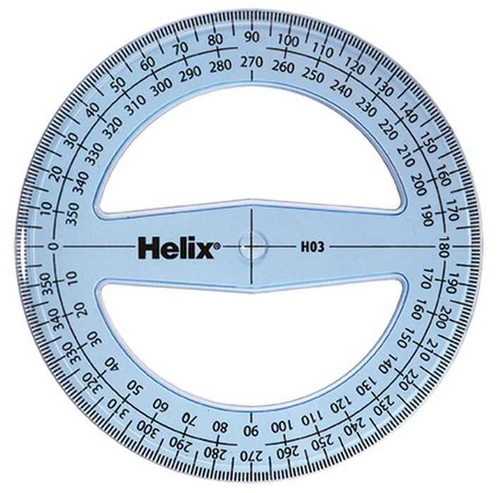
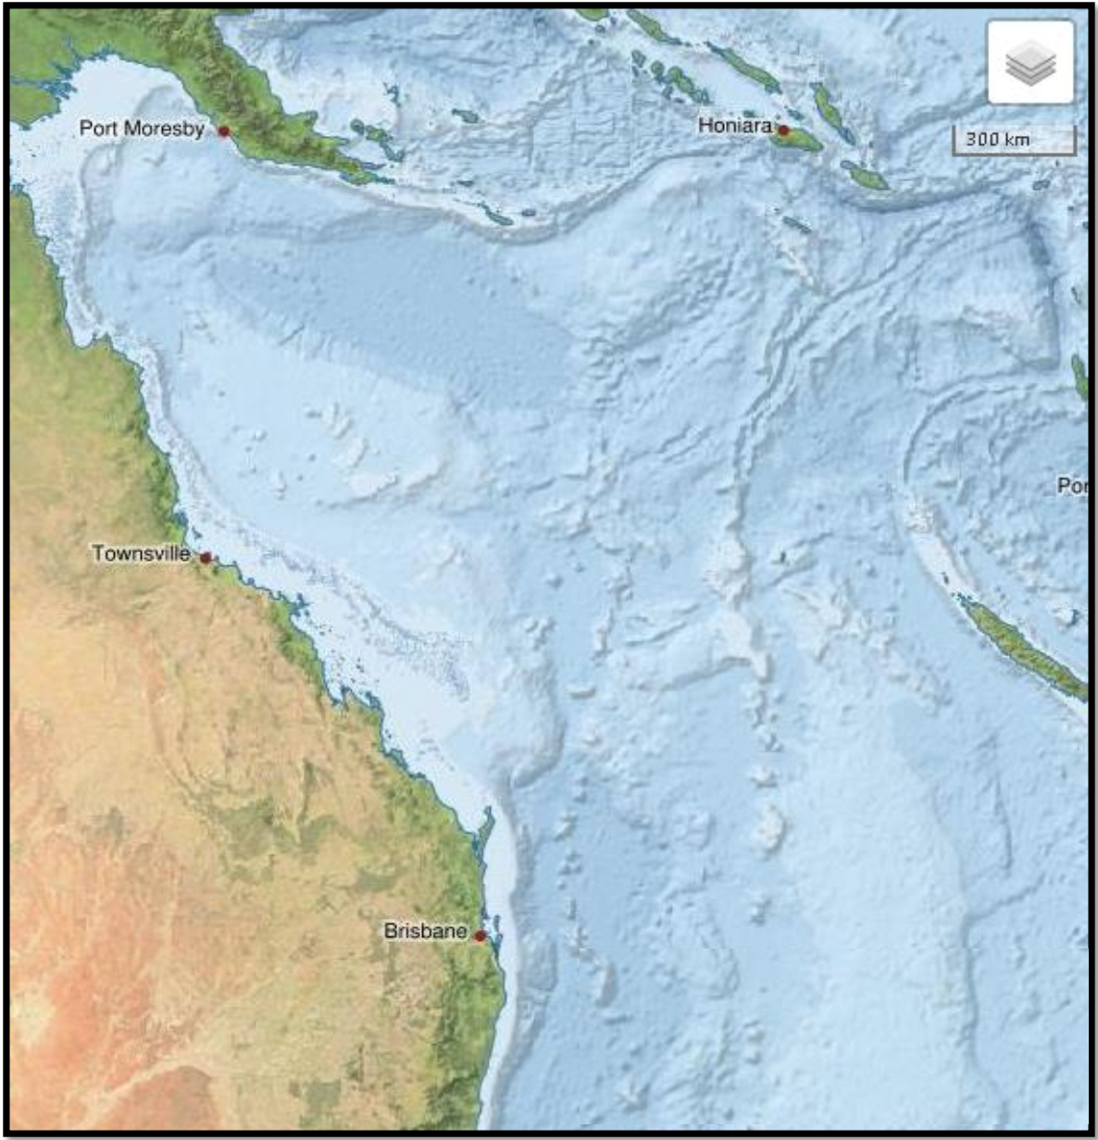
Example 1: What is the rough compass direction from Cairns to Brisbane? …………………… What is the bearing from Cairns to Brisbane? ……………………
South East
148°
Cairns
North
Brisbane

Slide 11
Measuring Bearings
Find the bearing of A from B.
Mark the North line on at B (if there isn’t a North line draw one in)
N
A
75°
Measure the angle clockwise from the North line to A
Give the answer as a three-figure bearing
B
075°

Slide 12
Measuring Bearings
Find the bearing of A from B.
Mark the North line on at B (if there isn’t a North line draw one in)
A
N
Measure the angle clockwise from the North line to A
294°
B
Give the answer as a three-figure bearing
294°

Slide 13
Example 2: The scale bar shows you the distance of 300km on your map. How many centimetres long is the 300km bar on your map? …………………… What distance does 1cm represent on your map? ……………………. How many centimetres is it on your map from Cairns to Brisbane? ………………. What is the distance from Cairns to Brisbane? ……………………
2cm
300 ÷ 2 = 150km
~9.3cm
9.3 x 150 = 1395km
Cairns
North
Brisbane
300km
2cm

Slide 14
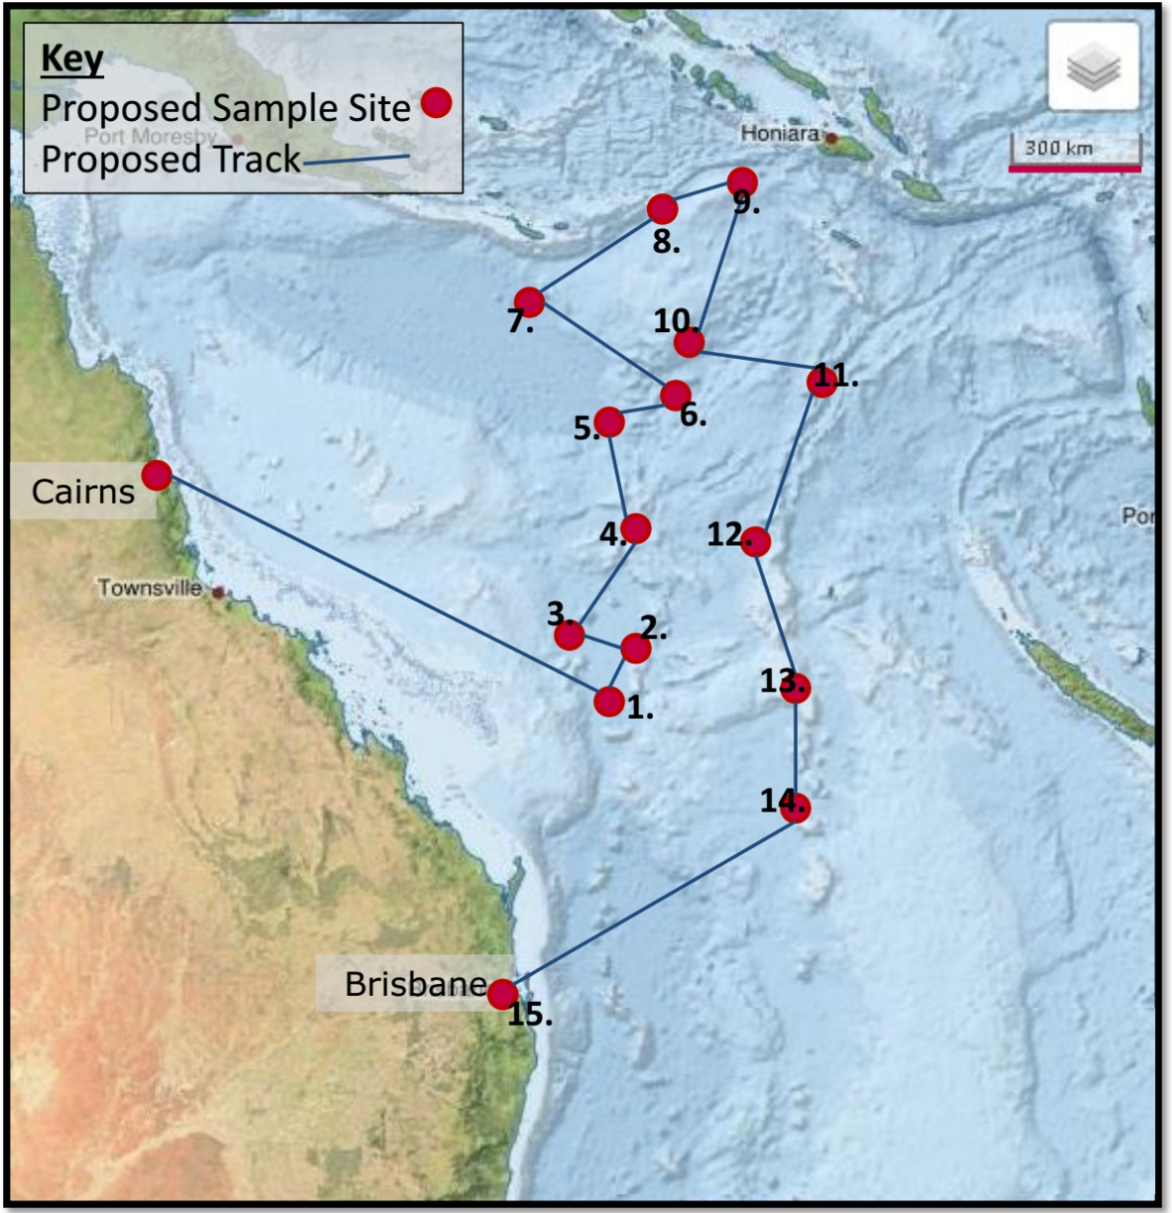
Your Task:
Work in pairs, with one of you finding the bearing and one of you finding the distance. Swap over after Site 7.
You are the navigator on the voyage. The scientists have told you a number of key sites where they want to collect data and have marked them on the map.
Calculate the bearings and distances that you will have travel on at each point in voyage so you can tell the captain where to sail. The voyage will set sail from Cairns and finish in Brisbane.
Make sure that you measure the angles and distances accurately; you don’t want to end up shipwrecked!

Slide 15
Your Task:
Work in pairs, with one of you finding the bearing and one of you finding the distance. Swap over after Site 7.
Calculate the bearings and distances that you will have travel on at each point in voyage so you can tell the captain where to sail. The voyage will set sail from Cairns and finish in Brisbane.
Step 1.
Measure the bearing.
Cairns to Site 1. = 118º
Make sure that you measure the angles and distances accurately; you don’t want to end up shipwrecked!

Slide 16
Your Task:
Work in pairs, with one of you finding the bearing and one of you finding the distance. Swap over after Site 7.
Calculate the bearings and distances that you will have travel on at each point in voyage so you can tell the captain where to sail. The voyage will set sail from Cairns and finish in Brisbane.
Step 2.
Measure and calculate the distance.
300km = 2cm on your maps
Cairns to Site 1. 7.5cm
7.5 x 150 = 1125km
300km = 2cm
___km = 1cm
Make sure that you measure the angles and distances accurately; you don’t want to end up lost at sea!

Slide 17
Your Task:
Work in pairs, with one of you finding the bearing and one of you finding the distance. Swap over after Site 7.
Calculate the bearings and distances that you will have travel on at each point in voyage so you can tell the captain where to sail. The voyage will set sail from Cairns and finish in Brisbane.
Cairns to Site 1:
Bearing: 118º
Distance: 1125km
300km = 2cm on your maps
Cairns to Site 1. 7.5cm
7.5 x 150 = 1125km
Make sure that you measure the angles and distances accurately; you don’t want to end up lost at sea!

Slide 18
Answers
Start | End | Bearing (º) | Distance cm km
Cairns | Site 1 | 120 | 7.5 | 1125
Site 1 | Site 2 | 30 | 1 | 150
Site 2 | Site 3 | 288 | 1 | 150
Site 3 | Site 4 | 39 | 2 | 300
Site 4 | Site 5 | 345 | 1.7 | 255
Site 5 | Site 6 | 78 | 1.1 | 165
Site 6 | Site 7 | 301 | 2.6 | 390
Site 7 | Site 8 | 56 | 2.5 | 375
Site 8 | Site 9 | 69 | 1.3 | 195
Site 9 | Site 10 | 193 | 3.5 | 525
Site 10 | Site 11 | 110 | 2 | 300
Site 11 | Site 12 | 204 | 2.6 | 390
Site 12 | Site 13 | 166 | 2.3 | 345
Site 13 | Site 14 | 180 | 1.8 | 270
Site 14 | Site 15 | 236 | 5.3 | 795
300km = 2cm on your maps
Make sure that you measure the angles and distances accurately; you don’t want to end up lost at sea!

Slide 19
Extension
Our eagle eyed wildlife spotters have seen some great wildlife whilst on board the ship.
Can you plot these sightings on your maps?
300km = 2cm on your maps
Hammerhead Shark:
Bearing 090, 450km from Cairns
Humpback Whale
Bearing 260, 150km from Site 7.
Tuna Bait Ball Bearing 135, 300km from Site 14.
Make sure that you measure the angles and distances accurately; you don’t want to end up lost at sea!

Slide 20
Extension
Can you calculate the total distance the ship will travel if it follows the proposed track?
If the ship travels at an average speed of 11knots – 20km/h for the duration of the voyage, how long will the voyage take?
300km = 2cm on your maps
Make sure that you measure the angles and distances accurately; you don’t want to end up lost at sea!

Slide 21
Review Quiz
What are the three key rules for bearings?
They must start from NORTH
They must be measured CLOCKWISE
They must have 3 DIGITS
Where did the voyage start?
Cairns
Where did the voyage finish?
Brisbane
Can you name one of the animals spotted en route?
Humpback Whale, Hammerhead Shark, Tuna Bait Ball

