Slide 1
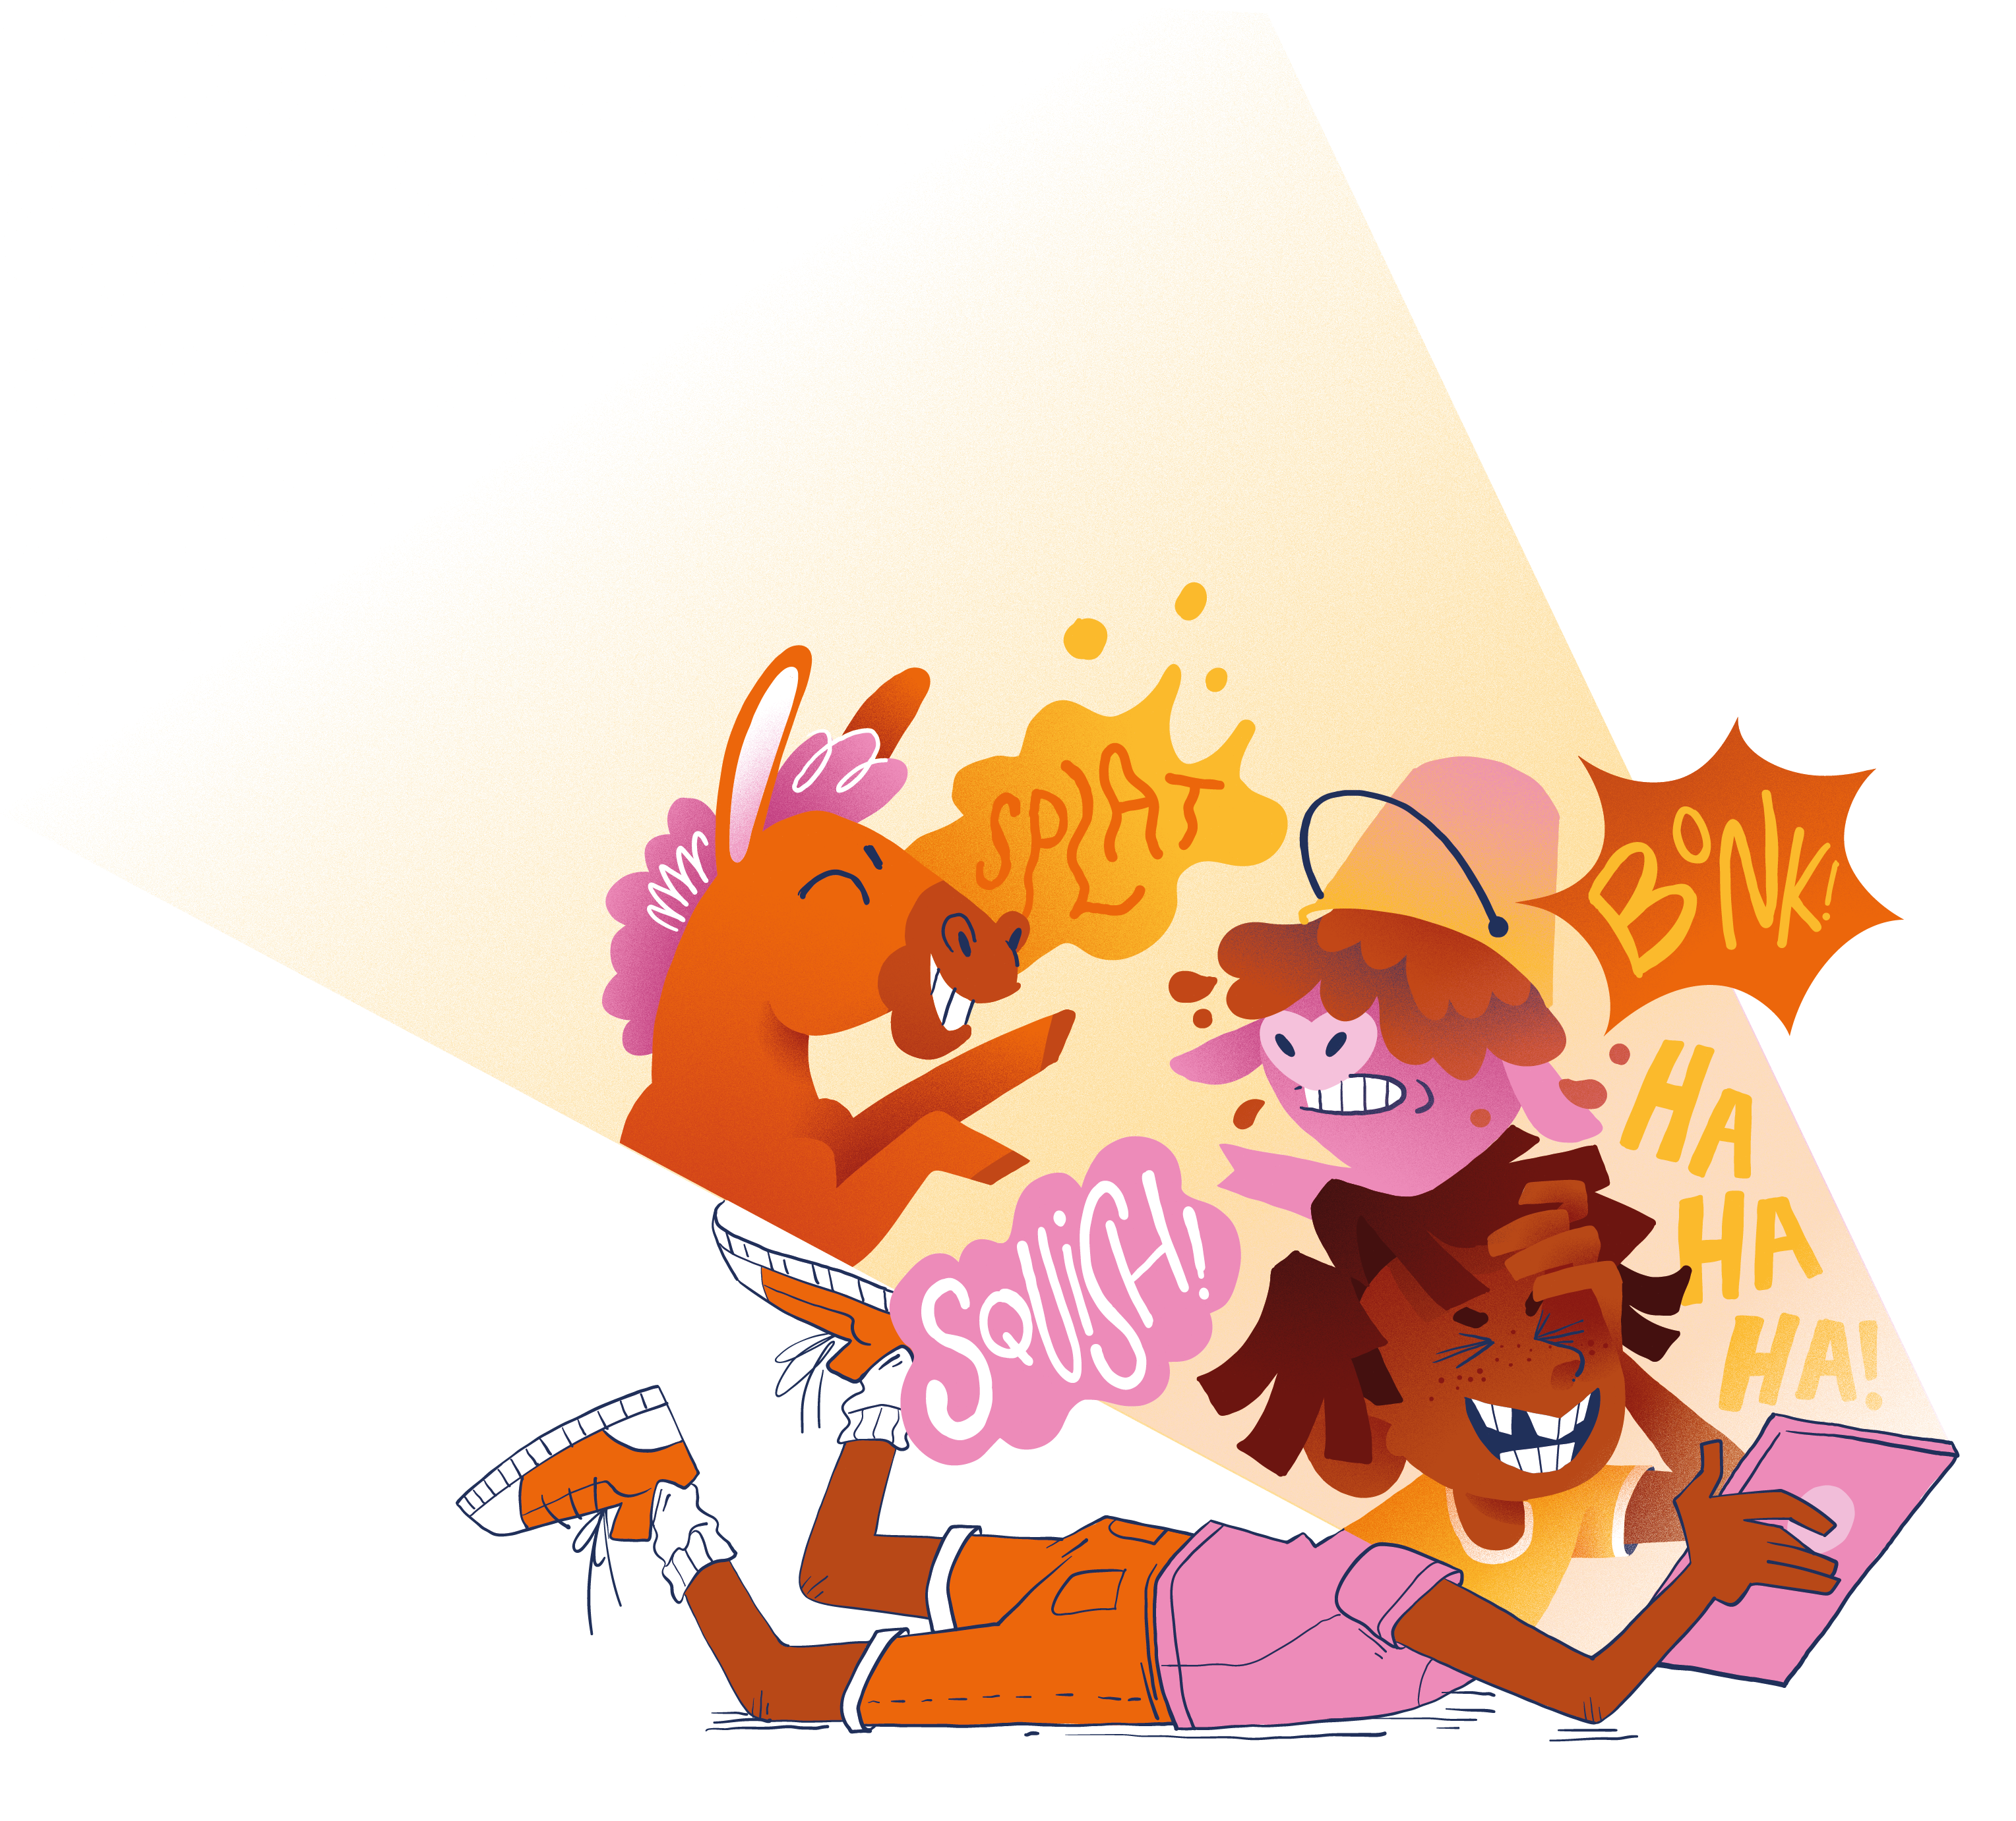
My Reading Success
Enjoyed a book | Discovered a new author that I like |  | Talked to someone about a book
Tried out a new genre | Read in my own time | Provided a short book review |  | Encouraged someone in my family to read more
Know what type of books I like | Enjoyed a graphic novel / picture book | Feel more confident choosing books |  | Learnt something new by reading a book

