Slide 1
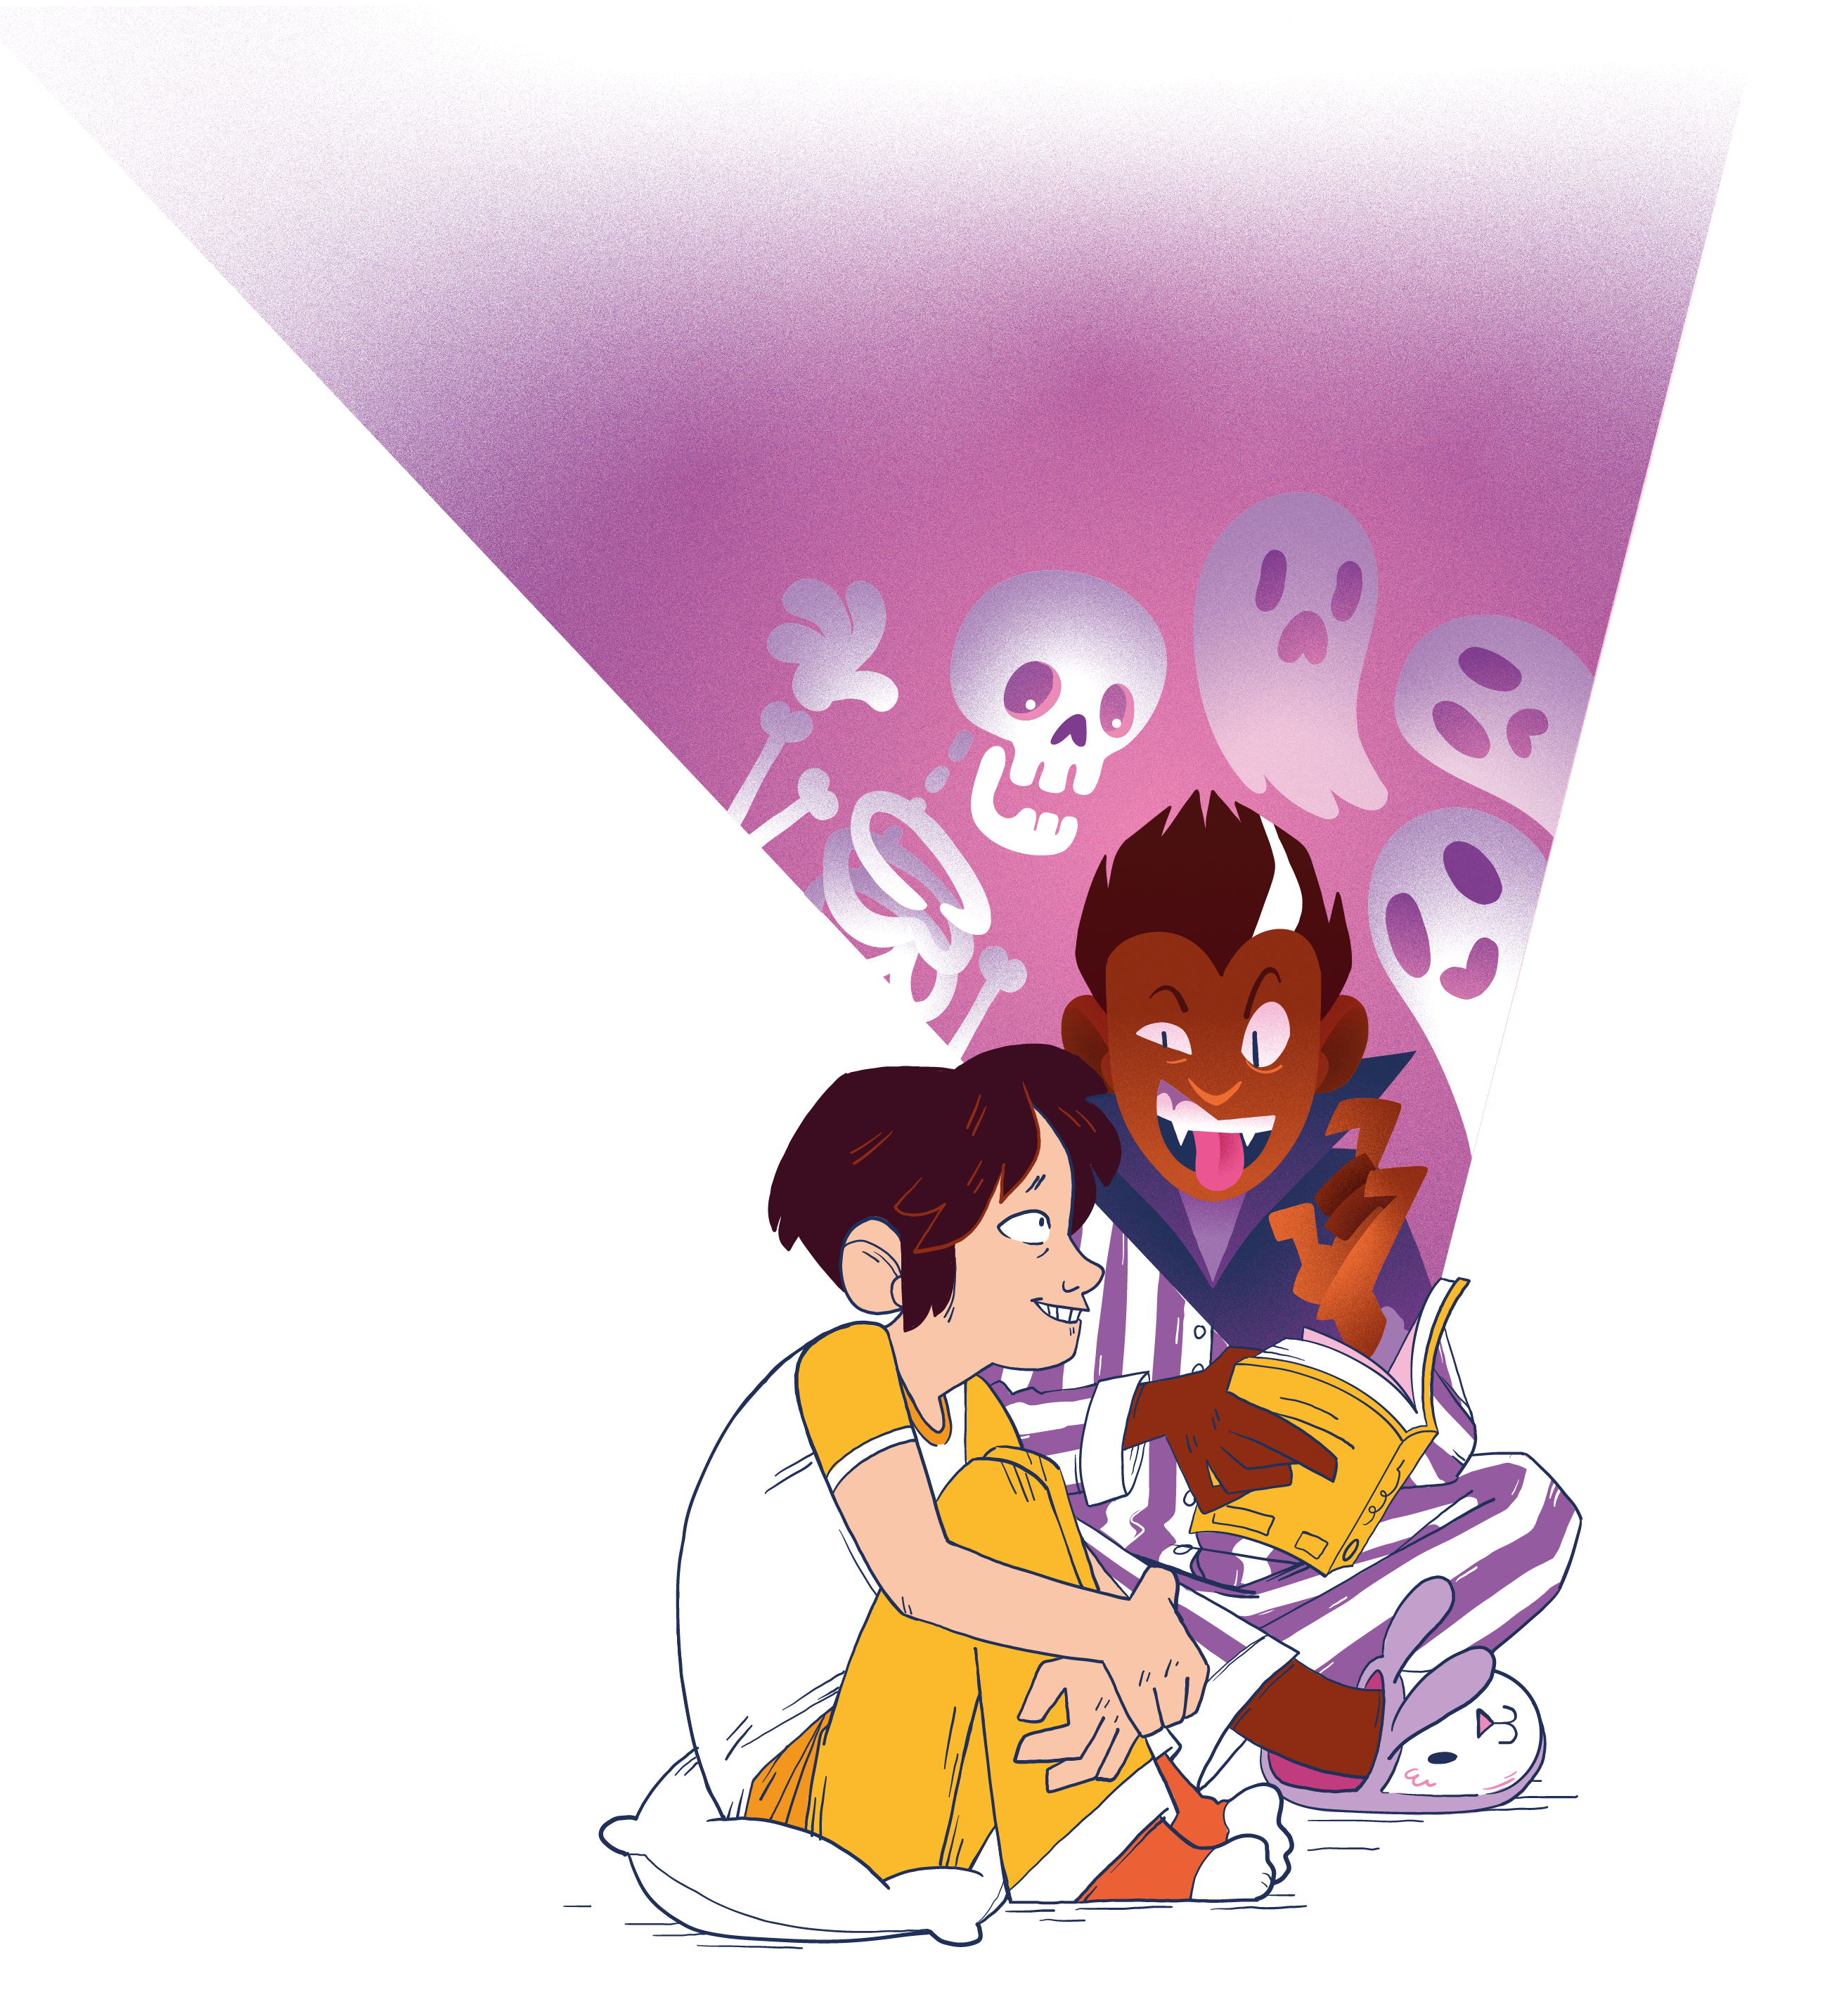
Sharing thoughts about books
Why not try one of these sentence starters to share your thoughts about books!
I would recommend this book because….
The best bit of this book was….
This book would have been better if….
If I were to describe this book in three words they would be…..
This book reminds me of….
I liked the way the author….
This book made me feel…
I found this book interesting because…
This book made me think about….

