Slide 1
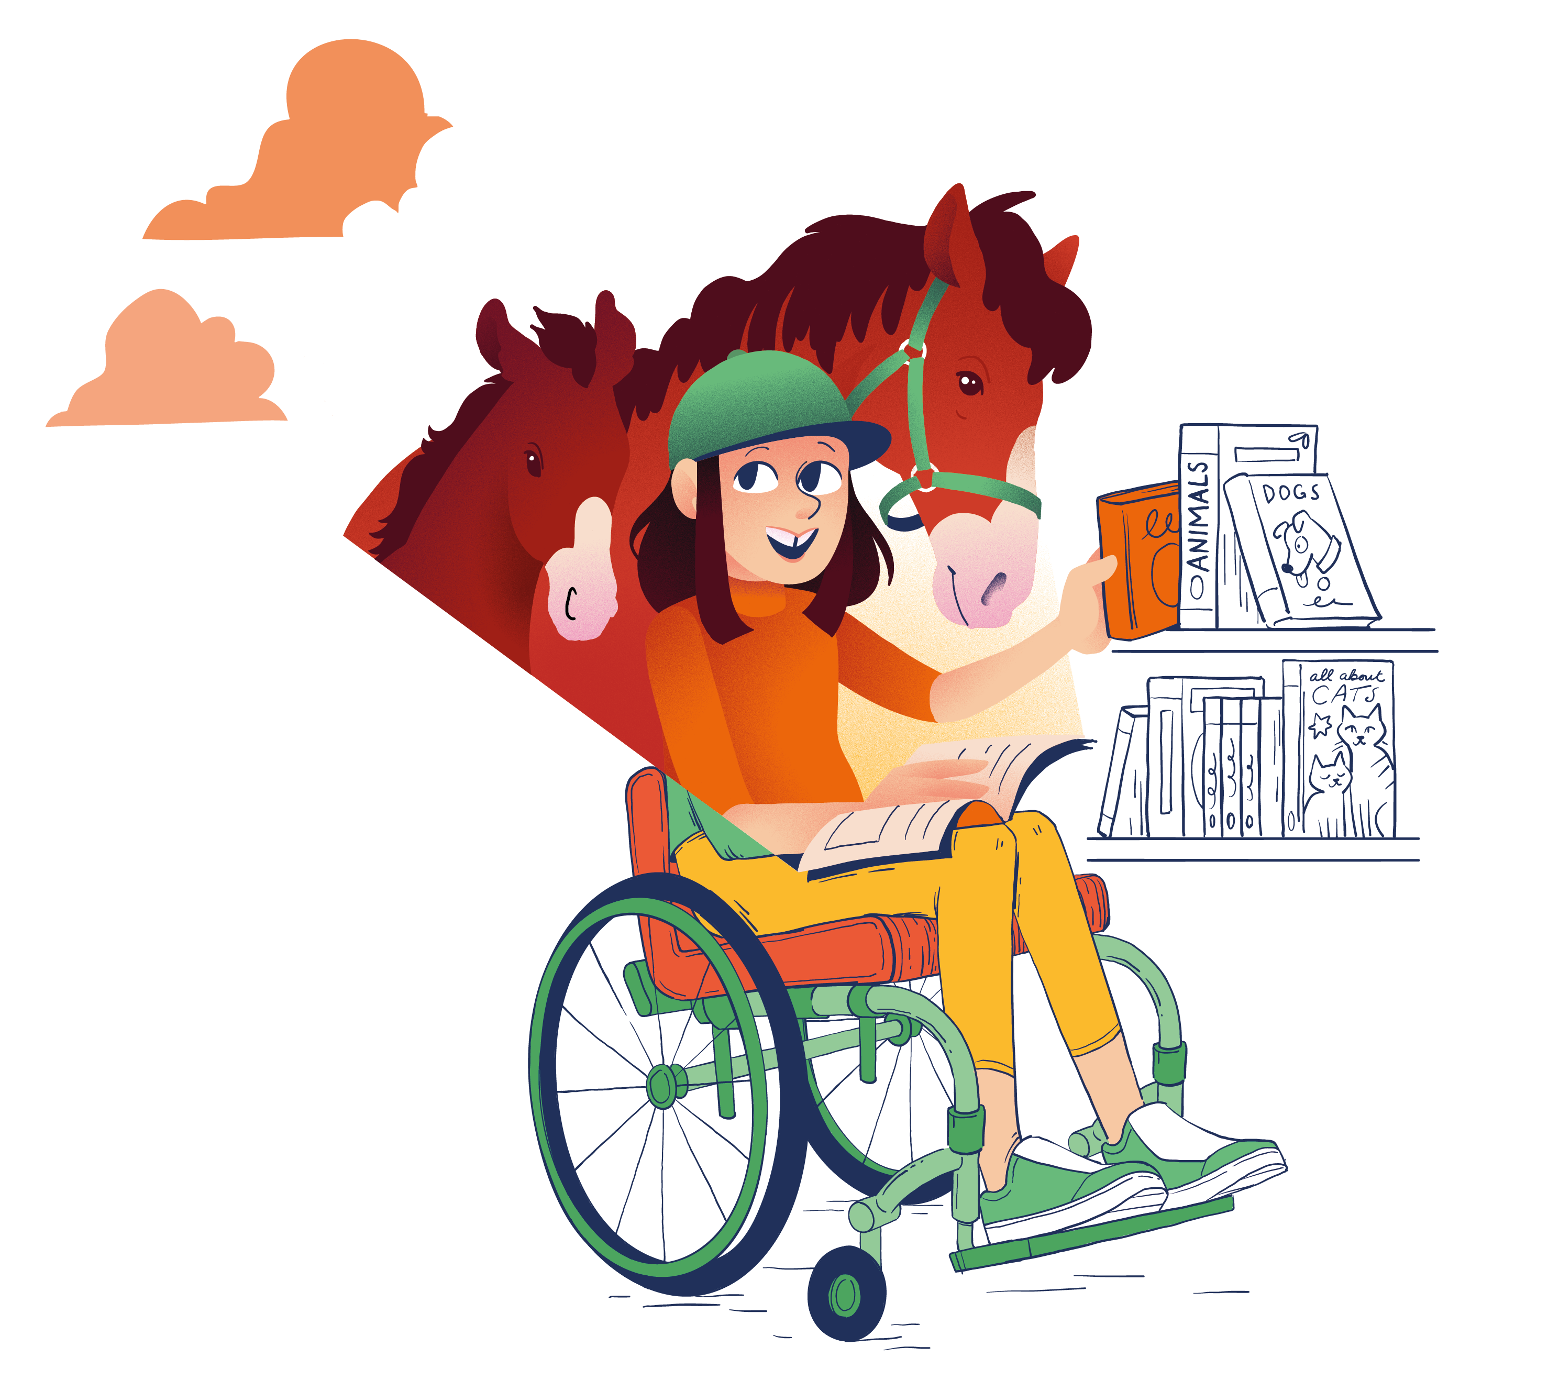
CHOOSING A BOOK
Everyone needs help to learn how to choose books they will enjoy!
Think What type of experience do you want to get from a book?
Choose
What ways could you use to choose a book?
Support – friends/classmates Which friend/classmate would be good to talk to about books?
Ask - adults Which adults would be good to talk to about books?

