Slide 1
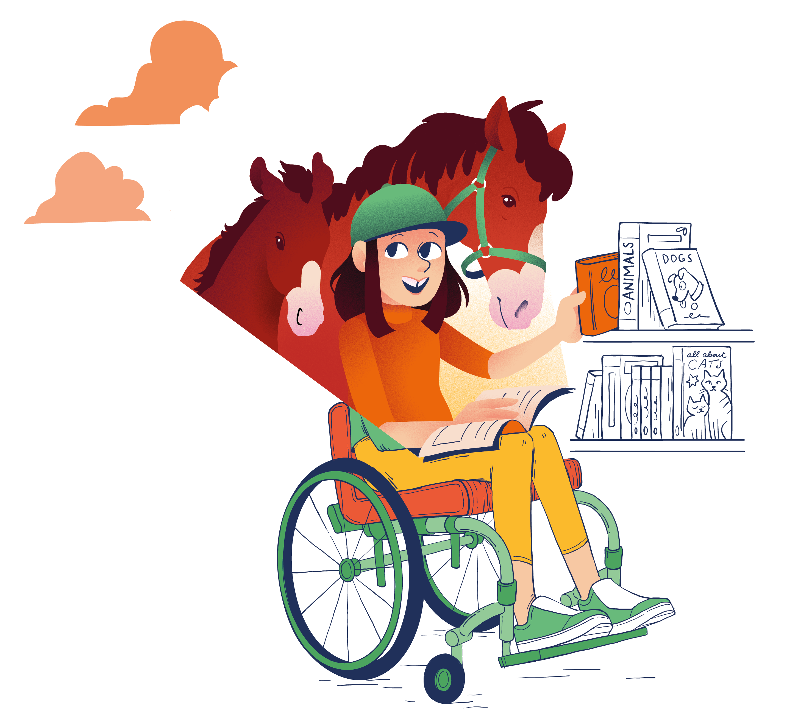
CHOOSING A BOOK
Everyone needs help to learn how to choose books they will enjoy! These are different ways you can try.
Think Before choosing a book, think about the type of reading experience you are seeking. Do you want something to make you laugh, to learn new things, to relax?
Choose There are lots of ways to choose a book. You can look at the front cover, the pictures, or read the blurb. You can choose based on genre, author, book series or get a recommendation. Whichever way you use, always read the first few pages to make sure you like it.
Support Suggest books to friends and listen to their suggestion too – especially if you like the same sorts of things as they do.
Ask Library staff can help you choose a book – let them know the types of things you like, and are interested in, and ask for help choosing.
Look Look at how books are displayed and organised in the library (e.g., by genre or topic) so you can choose more easily. Look out for written reviews from others too!
Swap Even with good ways of choosing, sometimes a book is just not right, and that is ok. If you’re not enjoying a book after trying it for a while, choose something else – there’s a better book out there for you!

