Slide 1
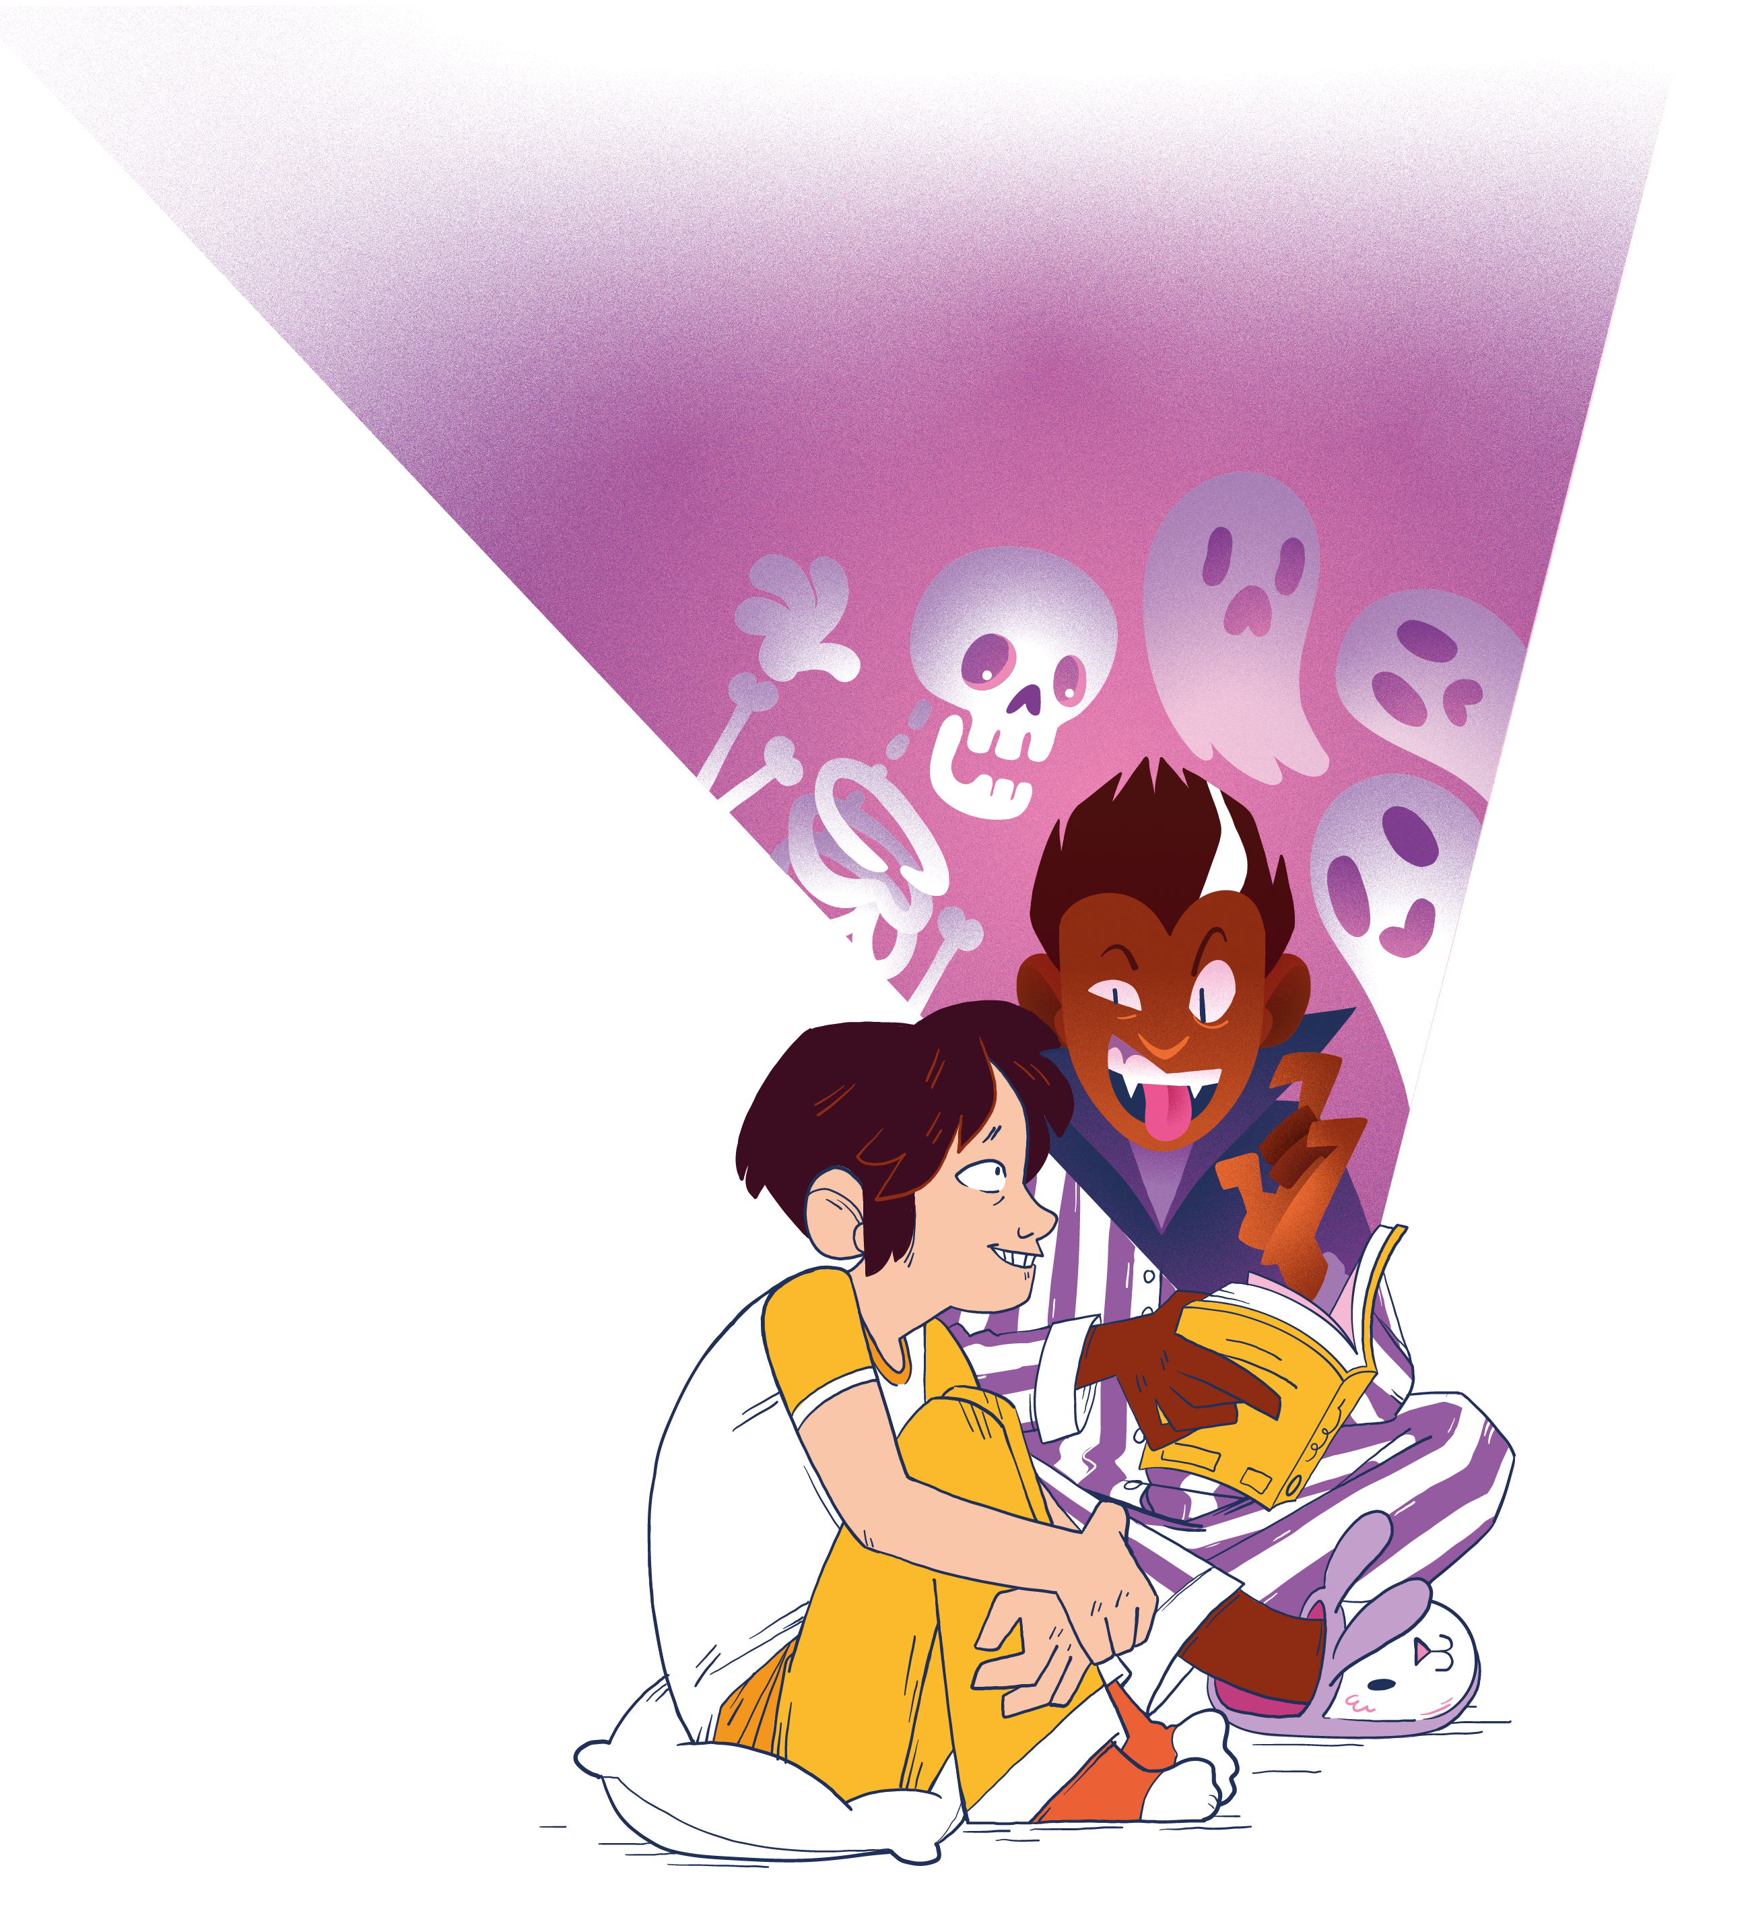
RECIPROCAL READING GOES SOCIAL
Connector Makes connections between the story/topic and existing knowledge, reading experiences, interests or life.
Character/subject Discusses the main character or subject in more detail.
Best bit Shares what they think are the best bits of the book.
Better if Suggests ideas to make the book more interesting/enjoyable/funny/exciting, etc.

Slide 2
FICTION
Connector
Was there anything about the story that reminded you of your own life?
Did this book remind you of any other books you’ve read?
Character
Did you like the main character or not? Why?
How do you think the character was feeling when ….?
Best Bit
What was the best part of the story? Why?
Better If
What would make this story better (e.g., funnier, more realistic, more exciting, more enjoyable).
NON-FICTION
Connector
Did this book remind you of things you already knew? If so, what?
Did this book remind you of any other books you’ve read?
Character
Do you find the subject interesting? Why?
What new things did you learn?
Best Bit
What was the best part of the book? Why?
Better If
What would make this book better (e.g., more interesting, more
enjoyable).

