Slide 1
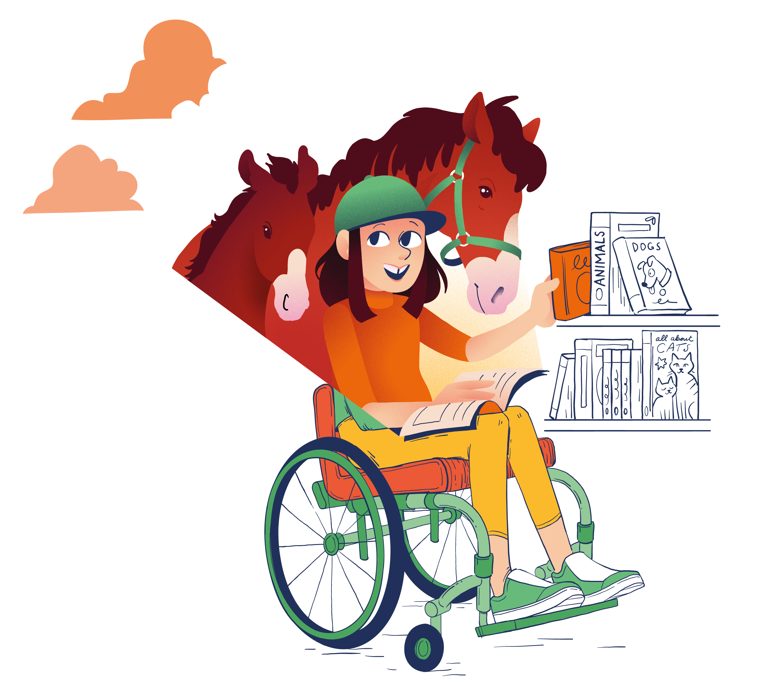

READING CHALLENGE
A short story
A
graphic novel
A book set in another country
A diary style book
An adventure
A friend told me to read this
A book featuring an
animal
A funny book
A non-fiction book
A poem

