Slide 1
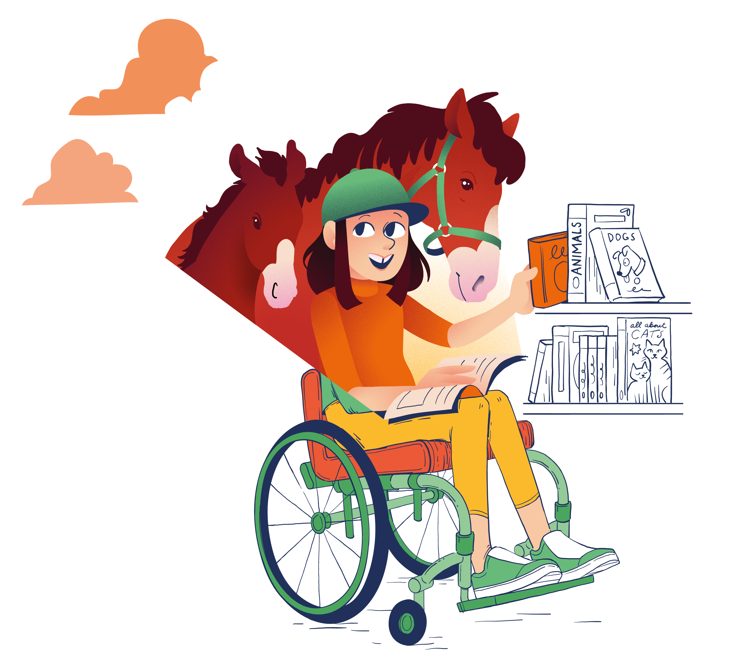
CHOOSING A BOOK
Everyone needs help to learn how to choose books they will enjoy! These are different strategies you can try.
1
Think
What type of book are you in the mood for? Something to make you laugh, take you on an adventure, excite you, or help you learn new things? Books offer us all types of wonderful experiences. Before choosing a book, think about what type of experience you are looking for!
2
Choose
There are lots of strategies to choose a book. For example, look at the front cover, the illustrations, read the blurb on the back, read the first few pages, pick a genre/author/series you enjoy, or choose a book based on a recommendation by someone or a review. You may want to use several different strategies at once! Don’t be tempted to always pick the same author, series or genre – trying something new might seem like a risk, but it is the only way to discover new things you might enjoy!
3
Support
Getting recommendations from your teacher and classmates can also help, and you can recommend books to them! If you have read a book that you think someone else will enjoy, tell them about it, write a short review/recommendation to display in your class, or suggest other similar books you think others will enjoy.

Slide 2
4
Listen
Your teacher probably has more experience than anyone in your class on how to choose a book! Listen to the strategies they use to choose books – they might have some good ideas, or may even make some book recommendations for you! Your teacher may also help you choose a book by offering a few different books for you to choose from, as sometimes too much choice can be hard!
5
Look
Look at how books are displayed in your class, reading spaces and/or school library. Learn how books have been organised so you can choose more easily based on genre (e.g., funny, exciting) or topic (e.g., sports, animals). Help your teacher to organise these displays to support reading choices, look out for written reviews from others, and consider displaying your own reviews too!
6
Swap
Even with good strategies, sometimes a book is just not right, and that’s ok. Becoming an independent and more confident reader is about knowing when a book is not right for you. So give it a go, don’t give up too soon, but if you are just not enjoying it, choose something else – there’s a better book out there for you!

