Slide 1
Better together: Research-practice partnerships in education
Dr Sarah McGeown
Moray House School of Education and Sport
University of Edinburgh
Scottish Universities Insight Institute Programme:
An Ethical Framework for Scottish Educational Research Partnership
March 2024

Slide 2
Research-practice partnerships in education
Collaborative research which seeks to improve children and young people’s educational experiences and outcomes, by drawing upon the collective knowledge, expertise and experience available from both research and practice (McGeown et al., 2023).
Growing interest in the use of research-practice partnerships (RPPs) in education (Sjolund et al., 2022) and examples from different international contexts.
See recent Open Dialogue for recent discussion: https://explore.bps.org.uk/content/bpsper/47/1
Research informing practice
Connecting research and practice

Slide 3
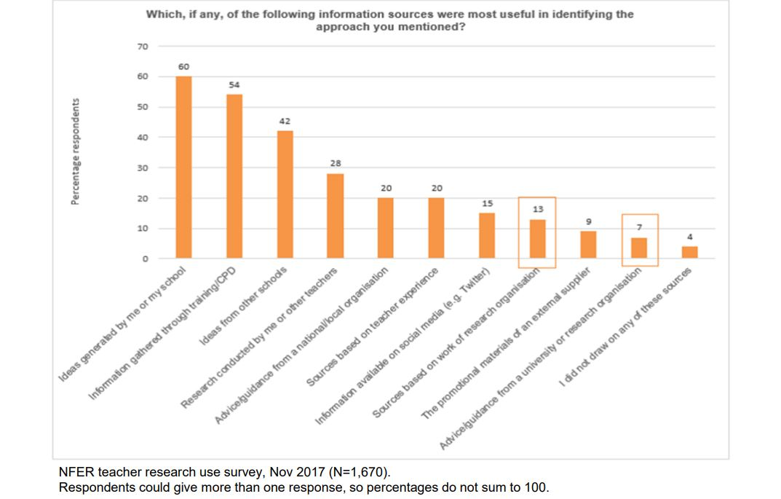
Why?
Disconnect between University based research and educational practice/policy (Nelson 2019).
In Scotland, the research evidence/data practitioners engage with most is school-level data (Lowden et al., 2019).
Nelson (2019). Measuring Teachers’ Research Engagement. Available from: https://educationendowmentfoundation.org.uk/projects-and-evaluation/evaluation/eef-evaluation-reports-and-research-papers/methodological-research-and-innovations/measuring-teachers-research-engagement
Lowden et al., (2019). https://www.gov.scot/publications/knowledge-utilisation-mapping-study-scottish-education-system/

Slide 4
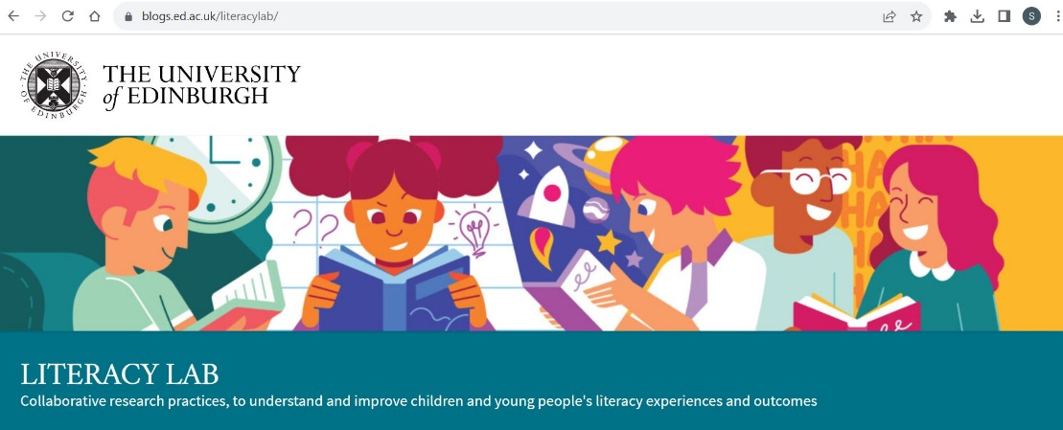
Research-practice partnerships
University of Edinburgh Literacy Lab
Website: https://blogs.ed.ac.uk/literacylab/
Current projects:
Love to Read: Primary Young People’s Reading Project
Reading and Wellbeing Love to Read: Reception
Reading and Narrative Fiction Disability Representation in Picture Books
Augmented Reality Books The Writing Lives of Children and Young People
Reading Engagement ReWriter Poetry App
Previous projects:
Growing Up A Reader Reading to Dogs
Improving Children’s Reading Sharing Stories
Move and Read

Slide 5
RPPs are diverse
Share common interest, but different types of knowledge, experience and expertise
National or community organisations
Professionals/educators: Teachers, school leaders, teaching assistants, early years practitioners
Professionals/specialists: Educational Psychologists, Speech and Language Therapists
Other sectors (e.g., libraries, etc)

Slide 6
Benefits
Educational research informed by the cumulative depth and breadth of knowledge, experience and expertise available (McGeown et al., 2023)
Research more likely to align with practice/policy priorities (Snow, 2015)
Programme implementation considered from the outset / increases likelihood of use (Cai & Hwang, 2021)
Improves teachers’ attitudes towards University based research (Ross & Bruce, 2012)
Democratises research (Sjolund et al., 2022)
Supports researchers and teachers’ professional development (McGeown et al., 2023)
McGeown, S. (2023). Research-practice partnerships in education: Why we need a methodological shift in how we do research. Opening Article. Psychology of Education Review: https://explore.bps.org.uk/content/bpsper/47/1

Slide 7
Methodological considerations
Different priorities in education research and practice (Donovan et al., 2003)
Time consuming (Snow, 2015)
Hierarchical structures/power imbalance (Skipper & Pepler, 2021)
Work in atypical ways (Coburn & Penuel, 2016)
Different perspectives on what counts as research, or on programme/intervention content or evaluation (London et al., 2018)
Communication difficulties (Steel et al., 2021)
McGeown, S. (2023). Research-practice partnerships in education: Why we need a methodological shift in how we do research. Opening Article. Psychology of Education Review: https://explore.bps.org.uk/content/bpsper/47/1

Slide 8
RPPs: Future directions
Funding
Infrastructure
Training
Time
McGeown, S. (2023). Research-practice partnerships in education: Future Directions. Closing Article. Psychology of Education Review: https://explore.bps.org.uk/content/bpsper/47/1

Slide 9
Participatory research
Participatory research approaches aim to break down the traditional barriers which exist between the researcher and the researched, creating inclusive, non-hierarchical relationships which support collaborative research practices.
UNCRC incorporated into Scots law in January 2024.
Principles of participatory research, benefits and methodological considerations
Scottish Government. Policy: Children’s Rights. Available from: https://www.gov.scot/policies/human-rights/childrens-rights/
Webber, C., Santi, E., Calabrese, J., & McGeown, S. (2024). Using participatory approaches with children and young people to research volitional reading. Language and Education, https://doi.org/10.1080/09500782.2024.2317962

Slide 10
Policy
Scottish Government School Research Plan 2023-2026. https://www.gov.scot/publications/scottish-governments-plan-school-research-2023-2026/
Skerritt (2023). Towards a mechanism for expert policy advice in education. British Educational Research Journal. https://doi.org/10.1002/berj.3867
BERA blog: https://www.bera.ac.uk/blog/is-there-value-in-this-proposed-mechanism-for-expert-policy-advice-in-education
Policy
Research
Practice

Slide 11
Thank you for listening
McGeown, S. (2023). Research-practice partnerships: Why we need a methodological shift in how we do research. Psychology of Education Review: Open Dialogue (Opening Article). Access here: Open_Dialogue_McGeown
McGeown, S. (2023). Research-practice partnerships in education: Future directions. Psychology of Education Review: Open Dialogue (Closing Article). Access here: Close_Open_Dialogue_McGeown
McGeown, S., Oxley, E., Love to Read Practice Partners, Ricketts, J., & Shapiro, L. (2023). Working at the intersection of research and practice: The Love to Read project. International Journal of Educational Research, 117, https://doi.org/10.1016/j.ijer.2022.102134
Webber, C., Santi, E., Calabrese, J., & McGeown, S. (2024). Using participatory approaches with children and young people to research volitional reading. Language and Education https://doi.org/10.1080/09500782.2024.2317962
BERA Blogpost:
https://www.bera.ac.uk/blog/better-together-research-practice-partnerships-in-education
Dr Sarah McGeown
s.mcgeown@ed.ac.uk
X: @DrSarahMcG / @UoELiteracyLab
University of Edinburgh Literacy lab:
https://blogs.ed.ac.uk/literacylab/
https://lalco.org.uk/

Slide 12
Reflection and discussion
What are the ethical considerations associated with RPPs and participatory approaches?
How can research-practice partnerships and participatory research approaches contribute towards a Framework for Ethical Research, to support and serve all those in Scottish education.
What challenges and successes are people currently experiencing in relation to school-based research?

