Slide 1
Better together: Research-practice partnerships
Dr Sarah McGeown
University of Edinburgh
14th September 2022
British Psychological Society Education Section

Slide 2
Why?
Growing interest in the use of research-practice partnerships (RPPs) in education (Sjolund et al., 2022).
Disconnect between University based research and practice/policy (NFER, 2017).
RPPs are collaborative non-hierarchical approaches to research which seek to improve children and young people’s educational experiences and outcomes, by drawing upon the collective knowledge, expertise and experience available from both research and practice.
Sjölund, S., Lindvall, J., Larsson M., & Ryve, A (2022a). Using research to inform practice through research-practice partnerships: A systematic literature review. Review of Education, 10,1, https://doi.org/10.1002/rev3.3337
NFER (2017). Measuring Teachers’ Research Engagement. Available from: https://educationendowmentfoundation.org.uk/public/files/Evaluation/Research_Use/NFER_Research_Use_pilot_report_-_March_2017_for_publication.pdf
Notes:
Nfer – 2017 Teacher’s use of research
Disconnect between University based research and practice (NFER 2017).
- Teacher practices based on own/school ideas (67%)
- Teacher practices based on academic research (16%)

Slide 3
Benefits
Educational improvement informed by cumulative depth and breadth of knowledge, experience and expertise available (McGeown et al., preprint)
Research more likely to align with practice/policy priorities (Snow, 2015)
Implementation considered from the outset (Cai & Hwang, 2021)
Improves teachers’ attitudes to research (Ross & Bruce, 2012)
Democratises the research system (Sjoland et al., 2022)
Supports professional development (Steel et al., 2021)

Slide 4
Challenges
Different priorities in research and practice (Donovan et al., 2003)
More time consuming (Snow, 2015)
Attracting funding when project is not well specified (Snow, 2015)
Imbalances in power/hierarchies (Skipper & Pepler, 2021)
Work in atypical ways (Coburn & Penuel, 2016; Skipper & Pepler, 2021)
Work in very different contexts (Steel et al., 2021)
Different views on what counts as research (London et al., 2018)
Communication difficulties (Steel et al., 2021)
Challenging with open research practices (Garrett et al., 2020)

Slide 5
Research-practice partnerships
University of Edinburgh Literacy Lab
Website: https://blogs.ed.ac.uk/literacylab/ @UoELiteracyLab
Current research projects:
Love to Read Young People’s Reading Project
Reading and Wellbeing Reading to Dogs
Move and Read Reading: Seeing ourselves and others
Augmented Reality Books Neurodiversity and Narrative Fiction
Previous projects:
Growing Up A Reader Sharing Stories
Improving Children’s Reading

Slide 6
Love to Read

Slide 7
Love to Read
Aim: To create a programme to inspire and sustain a love of reading among children (aged 8-11)
Initial funding application: Three researchers, three stakeholders and two experienced teachers.
Once funded: Interviews with children (n= 59) and co-design with teachers (n = 6) to develop the programme.
Co-design process
Research-practice partnership

Slide 8
Love to Read
Phase 1:
Research input
Literature review:
- Relevant theory/research
- Links with curricula
Phase 2:
Child input
Individual and group interviews (n = 59, 4 UK schools) to seek children’s perspectives and experiences.
Phase 3:
Teacher input
Recruitment of 6 teachers
Co-design online
Practice partner input
PROGRAMME DEVELOPED
Phase 4:
Evaluation
- Feasibility study, 6 UK schools, approx. 250 pupils
- Mixed methods
- Implementation (and effectiveness)
Preregistration: https://osf.io/5ztjk
Preregistration: https://osf.io/xsjhc
Preregistration: https://osf.io/qvuka

Slide 9
Phase 1: Research input
Comprehensive (but not systematic) review of the literature
Both quantitative and qualitative research
Psychological, sociocultural and educational research
Relevant curricula
Existing sources of support for teachers
Identification of six research-informed principles: Access, choice, time, connection, social and success

Slide 10
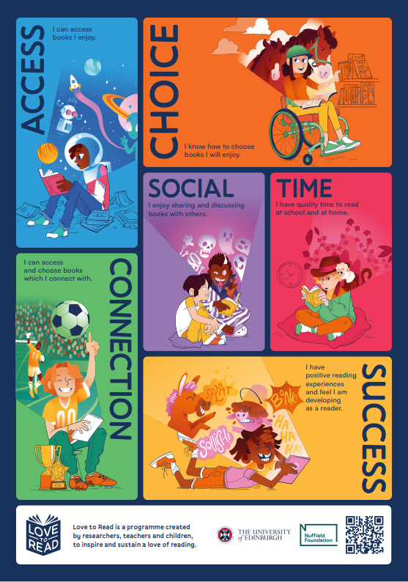
Phase 1: Research-informed principles
Access: Children have regular and easy access to books at school that align with their reading habits and interests.
Choice: Children have choice over their independent reading activities; schools have the structure, and children have the skills, to ensure ‘good’ (i.e., skill and interest aligned) reading choices
Time: Children have regular quality time to read books they engage with in school and at home
Connection: Children can access and choose books, and book reading activities, which are personally relevant, and relevant to their reading goals
Social: Children have the time, opportunities, and the skills, to share and discuss books with others.
Success: Children have a broad range of positive and successful reading experiences, can set meaningful goals, and recognise their growing success as readers

Slide 11
Phase 2: Children’s input
From children’s perspectives, what school practices would increase their reading motivation and engagement?
What are children’s perspectives and experiences of the six research-informed principles?
Online and in person interviews with 59 children from 4 UK schools (2 England, 2 Scotland)

Slide 12
Prior to Phase 3: Synthesis
Overview to inform the co-design process and programme development
Research overview
Details of the six principles (definitions, research)
Project/programme aims
Programme parameters (e.g., age range, duration, approach)
Links to relevant curricula
Co-design process: Structure, roles, etc
Reviewed by a practice partner within the Love to Read team
Simultaneously - selection and recruitment of 6 teachers
Notes:
35 pages

Slide 13
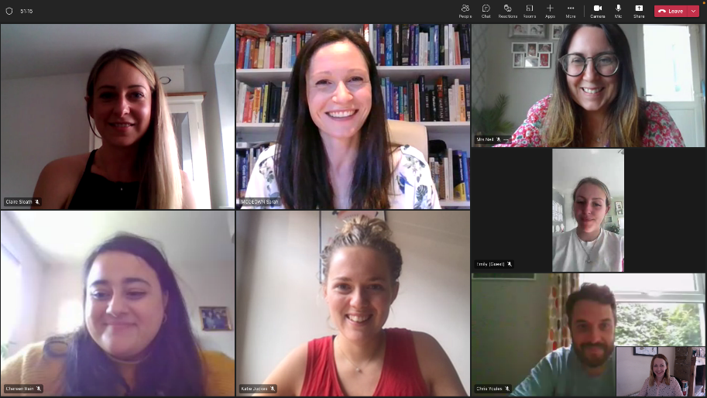
Phase 3: Teacher input
Six online meetings:
Introductions and research overview (1)
Co-design (2-4)
Review of programme/resources (5)
Final review of programme/resources (6)
Pre-meeting preparation: Independent written contributions/comments on programme
Online and offline communication
Evaluation of the co-design process

Slide 14
Phase 4: Evaluation
Practice partner and teachers input into the evaluation
Mixed methods
Programme implementation (acceptability and feasibility) and effectiveness (exploratory)
Use the evaluation to revise the programme, identify additional resources, training needs, etc

Slide 15
Teachers’ perceptions of the process
OVERVIEW RECEIVED
CO-DESIGN PROCESS
COMMUNICATION
“The facilitators were very open to suggestions and took ideas into account, while also offering their research knowledge”
“The reading time ensured that we all had notes and ideas ready to bring to each meeting. This enabled us to have meaningful discussions with no time wasted. This meant all sessions were productive”
“Having the guidance beforehand was great and gave me a good idea of what the material would be structured around”
“

Slide 16
Teachers’ perceptions of the process
TEAM COMPOSITION
PROFESSIONAL LEARNING
EMPOWERING
“I found the expertise of each member of the team was excellent and broad. They had clearly been chosen from a range of schools and knowledge and this enabled us to learn a lot, have productive conversations and make valuable contributions to the project”
“Inspired me to engage with further research and continue to nurture my passion in this area.”
“Empowers teachers to support other teachers and widest community”

Slide 17
Teachers’ perceptions of the process
RECOGNITION OF THEIR EXPERTISE
PERCEPTIONS OF CONTRIBUTION
PROGRAMME DESIGN
“Hearing different perspectives and involving the teachers (I hope anyway) gave you a on the ground experience of what it will be like to implement in the classroom”
“…wide range of resources to aid the implementation. There are clear guidelines and the resources are clear and child-friendly. So much thought and effort has gone into additional resources…”
“It has taken on board everyone's ideas and feedback”

Slide 18
Final points….
TEACHERS’ CONTINUED INPUT
CHILDREN’S PERSPECTIVES
“Using the co-design teachers to promote, raise profile and support implementation may be something to consider”
“Erm, I think they should do what we’re doing now, they should maybe ask kid’s opinion”

Slide 19
Reflections
Entire process ran smoothly, with positive responses from all involved.
HOWEVER:
Teachers role/responsibilities decided by the research team, with limited opportunity for teacher input.
Teachers were all motivated/interested in the topic.
Research area is one of consensus.
Very specific process (short-term, online, etc)
Need sufficient time.
Need scope to create additional teacher suggested resources
Will the programme be more acceptable/effective?

Slide 20
Implications
Systems change:
Funding to support development of partnerships/infrastructure to sustain partnerships is essential.
Funding agencies need to be more flexible.
Development of researcher and practitioner skills to collaborate effectively (Donovan et al., 2013).
University systems to support (ethics, legal services, etc)
Incentives for researchers and teachers to work this way.

Slide 21
Thank you for listening
Dr Sarah McGeown
s.mcgeown@ed.ac.uk
Twitter: @DrSarahMcG and
@UoELiteracyLab
Literacy lab: https://blogs.ed.ac.uk/literacylab/
Love to Read: https://blogs.ed.ac.uk/lovetoread/
Steel, J, Williams, J., & McGeown, S. (2022) Teacher-researcher collaboration in animal-assisted education: Co-designing a reading to dogs intervention. Educational Research. 10.1080/00131881.2021.2016061
McGeown, S., Oxley, E., Ricketts, J., & Shapiro, L. (preprint). Working at the intersection of research and practice: The Love to Read project. https://osf.io/mj5fd

