Slide 1
Resilience and Avoiding Self-Sabotage
Future Leaders Fellows Development Network
Dr Sara Shinton
Welcome! We will get started at 11:00

Slide 2
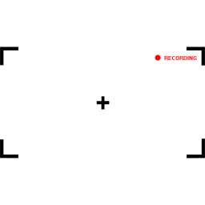
This session is being recorded
Please message me if you would prefer any of your comments/ discussion to be edited out of the session
This Photo by Unknown Author is licensed under CC BY-NC-ND

Slide 3
About the Bridging Courses
This event is one of a series of Bridging Courses taking place until Spring 2021. They are aimed at new FLFs who do not have access to leadership training in their host institution.
Whilst they do not replace a formal leadership programme, they provide an opportunity to engage in a variety of relevant topics and take time to reflect on your leadership of self and others.
Fellow to Fellow interaction is tricky in these sessions, but a "coffee room" link will enable us to meet in small groups during the break.
Notes:
https://eu.bbcollab.com/guest/742e25b4015740688d542a3ed2fc3ee0

Slide 4
Resilience and Avoiding Self-Sabotage
Future Leaders Fellows Development Network
Dr Sara Shinton, Network Director
Notes:
https://blogs.ed.ac.uk/iad4researchers/2020/05/01/a-fresh-look-at-resilience/

Slide 5
Protected
Space

Slide 6
Mental health advice
Clinical expertise
Set of rules
Accepting nonsense
Wellbeing advice
Researcher development expertise
Suggestions from physicists
Standing up to nonsense
Image: https://www.freepik.com
Notes:
Room booked from 3-5.30
Talk for half an hour then questions for a panel
SS - I may take the opportunity to talk for a little longer so we can introduce some interactivity to the event Questions come through electronically
happy with this, but to ensure that we engage with the audience as well, I’m happy to alternate with questions asked “live” as well
Event is around resilience and wellbeing
As I think you know, my preference is not to talk about mental health. I’ll explain why at the start - I’m not clinically trained and there are experts in the Uni who will do a better job (hopefully there will be someone from the Counselling Service) but we can all take steps to protect and build our own wellbeing, as well as all being able to create an environment in which we all promote wellbeing and look out for others.
New STEM Equals project (BAM Nuttall sponsored)
Wellbeing service
Academic
PhD or postdoc
this would be a great panel - the STEM Equals project is a partner project to my own diversity project - so good to have a chance to share a platform with them again
Scope is up to me – resilience toolkit
I’m going to base the session on the good practice in the toolkit which I sent you earlier. I ran an event in the School of Physics and Astronomy at UoE two years ago - all the slides and resources are online if you want to see the “base” material which I’ll be tailoring. It would be helpful to have any logo (aware that you don’t have a marketing person - hee hee) or branding to put on the slides for our session. I’ll go through the ten tips for building resilience from that workshop and then have a couple of discussions - I’d like one to be the primer for the Heads of Schools session so I plan to ask what the people in the room could realistically ask of the school or Uni. I will discourage any magic dreams which couldn’t possibly be resourced.
Below are some notes from the conversation with Zoe which may possibly come up in questions at the end. If not, they will naturally crop up in the presentation when I talk about imposter syndrome, rest, etc which are all in the ten strategies. Unconscious confidence of those who belong
About giving those in minorities more confidence when they don’t feel they belong
Good mental health in research and value of taking time out
Concept of presenteeism and long hours culture
Can do good science in 40 hours a week –
Being an advocate for yourself colleagues and students
Make use of flexible working and other resources – quiet spaces
Work smarter, not longer
Additional demands of doing all this with mental health issues – acknowledging additional burden of doing research with mental health issues
Want it to be uncomfortable for the university ;-)
Not too much - I’d like them to feel “discomforted” by seeing what they could do easily (then being inspired to do it) not witch-hunted into running away
Bring the wellbeing plan along
Workshop at the end if time – roles of researchers, roles of supervisors and managers, role of the institution
We talked about this - also mentioned above.
https://www.freepik.com

Slide 7
Why me? IOP guide author 20 years supporting researchers
People vector created by freepik - www.freepik.com
Full of bad habits
Notes:
<a href="https://www.freepik.com/free-photos-vectors/people">People vector created by freepik - www.freepik.com</a>

Slide 8
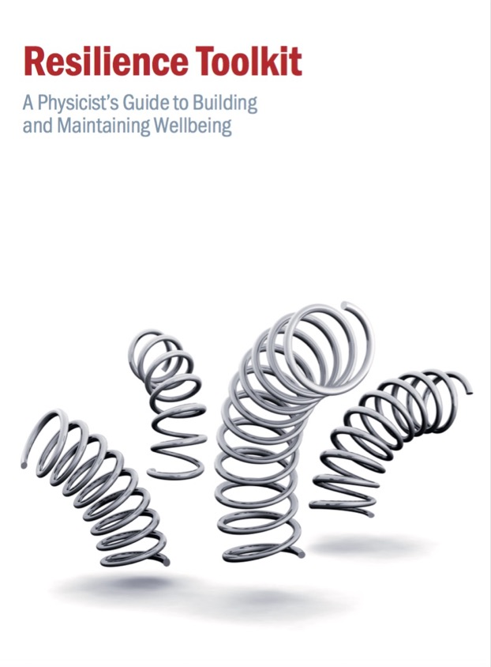
https://www.iop.org/sites/default/files/2018-10/resilience-toolkit.pdf
Notes:
https://www.iop.org/sites/default/files/2018-10/resilience-toolkit.pdf

Slide 9
Don’t just sit there!
Interrupt me
Ask questions
Share perspectives and ideas

Slide 10
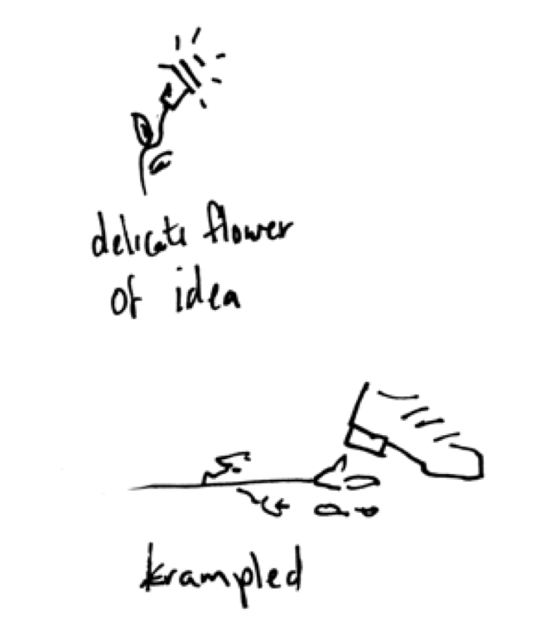

Slide 11
No quick fixes
Understand what’s going on
01
Look at a range of solutions and find the match
02
Embed better habits and decisions in your routine
03

Slide 12
My Resilience ≠ Your Resilience

Slide 13
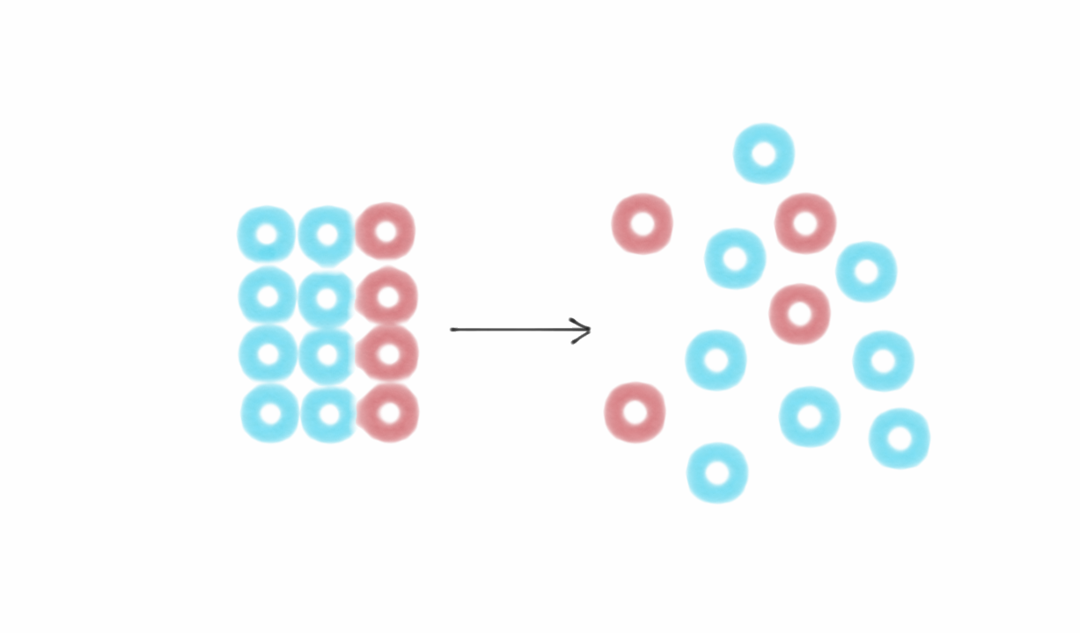
Know your own disorder
Image from https://fs.blog/2018/11/entropy/

Slide 14
A bit of personal context

Slide 15
Uncertainty is corrosive It’s ok not to be ok

Slide 16
What’s your story?
Reflect on your own time management, personal brand of “disorder” and habits
What are the characteristics of your problem?
There are lots of ways to track your time – find one that you find easy to engage with

Slide 17
Dig into the story
Start with an honest list of what you have done
Why are you doing that task?
Why have you prioritized this over other options?
Part of your role?
Motivates you?
Art of the possible?

Slide 18
What can you do?
http://yourselfseries.com/teens/files/2012/09/resilience_building1.jpg

Slide 19
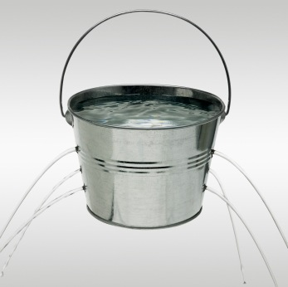
There are new holes in our buckets!
Don’t expect “business as usual”
BE KIND AND PATIENT

Slide 20
Notes:
https://eu.bbcollab.com/guest/d11e2f46d4974deaa343f52da6b42316

Slide 21
Good practice and tips

Slide 22
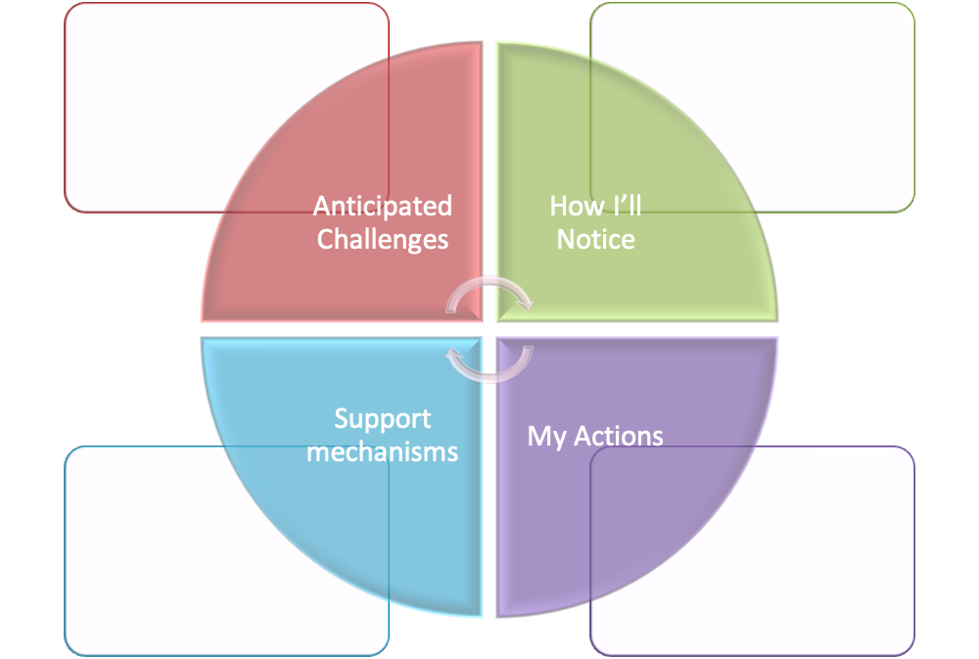
I’ll put this on the blog afterwards
https://blogs.ed.ac.uk/iad4researchers/
Notes:
Anticipated Challenges
How I’ll notice
Support Mechanisms
My Actions
https://blogs.ed.ac.uk/iad4researchers/wp-content/uploads/sites/448/2020/03/Wellbeing-and-resilience-plan.docx
https://eu.bbcollab.com/guest/742e25b4015740688d542a3ed2fc3ee0

Slide 23
Ten Strategies to Build Resilience
Reduce Isolation
Recognise Imposter Syndrome
Rest Properly
Ask for Help
Be objective
Focus on fewer things, do them better
Schedule what isn’t getting done
Use technology to help, or reduce
Have coping strategies
Learn from failure
Notes:
Mapping onto grant failure
1 – talk to people and you’ll find out it’s normal – the more we talk the more normalised it will be
2 – entirely natural to think it’s you – it may confirm self doubt but don’t let one rejection define you (or many)
3 – always good advice
4 – really hard to do this on your own – you’ve got your grant to the point you thought it was perfect – so use help on offer from research director, colleagues and RSO
5 - feel like a personal rejection, but it’s a complex system and you have little control over much of it
6 – set out a set of tasks and develop a process to manage the response to referees or the rejection – don’t try to bounce from one ot the other – fund focus
7 – general good advice but plan in advance to either manage referee response (if funder can give you a timeline) or prepare colleagues to support you
8
9 – think in advance – fresh air? Time with supprotive people? Exercise?
10 – know the stats – accept fair criticism – be honest about what could have been better

Slide 24
Some motivations
Set backs in science are COMMON
COMPETITION means you will face REJECTION at some point
If you supervise others as an academic, you will need to help them be more resilient
Being flexible and positive will help in all careers
Feeling in control will help you face challenges constructively

Slide 25
Strategy 1: Reduce Isolation
Do I recognise this?
What could I do to reduce my isolation?
Notes:
Reduce isolation
All too easy to hide away and try to stop people seeing the problems. might worry that they’ll judge your negatively in future, but don’t do this.
Find people who understand what you are going through and talk to them
Work collaboratively on problems
share your solutions and ask people for theirs
IOP can help…
through communities like Women In Physics, local sections, special interest groups and the online communities, mentoring, events, students conferences
Your workplace can help…

Slide 26
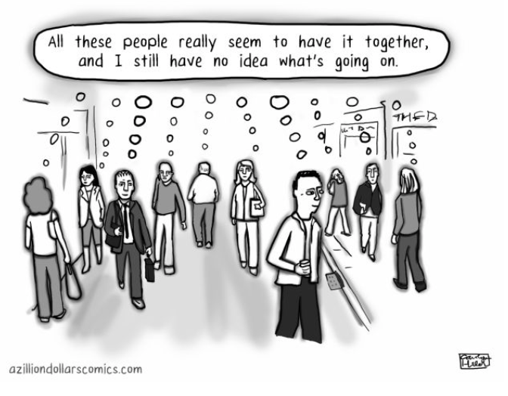
Strategy 2: Recognise Imposter Syndrome
Do I recognise this?
What could I do to reduce my imposter feelings?
Notes:
Reduce isolation
All too easy to hide away and try to stop people seeing the problems. might worry that they’ll judge your negatively in future, but don’t do this.
Find people who understand what you are going through and talk to them
Work collaboratively on problems
share your solutions and ask people for theirs
IOP can help…
through communities like Women In Physics, local sections, special interest groups and the online communities, mentoring, events, students conferences
Your workplace can help…
You’ll notice an unconscious confidence from some people – in some cases this is because they think they belong, in others, it’s their way of coping with a belief they don’t. Don’t compare your insides to their outsides!

Slide 27
Strategy 3: Rest Properly
Do I recognise this?
What could I do to properly rest and recuperate?
Notes:
walk away from work for one hour as an experiment
see if you are more productive when you come back if you haven’t thought about it OR felt guilty about not working
Good mental health in research and value of taking time out – holidays and switching off
Working longer hours isn’t productive

Slide 28
Strategy 4: Ask for Help
Do I recognise this?
What could I ask for help?
AND WHO COULD I HELP?
Notes:
look at some of the discussions online #phdchat

Slide 29
Strategy 5: Be objective
Do I recognise this?
What could I do to view my situation objectively?
Notes:
do a survey of your strengths or make a list of things to be grateful for
atmybest online
strengths finder

Slide 30
Strategy 6: focus on fewer things, do them better
Do I recognise this?
What could I do to make better use of my strengths and best times?
Notes:
keep a time diary and work out when you are most productive or creative. note what you currently do in those times

Slide 31
Strategy 7: schedule everything you aren’t getting done
Do I recognise this?
What could I change about how I use my time every day?
Notes:
keep a time diary and work out when you are most productive or creative. note what you currently do in those times

Slide 32
Strategy 8: technology should help not hinder
Do I recognise this?
What could I change about my internet/phone/tech use?
Notes:
No email first thing

Slide 33
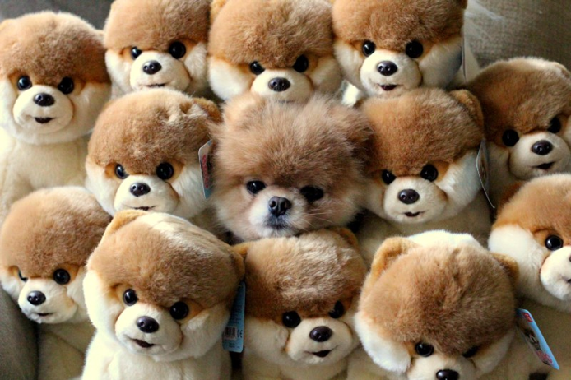
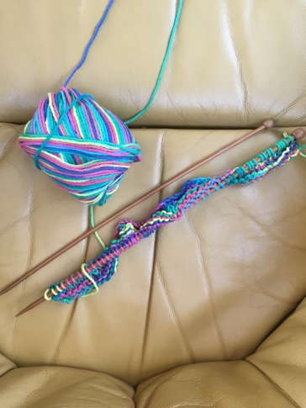
Strategy 9: Coping Strategies
coping strategies
Do I recognise this?
What are my coping strategies?
Notes:
think of something that you enjoy and makes you feel better
set a time in the next week to do this or make a firm plan to do it as soon as is reasonable
get some exercise

Slide 34
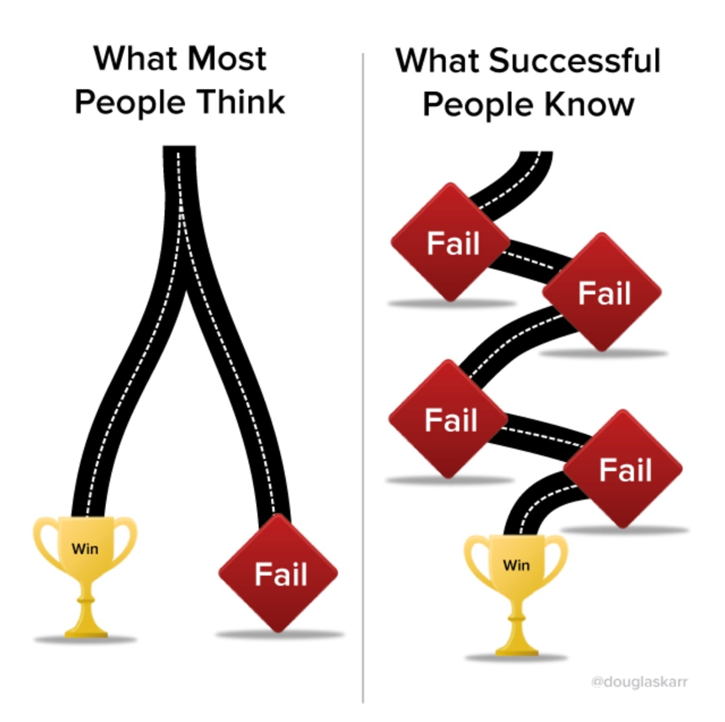
Strategy 10: Learn from Failure
Do I recognise this?
What have I learnt from failures on the past?

Slide 35
Image created by Michael James Schneider @BLCKSMTHdesign Words by @jennyjaffe)
Are you judging yourself by the wrong standards?

Slide 36
Start recognising your triggers and responses
Why?
helps to respond to problems rather than just reacting to them
makes it easier to be objective about your situation and come up with solutions when you aren’t feeling low
might help you to see a pattern or trigger which you can avoid or tackle

Slide 37
I’m worried my job might disappear
I feel tired all the time
I’ve no chance of progressing against the criteria I’m judged by
I’m doing the lion share of family care
I’m expected to do too much, all at once
I don’t know what I’m going to do if we stay in lockdown
I don’t have all the skills I need to achieve my goals
My manager expects too much
I can’t keep up with my workload
My colleagues seem really productive
I’m always being criticised
I don’t know how well I’m doing and never get any useful feedback
I feel I need to be “seen” working all the time
I make lots of mistakes
I don’t have any help
I’m not sleeping
There’s no-one I can talk to about how I feel
All I ever do is work
I haven’t done what I thought I could achieve in this time
There’s no clarity about what I should be doing

Slide 38
When things start to go wrong
Notice greater tolerance and understanding about mental health issues
Remember this is normal - Statistics suggest that most of us will experience issues either personally or in our close family and social circles.
Get help if you start to feel very negative and down about yourself and your situation.
Notes:
Unconscious confidence of those who belong
About giving those in minorities more confidence when they don’t feel they belong
Good mental health in research and value of taking time out
Concept of presenteeism and long hours culture
Can do good science in 40 hours a week –
Being an advocate for yourself colleagues and students
Make use of flexible working and other resources – quiet spaces
Work smarter, not longer
Additional demands of doing all this with mental health issues – acknowledging additional burden of doing research with mental health issues

Slide 39
Notes:
https://eu.bbcollab.com/guest/d11e2f46d4974deaa343f52da6b42316

Slide 40
Embedding Better Habits

Slide 41
Habit is habit and not to be flung out of the window by any man, but coaxed downstairs a step at a time.
Mark Twain

Slide 42
Step by Step
What could you change to improve your resilience by 5%?
Put any questions or comments in the chat pane →
Notes:
“Self-sabotage is when we say we want something and then go about making sure it doesn’t happen.” -Alyce Cornyn-Selby

Slide 43
Ten Strategies to Build Resilience
Reduce Isolation
Recognise Imposter Syndrome
Rest Properly
Ask for Help
Be objective
Focus on fewer things, do them better
Schedule what isn’t getting done
Use technology to help, or reduce
Have coping strategies
Learn from failure
Notes:
Mapping onto grant failure
1 – talk to people and you’ll find out it’s normal – the more we talk the more normalised it will be
2 – entirely natural to think it’s you – it may confirm self doubt but don’t let one rejection define you (or many)
3 – always good advice
4 – really hard to do this on your own – you’ve got your grant to the point you thought it was perfect – so use help on offer from research director, colleagues and RSO
5 - feel like a personal rejection, but it’s a complex system and you have little control over much of it
6 – set out a set of tasks and develop a process to manage the response to referees or the rejection – don’t try to bounce from one ot the other – fund focus
7 – general good advice but plan in advance to either manage referee response (if funder can give you a timeline) or prepare colleagues to support you
8
9 – think in advance – fresh air? Time with supprotive people? Exercise?
10 – know the stats – accept fair criticism – be honest about what could have been better

Slide 44
Avoiding sabotage
Reflect on why you are fighting this goal
Notice your personal “dis-order”
Talk through with someone you trust
Choices – Decisions – Actions
Notes:
“Seemingly irrelevant decisions”
https://greatergood.berkeley.edu/article/item/how_to_stop_sabotaging_yourself
For example, you might realize that if you start a new task within 30 minutes of when you plan to leave work, it’s highly likely that you’ll leave late. Or, if you’re prone to running late for appointments, you might learn to recognize your sabotaging behavior of answering the phone when you should be walking out the door to be on time.
On the positive side, you can also learn what makes it more likely you’ll do positive, wanted behaviors later. A micro decision for me is whether I leave a document open on my computer when I plan to go back and work on it after taking a break. If I leave it open, I’ll generally go back to it. If I close it, I won’t. It can be very satisfying to understand your own psychology and realize your personal patterns.

Slide 45
Change.

Slide 46
Better habits
Use time management tips to find circumstance to better habits and avoid those that undermine you
Small changes – remember Twain
Write down goals – share them if others can help
Notes:
https://www.entrepreneur.com/article/324900

Slide 47
The People Problem

Slide 48
Map out what can change and what can't
Map out what is within your power to change
Map out what requires change in others
Is it your problem?
Or something (someone) else?

Slide 49
How will you know when things are making a difference?
What are the signs you'll be looking for?
Put any questions or comments in the chat pane →

Slide 50
Stop, modify or start?

Slide 51
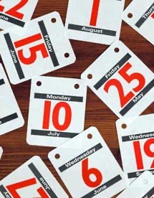
GROW
Goal – Reality – Options -- Will

Slide 52
Finally!
Look after yourself
We’ll keep building the resources you need – let us know
Do as much of this with pen and paper as a strategy for digital rationing
Get some fresh air
Take your weekends off
Suggestions for future sessions welcome!

Slide 53
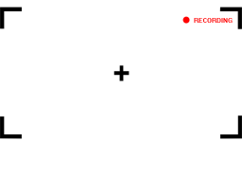
Reminder: This session has been recorded
Please message me if you would prefer any of your comments/ discussion to be edited out of the session
This Photo by Unknown Author is licensed under CC BY-NC-ND

Slide 54
Thank You

