Slide 1
Setting Priorities and Managing Time
Future Leaders Fellows Development Network
Dr Sara Shinton
Welcome! We will get started at 11:00

Slide 2
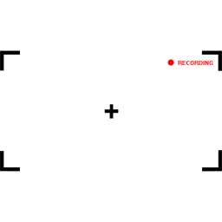
This session is being recorded
Please message me if you would prefer any of your comments/ discussion to be edited out of the session
This Photo by Unknown Author is licensed under CC BY-NC-ND

Slide 3
About the Bridging Courses
This event is one of a series of Bridging Courses taking place until Spring 2021. They are aimed at new FLFs who do not have access to leadership training in their host institution.
Whilst they do not replace a formal leadership programme, they provide an opportunity to engage in a variety of relevant topics and take time to reflect on your leadership of self and others.
Fellow to Fellow interaction is tricky in these sessions, but a "coffee room" link will enable us to meet in small groups during the break.

Slide 4
Setting Priorities and Managing Time
Future Leaders Fellows Development Network
Dr Sara Shinton, Network Director

Slide 5
About the Bridging Courses
This event is one of a series of Bridging Courses taking place until Spring 2021. They are aimed at new FLFs who do not have access to leadership training in their host institution.
Whilst they do not replace a formal leadership programme, they provide an opportunity to engage in a variety of relevant topics and take time to reflect on your leadership of self and others.

Slide 6
Protected
Space

Slide 7
Ever been on a time management course before?

Slide 8
Beatrice the Biologist

Slide 9
No quick fixes
Understand what’s going on
Look at a range of solutions and find the match
Embed better habits and decisions in your routine

Slide 10
What is going on with your time management?

Slide 11
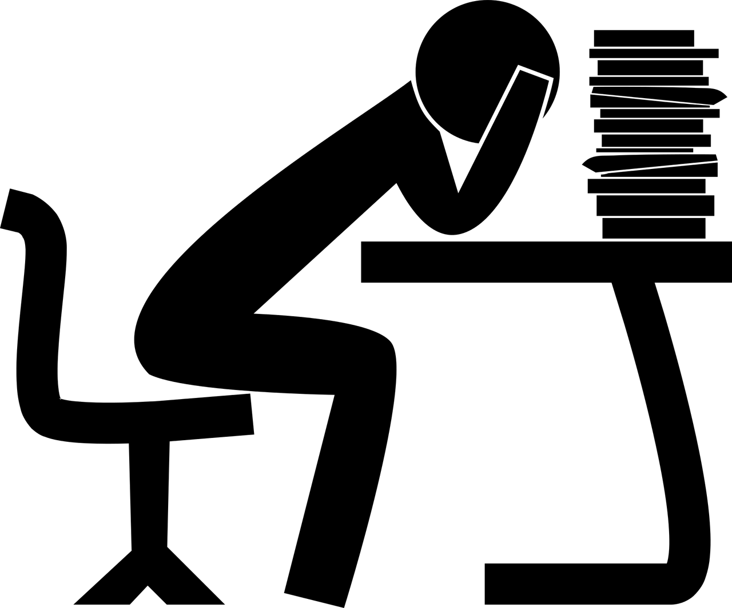
Overload?
Image by kmicican from Pixabay
Put any questions or comments in the chat pane →
Notes:
Overload and overcommitment. Saying yes to too many things

Slide 12
DO me!
DO me!
Overload?
DO me!
I’m overdue
You’ve started me 8 times – why not make it 9?
Someone else should be doing me
I’m not important but someone’s shouting for me!
…and me!
Image by kmicican from Pixabay
Notes:
Overload and overcommitment. Saying yes to too many things
This fragmentation of academic time

Slide 13
Overload?
Where did these all come from?
Image by kmicican from Pixabay
Notes:
Overload and overcommitment. Saying yes to too many things

Slide 14
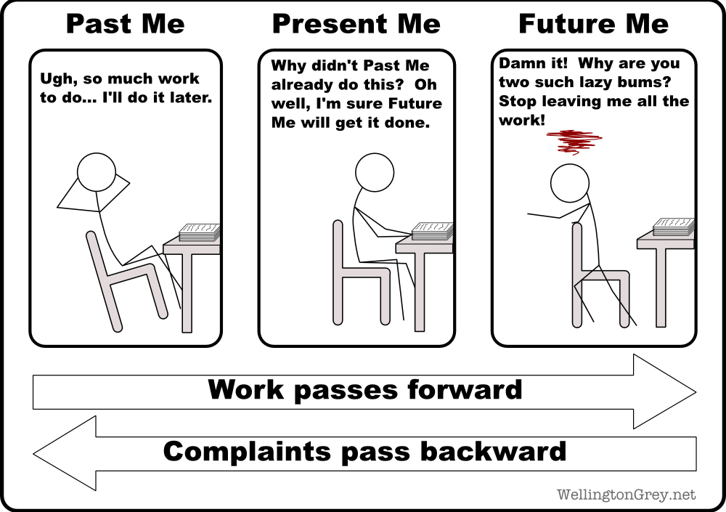
My time management problem in a nutshell
Put any questions or comments in the chat pane →
Notes:
Procrastination and inability to work unless there’s a pressing deadline

Slide 15
Taking on too much responsibility
Image by Tim Walker
Notes:
Being a leader means taking responsibility, but you can go too far
Feeling guilty, avoiding conflict, feeling exploited may be signs you’ve taken on too much responsibility
Helping and supporting others is important, but is this a sign of something else?

Slide 16
Taking on too much responsibility
Being a leader means taking responsibility, but you can go too far
Feeling guilty, avoiding conflict, feeling exploited may be signs you’ve taken on too much responsibility
Helping and supporting others is important, but is this a sign of something else?
Image by Tim Walker

Slide 17
Imposter Syndrome?
Put any questions or comments in the chat pane →
Image by Clker-Free-Vector-Images from Pixabay
Notes:
Time management is also affected if you are fearful about making the wrong decisions.
If you worry that committing to an action might draw attention to your lack of knowledge or experience, this might also be affecting you.
Imposter syndrome is real, but none of us appeared fully formed – we got here by learning from mistakes and feedback.

Slide 18
Imposter Syndrome?
Time management is also affected if you are fearful about making the wrong decisions.
If you worry that committing to an action might draw attention to your lack of knowledge or experience, this might also be affecting you.
Imposter syndrome is real, but none of us appeared fully formed – we got here by learning from mistakes and feedback.
Image by Clker-Free-Vector-Images from Pixabay
Notes:
Working on things that on closer inspection are not your responsibility or serving you . Other people’s problems

Slide 19
Welcome to Covid-19.
Current Status:
Put any questions or comments in the chat pane →
Notes:
Running on empty. Too tired to operate effectively
Please don’t try to apply “business as usual” strategies. This session is designed to help you be as effective as it’s reasonable to be. Online working is draining. Anxiety and uncertainty are distracting. Working in the midst of your family creates tensions on your time.
Building resilience and recharging might be the best use of your time at the moment.

Slide 20
Welcome to Covid-19.
Current Status:
Please don’t try to apply “business as usual” strategies. This session is designed to help you be as effective as it’s reasonable to be. Online working is draining. Anxiety and uncertainty are distracting. Working in the midst of your family creates tensions on your time.
Building resilience and recharging might be the best use of your time at the moment.
Put any questions or comments in the chat pane →
Notes:
Running on empty. Too tired to operate effectively

Slide 21
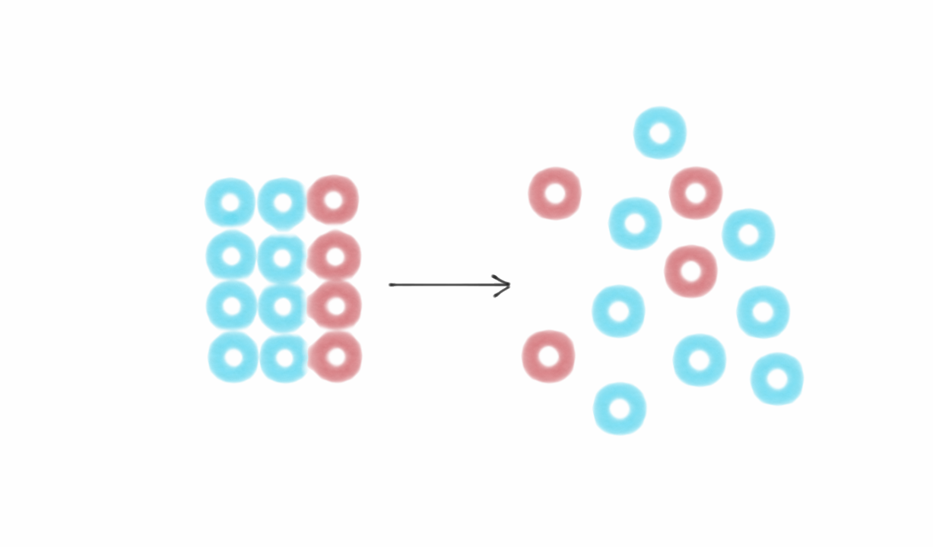
Know your own disorder
Image from https://fs.blog/2018/11/entropy/

Slide 22
Know your own disorder
What are you doing that is reducing the energy you have available for work?
What personal “disorder” are you bringing to your time and priority management?
Don’t waste more time on time management until you know what the problem is
Image from https://fs.blog/2018/11/entropy/

Slide 23
What’s your story?
Reflect on your own time management, personal brand of “disorder” and habits
What are the characteristics of your problem?
There are lots of ways to track your time – find one that you find easy to engage with

Slide 24
Dig into the story
Start with an honest list of what you have done
Why are you doing that task?
Why have you prioritized this over other options?
Part of your role?
Motivates you?
Art of the possible?

Slide 25
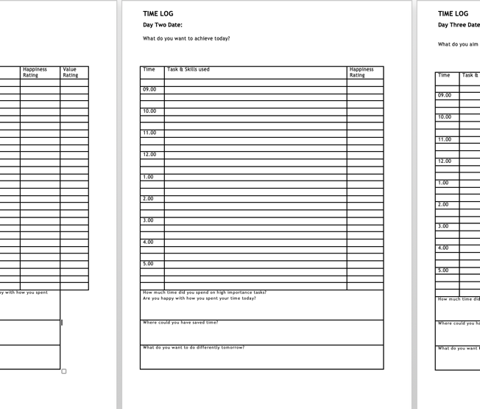
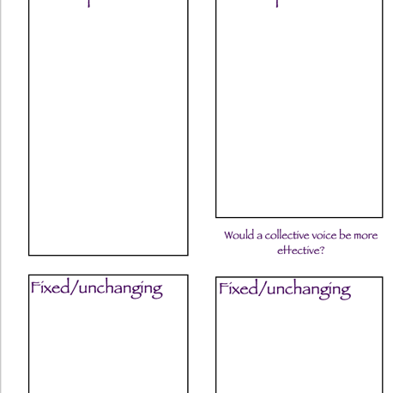
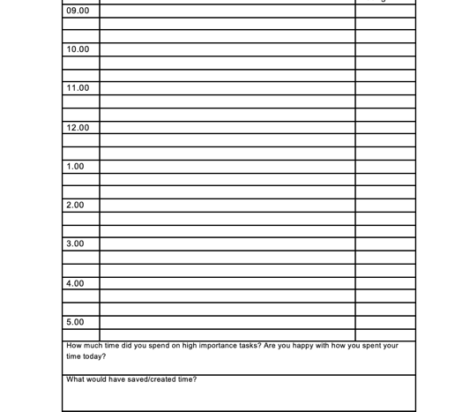
Use time grids if they help
What
Why
Who
Happy?
Notes:
What did you do
Why did you prioritise this
Who was involved in the thing you did – why did you do it
Are you happy about doing the thing – was this the right use of your time?
http://www.docs.hss.ed.ac.uk/iad/Researchers/Research_staff/Time_Management_Online_Resource_FINAL.pdf

Slide 26
Your brain is not a hard drive…

Slide 27
Five Minutes Writing
My time management would be better if…

Slide 28
Notes:
https://eu.bbcollab.com/guest/d11e2f46d4974deaa343f52da6b42316

Slide 29
Good practice and tips

Slide 30
Image by Lo Cole in The Guardian
Once you have characterised your current decisions and approaches, you can start thinking about the best solutions
We'll look at ten time management tips here
It's up to you to decide which will address your problem

Slide 31
Habit is habit and not to be flung out of the window by any man, but coaxed downstairs a step at a time.
Mark Twain

Slide 32
Some new habits

Slide 33
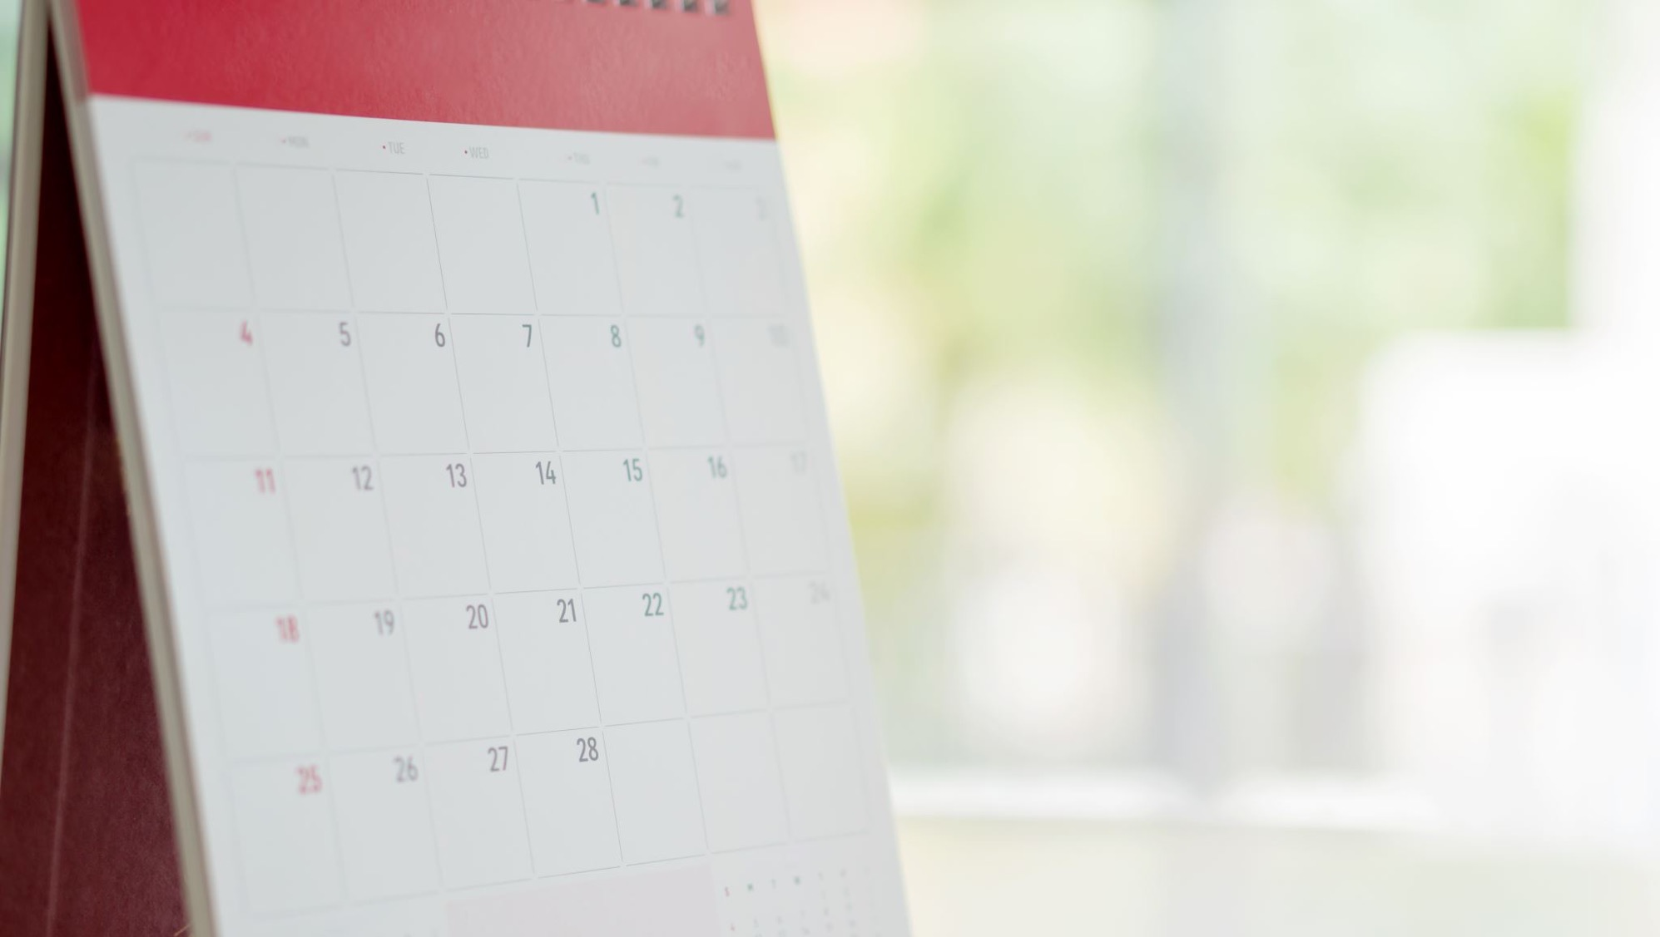
#1 Do the most important stuff first

Slide 34
Defining “Important”

Slide 35
Set a ‘triage test’
From Tracey’s session…”Big picture” important
Think about what your medium or longer term goals
What 3 rules would you set for the things you say ‘yes’ to?
Things that you can clearly see will lead you towards these goals.
This Photo by Unknown Author is licensed under CC BY-NC
Notes:
[1] Think about your medium or long term goals: what do you want to have done, learnt, or have on your CV this time next year, or in 3 to 5 years’ time? What do you want life and work to feel like. If you watched the presentation on optimism (focussing on the future), which is another video included in this online resource, you might want to use the outcomes of that exercise to help you here.
[2] Now, think of three rules you could set for the opportunities you will say yes or no to, or the tasks you say yes or no to spending quality time on.
[3] If you can say yes, then you know that this task or opportunity will lead you towards that future goal. Saying no means it will be a distraction or delay.

Slide 36
Set a ‘triage test’
From Tracey’s session…
Will it enable me to build my networks?
Will this mean I am able to spend more time working from home?
Will this mean that I develop a new leadership skill?
Could this lead to some funding?
Will this raise my profile or enhance my reputation?
Will this involve working with people that inspire me or I have fun with?
This Photo by Unknown Author is licensed under CC BY-NC
Notes:
Try to frame the rules as questions, such as:
Will it enable me to build my networks?
Will this mean I am able to spend more time working from home?
Will this mean that I develop a new leadership skill?
Could this lead to some funding?
Will this raise my profile or enhance my reputation?
Will this involve working with people that inspire me or I have fun with?
Now…

Slide 37
Embedding triage thinking
What prompts will help you prioritise?

Slide 38
Am I doing the most important thing? (If not, why?)
Why do I think this the most important thing to do now?
(am I convinced this stands up to scrutiny?)
What am I choosing not to do because I’m doing this?
(is there anything about this choice that helps me understand my time management approach?)
Who benefits from me doing this now?
Could/should someone else do this?
Could /should this wait?
Is this something I planned to do at the start of the day?
Am I happy about doing this?

Slide 39
Test drive these questions (or your own)
No judgments
No need to share
Diagnostic phase
We’ll get back to the tips now

Slide 40
#2 Manage digital disruption

Slide 41
#2 Turn off email, Teams, Zoom, Collaborate, Twitter etc It’s OK to disconnect if you need to get something done. Agree when you will be available. If needed, have an “override” mechanism which people can use if they HAVE TO. Use the Pomodoro technique for short focused bursts, change habits to create sustained space

Slide 42
#3 Work to meaningful deadlines on a meaningful schedule

Slide 43
#3 Work to meaningful deadlines …but set yourself up to be successful. Factor in the extra time needed to work remotely, in a shared space, on dubious wifi, when you’re worried about family

Slide 44
#3 Work to meaningful deadlines …by understanding what motivates you to get things done. Bring in other people? Link to your goals? Rewards?

Slide 45
#4 Work in the right environment Or change your environment (how other people act)

Slide 46
# 4 Work in the right environment or change your environment (how other people act) The time it takes to get your workplace set up is work time It’s *probably* harder to negotiate with your toddler than your colleagues or students to be left uninterrupted
Put any questions or comments in the chat pane →

Slide 47
The People Problem
Look back to your time analysis
Are others part of your time management problems?
Is a better solution to have a difficult conversation or manage their expectations?
We’ll come back to this in part 3 of the session

Slide 48
#5 Get to know the energy rhythm of your day

Slide 49
#5 Get to know the energy rhythm of your day It’s ok if this is different, but not ok to expect everyone to be available at the same time
Put any questions or comments in the chat pane →

Slide 50
#6 Stop solving SEPs SEP = Somebody Else’s Problem

Slide 51
#6 Stop solving Somebody Else’s Problem This has to be balanced against the amazing collegiality which is helping us all to get through. Get into the habit of a daily reflection on what you’ve done and why. Think about whether you are prioritising other people’s work and why you’re doing this. It’s OK to ask someone to wait for something.
Put any questions or comments in the chat pane →

Slide 52
Say NO
Notes:
https://dart.ed.ac.uk/radical-no/
http://dart.ed.ac.uk/nine-months-no/
https://dart.ed.ac.uk/time-management/
https://dart.ed.ac.uk/time-to-say-yes/

Slide 53
#7 Identify things you can make progress on in the margins during each day

Slide 54
#7 Identify things you can make progress on in the margins during each day Some days might be ALL margins, so acknowledge this in your planning and manage the expectations of others.
Put any questions or comments in the chat pane →

Slide 55
#8 Notice what makes you break your resolutions

Slide 56
#8 Notice what makes you break your resolutions If it’s anxiety, disruption, uncertainty etc, then working out how to manage these is a work task. If you don’t have the energy or drive, refreshing yourself is a valid choice If it’s lack of resources, then exploring alternatives is a work task
Put any questions or comments in the chat pane →

Slide 57
#9 Wean others off their expectations of instant gratification
Image by Gerd Altmann from Pixabay

Slide 58
#9 Wean others off their expectations of instant gratification Update people on your situation and explain the impact it’s having. Ask for patience and reasonable deadlines or for clarity about priorities.
Put any questions or comments in the chat pane →

Slide 59
#10 Do things well (enough)

Slide 60
#10 Do things well (enough) Remember the resources you’re working with. Remember the nature of your working day and space. Remember that contact with a colleague could be disrupted at any point. A “work in progress” is often fine
Put any questions or comments in the chat pane →

Slide 61
Notes:
https://eu.bbcollab.com/guest/d11e2f46d4974deaa343f52da6b42316

Slide 62
Embedding Better Habits

Slide 63
Habit is habit and not to be flung out of the window by any man, but coaxed downstairs a step at a time.
Mark Twain

Slide 64
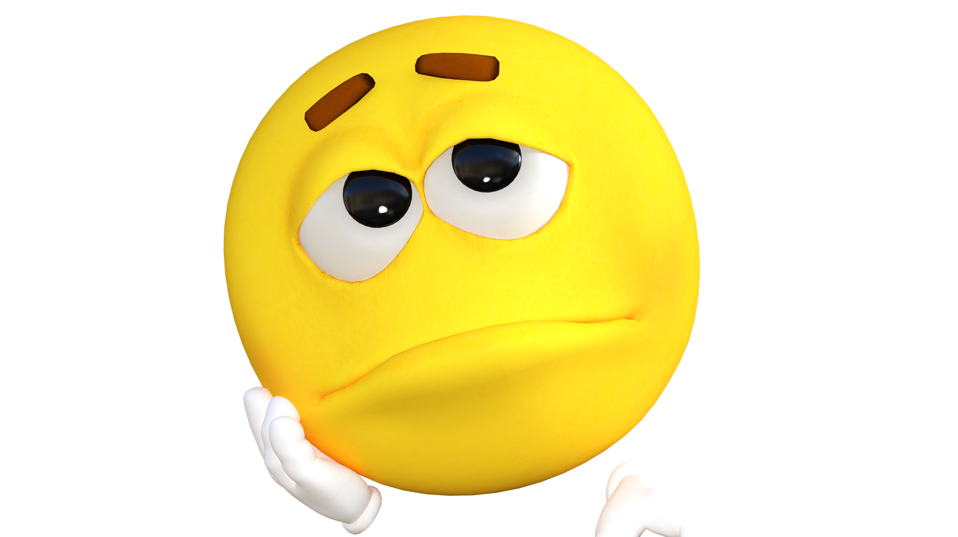
Moving forwards
Stop dwelling on the negative
Fresh start from today
Image by Pete Linforth from Pixabay

Slide 65
Moving forwards
Stop hiding from any problems
Resolve to make things different
Remember stairs not windows
Image by Pete Linforth from Pixabay

Slide 66
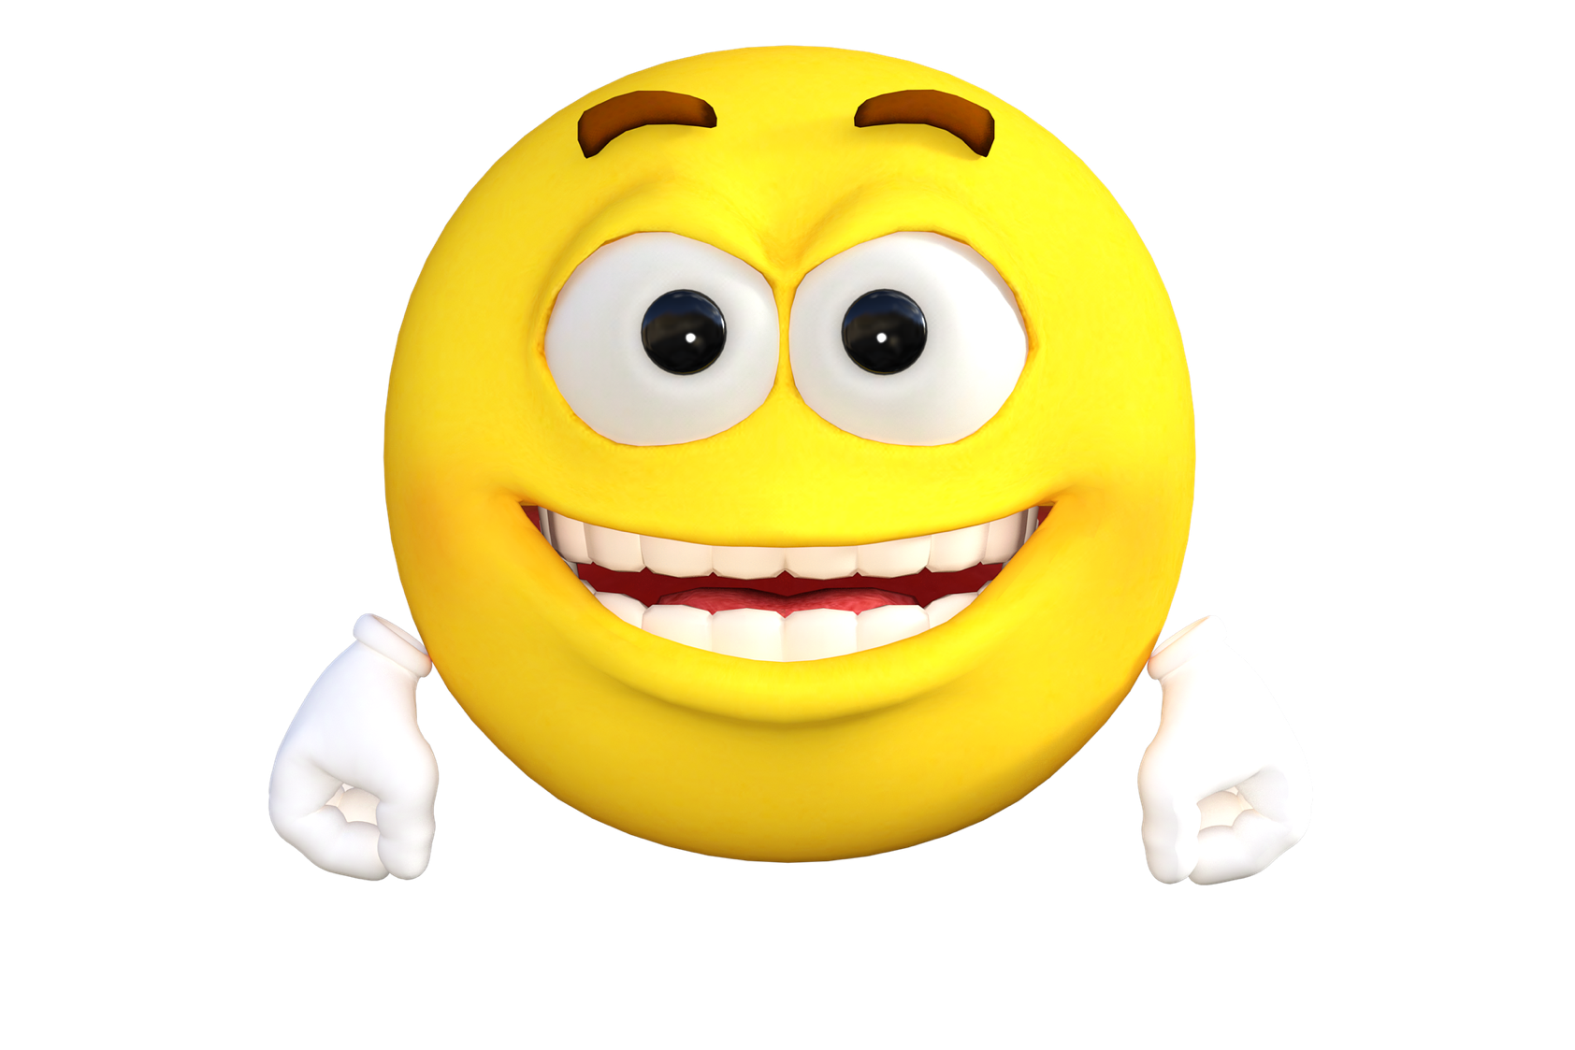
Celebrate the wins
Note when you’ve had a good day in the same way you note a bad one!
Share advice and tips with each other
Image by Pete Linforth from Pixabay

Slide 67
Step by Step
What could you change to improve your time management by 5%?
Put any questions or comments in the chat pane →

Slide 68
Ten Tips
Prioritise important stuff
Minimise distractions
Create deadlines
Improve environment
Know your energy rhythm
Minimise other people’s work
Use margins of time
Notice set backs to plans
Manage demands from others
Do it well enough

Slide 69
Say NO
Notes:
https://dart.ed.ac.uk/radical-no/
http://dart.ed.ac.uk/nine-months-no/
https://dart.ed.ac.uk/time-management/
https://dart.ed.ac.uk/time-to-say-yes/

Slide 70
The People Problem

Slide 71
Map out what can change and what can't
Map out what is within your power to change
Map out what requires change in others
Is your problem time management?
Or something (someone) else?

Slide 72
It's about me I can change it | It's about others They could change
It's about me I can't change it | It's about others They won't change
What’s the problem?

Slide 73
It's about me I can change it Time Management
What's your best TM strategy?

Slide 74
 | It's about others They could change Negotiation
What's your best TM strategy?
Notes:
Add link to difficult conversations
https://www.judyringer.com/resources/articles/we-have-to-talk-a-stepbystep-checklist-for-difficult-conversations.php

Slide 75
It's about me I can't change it Change priorities & expectations
What's your best TM strategy?

Slide 76
 | It's about others They can't change Institutional issue?
What's your best TM strategy?
Notes:
Lobbying – reporting – using your power and influence – “politics” of organisation

Slide 77
Your brain is not a hard drive…

Slide 78
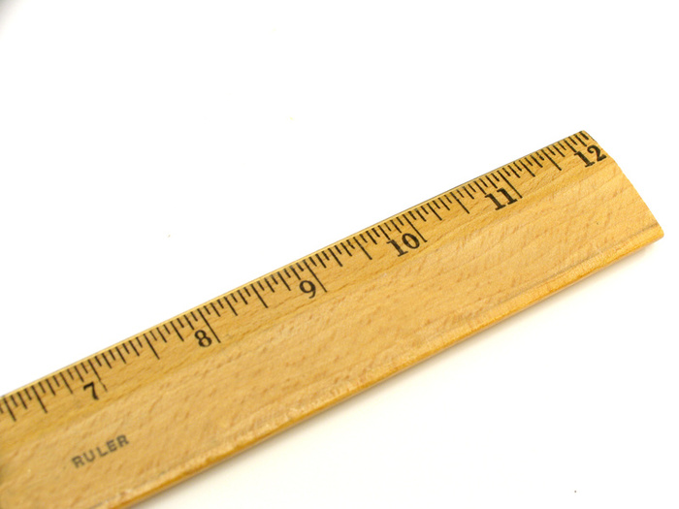
How will you know when things are making a difference?
What are the signs you'll be looking for?
Put any questions or comments in the chat pane →

Slide 79
Change.

Slide 80
Stop, modify or start?

Slide 81
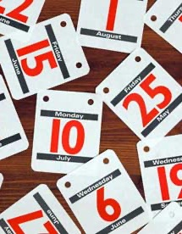
GROW
Goal – Reality – Options -- Will

Slide 82
Want a gentle nudge? Leave me your email and I'll follow up in three months

Slide 83
Want a gentle nudge? Leave me your email and I'll follow up in three months
No I won’t…
What unnecessary work do you create for yourself?

Slide 84
Finally!
Look after yourself
We’ll keep building the resources you need – let us know
Do as much of this with pen and paper as a strategy for digital rationing
Get some fresh air
Take your weekends off
Suggestions for future sessions welcome!

Slide 85
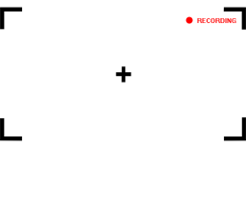
Reminder: This session has been recorded
Please message me if you would prefer any of your comments/ discussion to be edited out of the session
This Photo by Unknown Author is licensed under CC BY-NC-ND

Slide 86
Thank You

