Slide 1




Learning to Create Useful Synthetic Data
www.synthpop.org.uk
Gillian M Raab, University of Edinburgh, gillian.raab@ed.ac.uk
Beata Nowok, Public Health Scotland, beata.nowok@phs.scot
IPDLN pre-conference workshop, 6th September 2022

Slide 2


Introduction
Gillian M Raab

Slide 3
Learning to create useful synthetic data
Plan for this afternoon
13.30 to 15.00 Session 1
Lecture 1: Basic synthpop via full conditional models Beata Nowok
Lecture 2: Utility of synthetic data Gillian Raab
Practical 1: Using the SD2011 data available with synthpop
15.00 to 15.30 Coffee/tea break
15.30 to 17.00 Session 2
Lecture 3: Other methods of creating synthetic data and differential privacy Gillian Raab
Practical 2: Using other data sets or your own data

Slide 4
History of synthpop - overview
SYLLS project started 2014 (Gillian Raab, Beata Nowok and Chris Dibben)
Widening access to census-linked UK Longitudinal Studies (LSs) while protecting confidentiality:
  Devise a method of generating bespoke synthetic data extracts to match individual user data requests,
  Bespoke data should look and behave (statistically) like real data so researchers can experiment and refine research without having to travel to safe settings.
Develop methods to allow staff at the LSs to create bespoke synthetic data sets
Created R Package synthpop
Only the SLS from the UK LSs makes these available
But the package is open source and used by other people

Slide 5
History of synthpop details
Year | Version | What
2014 | 1.0 | Creation of one or more synthetic data sets from real data by conditional models with many choices of methods and other options. But defaults make this easy. syn_version <- syn(data) Visualisation of univariate comparisons and of the results of fitting models to synthetic and original data (specific utility)
2015 | 1.1 | Statistical Disclosure Control (SDC) added
2016 | 1.2 & 1.3 | Functions to calculate general utility measures added utility.gen(syn_version, data) utility.tab(syn_version, data)
2018 | 1.5 | New methods of synthesis for categorical data added. Not conditional models. method = "catall" or method = "ipf"
2021 | 1.7 | Added many more utility measures and methods for visualising them utility.tables(syn_version, data, tables = "twoway")
2022 | 1.8 | Methods for categorical data can be made differentially private

Slide 6
Synthetic data essentials
A model is fitted to the original data to give estimates of the parameters and the distribution of the data given these parameters
Synthetic data are generated from this model with random noise
There is a large literature on synthetic data that discusses ways of creating synthetic data. We will cover some of this including
  Evaluating the utility of synthetic data and using it to tune a synthesis Session 1 and Practicals
  Models specified via conditional distributions (fcs = full conditional specification) Session 1 and Practicals
  Log-linear models for categorical data Session 2 and Practicals
  Other methods not in synthpop Session 2
  Making the synthetic data differentially private Session 2 and Practicals

Slide 7
Our approach in this workshop
We will be teaching you how to create synthetic data with only a tiny touch of theory or even much in depth how the methods work.
I don’t believe anyone ever really understands a method of statistics or data analysis until they have used it on real data
You will learn about the synthpop package for R and use it to create synthetic data and evaluate its utility/fidelity
This workshop will (we hope) enable you to create synthetic versions of an original data file
Good luck!

Slide 8

RDS Synthetic Data User Forum: 22/11/22 2pm
Dr Lynne Adair (Forrest)
Data Curation Manager
lynne.adair@researchdata.scot
Synthetic data can help improve access to data
Are you a researcher interested in using synthetic data?
Find out about RDS synthetic data plans and help RDS develop synthetic datasets that fit user needs
What do you use/would like to use synthetic data for?
  Training
  Data discovery
  Code development
  AI/Model training
What datasets would you like synthesised?
What access methods would you use/prefer?
What do you think are the main issues with synthetic data?
To register interest contact:
Info@researchdata.scot
Website: https://researchdata.scot

Slide 9
Lecture 1 Basic synthpop
Beata Nowok

Slide 10

R package for generating synthetic versions of sensitive microdata
www.
.org.uk
CRAN.R-project.org/package=synthpop

Slide 11
Basic synthpop: outline
What does synthpop do?
General synthesising method
Synthesising function and its main parameters
Overview of other synthpop functions
11

Slide 12
Observed
(input)
Sex | Age | Education | Marital status | Income | Life satisfaction
FEMALE | 57 | VOCATIONAL/GRAMMAR | MARRIED | 800 | PLEASED
MALE | 41 | SECONDARY | UNMARRIED | 1500 | MIXED
FEMALE | 18 | VOCATIONAL/GRAMMAR | UNMARRIED | NA | PLEASED
FEMALE | 78 | PRIMARY/NO EDUCATION | WIDOWED | 900 | MIXED
FEMALE | 54 | VOCATIONAL/GRAMMAR | MARRIED | 1500 | MOSTLY SATISFIED
MALE | 20 | SECONDARY | UNMARRIED | -8 | PLEASED
FEMALE | 39 | SECONDARY | MARRIED | 2000 | MOSTLY SATISFIED
MALE | 39 | SECONDARY | MARRIED | 1197 | MIXED
FEMALE | 38 | VOCATIONAL/GRAMMAR | MARRIED | NA | MOSTLY DISSATISFIED
FEMALE | 73 | VOCATIONAL/GRAMMAR | WIDOWED | 1700 | PLEASED
FEMALE | 54 | SECONDARY | WIDOWED | 2000 | MOSTLY SATISFIED
MALE | 30 | VOCATIONAL/GRAMMAR | UNMARRIED | 900 | MOSTLY SATISFIED
MALE | 68 | SECONDARY | MARRIED | -8 | DELIGHTED
MALE | 61 | PRIMARY/NO EDUCATION | MARRIED | -8 | MIXED
Synthetic
(output)
Sex | Age | Education | Marital status | Income | Life satisfaction
MALE | 81 | PRIMARY/NO EDUCATION | MARRIED | 2100 | PLEASED
MALE | 54 | VOCATIONAL/GRAMMAR | MARRIED | 1700 | PLEASED
FEMALE | 32 | VOCATIONAL/GRAMMAR | DIVORCED | 870 | MIXED
FEMALE | 98 | PRIMARY/NO EDUCATION | MARRIED | 800 | MOSTLY DISSATISFIED
FEMALE | 50 | PRIMARY/NO EDUCATION | MARRIED | NA | MOSTLY SATISFIED
FEMALE | 37 | VOCATIONAL/GRAMMAR | MARRIED | 158 | PLEASED
MALE | 28 | VOCATIONAL/GRAMMAR | NA | 1500 | MOSTLY SATISFIED
FEMALE | 62 | PRIMARY/NO EDUCATION | MARRIED | 830 | MOSTLY SATISFIED
MALE | 78 | PRIMARY/NO EDUCATION | MARRIED | NA | PLEASED
FEMALE | 29 | SECONDARY | MARRIED | 580 | MOSTLY SATISFIED
MALE | 59 | PRIMARY/NO EDUCATION | MARRIED | 1300 | MOSTLY SATISFIED
MALE | 41 | SECONDARY | UNMARRIED | 1500 | MIXED
MALE | 18 | SECONDARY | UNMARRIED | -8 | PLEASED
FEMALE | 73 | PRIMARY/NO EDUCATION | WIDOWED | 1350 | MOSTLY SATISFIED
Data that look (structurally) like original data but contain artificial units only
12

Slide 13
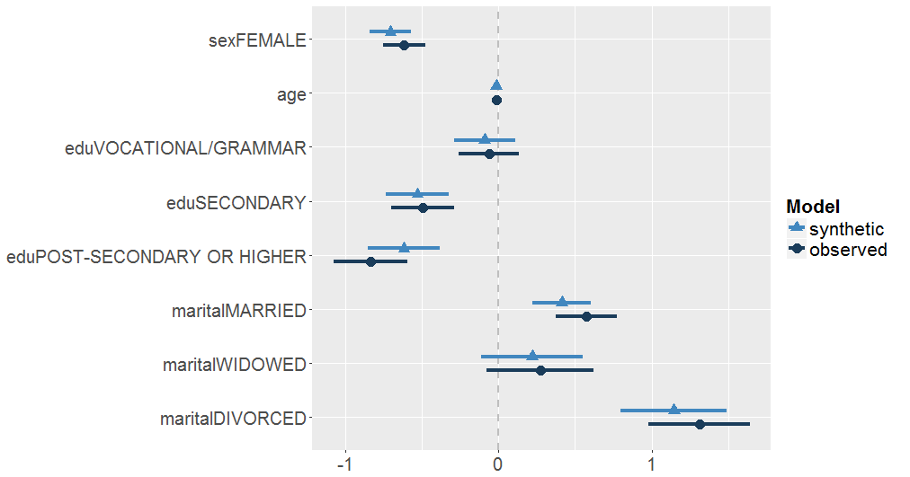
Observed vs. synthetic data
Chance of being a smoker
Data that behave (statistically) like original data
13

Slide 14
Generating synthetic data
Fitting statistical models to the original data and generating completely new fake records
Joint distribution is approximated by a set of conditional distributions
14

Slide 15
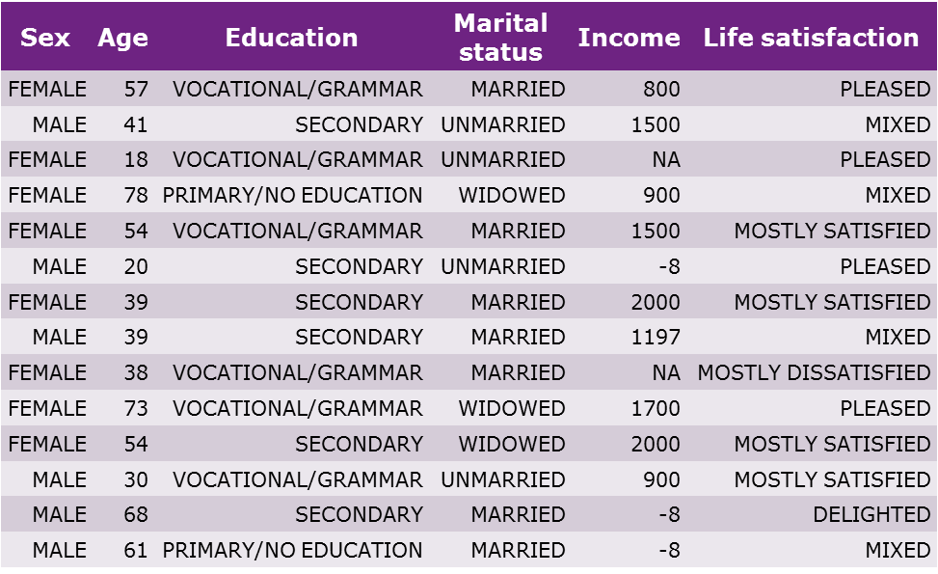
Observed
Sex
MALE
MALE
FEMALE
FEMALE
FEMALE
FEMALE
MALE
FEMALE
MALE
FEMALE
MALE
MALE
MALE
FEMALE
Sex distribution
Generate Sex
15

Slide 16
Observed
Sex
MALE
MALE
FEMALE
FEMALE
FEMALE
FEMALE
MALE
FEMALE
MALE
FEMALE
MALE
MALE
MALE
FEMALE
Age
81
54
32
98
50
37
28
62
78
29
59
41
18
73
Age predicted from Sex
Generate Age
16

Slide 17
Observed
Sex | Age
MALE | 81
MALE | 54
FEMALE | 32
FEMALE | 98
FEMALE | 50
FEMALE | 37
MALE | 28
FEMALE | 62
MALE | 78
FEMALE | 29
MALE | 59
MALE | 41
MALE | 18
FEMALE | 73
Education
PRIMARY/NO EDUCATION
VOCATIONAL/GRAMMAR
VOCATIONAL/GRAMMAR
PRIMARY/NO EDUCATION
PRIMARY/NO EDUCATION
VOCATIONAL/GRAMMAR
VOCATIONAL/GRAMMAR
PRIMARY/NO EDUCATION
PRIMARY/NO EDUCATION
SECONDARY
PRIMARY/NO EDUCATION
SECONDARY
SECONDARY
PRIMARY/NO EDUCATION
Education predicted from Sex and Age
Generate Education
17

Slide 18
Observed
Sex | Age | Education | Marital status | Income
MALE | 81 | PRIMARY/NO EDUCATION | MARRIED | 2100
MALE | 54 | VOCATIONAL/GRAMMAR | MARRIED | 1700
FEMALE | 32 | VOCATIONAL/GRAMMAR | DIVORCED | 870
FEMALE | 98 | PRIMARY/NO EDUCATION | MARRIED | 800
FEMALE | 50 | PRIMARY/NO EDUCATION | MARRIED | NA
FEMALE | 37 | VOCATIONAL/GRAMMAR | MARRIED | 158
MALE | 28 | VOCATIONAL/GRAMMAR | NA | 1500
FEMALE | 62 | PRIMARY/NO EDUCATION | MARRIED | 830
MALE | 78 | PRIMARY/NO EDUCATION | MARRIED | NA
FEMALE | 29 | SECONDARY | MARRIED | 580
MALE | 59 | PRIMARY/NO EDUCATION | MARRIED | 1300
MALE | 41 | SECONDARY | UNMARRIED | 1500
MALE | 18 | SECONDARY | UNMARRIED | -8
FEMALE | 73 | PRIMARY/NO EDUCATION | WIDOWED | 1350
Life satisfaction
PLEASED
PLEASED
MIXED
MOSTLY DISSATISFIED
MOSTLY SATISFIED
PLEASED
MOSTLY SATISFIED
MOSTLY SATISFIED
PLEASED
MOSTLY SATISFIED
MOSTLY SATISFIED
MIXED
PLEASED
MOSTLY SATISFIED
Life satisfaction predicted from all other variables
Generate Life satisfaction
Generate Education
18

Slide 19
Observed
Synthetic
Sex | Age | Education | Marital status | Income | Life satisfaction
MALE | 81 | PRIMARY/NO EDUCATION | MARRIED | 2100 | PLEASED
MALE | 54 | VOCATIONAL/GRAMMAR | MARRIED | 1700 | PLEASED
FEMALE | 32 | VOCATIONAL/GRAMMAR | DIVORCED | 870 | MIXED
FEMALE | 98 | PRIMARY/NO EDUCATION | MARRIED | 800 | MOSTLY DISSATISFIED
FEMALE | 50 | PRIMARY/NO EDUCATION | MARRIED | NA | MOSTLY SATISFIED
FEMALE | 37 | VOCATIONAL/GRAMMAR | MARRIED | 158 | PLEASED
MALE | 28 | VOCATIONAL/GRAMMAR | NA | 1500 | MOSTLY SATISFIED
FEMALE | 62 | PRIMARY/NO EDUCATION | MARRIED | 830 | MOSTLY SATISFIED
MALE | 78 | PRIMARY/NO EDUCATION | MARRIED | NA | PLEASED
FEMALE | 29 | SECONDARY | MARRIED | 580 | MOSTLY SATISFIED
MALE | 59 | PRIMARY/NO EDUCATION | MARRIED | 1300 | MOSTLY SATISFIED
MALE | 41 | SECONDARY | UNMARRIED | 1500 | MIXED
MALE | 18 | SECONDARY | UNMARRIED | -8 | PLEASED
FEMALE | 73 | PRIMARY/NO EDUCATION | WIDOWED | 1350 | MOSTLY SATISFIED
19

Slide 20
Types of model
Synthetic data are only as good as the models that created them
Parametric model can sometimes work well, but need to be selected carefully
The use of more flexible models such as Classification and regression trees (CART) has been found to be a useful alternative to use for some or all of the conditional distributions
20

Slide 21
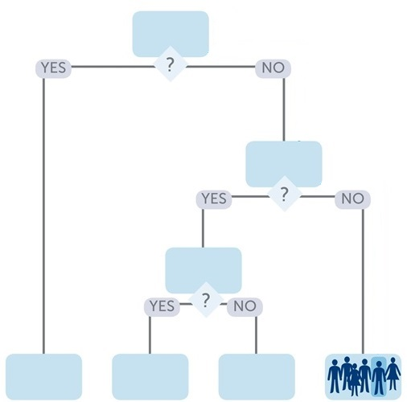
Classification and regression trees (CART)
Life satisfaction
health status = fair / poor
Build a tree (binary splits)
Y_{j} ~ (Y₀, . . . , Y_{j−1})
Generate Y_{j} by:
  Running Y₀,…,Y_{j-1} down the tree
  Sampling Y_{j} from the leaves
age < 50
sex = male
21

Slide 22
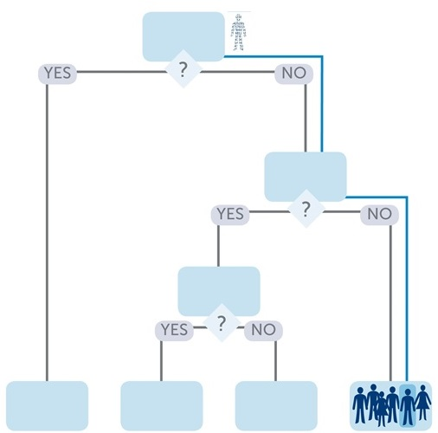
Classification and regression trees (CART)
healthy male
aged 56
Life satisfaction
health status = fair / poor
Build a tree (binary splits)
Y_{j} ~ (Y₀, . . . , Y_{j−1})
Generate Y_{j} by:
  Running Y₀,…,Y_{j-1} down the tree
  Sampling Y_{j} from the leaves
age < 50
sex = male
synthetic value
of life satisfaction
22

Slide 23
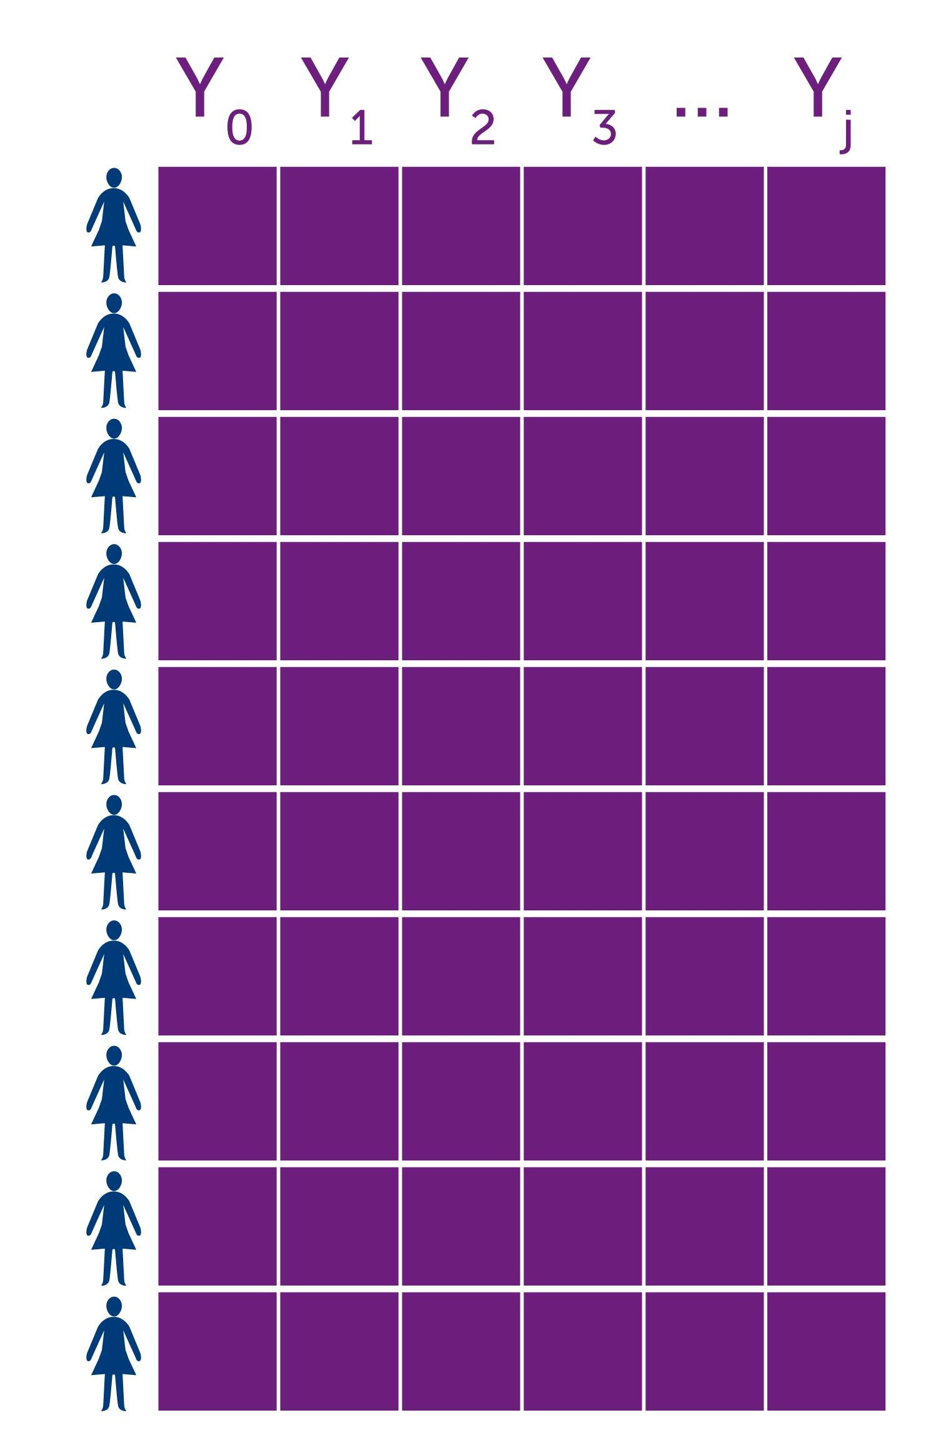
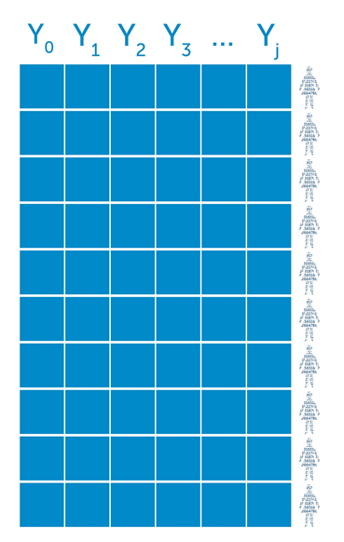

Generating synthetic data: synthpop
syn()
observed
synthetic
Y_{j} ~ (Y₀,Y₁,...,Y_{j−1})
library(synthpop)
sds <- syn(ods)
23

Slide 24
Default parameters
syn()
CART method (except the first variable)
A single synthetic data set
Synthesis in the order of variables in the data set
All previously synthesised variables used as predictors
sds <- syn(ods,
method = "cart",
m = 1,
visit.sequence = 1:ncol(ods),
predictor.matrix = NULL)
24

Slide 25
Output of sds <- syn(ods)
syn()
A named list of class "synds" (synthetic data set object) that contains both the synthetic data and information about how it has been synthesised.
25

Slide 26
Class "synds" important components
syn()
sds$syn
synthetic data frame (m = 1) or list (m > 1)
sds$method
vector of methods for each conditional distribution
sds$visit.sequence
order of variables to create conditional distributions
sds$predictor.matrix
how predictors defined for each variable
And many more components.
See the value entry in the help file for syn()
?syn
26

Slide 27
method
syn()
Single string
  same method for each variable, except the first one to be synthesised ("sample")
  default "cart" ("ctree" different implementation of CART)
  if "parametric" default parametric methods assigned to variables to be synthesised based on their types (default.method)
  method for deterministic relations: "~I(…)"
  non-negativity / non-normality: "lognorm", "sqrtnorm" or "cubertnorm"
Vector of strings
  method has to be specified for each variable in the data set (in the order as in the data set)
  for variables to be left unchanged use an empty method ("")
27

Slide 28
method
syn()
  See ?syn for all methods currently available:
  "ctree", "cart", "bag", "rf", "ranger", "survctree", "norm", "normrank", "lognorm", "sqrtnorm", "cubertnorm", "logreg", "polyreg", "polr", "pmm", "sample", "passive, "nested, "satcat, "catall", "ipf"
  See ?syn.cart, ?syn.norm, etc. for details about specific method
  Use your own method: write syn.new_method()
  and use "new_method" in syn()
28

Slide 29
syn()
visit.sequence, predictor.matrix
visit.sequence can be used to change synthesis order
  column indices or variable names can be used
  variables NOT in visit.sequence will NOT be synthesised
predictor.matrix can be used to specify the set of variables to include as predictors
  1 or 0 indicates whether to include a variable in a column as a predictor for a variable in a row
  variables that are not synthesised yet cannot be used as predictors,
  variables to be left unchanged (method = "") can be used as predictors
  matrix has to include all variables from the data set (in the original order)
29

Slide 30
syn()
visit.sequence, predictor.matrix
$visit.sequence
          sex age edu marital income ls smoke
          1 2 3 4 5 6 7
$predictor.matrix
      sex age edu marital income ls smoke
      sex 0 0 0 0 0 0 0
      age 1 0 0 0 0 0 0
      edu 1 1 0 0 0 0 0
      marital 1 1 1 0 0 0 0
      income 1 1 1 1 0 0 0
      ls 1 1 1 1 1 0 0
      smoke 1 1 1 1 1 1 0
predictors
outcome variables
30

Slide 31
syn()
cont.na, semicont, rules & rvalues
Missing-data codes for continuous variables to be modelled separately: cont.na
Semi-continuous variables: semicont
Restricted values (interrelationships between variables): rules & rvalues
31

Slide 32
syn()
Customised synthesis
sds <- syn(ods,
m = 5,
visit.sequence = c(5, 3:1, 4),
method = "ctree",
ctree.minbucket = 10,
smoothing = "spline",
cont.na = list(income=c(NA, -8), nofriend = -8),
rules = list(marital = "age < 18 & sex == 'MALE'"),
rvalues = list(marital = 'SINGLE’),
models = TRUE)
32

Slide 33
Stratified synthesis
syn.strata()
Preserves the relationships between the stratifying variable(s) and the other ones
Avoids computational problems
Very useful for longitudinal data in wide format from waves of a survey. Stratify by response pattern to preserve missing data patterns
sds_strata <- syn.strata(ods, strata = "sex")
33

Slide 34
Statistical disclosure control
sdc()
Data labelling: label
Removing replicated uniques: rm.replicated.uniques
Bottom- and top-coding: recode.vars, bottom.top.coding, recode.exclude
At synthesis stage: smoothing, minbucket
34

Slide 35
Statistical disclosure control
sdc()
sds_sdc <- sdc(sds,
ods,
label = "FALSE DATA", rm.replicated.uniques = TRUE, recode.vars = "income",
bottom.top.coding = c(NA,7000))
head(syn_sdc$syn)
35

Slide 36
Overview of synthpop functions
models
compare.fit.synds()
lm.synds()
glm.synds()
summary.fit.synds()
data
class: fit.synds
utility.tab()
utility.gen()
utility.tables()
compare.synds()
multi.compare()
summary.synds()
sdc()
observed
syn()
syn.strata()
synthetic
class: synds
syn.codebook()
36

Slide 37
Lecture 2 Utility of synthetic data
Gillian M Raab

Slide 38
Utility of synthetic data
Specific Utility
Measures of General Utility
Visualising utility of synthetic data
Using utility measures to tailor synthesis

Slide 39
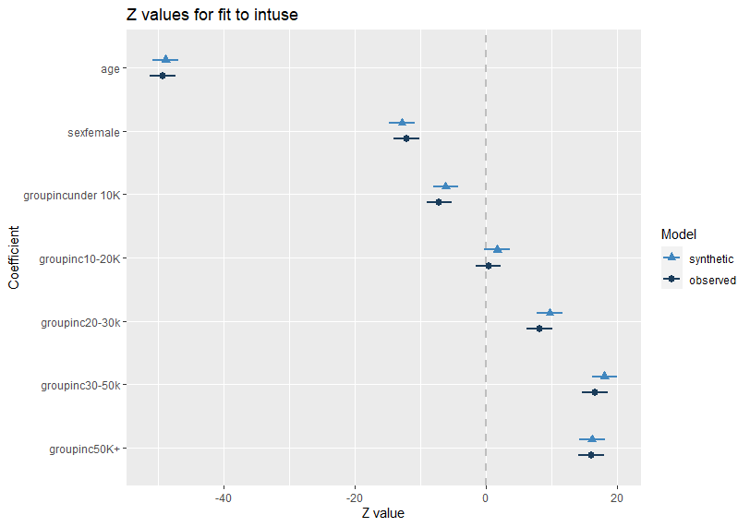
Specific utility measures
Compares the results of statistical analyses with the original and synthetic data
Here an example from synthesis of the Scottish Household Survey (SHS) data – used in Practical 2
Prediction of internet use
CODE
intuse_fit <- glm.synds(intuse ~ age + sex + groupinc, syn_cart, family = "binomial")
compare(intuse_fit, shs)
OUTPUT
Measures for one synthesis and 8 coefficients
Mean confidence interval overlap: 0.7488432
Mean absolute std. coef diff: 0.9845167
Mahalanobis distance ratio for lack-of-fit (target 1.0): 0.65
Lack-of-fit test: 5.198683; p-value 0.7361 for test that synthesis model is compatible with a chi-squared test with 8 degrees of freedom.
39

Slide 40
Drawbacks of specific utility measures
Model fitting is generally preceded by data checking and cleaning
Final model is only known when these steps are complete
This comparison can only be made by someone with access to the original data as well as the synthetic data
The people creating the synthetic data don’t know what analyses will be carried out
We will not cover these methods in practicals today – though you could explore them from help files for (e.g. glm.synds())
So we need something else that people creating synthetic data can use to assess and improve (tune) the synthesis
Overall measures of utility – General Utility

Slide 41
General utility functions in synthpop
Two approaches in the literature implemented in functions
  Propensity scores utility.gen(syn, orig, method = "cart", …)
  Tables utility.tab(syn, orig, vars = )
Each function can output one of several utility measures
They can each give standardised measures to compare the value from that expected if the generating model is “correct”.
But not used much used – what to do if they give poor results??
We now suggest procedures to use for assessing and improving synthesis
This workshop is about practical methods. If you want to read the background theory see utility vignette
The utility measure we suggest and the one produced by default in synthpop is the Propensity score standardised mean-squared error (S_pMSE) with an expected value of 1.0 if model is “correct”
Turns out to be the same as a modified chi-square for comparing tables =
Ʃ( obs – syn)²/[(obs+syn)/2] standardised by dividing by the degrees of freedom for the table.

Slide 42
Measures for tuning syntheses
A general utility measure does not have to be just one number
  Not helpful in diagnosing problems and tuning syntheses
  Can be a collection of measures
  Any set of summaries (means, correlations etc.) will do
  Our preference is for sets of tables 1-way, 2-way 3-way with continuous variables grouped
Tuning synthpop can involve
  Changing methods for some variables
  Changing order of conditional distributions
  Restricting prediction matrix
  Stratifying the synthesis

Slide 43
Suggested procedure
Start with all 1 way tables
  compare.syn(synthetic, original)
  now also gives a table of utilities
Fix if not OK
Look at 2 way tables
utility.tables(synthetic, original, tables = "twoway")
produces tables and averages of utilities (possible summary measure)
Fix if not OK
Perhaps move on to 3 way tables
utility.tables(synthetic, original, tables = "threeway")
produces tables and averages of utilities (possible summary measure)

Slide 44
Tuning examples taken from the data you can use in Practical 2
These are real data sets, sometimes with modifications, that we have permission to distribute to you for the course. Because of the modifications be careful with them and do not redistribute. But you can keep them for practice.
Practical 2 a) acs2018
A large extract (140 K records) of 22 variables from the American Community Survey data made available by the IPUMS project.
Practical 2 b) shs
An extract from the Scottish Household Survey on internet use in 2001/2002.

Slide 45
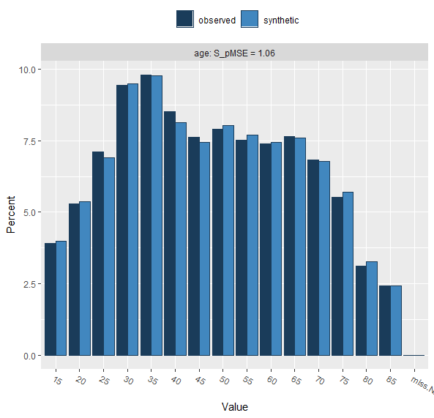
One way tables SHS with cart model
compare(syn_cart, shs, plot = FALSE)
Selected utility measures:
pMSE S_pMSE df
shs_6cla 9.0e-06 0.669295 6
council 7.1e-05 1.054199 31
hours_int 1.8e-05 1.657268 5
int_grocery 1.0e-06 0.158408 2
int_other 4.0e-06 0.863287 2
intuse 1.0e-06 0.316561 1
groupinc 7.0e-06 0.645129 5
age 1.2e-05 1.061947 5
sex 0.0e+00 0.051507 1
emp_sta 2.0e-05 0.841098 11

Slide 46
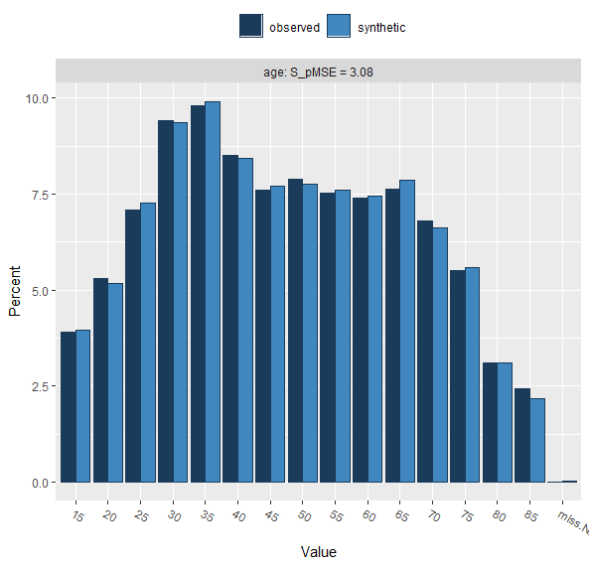
One way tables SHS with "parametric" model
This uses a method "normrank"
Carries out the regression on transformed Normal scores derived from percentiles
Selected utility measures:
pMSE S_pMSE df
age 3.4e-05 3.078044 5
Rule of Thumb
Values up to 10 are OK
And up to 30 are acceptable
Over 30 you should check
This still looks OK

Slide 47
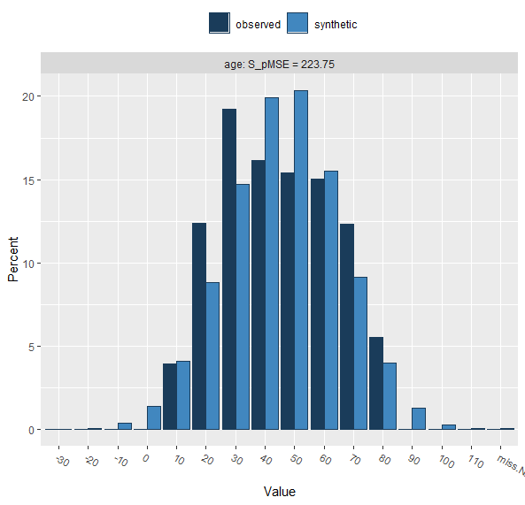
One way table SHS with method$age = "norm"
Replace "normrank" in method with a Normal distribution
Selected utility measures:
pMSE S_pMSE df
age 0.002438 223.745 5
Here well over 30 and unacceptable

Slide 48
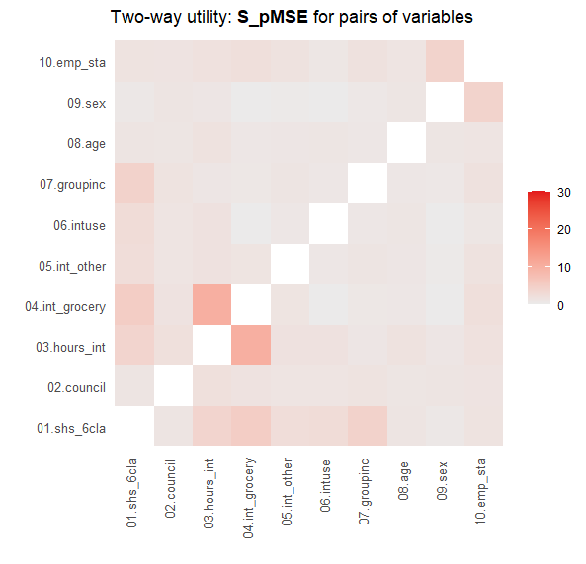
Two-way tables SHS cart model
utility.tables(syn.cart, shs, max.scale = 30,
ntabstoprint = 1)
Two-way utility: S_pMSE value plotted for 45 pairs of variables.
Variable combinations with worst 2 utility scores (S_pMSE):
03.hours_int:04.int_grocery 01.shs_6cla:04.int_grocery
10.2046 5.1821
int_grocery
hours_int no yes <NA>
Up to 1 hour a week 3473 191 0
Over 1 hour, up to 5 hours 3261 320 0
Over 5 hours up to 10 hours 844 120 0
Over 10 hours up to 20 hours 371 57 0
Over 20 hours 190 35 0
<NA> 0 0 19823
Synthetic data:
int_grocery
hours_int no yes <NA>
Up to 1 hour a week 3257 282 0
Over 1 hour, up to 5 hours 3330 308 0
Over 5 hours up to 10 hours 929 78 0
Over 10 hours up to 20 hours 375 32 0
Over 20 hours 208 19 0
<NA> 0 0 19867

Slide 49
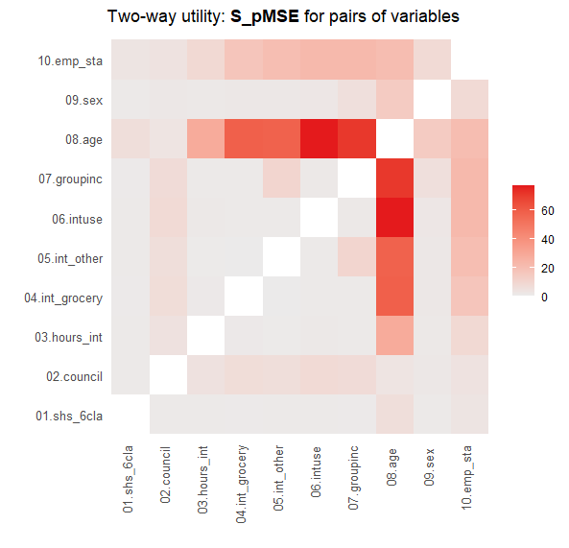
Two way tables SHS parametric model
utility.tables(syn_para, shs)
Variable combinations with worst 5 utility scores (S_pMSE):
06.intuse:08.age 07.groupinc:08.age
77.3003 71.2550
04.int_grocery:08.age 05.int_other:08.age
58.7230 58.0873
03.hours_int:08.age
28.3461
Medians and maxima of selected utility measures for all tables compared
Medians Maxima
pMSE 0.0003 0.0051
S_pMSE 3.2251 77.3003
df 23.0000 376.0000
For more details of all scores use print.tabs = TRUE.
Relationships of internet use and age are not maintained
Next slide illustrates why this has happened

Slide 50
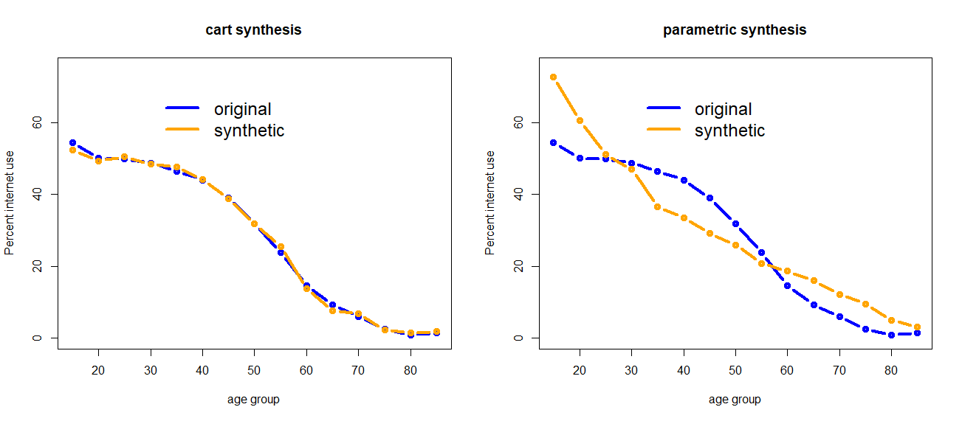
Internet use by age group- not linear

Slide 51
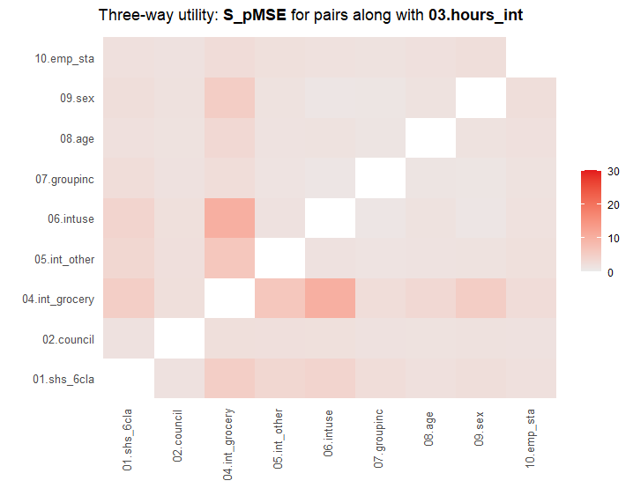
Finally three way tables SHS cart model
utility.tables(syn.cart, shs,max.scale = 30, tables = "threeway"))
Three-way utility (total of 120 variable combinations):
Variable with highest average score, 03.hours_int, selected to make plots.
To see others, set parameter 'third.var'.
Variable combinations with worst 5 utility scores (S_pMSE):
03.hours_int:04.int_grocery:06.intuse
10.2046
03.hours_int:04.int_grocery:05.int_other
6.2618
03.hours_int:04.int_grocery:09.sex
5.2003
01.shs_6cla:04.int_grocery:06.intuse
5.1821
01.shs_6cla:03.hours_int:04.int_grocery
4.9827
Note scale is capped at 30
Plot shows the worst threeway slice
Few problems with three way tables

Slide 52
Conclusion
For tuning
Visualise one-way, two-way and maybe three-way tables
Use results to compare methods of synthesis
And adjust methods until utility improves
More detail about utility in our paper
Assessing, visualizing and improving the utility of synthetic data
Gillian M Raab, Beata Nowok, Chris Dibben (2021)
Available from https://arxiv.org/abs/2109.12717

Slide 53
Tips and tricks
Synthesising a file with many variables can be slow
For today’s practicals we will just use a few variables at a time
Variables have lots of levels can slow things down – warning if >60 levels, can be overridden
Put them at the end of the visit sequence
Also reduce the number of variables used to predict them
Use nested methods for details of groups
Stratification can improve both speed and utility
Use it for variables that you think may be of interest to the analyst

Slide 54
Tips and tricks – things you can change
Method ("ctree" or "cart")
Visit sequence
Stratification
Predictor matrix (fiddly)
Now some examples from acs2018 data

Slide 55
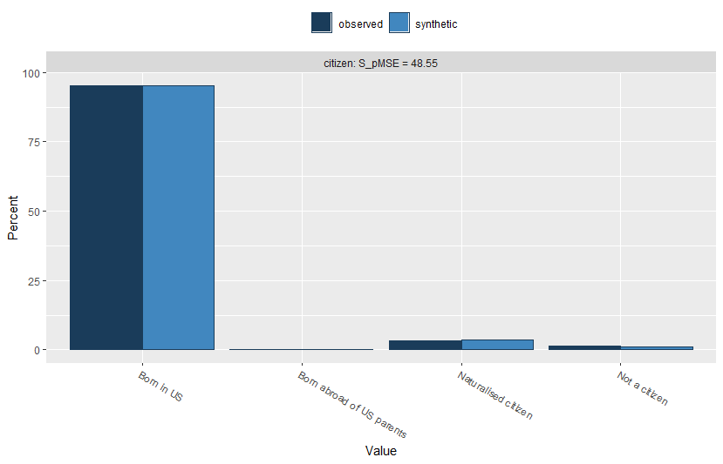

compare(syn_cart, acs2018, vars = "citizen", table = TRUE)
$citizen
Born in US Born abroad of US parents Naturalised citizen Not a citizen
observed 95.25636 0.1673979 3.204274 1.371965
synthetic 95.21521 0.1708853 3.533490 1.080414
Selected utility measures:
pMSE S_pMSE df
citizen 6.3e-05 48.54719 3
Moving citizen to near start of synthesis
$citizen
Born in US Born abroad of US parents Naturalised citizen Not a citizen
observed 95.25636 0.1673979 3.204274 1.371965
synthetic 95.30798 0.1625154 3.170795 1.358713
Selected utility measures:
pMSE S_pMSE df
citizen 0 0.31195 3

Slide 56
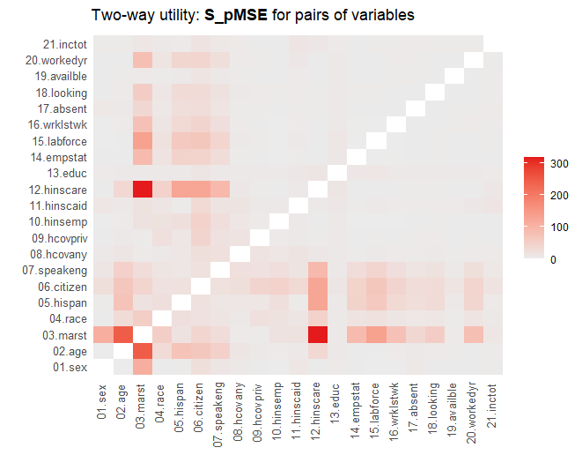
utility.tables(syn_cart, acs2018)
Relationships with marst not well preserved
Was fixed by stratifying by marital status

Slide 57
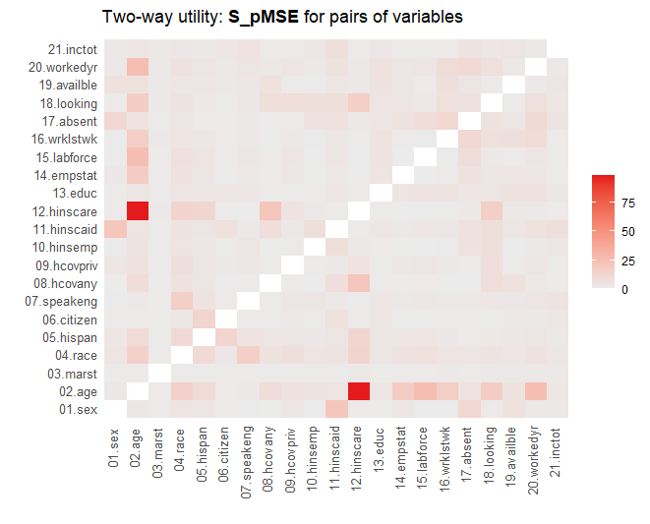
utility.tables(syn_cart3, acs2018)
After these and other improvements.
One pair of variables is not right – age and hinscare
Use multi.compare() to work out what is going wrong

Slide 58
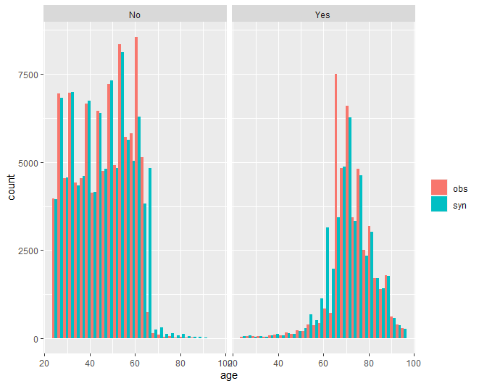
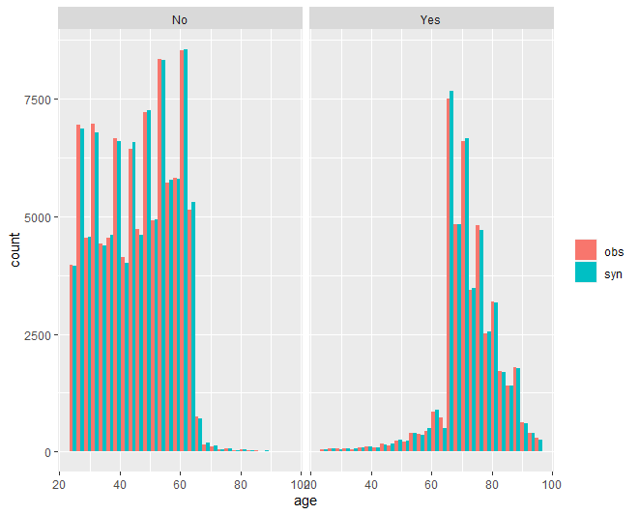
multi.compare(syn_cart3, acs2018, var = "age", by = "hinscare")
Problem at age 65 S_pMSE = 98.8
After adding age 65 or over to the stratification S_pMSE now < 1

Slide 59
Practical 1
Social Diagnosis 2011 - Objective and Subjective Quality of Life in Poland
Instructions: SD2011_tasks.pdf
Data: SD2011 data frame available in synthpop
Sample code: synthesis_SD2011.R

Slide 60
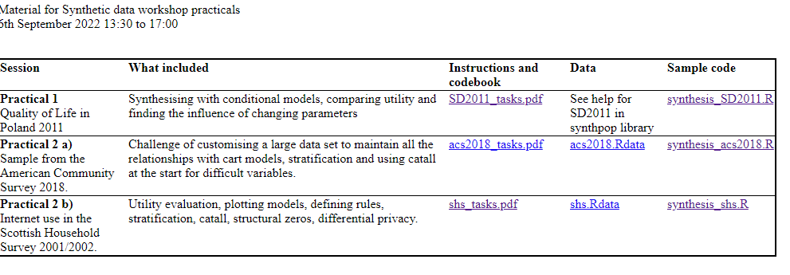
Index.htm

Slide 61
Lecture 3 Other methods
Gillian M Raab

Slide 62
Other methods
In synthpop
Not in synthpop
Differential privacy
62

Slide 63
Other methods in synthpop
Defined in terms of the whole distribution
  NOTE : You can get a multivariate Normal synthesis via conditional distributions
Can be used for all variables or as a group of variables taken together at the start of the synthesis
Two methods for categorical data have been implemented in synthpop, both based on log-linear models for tables
  A saturated log-linear model "catall"
  One based on defined marginals via iterative proportional fitting "ipf"
Both require your computer to store a table that cross-tabulates all your variables

Slide 64
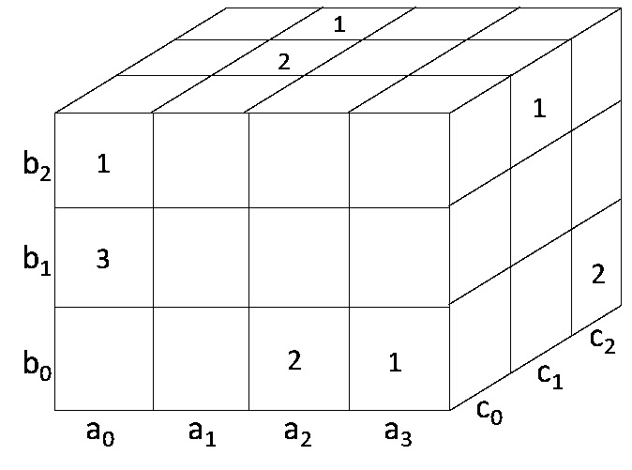
Restructure the data as an n-fold table
row a b c
1 0 2 0
2 0 1 0
3 0 1 0
4 0 1 0
5 1 2 1
6 1 2 1
7 1 2 2
8 3 0 0
9 3 2 1
10 3 0 2
11 .....
12 .....
Data file
with n rows
n = 10 +
Data cuboid with N cells
N = 36
Histogram
000 | 100 | 200 | 300 | 010 | 110 | 210 | 310 | 020 | 120
0 | 0 | 2 | 1 | 3 | 0 | 0 | 0 | 1 | 0
220 | 320…………..
0 | 0…………………
Length N sum n

Slide 65
"catall"
Forms a n-way table
Creates a new table by simulating from a multinomial distribution with probabilities defined by the proportions of the total N in each cell of the table.
Restructures it back to a data frame
Problem: zero cells will remain as zeros
Solution: add a small constant to every cell of the table unless they are structural zeros. Parameter nprior spreads this value evenly over all the cells in the table. Default is nprior = 1.
Example – using all 10 variables from the Internet Use example
This gives a table with 80 million cells, just under the default limit of 10⁸ - can be overridden

Slide 66
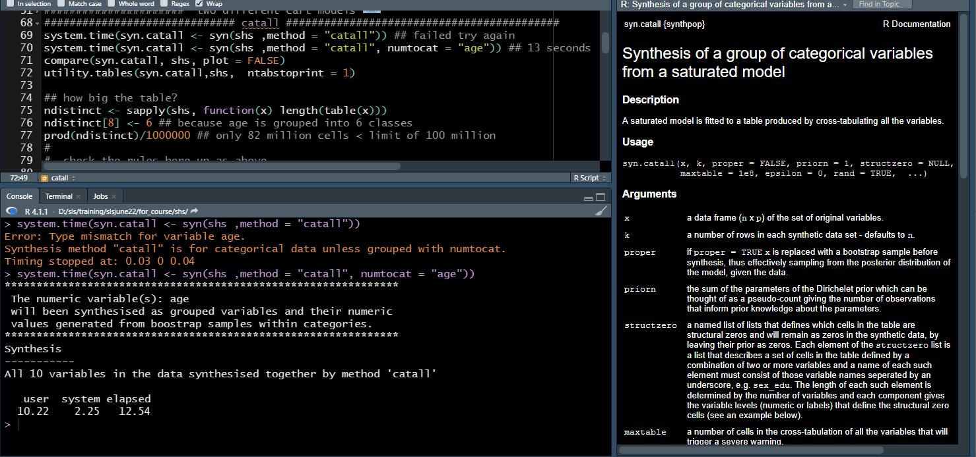
SHS with "catall"

Slide 67
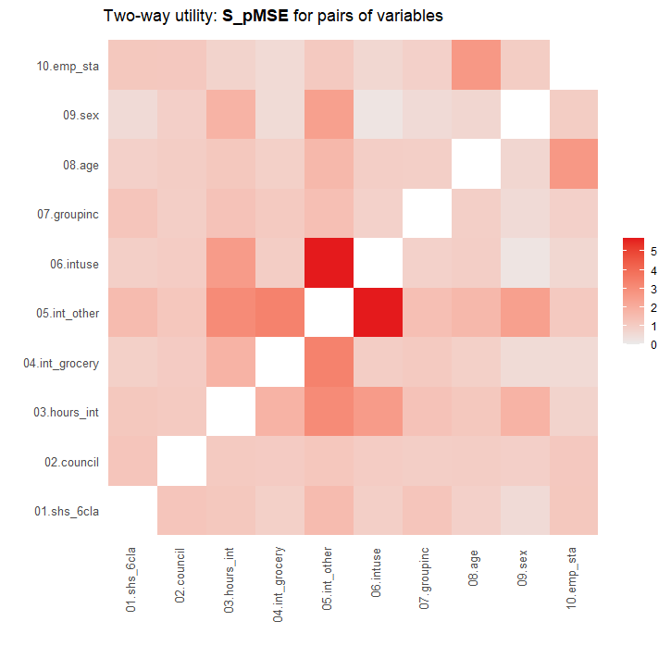
Utility of "catall" with SHS
All one-way, two-way and three-way tables have acceptable utilities
Can use it for a few variables at the start of a synthesis and then do others by conditional models
Select those where relationships difficult to get right and/or important ones
Example in acs2018 synthesis

Slide 68
"ipf" iterative proportional fitting
Also needs a big table
Instead of simulating from the original table it starts by defining the margins of the table, and getting the table that best fits these margins
Then proceeds using this table rather that the original
"ipf" can be slow to fit
No advantage over "catall" except for Differential Privacy - later
Will not discuss them further here

Slide 69
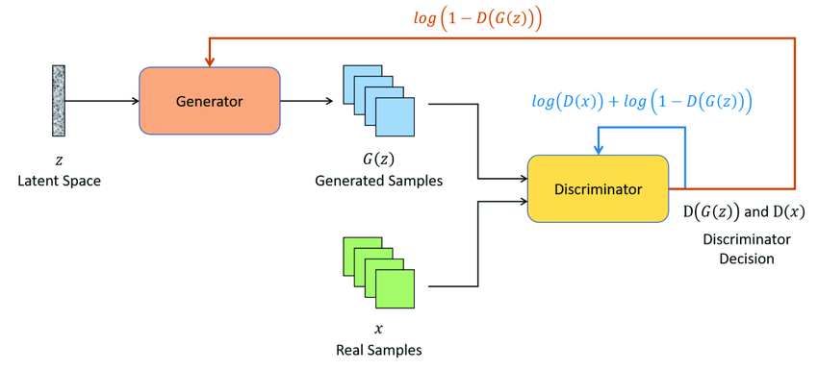
Other methods NOT in synthpop
Based on graphical models to define which relationships should be maintained – a bit like cart models
Generalised adversarial networks (GANS) image processing
  Starts by generating random data
  Discriminator then compares it to real data and feeds back information to the generator
  Generator can improve model
  Based on this feedback
SourceVint, David et al. . Remote Sensing. 13. 596. 10.3390/rs13040596.

Slide 70
DP essentials
An ε-DP mechanism adds random noise to a query from a database such that the likelihood ratio of the answer to the query from two databases that differ in only one record is bounded by exp(ε).
For several queries from the same data base the ε is the sum of all the ε values for all the queries.
It is a very strong privacy guarantee and it is argued that once it is satisfied there should be no other worry about privacy,
But it can also damage utility.
 | 0.1 | 0.5 | 1 | 2 | 10
exp(ε) | 1.1 | 1.65 | 2.72 | 7.39 | 22,000
Big noise
privacy
Low noise
unchanged
utility

Slide 71
DP Laplace mechanism – one option

Slide 72
Making synthpop DP – new in version 1.8
Methods for N records for p categorical variables
  "catall" Makes a table from the whole data, set calculates proportions in each cell. Generates synthetic data as a multinomial sample of N records from this vector of proportions.
  "ipf" You decide which margins you wish to preserve in the synthetic data. Fit a model to these margins by iterative proportional fitting. Get synthetic data from cell proportions, as above.
To make each of these DP
  "catall" add ε-DP noise to each cell in the table, adjust to get rid of negative values (post-processing)
  "ipf" add ε-DP noise to cells of each margin with final ε the sum of εs for all margins, then post-process to get rid of negative cells.
  Use the iterative proportional fitting algorithm as usual, this now adjusts margins as well as cell entries.

Slide 73
DP synthetic data
Practical developments in DP have been stimulated by work carried out to make the US 2021 Census DP.
E.g. to make DP synthetic data you can add noise to each of the parameters of your model. Total ε is sum for all parameters
Many papers published and open source code made available mostly in python
Stimulated by a synthetic data challenge run by NIST in USA. Teams had to create DP synthetic data from real data with specified ε values.
Teams used two main methods
  Decide which marginals will be used to model the data. Add DP noise to each marginal so that the sum of all the εs gives the final ε. Make the margins compatible and generate synthetic data from this model. No preliminary analyses of the real data can inform the models.
  Use a GAN model where the feedback from the discriminator to the generator is via a DP query. The total is the sum of all the εs used at each iteration of the GAN. Iterations must cease when the total ε budget is used up.
Teams using method 1 tended to score higher.

Slide 74
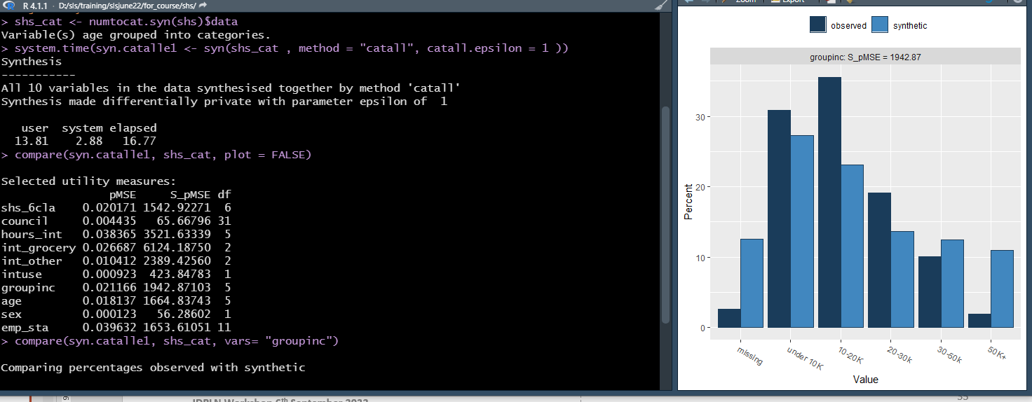
Making the synthetic SHS data DP with "catall"

Slide 75
DP synthetic data provisional conclusions
This is what you get with an epsilon of 1 for one-way tables.
You can investigate other values of epsilon and two-way tables
And perhaps even try making "ipf" DP – should be better - need to read help files.
MESSAGE: DP damages utility
"ipf" may be better but slow and difficult
For more detail see Utility and Disclosure Risk for Differentially Private Synthetic Categorical Data
https://arxiv.org/abs/2206.01362

Slide 76
Practical 2
Choose one a) American Community Survey for 2018 b) Internet use in the Scottish Household Survey (2001/2002)
Instructions & codebook: acs2018_tasks.pdf
Data: acs2018.rds
Sample code: synthesis_acs2018.R
Instructions & codebook: shs_tasks.pdf
Data: shs.rds
Sample code: synthesis_shs.R

Slide 77
Index.htm

