Slide 1
Workshop understanding synthpop session2 find course material at https://blogs.ed.ac.uk/graab/workshop/
Gillian M Raab
University of Edinburgh
Administrative Data Research Centre - Scotland
EU meeting Feb 2024

Slide 2
Explore the original and the low-fidelity data
Any interesting findings?
Would it be any use to you?
Try the following functions that are part of synthpop – use the help menus
Think about the disclosiveness of the original data?
What scenarios can you think of that might lead to unwanted disclosures?

Slide 3
More Low fidelity
c
What you can do with it:
Export the data
Assess utility (3 functions)
Statistical disclosure control (sdc)
Adds labels to show not real
Remove replicated uniques
Top and/or bottom coding
Smoothing
write.syn(syn1, “syn1”,”csv”)
utility.tables(syn1,bike1)
newSynObject <- sdc(syn1,bike1,….)
Parameters of sdc
Label = “Not real data”
rm.replicated.uniques = TRUE
Recode.vars = “dur_minutes” bottom.top.coding = c(NA,7)
Smooth.vars = “dur_minutes”

Slide 4
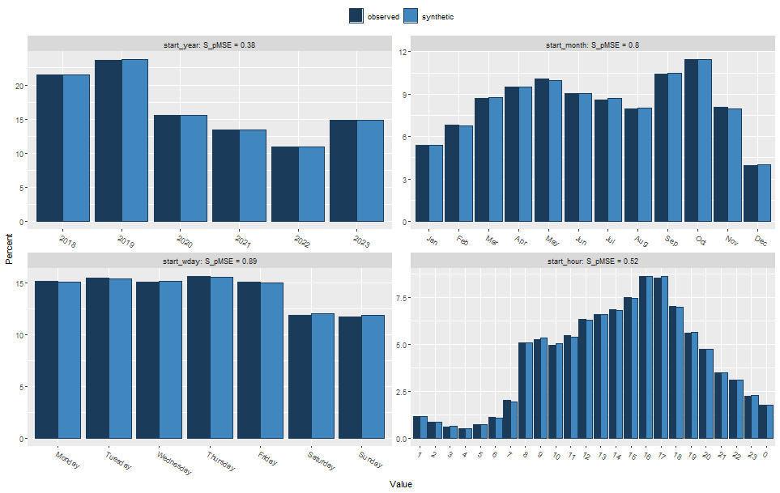
Low fidelity only one way tables

Slide 5
Low fidelity two way tables
start_month start_year Jan Feb Mar Apr May Jun Jul Aug Sep Oct Nov Dec 2018 1823 2308 2980 3253 3363 3128 2983 2708 3528 3868 2810 1341 2019 2044 2575 3285 3533 3744 3441 3262 2999 4006 4357 2882 1491 2020 1351 1658 2188 2396 2485 2187 2154 2024 2489 2797 1954 977 2021 1140 1469 1830 1977 2106 1889 1817 1694 2282 2471 1691 857 2022 898 1139 1480 1639 1715 1568 1521 1417 1817 1980 1445 703 2023 1234 1578 2084 2281 2393 2145 2027 1855 2464 2659 1820 942
start_month start_year Jan Feb Mar Apr May Jun Jul Aug Sep Oct Nov Dec 2018 1823 2308 2980 3253 3363 3128 2983 2708 3528 3868 2810 1341 2019 2044 2575 3285 3533 3744 3441 3262 2999 4006 4357 2882 1491 2020 1351 1658 2188 2396 2485 2187 2154 2024 2489 2797 1954 977 2021 1140 1469 1830 1977 2106 1889 1817 1694 2282 2471 1691 857 2022 898 1139 1480 1639 1715 1568 1521 1417 1817 1980 1445 703 2023 1234 1578 2084 2281 2393 2145 2027 1855 2464 2659 1820 942
Original
start_month
start_year Jan Feb Mar Apr May Jun Jul Aug Sep Oct Nov Dec
2018 1195 1737 2029 2727 3163 2909 3299 2897 3931 4750 3584 1889
2019 2670 2718 3437 3882 4161 3266 2839 2666 3814 3755 2796 1440
2020 2002 2165 2018 1108 1832 2162 1981 1952 2762 2899 2315 1398
2021 836 1364 3016 3538 3237 2563 2371 1160 1236 484 1196 323
2022 399 699 1268 1376 1297 1053 958 1134 1863 3148 2929 1234
2023 1425 2076 2062 2441 2242 2373 2130 2786 2920 3114 0 0
Synthetic
start_month
start_year Jan Feb Mar Apr May Jun Jul Aug Sep Oct Nov Dec
2018 1823 2308 2980 3253 3363 3128 2983 2708 3528 3868 2810 1341
2019 2044 2575 3285 3533 3744 3441 3262 2999 4006 4357 2882 1491
2020 1351 1658 2188 2396 2485 2187 2154 2024 2489 2797 1954 977
2021 1140 1469 1830 1977 2106 1889 1817 1694 2282 2471 1691 857
2022 898 1139 1480 1639 1715 1568 1521 1417 1817 1980 1445 703
2023 1234 1578 2084 2281 2393 2145 2027 1855 2464 2659 1820 942

Slide 6
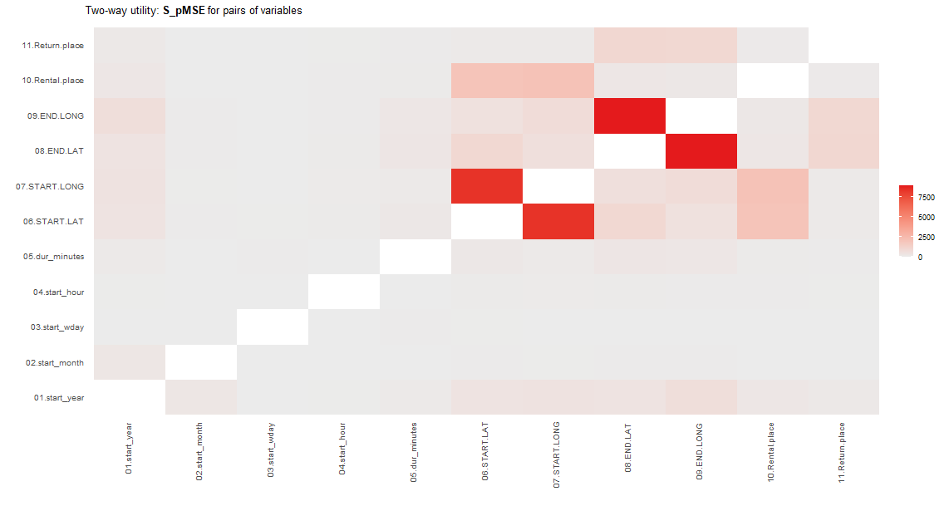
Utility.tables(syn1, bike1)
This measure should give values below 10
Here top of range is
7,500
Median was 69

Slide 7
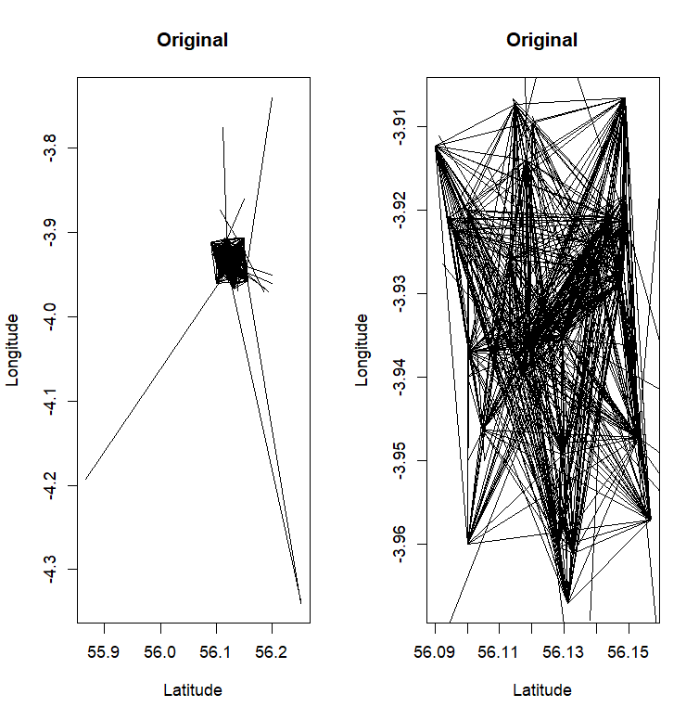
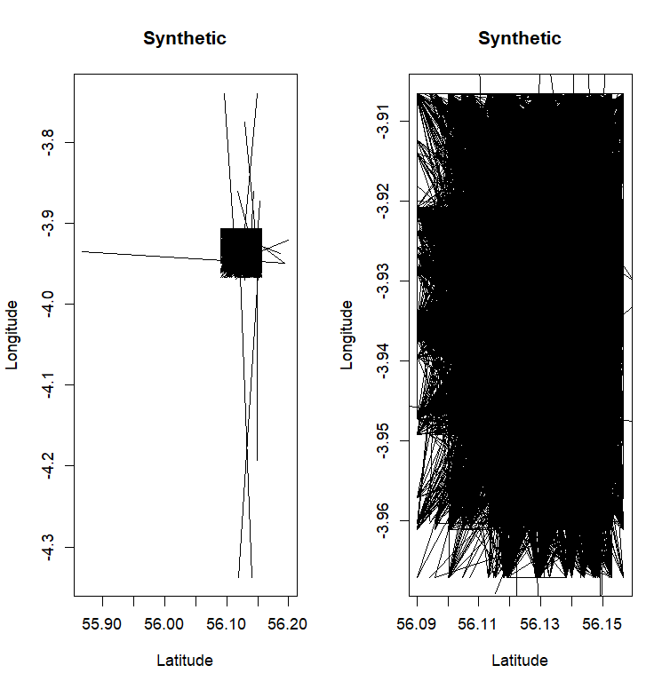
Low fidelity only one way tables

