Slide 1
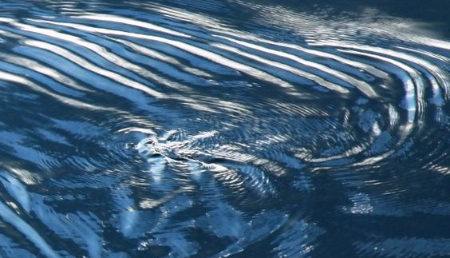
DIGITAL MEDIA STUDIO PROJECT
THEME: Process
GROUP MEMBER: Jaela Wang (s2417731), Jin Qin (s2309515), Rudan Zheng (s2309043), Yuan Tian (s2453498)

Slide 2
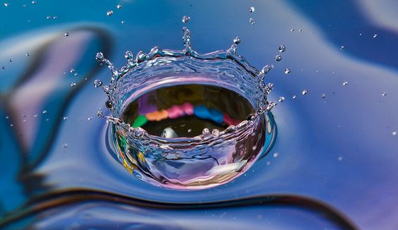
Role Division based on capabilities and preferences
Jaela Wang: Video and editing + Installtion + Equipments
Yuan Tian: Music generation + Installtion + pops
Rudan Zheng: Installation + Arduino coding + financial
Jin Qin: Installtion + Arduino coding + time control

Slide 3
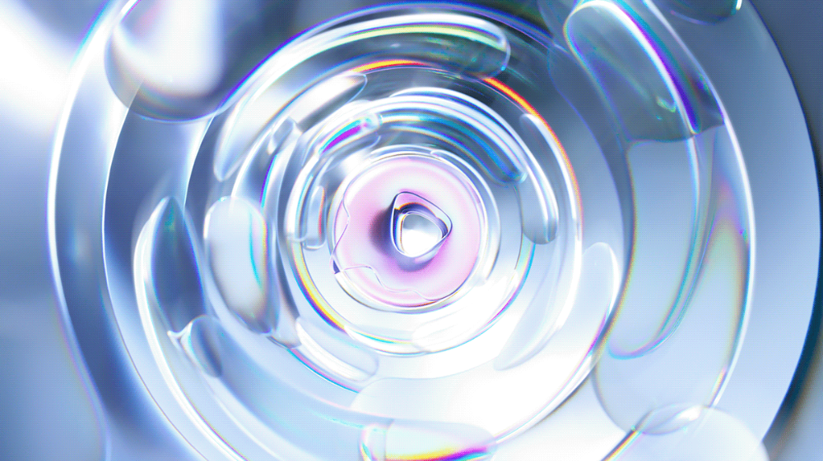
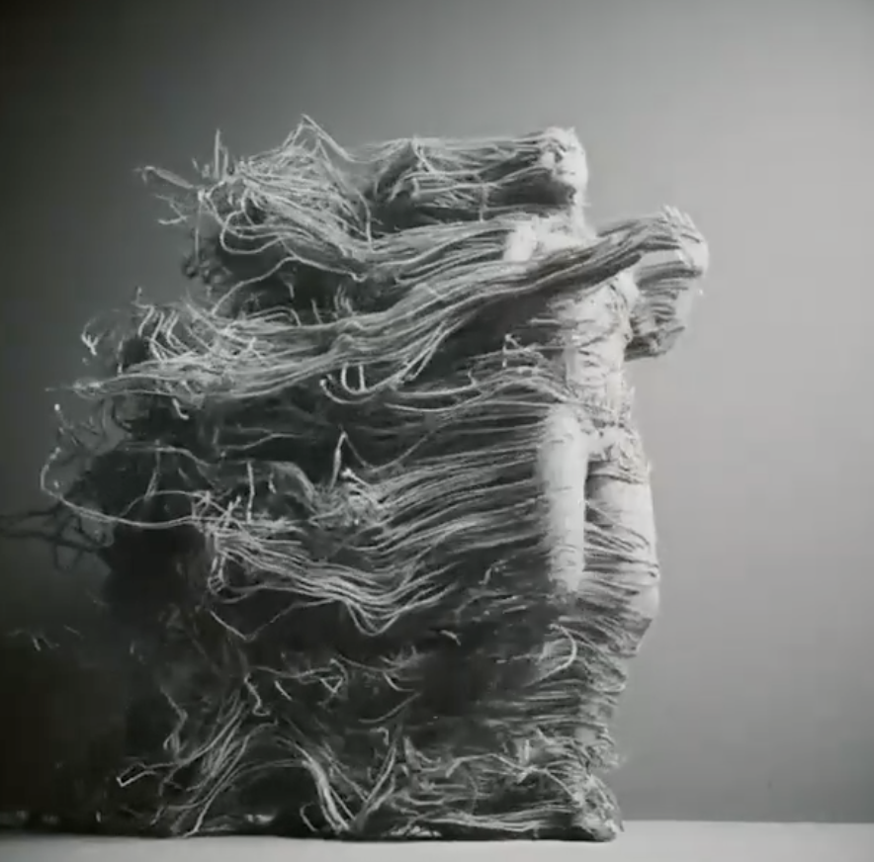
Keywords: Sound, AI
Initial Concept Generation

Slide 4
Brainstorm
1.Sounds of the season: capturing the sounds of the seasons and synthesizing them into a piece of music with AI
2.The world of color blindness: If I were a color blind person, could I experience the colorful world through sound
3.Musical Puzzles: exploring whether someone who doesn't know music can make a piece of music, through a collage (similar to a material puzzle, then synthesized with ai music)
4.Musical visualization device: embodied music
5.Vibrations of music (amplified) - water/vibrations of lines/line drawings/other media
6.Music and Time: rhythm and the different frequencies of time, exploring whether music can change one's perception of time
7.A world of astigmatism: what would the world look like if I blurred your eyes (Using AI as an example, blur the image with hairy glass or water and use ai for analysis)
Among those ideas, we prefer the element of water, namely the fifth idea, and them we discussed the details and its way of realization.

Slide 5
Our initial scheme was：
A drop of water evaporates for 30 minutes. During the process, the vibration of sound will change the refraction of light, and display wonderful light and shadow exhibition. The process can be divided into three stages, which is similar to a lifetime of a person. Also, the music will be separated into three stages to cooperate with the changes. At the same time, there will be a projector for casting various environments animation to create a more immersive experience for the audience.
In terms of sound design, the music is selected to represent the trajectory of different periods in life, using the vibrations of the speaker's diaphragm to make contact with the wooden board, allowing a drop of water to resonate with the sound, which is perceived visually through the amplitude of the water drop's rippling vibrations. Over time, the water droplets slowly and unconsciously evaporate, allowing for an association between perception and imagination, engaging the senses, and bringing about an interactive experience of time and space.
We collected some reference pictures and tutorials, and then created a moodboard.

Slide 6
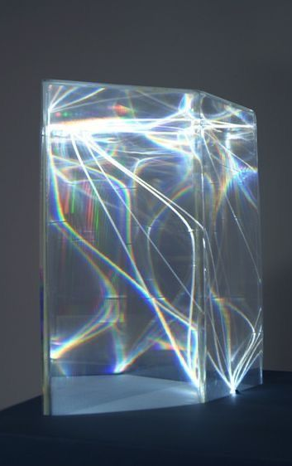
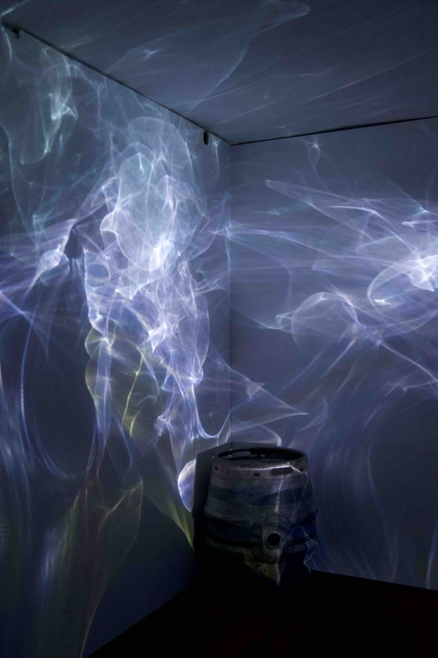
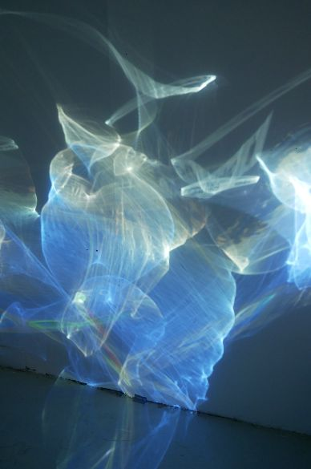
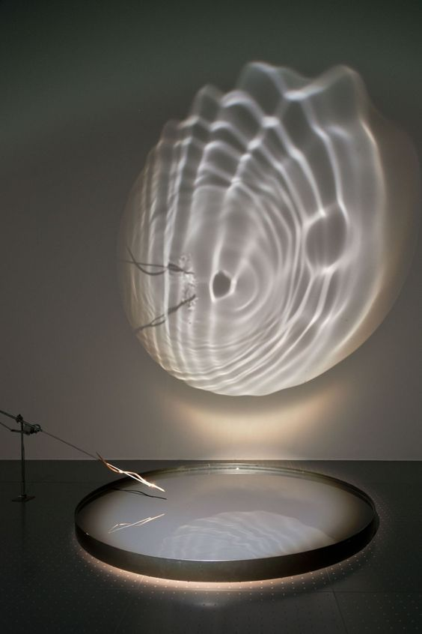
Moodboard

Slide 7
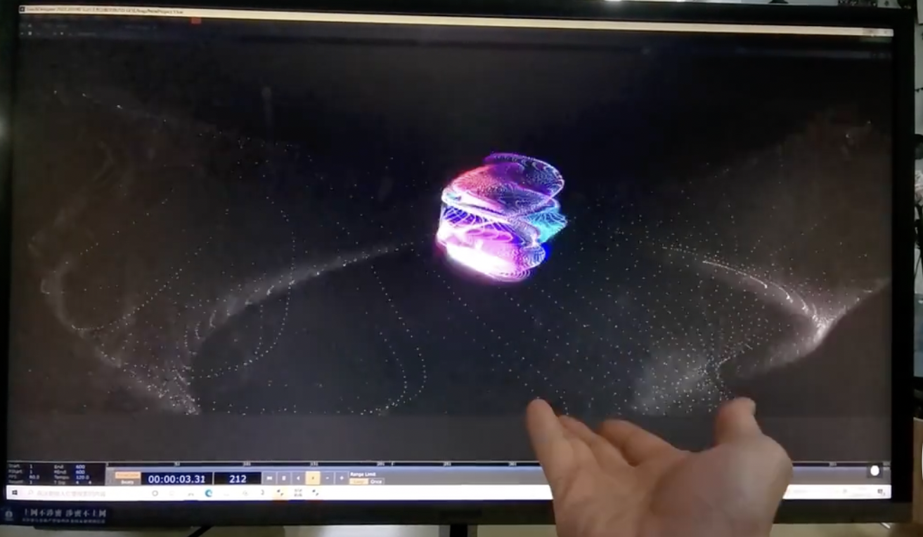
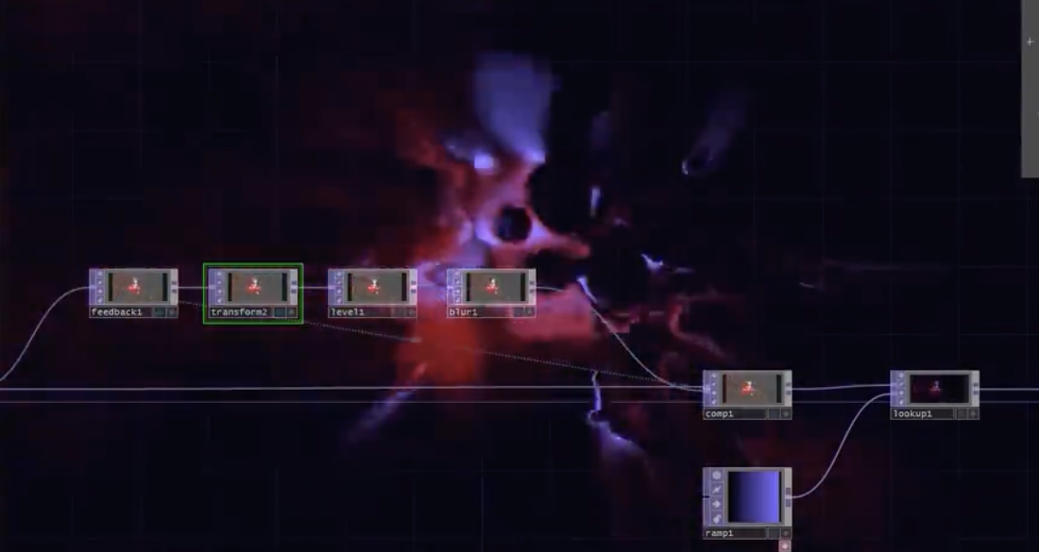
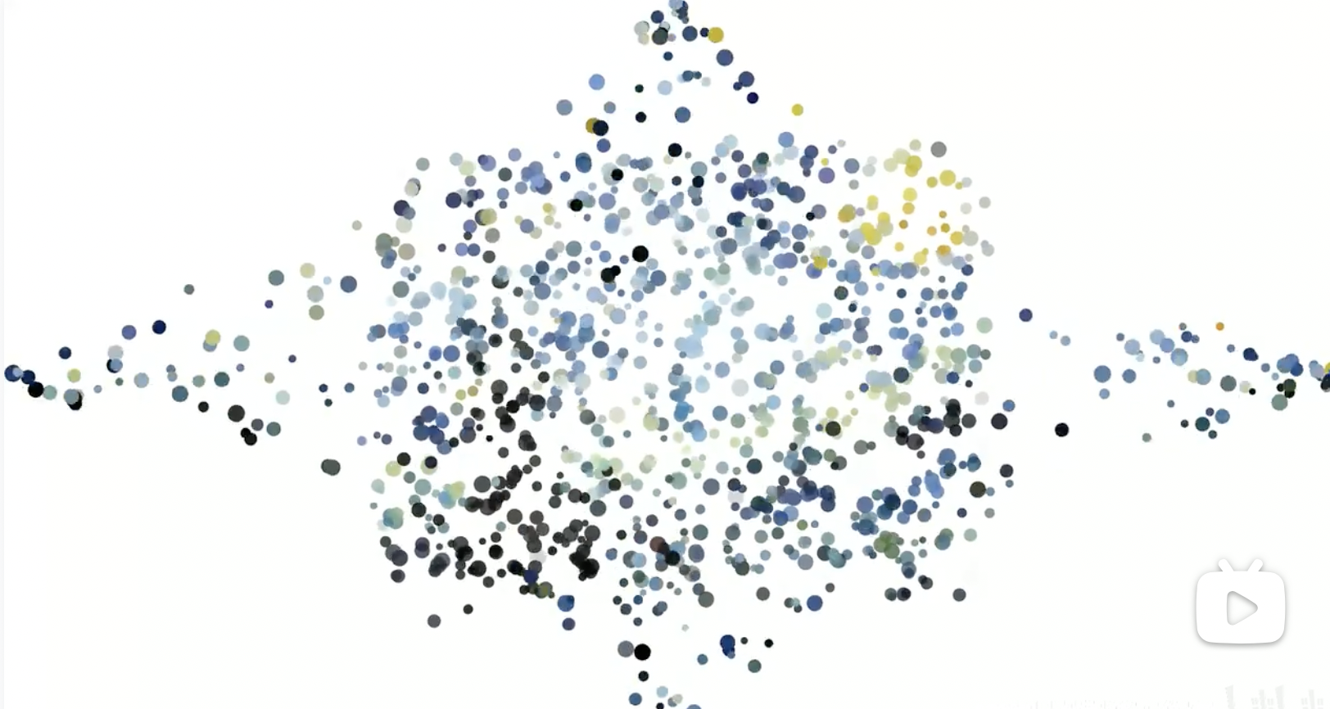
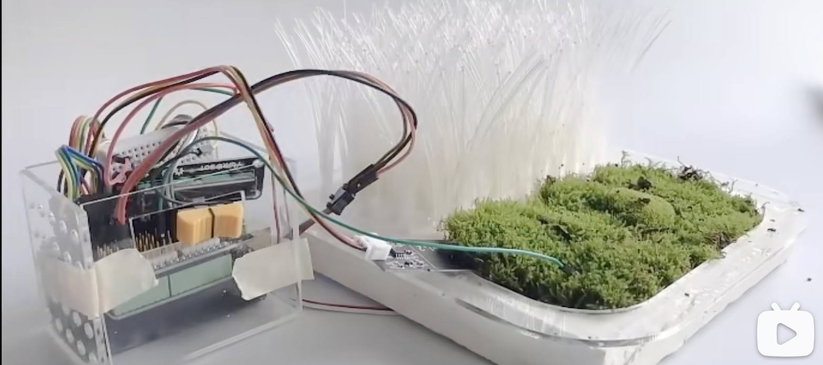
Reference list :
【TouchDesignerTutorials｜Noise Creative Spin BallLeapMotion Gesture interaction】
https://www.bilibili.com/video/BV1EG4y1g72Z/?share_source=copy_web&vd_source=a8711564270b15c0c52431a25b613a14
【Audio-visual Interactive - Aurora_】
https://www.bilibili.com/video/BV1d84y1k723/?share_source=copy_web&vd_source=a8711564270b15c0c52431a25b613a14
【Processing--Blowing interaction】
https://www.bilibili.com/video/BV1PE411k7bf/?share_source=copy_web&vd_source=a8711564270b15c0c52431a25b613a14
【Plant sensory visualisation/A sketchy interactive installation】
https://www.bilibili.com/video/BV1LL4y1T7oG/?share_source=copy_web&vd_source=a8711564270b15c0c52431a25b613a14

Slide 8
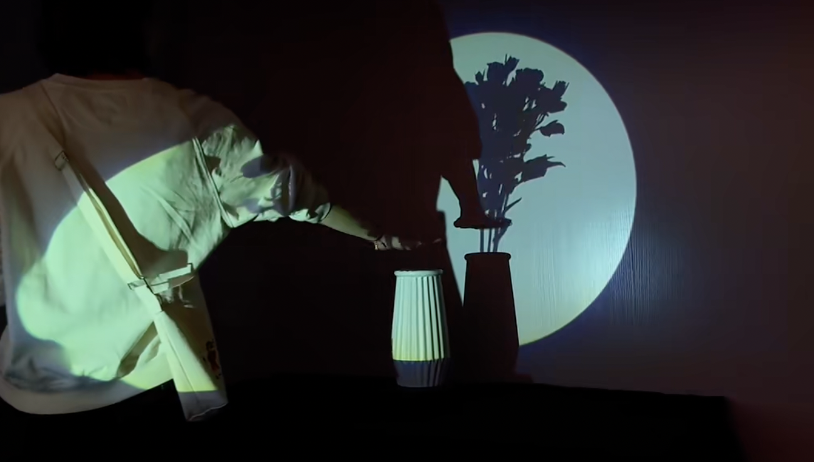
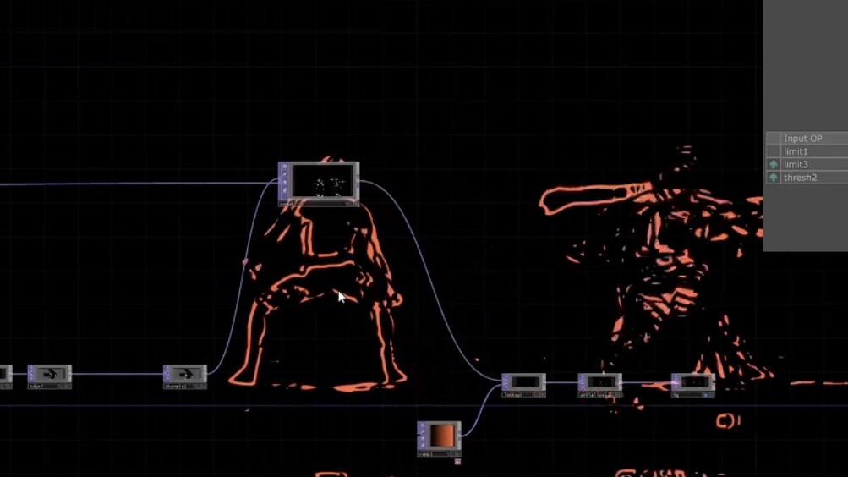
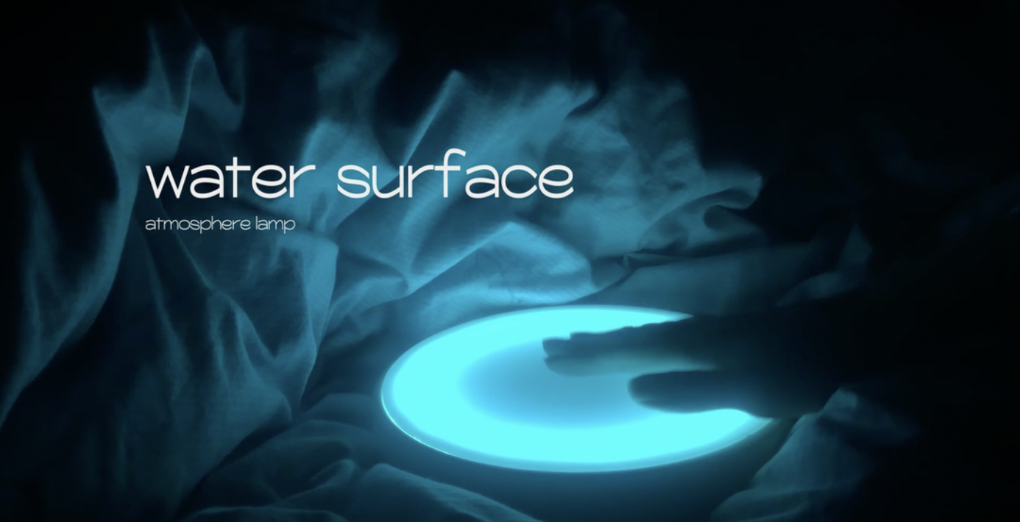
Reference list :
【Interactive artwork AS IF】
https://www.bilibili.com/video/BV1hP4y1c7PN/?share_source=copy_web&vd_source=c0cd555c871b3d6c3923522ce3b0a1a8
【Simple Motion Visualisation –Simple motion visualisation can be done using Kinect】
https://www.bilibili.com/video/BV1Pd4y1o71B/?share_source=copy_web&vd_source=a8711564270b15c0c52431a25b613a14
【Touchdesigner Sound and picture interactive lines】
https://www.bilibili.com/video/BV1BV4y137kL/?share_source=copy_web&vd_source=a8711564270b15c0c52431a25b613a14
【"Water" ambient light - Arduino design】 https://www.bilibili.com/video/BV18X4y1u7XP/?share_source=copy_web&vd_source=a8711564270b15c0c52431a25b613a14

Slide 9
Dissection of “Process
However, after our clarification to Jules on Thursday in week three, Jules pointed out that our discussion limited in the practical aspects, without the dissection of concept of “Process” and the inclusion of AI. Therefore, we carried on analysis on the concept “Process” in two dimensions: the first one is the dissection of project content and connotation, the second one is the dissection of design process.
Dissection of the Process of our project Content
We analyzed on “Process” based on our initial concept of water projection. Analogy is applied to explain the project objects and connotation. The water (the project object) is equivalent to Me (the analogy object), The dripping speed of waterdrop represents the speed of my growth, The size of water in the container represents the extent of my growth, The light expresses the society, and the beam of light striking on the water means the influence of the society on us, The vibration of sounds or music represents the influence of our family/others' evaluation on us, The light and shadow of water projected on the wall represent my image in the eyes of others, The flow of water from less to more to none in this device shows the period of my lifetime from birth to the complete of my sentence.

Slide 10
Dissection of our design process
AI artists are playing a more and more significant role in Art and Design field. Meanwhile, Hidden danger and controversy are ensuing, such as the unclear copyright, the substitutability of AI artists to human artists, and the artistry of AI works of art. Therefore, we would like to discuss some questions like:
1. What role does AI play from the artist's design process to the final production?
2. Whether AI can replace artists in design or not?
3. If AI intervenes in most of the content during the design process, can the final work touch the audience?

Slide 11
Under such questions, we designed a working flow to test the competition between AI artists and human artists through two controlled experiments.
 | Human Artist | AI Artist
First Stage | Take a series of photos, and create an animation based on the photos | The series of photos fed to AI and AI artist outputs continuous pictures for animation
Second Stage | Create music based on the animation created in the first stage | Generate music based on the animation video feeding to AI like Clip Interrogator
Third Stage | Exhibit two final composition works,and let the audience choose their favorite work

Slide 12
Final Preference
We prefer the dissection of the project content after analysis and plan on the two different understandings. From our perspective, AI is regarded as a tool for helping human artists broaden their mind. Subjective initiative of a human artist is the reason of the origin and existence of art. In this case, we focus on our project content with AI working as a tool for making up for our shortcomings. In addition, our work is expected to review social phenomenon, with social meaning rather than discuss “meaning”. Besides, the form of combining installation creation with coding is more challenge to us, which needs to be tested, improved, deleted, modified for a long term. For us, the process of challenging and creating is meaningful too, so we will keep recording the process of project creation.

Slide 13
The specific plan as follows
Fig. 1. Text Flow of Project Process

Slide 14
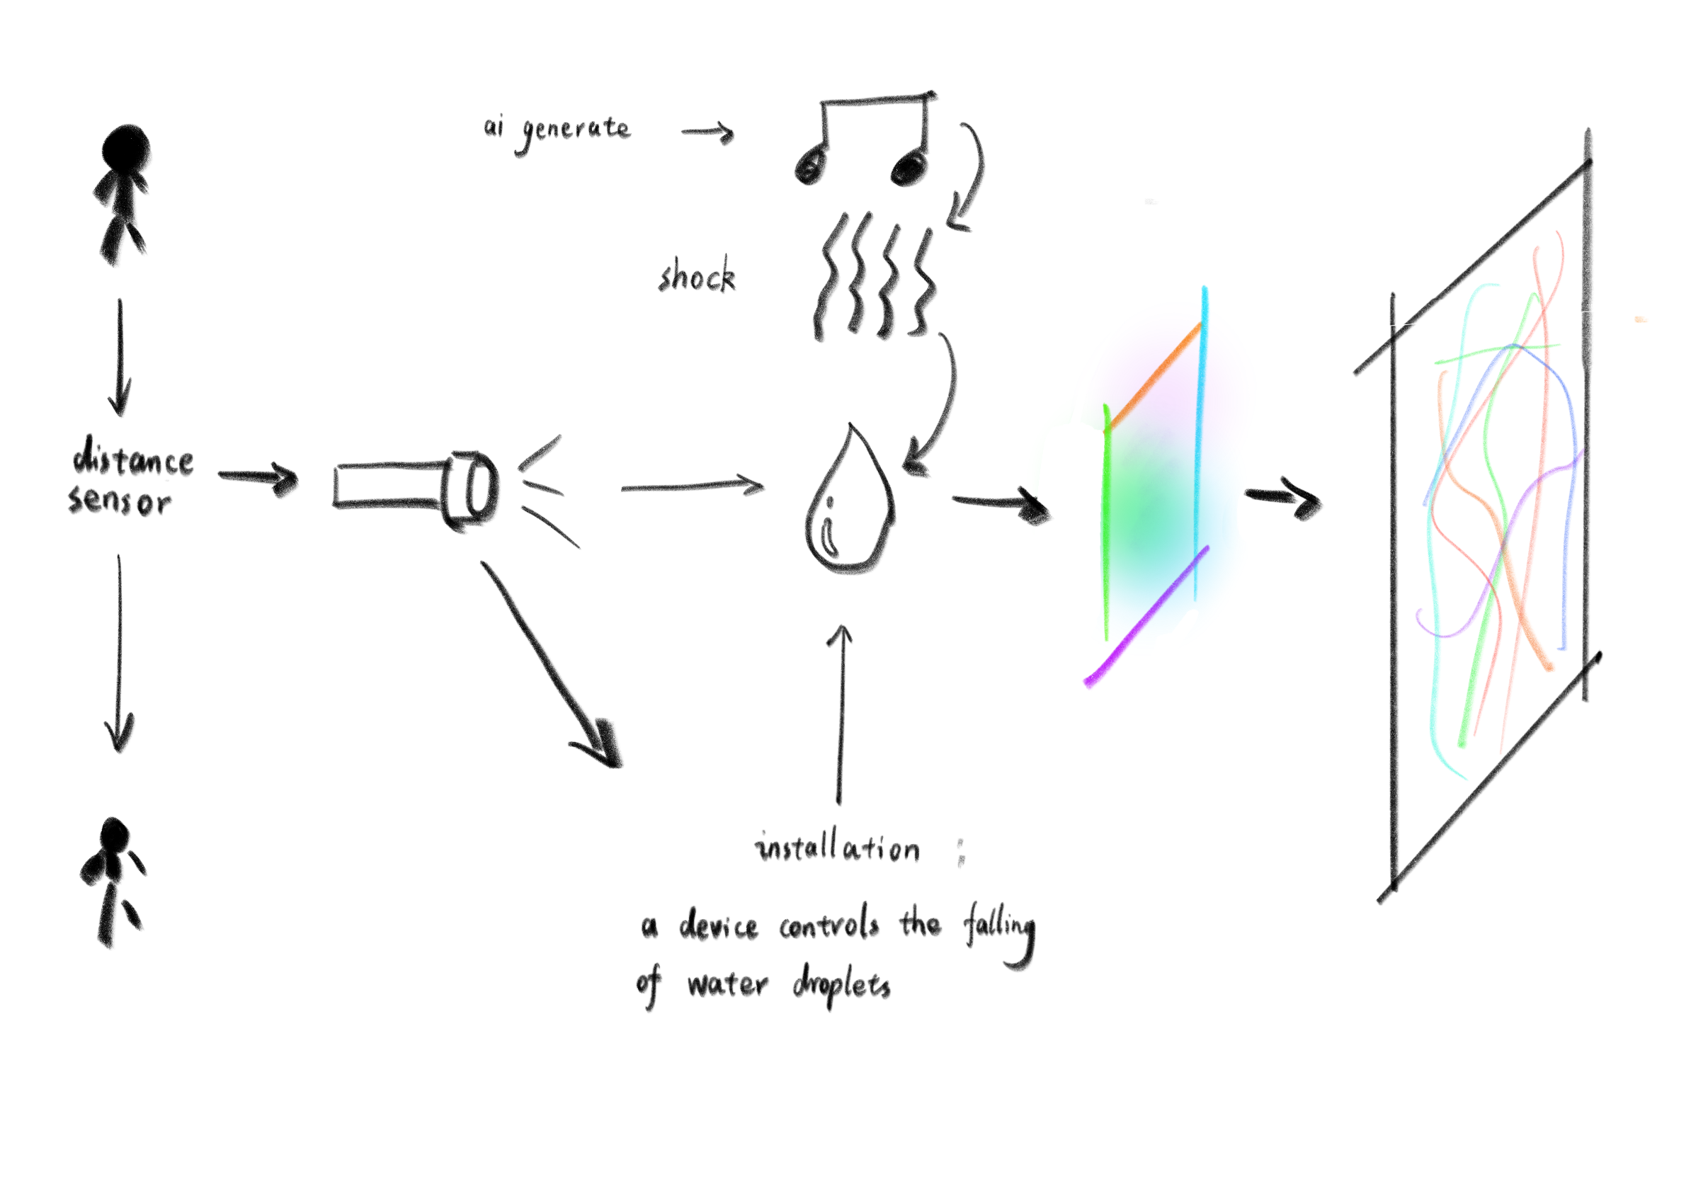
The installation includes a distance sensor. Once the audience approaches the sensor, the speaker, the light, and water-dropping system start running. The speed of water dropping changes according to different stages. Ripples appear, and the vibration of the speaker can influence water’s morphology and dynamics. Ray though the laser paper and water projects special changes of water on the wall. When the water is full of the container installation, they will be poured away from the container. The whole process can be divided into three stages, where music and speed of water-dropping are continuously changing.
Fig. 2. Picture Flow of Project Process

Slide 15
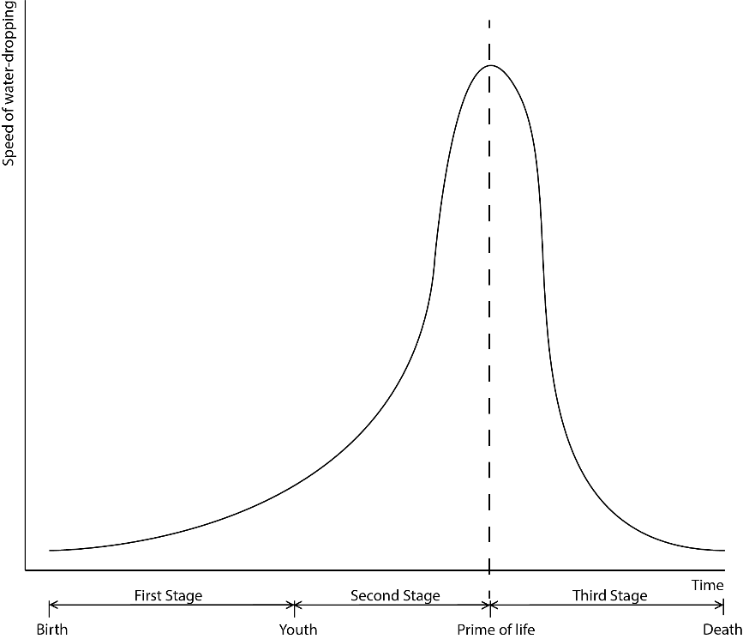
The speaker is placed flat under a table with a container, on top of the speaker diaphragm and water drops are placed in the container so that the drops create ripples through the sonic Hertzian vibrations of the music. We will take photos of shadows and lights of the water and record some sounds. Those photos and sounds will be learned by AI, such as Mubert-text-to-music, disco diffusion, and clip interrogator, and then AI will generate some pieces of music. Before each stage starts, we will invite an audience to pick one piece of music from three pieces we provide to influence the ripples.
Fig. 3. Graph of Relationship of Time and Speed of water-dropping

Slide 16
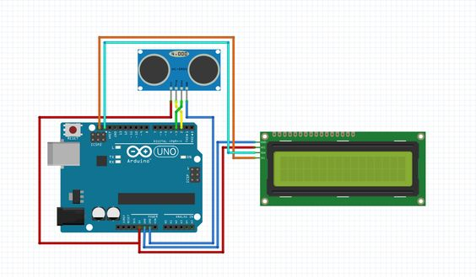
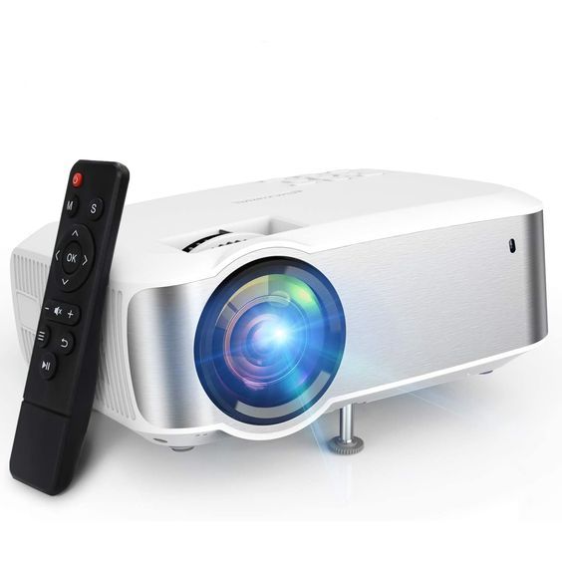
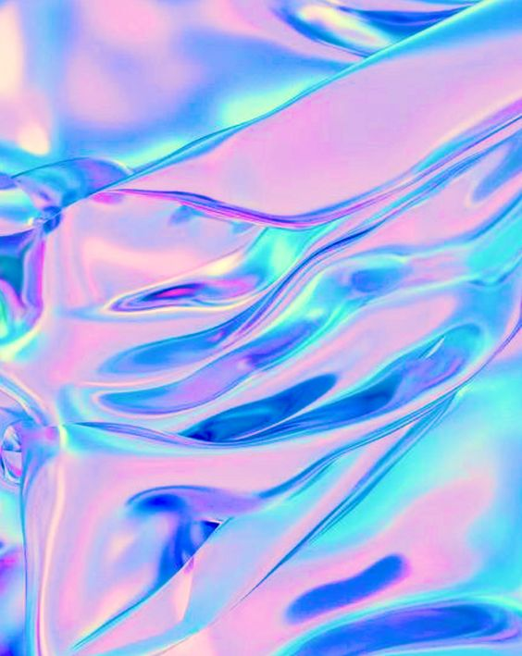
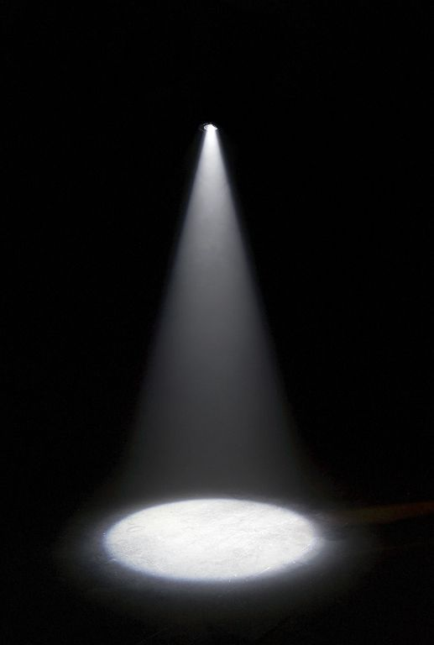
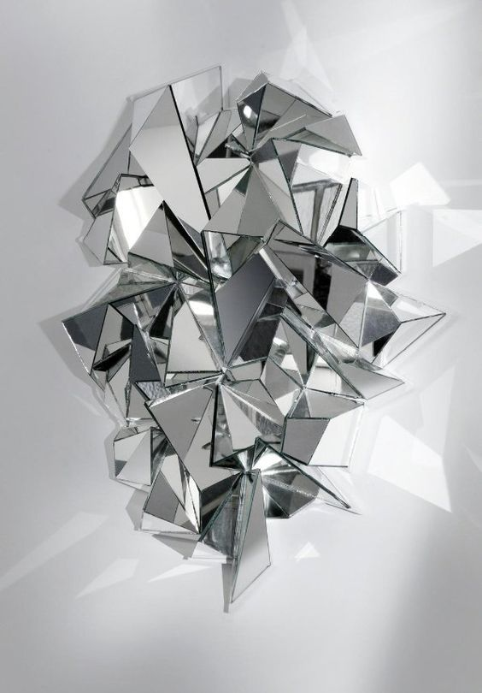
Materials we need
Water, Mirror, camera, spotlights, Laser paper, transparent container, straws, distance sensor, Arduino motherboard, water-dropping installation, a room without window or with curtain, speaker, speaker diaphragm

Slide 17
Time Schedule
Week 1 – lecture Week 2 – brainstorming, group discussion Week 3 – modification and improvement of the project according to suggestions of Jules and Philly Week 4 – decision on detailed design, material preparation and space lease Week 5 & 6 – project testing, sound test, AI learning, installation design Week 7 – testing in room Week 8 & 9 & 10 – video editing, sound editing, Arduino coding and testing Week 11 & 12 – complete testing Week 13 – modification Week 14 - final composition, video editing

