Slide 1
What causes the asymmetry between index and open-hand pointing in L1 acquisition?
Amalia Skilton (Cornell)
Alejandra Gonzalez (Cornell)
LSA Denver 2023
January 9, 2022
Notes:
Please save questions for the end of the talk
Interpreters, I welcome requests to slow down, please deliver them early and often!

Slide 2
Acknowledgements
Thanks to:
Cushillococha community
All participants and families
Angel Bitancourt Serra
“Karina”
Previous audiences
Funders
NSF GRFP; NSF/DEL DDRIG (BCS-1741571); NSF SPRF (SMA-1911762); & Cornell Klarman Fellowship to Amalia Skilton
Opinions ours and not those of NSF

Slide 3
Motivations
This project began as a cross-linguistic study of learning of deictic/ demonstrative words.
But deixis is not just about demonstratives.
We can only understand verbal deixis (i.e., dems) in concert with deictic visual behavior.

Slide 4
Child Pointing & Language Development
There is a close relationship between deictic gesture development & language development
But relationship limited to points with extended-index (IX) handshape
Onset of IX → Onset of word learning
IX frequency → Vocabulary size, social/cognitive measures outside language
Does not extend to open-hand/whole-hand (OH) gestures
Carpenter et al. (1992), Liszkowski & Tomasello (2011), Liszkowski et al. (2012), Cameron-Faulkner et al. (2020)

Slide 5
Why the asymmetry?
Motor bias toward IX
Due to species-specific handedness & precision grip
Cognitive bias toward IX
IX intrinsically directs attention, OH is simply reaching
But if these biases exist, why are there conventional non-IX points?
Non-IX can be preferred form (Cooperrider)
Or can be one form among many (Fenlon; Kendon & Versante)
Povinelli & Davis (1994), Butterworth (2003), Liszkowski & Tomasello (2011), Cooperrider et al. (2018), Kendon & Versante (2003), Fenlon et al. (2019)

Slide 6
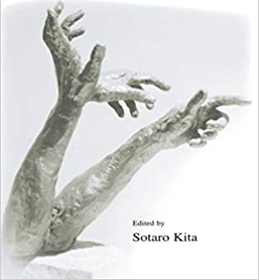
Our hypothesis
While IX is always present in the gestural vocabulary, it is not always conventional.
So we hypothesize that IX-OH asymmetry results from learning.
In populations represented in lit, IX is conventional, OH is not.
When OH is absent or rare in input, it falls away over time – like a non-native phoneme

Slide 7
Roadmap
Background on deictic gesture
Background on deixis fieldwork w/ Ticuna speakers
Methods
Results & Discussion
Conclude

Slide 8
Background: Ticuna Language

Slide 9
Ticuna Language & People
Isolate
Spoken along Amazon River in Brazil, Colombia, and Peru
40,000 - 70,000 speakers
Most widely spoken Indigenous language in Brazil
Anderson & Anderson (2017), Montes Rodriguez (1995), Santos (2004), Soares (2000)

Slide 10
Field Site
Data from Cushillococha, Peru
Titled Indigenous community with ~5,000 people
Skilton conducted fieldwork 15 months 2015-2022
2015-2018 mostly w/ adults
2019, 2022 w/ kids

Slide 11
Ticuna Adults’ Pointing
6 Ticuna speakers completed 30-minute monolingual interview about current + historical location of landmarks (Kita 2001)
Analyze 484 demonstrative + gesture composite utterances
All of the participants used IX handshapes <65% of the time
Main non-IX handshapes were open (ASL 5-hand) and flat (ASL flat B)

Slide 12
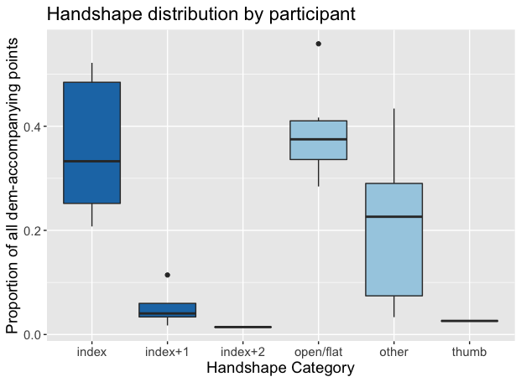

Slide 13
Hypotheses

Slide 14
Research Question
What causes the asymmetry between IX and OH in development?
Our hypothesis:
Learning from caregivers who use mostly IX.
Alternative hypothesis:
Motor or cognitive bias toward IX.
Notes:
Is it due to culturally specific gestural conventions or to some innate association between IX pointing and language acquisition?
Our hypothesis, is that this asymmetry is learned from caregivers, that is, as children mature, their pointing preferences reflect those of their caregivers. We can call this the learning hypothesis.
The alternative hypothesis is there is some sort of motor or cognitive bias towards IX pointing, which is on a maturational timetable along with language acquisition, marking the importance of IX to language development.

Slide 15
Prediction 1: IX-OH Ratio
Learning hypothesis:
Ticuna children will display same proportion IX as Ticuna adults (<0.6).
IX proportion will not change with age > 12 months.
Motor/cog bias hypothesis:
Children will use proportionally more IX than adults (emergence of the unmarked).
IX proportion will decrease with age > 12 months.
Notes:
We have two predictions for our data, the first focusing on the ratio of index to open hand points.
Under the learning hypothesis, we expect to see no more than 60% of children’s points to be IX points, which is about the same proportion we saw in adults in the adult-directed interview study. We don’t expect this proportion to change within the age range of our study, which starts at 12 months.
Under the motor or cognitive bias hypothesis, we expect to see children using more IX pointing than their adult caregivers – because under this hypothesis, IX is the unmarked or articulatorily natural pointing form. Over time, children will learn from their caregivers that this amount of IX is not adult-like. So their IX proportion will decrease until it eventually becomes more like the adults’ IX proportions.

Slide 16
Prediction 2: IX-OH & Language Acquisition
Learning hypothesis:
Children’s IX frequency & OH frequency will have similar relationships to their language development, as measured by MLU or turn count.
Motor/cog bias hypothesis:
Ticuna children will maintain the unique relationship between IX and language development seen in other populations.
Notes:
Our second prediction looks at the relationship between language acquisition, as measured by MLU or turn count, and index or open hand pointing.
If the learning hypothesis is supported, we expect to see IX and OH pointing to both have similar relationships with language development, since they are both adult-like pointing forms.
If the alternative hypothesis is supported, we expect to see the unique positive relationship between IX pointing and language development that we see among Western populations. That’s because, under this hypothesis, there is an intrinsic link between IX and the social cognitive abilities that are required for language learning.

Slide 17
Methods

Slide 18
Participants: Individuals
Cross-sectional study
45 participants aged 1;0 – 4;11
Data collected in Cushillococha in 2019
Recruitment criteria
Primary caregiver speaks Ticuna as native & dominant language
Child seems to be typically developing & acquiring Ticuna as L1
16 also had exposure to Spanish / Spanish as concurrent L1

Slide 19
Data
Each child completed two tasks:
Object Play – 30 min, all with same object
Free Play – 60 min, no instructions
Recorded with dual-camera video and body-worn audio recorders.
Sample 10 minutes per child per task.

Slide 21
Annotation
Speech transcribed & translated
All JA sequences > 3 seconds identified
Within JA sequences, points were coded on two features:
Handshape – index vs. open vs. other
Force – declarative vs. interrogative vs. imperative
Reliability is much greater for handshape (Cohen’s k = 0.68) than for handshape + force (Cohen’s k = 0.54)

Slide 22
Results

Slide 23
Use of IX vs. OH/Other Handshapes
In this dataset, caregivers use primarily IX (mean = 0.84, SD = 0.25)
Kids do not: mean IX proportion = 0.64, SD = 0.33
Sample size of points is small, especially for kids (<1 point/minute)
Notes:
We were surprised to see caregivers behaved differently than in adult directed study, much more IX when interacting with kids, observer or effect of addressee
Children show similar proportions to adult-directed study based on interviews, caregivers use index 80% of the time, in baseline, they only use it 60% of the time
Takeaway: children’s proportion of index is 60% (more than half the time)

Slide 24
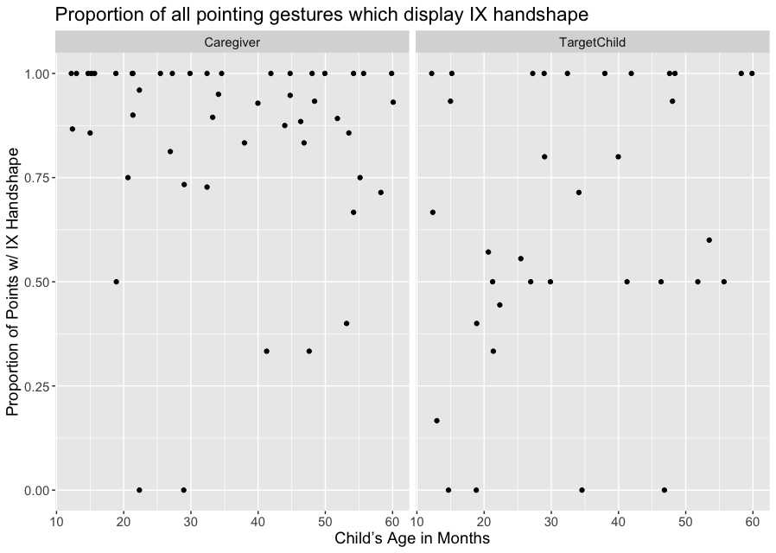
Notes:
Takeaway: IX is not related to age
Introduce plot by orienting X, Y, two panels show A and B
Age in months age of child adult interacts with
Then explain clustering per side
No significant correlation between age and IX proportion
No significant effect of anything in logistic regression w/ IX proportion as DV, age and caregiver’s IX proportion as IV’s
Model criticism (e.g. removing caregiver IX proportion) does not change this outcome
This is what we predicted!
Continuity only surprising if we think OH is immature & should fall away.

Slide 25
IX vs. MLU
MLU is imperfect for languages with complex morphology.
That said, MLU in words does clearly increase with age:
How does MLU relate to use of IX?
 | 1;0-1;11 |  | 2;0-2;11 |  | 3;0-3;11 |  | 4;0-4;11
 | M | SD | M | SD | M | SD | M | SD
Word types | 19.3 | 18.4 | 49.8 | 42.1 | 73.5 | 44.0 | 92.2 | 47.1
MLU (words) | 1.4 | 0.4 | 1.7 | 0.3 | 2.0 | 0.5 | 2.3 | 0.6
Notes:
Takeaway: in western based studies we see a strong relationship between IX and MLU. We want to know if this also holds in our dataset.
We’re going to use MLU as our measure of lang div. Ticuna has complex morphology, so MLU measured in words is a less useful measure than it would be for a more analytic lang such as English.
However, we do see a consistent increase in MLU in words with age, so we are willing to use it for now.
What is the relationship between MLU and proportion IX?
Under our learning hyp, we predict no relationship between MLU and IX because IX is not privileged over other pointing forms (in terms of input frequency or frequency in children’s own production).
Based on Western literature, OTOH, we predict that higher IX would be associated with higher MLU (as well as older age). These can be dissociated in the case of kids who have unusually high or low MLU values for their age.

Slide 26
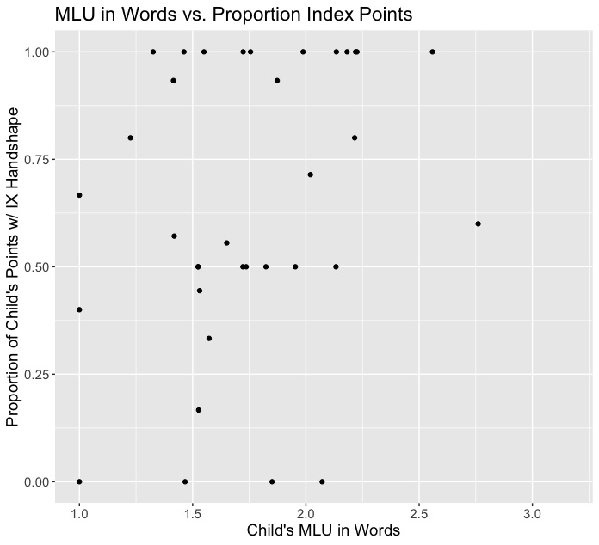
Notes:
Orient the graph and then say: There is no relationship here

Slide 27
Null Again
Two logistic regressions with MLU and age as IV’s
Proportion IX as DV
Proportion OH as DV
Neither predictor (age or MLU) is even close to significance.
This again does not change under different model structures (e.g. dropping age, not collapsing across samples).
Notes:
We created two different logistic regression models. One had IX as the dependent variable, the other had OH as the dependent variable, this was necessary because some points could not be categorized as either IX or OH so the handshape variable is not strictly binary.
The models included age and MLU and their interaction as independent variables
There was no effect of either predictor in either model and model criticism such as removing age did not change this.
Takeaway: IX is not related to MLU or age no matter how much you try.

Slide 28
Discussion

Slide 29
Prediction 1: IX-OH Ratio
We predicted: If IX>OH preference is learned, children will display ~60% IX, and IX proportion will not change with age
Both supported:
Mean of child IX proportions was 0.64 - like adult interview data
No change in IX proportion over time
No evidence for motor bias prediction (start with high IX and decline)

Slide 30
Prediction 1: IX Proportion
In terms of pointing form, caregivers in this data did not behave much like adults in interview data
Mean proportion IX for caregivers = 0.84, in interviews = 0.44
Why?
Register?
Unique properties of dem-accompanying gestures?
Tradeoff between non-IX points and other JA behavior?
Notes:
One person was in both samples: 90% IX to her child, 59% IX in interview

Slide 31
Prediction 2: IX and Language Development
We predicted: If IX>OH preference is learned, children will display same relationship between IX & MLU as between OH & MLU.
Also supported. But in an unexpected way:
MLU doesn’t predict either IX or OH proportion
So is there a problem with MLU?
Probably not – Alejandra Gonzalez (Cornell) found same relationship w/ turns of contingent talk

Slide 32
Conclusion

Slide 33
Substance
IX use is present in all cultures/populations, but IX preference is not.
Children who live in cultures with a strong IX preference, such as AmEnglish speakers, display unique relationships between IX & language development.
Ticuna children, who lack a strong IX preference, do not.
→ IX uniqueness is epiphenomenal on IX preference.

Slide 34
Implications
Manual pointing and the IX handshape are not synonymous.
Deictic visual behavior goes far beyond IX, and even beyond pointing.
We’ve argued that OH as well as IX matters to joint attention management
But this dataset suggests that non-pointing JA behaviors matter even more – pointing is only ~15% of JA codes

Slide 35
Thank You!
Find more about this work at
http://blogs.cornell.edu/amaliaskilton

Slide 36
Extra Slides

Slide 37
Dataset Size
 | Caregivers | Children
Turns at talk | 13,217 | 8,480
Time in joint attention* | 218 min 32 sec | 213 min 24 sec
All JA-related gestures | 3,402 | 3,032
Pointing gestures* | 491 | 162
* with/addressed to other target participants

Slide 38
Participants: Families
Kids live in large households
Average nuclear household has 5.9 people (range: 3 – 10)
89% live in an extended household, average size = 16.0 people (range: 8 – 28)
Caregiving distributed across family
60% have >1 primary caregiver
→ Abundant and diverse input from adults and other kids
(cf. Bergelson et al., 2019; Casillas et al., 2020, 2021)

Slide 39
Sampling Procedure
Object play: Smooth distribution of speech over time
Sampled first 10 min per rec per participant
Free play: Irregular distribution of speech over time
Bursts of talk + activity at unpredictable timepoints
→ Sampling based on speech:silence ratio
10 min with highest speech ratio

Slide 40
Activity Type Coding
Identify joint attention sequences vs. 7 other sequence types
Defined by language plus visual behavior
All interactions w/ a person about an object are JA
>3 seconds change in activity = new annotation
25% recoded by secondary coder
All 8 categories: Cohen’s k = 0.67
JA vs. not JA: Cohen’s k = 0.79

Slide 41
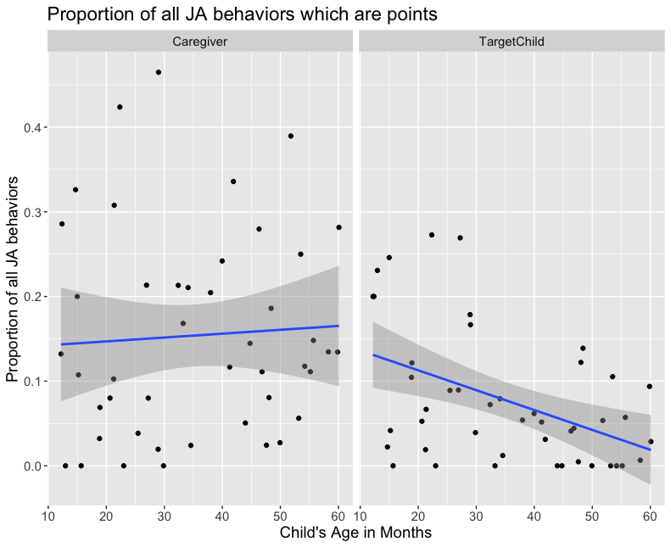

Slide 42
Data Characteristics
Language production measures per session:
 | 1;0-1;11 |  | 2;0-2;11 |  | 3;0-3;11 |  | 4;0-4;11
 | M | SD | M | SD | M | SD | M | SD
Word tokens | 28.8 | 30.9 | 81.4 | 71.0 | 135.3 | 96.1 | 162.8 | 103.0
Word types | 19.3 | 18.4 | 49.8 | 42.1 | 73.5 | 44.0 | 92.2 | 47.1
MLU (words) | 1.4 | 0.4 | 1.7 | 0.3 | 2.0 | 0.5 | 2.3 | 0.6

Slide 43
What about counts?
In all of these analyses, DV is a proportion
Differences in total point count, total time in JA
Corner of evidence for change: Count of OH/other points over developmental time
Child participants with >1 OH/other per sample are all 1-2 years old

Slide 44
