Slide 1
Children acquire non-egocentric demonstratives later than egocentric ones
Amalia Skilton
University of Texas at Austin
Linguistic Society of America
January 9, 2021
Notes:
I welcome both clarification and content questions during the talk. However, please save them for the “Interim summary” slides at the end of each section
This is a work in progress, so I have included some points for discussion in the interim summary slides. For example with analytical decisions that I have not yet made, or that I am thinking of changing

Slide 2
Roadmap
Background on demonstrative (this/that, here/there) acquisition
Background on Ticuna language
Methods
Results & Discussion
Conclude

Slide 3
Theoretical Background

Slide 4
Acquisition of English demonstratives
Early emergence
  This/that, here/there appear very early (Clark 1978)
  Among first 10 words (though cf. Gonzalez-Peña et al., 2020)
  Very frequent in early production (7-10% of all word tokens for 1-year-olds)
Late mastery
  Early production not adult-like: no contrast
  Adult-like comprehension very late: 6-7 years (Webb & Abrahamson 1976; Clark & Sengul 1978)

Slide 5
Demonstratives and egocentrism
Early emergence-late mastery holds across languages
  Spanish, Turkish, Mandarin, Yucatec Maya (Gonzalez-Peña et al. 2020, Küntay & Özyürek 2006, Chu & Minai 2018, Espinosa Ochoa 2009)
Late mastery explained via (spatial) egocentrism
  Causes egocentric interpretations of other speakers’ dems
  e.g., here = near child, there = far from child (Clark & Sengul 1978)

Slide 6
Early emergence, late mastery
Our hypotheses about this pattern:
Early emergence is due to very high frequency.
Late mastery is due to status as deictic.
  Requires construing Ref from another’s perspective → challenges egocentrism
Wherever 1 & 2 are true about dems, predict same behavior.

Slide 7
Language Background

Slide 8
Ticuna Language & People
Isolate
Spoken along Amazon River in Brazil, Colombia, and Peru
40,000 - 70,000 speakers
Most widely spoken Indigenous language of Brazil
Anderson & Anderson (2017), Montes Rodriguez (1995), Santos (2004), Soares (2000)

Slide 9
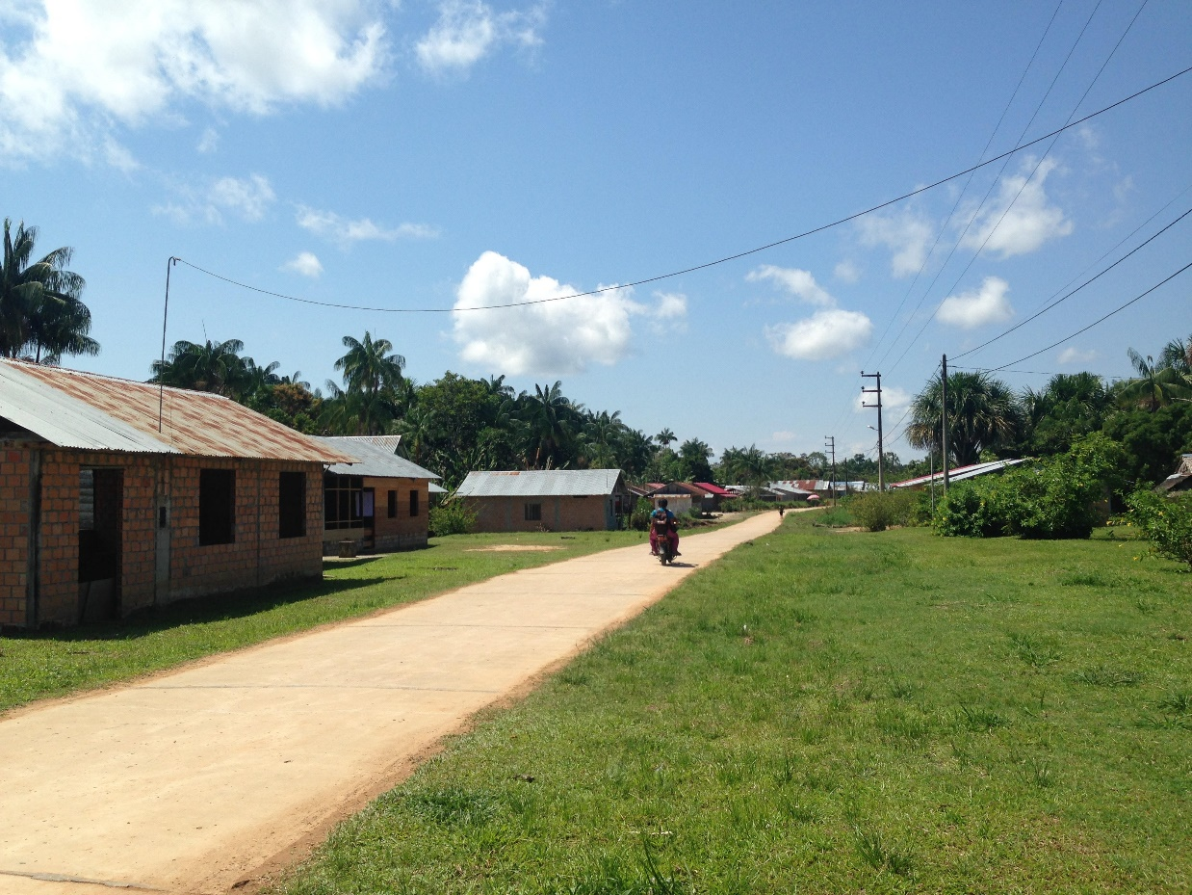
Field Site
Data from Cushillococha, Peru
  Titled Indigenous community with ~5,000 people
  Mostly monolingual Ticuna
Fieldwork 13 months 2015-2019
  Dissertation on demonstrative system as used by adults (Skilton 2019)

Slide 10
Demonstrative System
2 syntactic categories of demonstratives:
  Nominal (this/that) – focus of this talk
  Locative (here/there)
In each category, 4 productive deictic demonstratives
Nominal Demonstrative |  | Noun Class Agreement Forms
Gloss | Paraphrase | I | II | III | IV | V
Speaker-Proximal | ‘this near me’ | da³¹ʔe² | da²a² | da³¹a¹ | ɲa⁴a² | ɲa⁴³a²
Speaker-Distal | ‘that far from me’ | gu³¹ʔe² | gu²a⁴ | gu²a² | ɟe³a² | ɟe⁴³a²
Dyad-Proximal | ‘this between us’ | ɟi³¹ʔe² | ɟi²a⁴ | ɟi²a² | ŋe³a² | ŋe⁴³a²
Addressee-Proximal | ‘that near you’ | ɟi³¹ʔe²ma⁴ | ɟi²ma⁴ | ɟi²ma² | ŋe³ma² | ŋe⁴ma²

Slide 11
Adult Demonstrative System
Frequency of each dem in adult-directed speech (ADS)
  Unattended camera recordings of informal conversation (Rossi et al. 2020)
  2,363 turns; 8 interactions; mean and SD by interaction
Demonstrative | Total Tokens | Mean Tokens Per 100 Words (SD)
Speaker-Proximal | 151 | 2.06 (0.992)
Addressee-Proximal | 178 | 2.07 (1.15)
Speaker-Distal | 32 | 0.350 (0.178)
Dyad-Proximal | 16 | 0.152 (0.0998)

Slide 12
Predictions
H1: Early Emergence
  Demonstratives will emerge before 3;0
  Predicted order, given cognitive biases (and assuming minimal effect of frequency):
  Speaker-Proximal > Speaker-Distal > {Addressee-Proximal, Dyad-Proximal}
H2: Late Mastery
  No demonstrative will display adult-like production until at least 5;0

Slide 13
Methods

Slide 14
Participants
Cross-sectional study
  45 complete participants
  Age range: 1;0 – 4;11
Recruitment criteria
  Primary caregiver speaks Ticuna as native & dominant language
  Child typically developing & acquiring Ticuna as L1
    29/45 participants appear monolingual (cf. Mateo Pedro 2010, Chee 2017)

Slide 15
Tasks
1. Object play session (30m)
  Child and caregiver play with locally acquired objects
  Researcher present
2. Free play session (60m)
  Child and caregiver do whatever they like, but stay in same room
  Non-target participants welcome
  Researcher not present
Recorded with dual-camera video and body-worn microphones

Slide 16
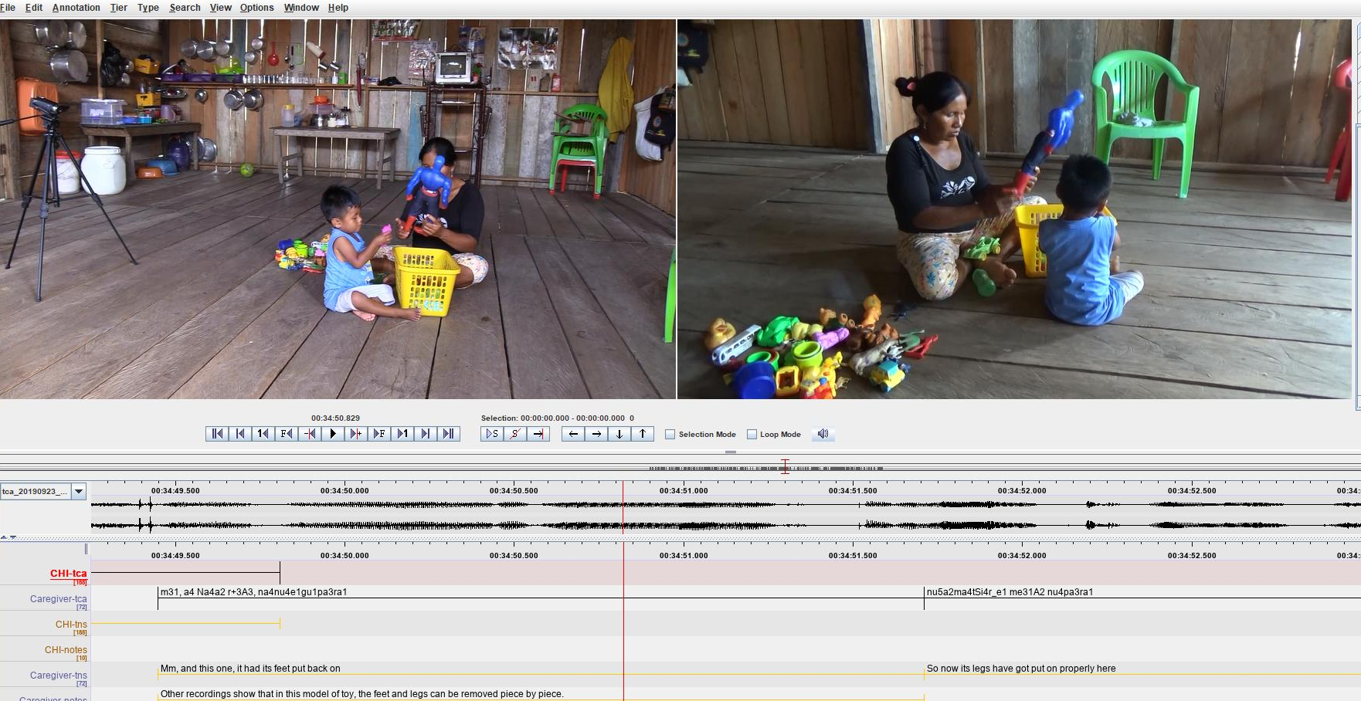

Slide 17
Post-Processing
Transcribed and translated 20 minutes recording time per child
  10m from each session
  Total sample = 15h 14m; 24,501 turns
Each turn coded for:
  Addressee (CDS vs. ADS)
  Number of tokens of each demonstrative
Ask me in Q&A about sampling, reliability, etc.

Slide 18
Results

Slide 19
Results Structure
Results organization:
  Caregivers
  Children
    Type analysis
    Token analysis
Data collapsed across session types

Slide 20
Results: Caregivers’ CDS
We analyze turns that:
  Contained at least one intelligible Ticuna word
  Were directed to target children
10,467 turns with 29,545 word tokens met criteria
  Total caregiver turns in sample = 13,217

Slide 21
Results: Caregivers

Slide 22
Results: Children
Analyze all turns with at least one intelligible Ticuna word
5,729 turns with 11,422 word tokens met criteria
  Total target child turns in sample = 8,480
  Most excluded turns were fussing/noncanonical babbling (n = 1321) or laughter (n = 606)
Divided into 4 one-year age groups for analysis

Slide 23
Type Analysis

Slide 24
Type Analysis
Egocentric dems display English-like early emergence (before 3;0)
  Speaker-Proximal, Speaker-Distal are robust across all age groups
Non-egocentric dems display late emergence (at/after 3;0)
  Addressee-Proximal, Dyad-Proximal are near-absent before 3;0
  Then display sharp rise (“developmental leap”)

Slide 25
Token Analysis

Slide 26
Token Analysis
Some dems – egocentric and non-egocentric – display late mastery
  Speaker-Proximal: Children overuse
  Addressee-Proximal: Children underuse (type and token bias)
Other dems have no evidence of late mastery
  Speaker-Distal: Adult-like frequencies from 2;0
  Dyad-Proximal: Adult-like frequencies from 3;0
Proviso: No consideration of context

Slide 27
Conclusion
As a class, demonstratives in Ticuna display the same early emergence-late mastery pattern seen in English (e.g., Clark & Sengul 1978).
Early emergence: Robustly present even for one-year-olds
Late mastery: Do not attain adult-like frequencies until at least 5;0

Slide 28
Conclusion
But early emergence-late mastery only holds for egocentric dems, such as Speaker-Proximal.
Addressee-Proximal displays late emergence (after 3;0), even later mastery.
This is not due to CDS frequency.
AddrProx equal to SpkrDist in CDS frequency.

Slide 29
Future Research
How do children index refs near the Addr when they don’t have the AddrProx? Do they overextend other dems? Which?
How do children learning other languages with AddrProx dems (e.g., Finnish) behave?
Does comprehension lead production, and by how much?

Slide 30
Thank you!
Thanks also to:
  All participants and families
  Angel Bitancourt Serra
  MPI Nijmegen FLADD, especially Caroline Rowland & Marisa Casillas
Funders
  NSF GRFP
  NSF/DEL DDRIG (BCS-1741571)
  NSF SBE Postdoctoral Research Fellowship (SMA-1911762)
  Opinions mine and not those of NSF

Slide 31
Thank you!
Find more of my work at:
http://sites.utexas.edu/amaliaskilton

Slide 32
References
Anderson, Doris, and Lambert Anderson, eds. 2017. Diccionario Ticuna-Castellano. Lima: Instituto Lingüístico de Verano.
Anderson, Lambert. 1959. Tikuna vowels with special regard to the system of five tonemes. In Serie Lingüística Especial 1. Rio de Janeiro: Museu Nacional.
Casillas, Marisa, Penelope Brown, and Stephen C. Levinson. 2019. Early Language Experience in a Tseltal Mayan Village. Child Development Early View.
Chee, Melvatha. 2017. A longitudinal cross-sectional study on the acquisition of Navajo verbs in children aged 4 years 7 months through 11 years 2 months. Ph.D. diss., University of New Mexico.
Chu, Chia-Ying, and Utako Minai. 2018. Children’s demonstrative comprehension and the role of non-linguistic cognitive abilities: a cross-linguistic study. Journal of Psycholinguistic Research 47 (6): 1343-1368.
Clark, Eve. 1978. From gesture to word: on the natural history of deixis in language acquisition. In J. S. Bruner & A. Garton (eds.), Human growth and development: Wolfson College lectures 1976. Oxford: Oxford University Press.
Clark, Eve V., and C. J. Sengul. 1978. Strategies in the acquisition of deixis. Journal of Child Language 5 (3): 457–475.
Küntay, Aylin C, and Asli Özyürek. 2006. Learning to use demonstratives in conversation: what do language specific strategies in Turkish reveal? Journal of Child Language 33(2): 303–320.
Montes, M. E. 1995. Tonología de la Lengua Ticuna (Amacayacu). Bogotá: Universidad de los Andes.

Slide 33
References
Santos, Abel Angarita. 2004. Hacia una Dialectologia Tikuna del Trapecio Amazonico Colombiano. M.A. thesis, Universidad Nacional de Colombia - Sede Leticia.
Tanz, Christine. 1980. Studies in the Acquisition of Deictic Terms. Cambridge: Cambridge University Press.
Tomasello, Michael. 2010. Origins of Human Communication. Cambridge: MIT Press.
Webb, P. A., & Abrahamson, A. A. 1976. Stages of egocentrism in children's use of ‘this’ and ‘that’: a different point of view. Journal of Child Language 3(3): 349-367.

Slide 34
Child vs. Caregiver Correlations
Could differences in kids’ production be driven by differences in CDS?
Correlations between CDS frequency and child age, child frequency
  Hear more Speaker-Proximal → produce more Speaker-Proximal
    (Spearman’s rho = 0.26, p = 0.0085)
  Older → hear more Dyad-Proximal (Spearman’s rho = 0.22, p = 0.029)
  No other significant correlations
Lateness of Addressee-Proximal is not driven by changes in CDS frequency

